Slide 1
Learning to build Resilience
Creating change from the inside out

Slide 2
Resilience
  Define Resilience
  Resilience is a layered topic and there are many factors that determine a person’s resilience: Relationships, family systems, trauma, poverty, even biology
  The one we are going to focus on, is the topic of our thoughts, our self-talk and the role it plays in our over all well-being
    Give examples of 2 different students

Slide 3
Adversity
Personal example
Write your own example

Slide 4
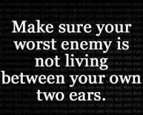
“Please write down a negative statement that you say to yourself on a daily basis.”

Slide 5
“I’m such a loser. No wonder no one likes me.”
4th grade girl

Slide 6
“I am the worst person on earth.”
2nd grade boy

Slide 7
“I am the center of nothing.”
4th grade boy

Slide 8
“I feel so fake. No one even
Knows the real me.”
6th grade girl

Slide 9
Define bullying
How does bullying stand apart?

Slide 10
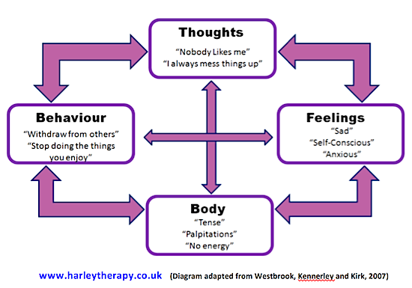
I am a terrible parent. I messed up again. My kids are anxious because of me!
Guilty, sad, overwhelmed, hopeless.
Tense, heart racing, crying, heavy
Lose my temper, withdraw

Slide 11
Pirate thoughts steal our confidence, self-esteem, and ambition. And leave us with overwhelming feelings of doubt, hopelessness, and shame.
Thought testing: Take your negative thought and write down the evidence that proves the thought to be right. Then, write down any evidence that proves it to be false. Then you be the judge.
Is the thought true or false?

Slide 12
Mindfulness
Learning how to be present with our emotions, not judge or criticize, just notice and be aware.
Who’s in control exercise?

Slide 13
Soul Pancake Love Letter video

