Slide 1
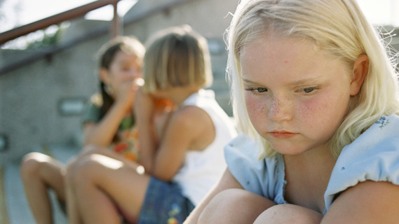
Her friends are excluding her and talking
about her behind her back.

Slide 2
Empathetic Responses
I noticed that you are sitting over here alone, would you like to talk?
I see that you have tears in your eyes. Are you feeling sad?
Non-Empathetic Responses
Why are you sitting over here all alone?
What are those girls saying about you?
Saying to another friend “I feel so bad for her, sitting all alone.”

Slide 3
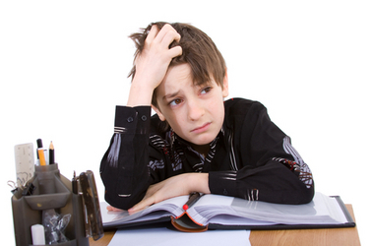
Does not understand anything
that the teacher is saying.

Slide 4
Empathetic Responses
I can tell that you are frustrated. Would you like some help?
I had a hard time understanding this at first too. I felt like I was the only one who didn’t get it. I asked the teacher for help at recess. Would you like me to talk to the teacher with you?
Non-Empathetic Responses
I don’t know why we have to learn this stuff.
You should have studied harder, then you would understand.
Sorry, I can’t help you right now.

Slide 5
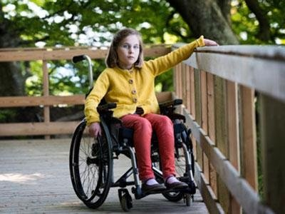
A young girl with a disability feels left out and that
life isn’t fair.

Slide 6
Empathetic Responses
You look lonely? How can we help include you?
I see that sometimes you look frustrated, how can I help?
Non-Empathetic Responses
At least you get to ride around in that cool chair.
Sorry you can’t play with us, I don’t think you would be able to play the game.

Slide 7
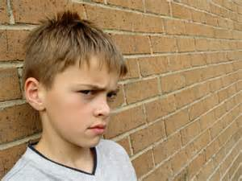
Just found out that his parents are getting divorced.

Slide 8
Empathetic Responses
You look angry. Would you like to talk about it?
I felt so many different things when my parents divorced. I am sorry that you are feeling this way right now.
Non-Empathetic Responses
I don’t know what it’s like and I can’t help you.
Don’t worry, now you will get two birthday parties.
He just told you to “GO AWAY”. You say to a friend, “Geez, he is so mean. Let’s not play with him anymore.”

Slide 9
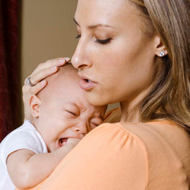
At the doctor’s office with her sick baby.

Slide 10
Empathetic Responses
I am sad that your baby is sick.
You look scared. I get scared when my mom gets sick.
Non-Empathetic Responses
That baby is crying so loud.
“Roll eyes”. Why doesn’t she do something to help that baby.

