Slide 1

Meet Your School Counselor
Mrs. Cummings

Slide 2

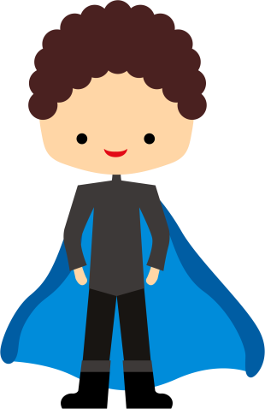
What is a school counselor?
School counselors are like superheroes. They fly around their building, helping however they can.
What do they do all day?
School counselors work with students, help adults, talk with parents, and organize fun programs.

Slide 3
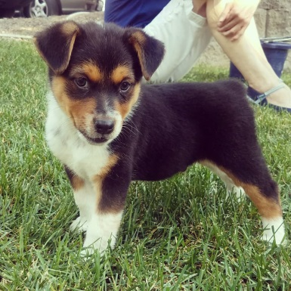
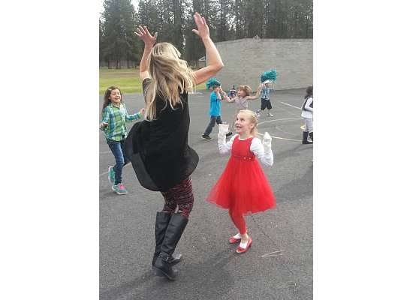

Fun facts about Mrs. Cummings
I have two girls, ages 6 and 8
We just got a new puppy!
I am very optimistic!
I LOVE to dance!

Slide 4
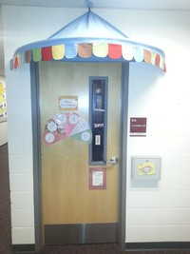
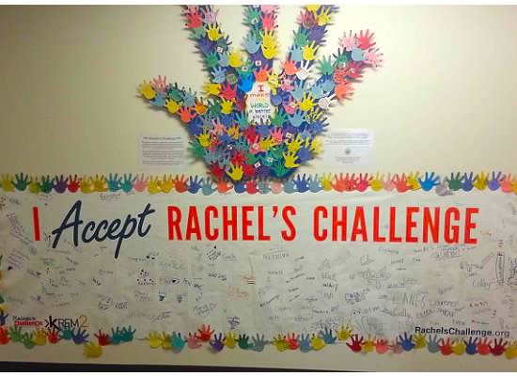
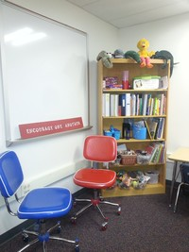

Office Tour

Slide 5
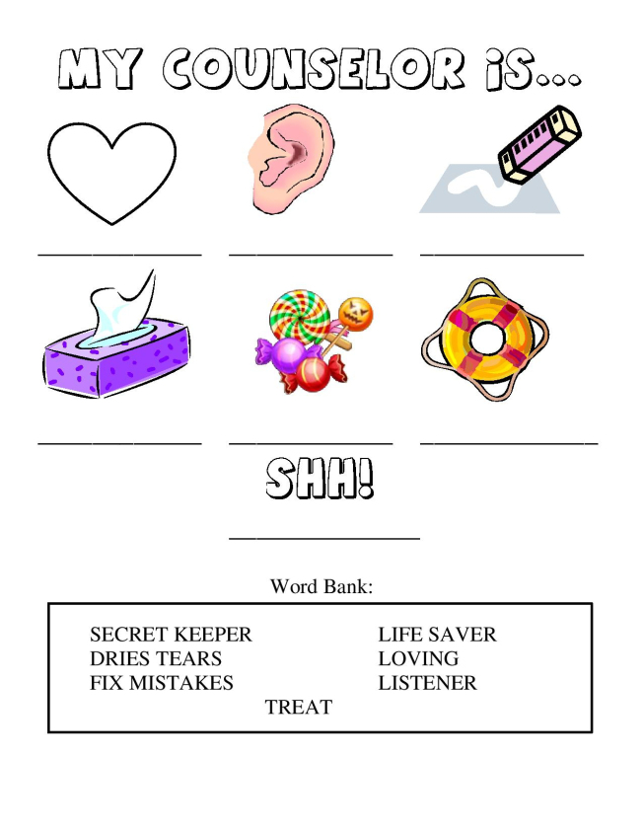


Slide 6

How to Visit a School Counselor
Fill out a form
Give the form to your teacher and she will make sure it gets to the school counselor, or drop in box outside my office
REMEMBER:
  Big Problem?
  Small Problem?
  Kelso’s Choices
Small Groups
Classroom lessons
Kindness and Compassion Club/Buddy Bench

Slide 7

Quiz
If you have a small problem, you
Go right to Mrs. Cummings or your teacher Use Kelso’s Choices first
Mrs. Cummings will always keep your secrets.
True False
What is the Buddy Bench?
A place to hang out with your friends A place to go if you’re feeling lonely

Slide 8
BONUS QUESTION!!!
Is our new puppy named:
Spike
Ronnie
Buddy
Duke

Slide 9






Let’s Have a Great Year!
We’ll work together to turn each of you
into your own superhero!!

