Slide 1
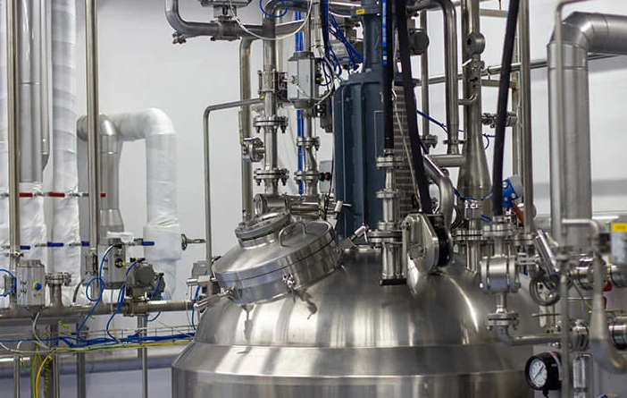
SP CHEMICALS - Consulting
Business Lines
Resin Intermediates
PIA (Purified Isophthalic acid)
NPG (neopenthylglycol)
DEG (di-ethyleneglycol)
MEG (mpono-ethylene glycol)
PENTA (pentoerithritol)
Benzoic Acid
PTBBA (para-tert-butylbenzoic acid)
MPG (propylene glycol)
TMP (trimethylolpropane)
MA (maleic anhydride)
PA (Phthalic achydride)
TMA (Trimellitic Anhydride)
AA (acrylic acid)
MAA (metacrylic acid)
MMA (Methyl metacrylate)
Melamine
Urea
Advantages:
Efficient logistics
Regional offices that oversee purchasing and quality control
Experience sales force
sp-chem.de

Slide 2
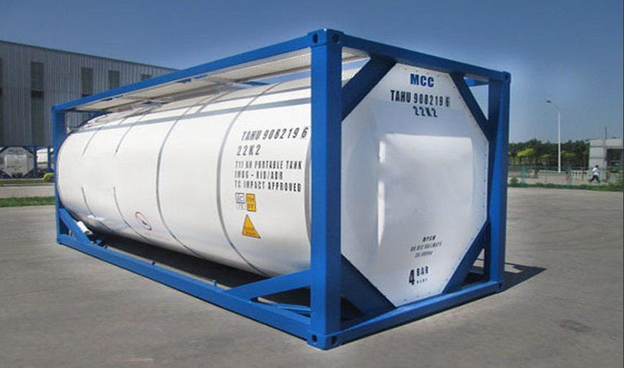
SP CHEMICALS - Consulting
Business Lines
Solvents / Intermediates
MPA (Methoxypropyl Acetate)
EAC (Ethyl Acetate)
BAC (Butyl Acetate)
MAC (Methyl Acetate)
IPA (Isopropyl alcohol)
MEK (Methyl Ethyl Ketone)
Acetone
Advantages:
Own ISO-Containers fleet
Logistics efficacy incl. Own railway platforms and trucks
Blending potential in Russia, Serbia and potentially in Poland
Experience sales force
Technical service / capability to build
sp-chem.de

