Slide 1
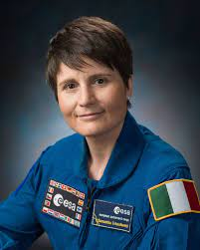
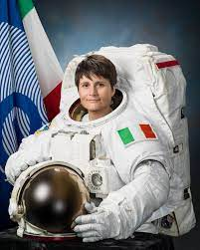
Samantha Cristoforetti
Born in Milan, Italy on April 26th, 1977

Slide 2
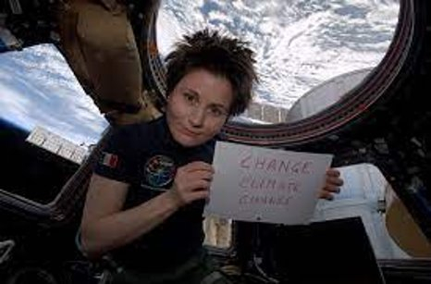
About her
She isn't just any person! She is:
- a military pilot
- an astronaut
- a wife
- a mother
- a diver
- an instructor
- And an activist! #change_climate_change

Slide 3
I do believe that in an average person's eye.
She would be someone whom most people would idolize.
Considering the fact she has made a lot more significant achievements than what we would think of doing in a lifetime!
I think that a quote from Joshua J. Marine could Fit her lifestyle
“Challenges are what make life interesting and overcoming them is what makes life meaningful.” — Joshua J. Marine”

Slide 4
A sum of her achievements
When she was 18 years old she went on AFS(American Field Service)
She went on 2 space expeditions!
Degree in Mechanical Engineering.
Graduated in Aeronautics Sciences.
She was one of the few woman whom completed her training and became lieutenant and fighter pilot!
She flown six types of military aircraft.
She completed the Euro-NATO Joint Jet Pilot training.
Logged over 500 hours in jet pilot training.
And has been awarded 2 honours!
And participated in one deep space training

Slide 5
Her studies
In the Technical University of Munich: She finished her Mechanical Engineering degree
She continued her studies in:
- Institut Supérieur de l'Aéronautique et de l'Espace;
In English: National Higher French Institute of Aeronautics and Space
- Mendeleev Russian University of Chemistry and Technology in Moscow.

Slide 6
Military achievements
As part of her training, she completed a bachelor’s degree in aeronautical sciences at the University of Naples Federico II, Italy, in 2005.
In Texas she completed the Euro-NATO Joint Jet Pilot Training.
She has been awarded 2 honours:
- Commander of the Order of Merit of the Italian Republic on 6 March 2013
- Knight Grand Cross of the Order of Merit of the Italian Republic on 16 July 2015

Slide 7
Her expeditions
NEEMO 23 underwater expedition
This training is believed to help new astronauts deal with communication delays and prepare them for repairing missions that may happen on the ISS (International Space Station)
It usually lasts 10 days and the participants do not emerge until the 10 days has passed or until complications arise.
Samantha Cristoforetti will command the NEEMO 23 mission
she spent 200 days living and working in the extreme environment of space, currently the longest spaceflight of a European.

Slide 8
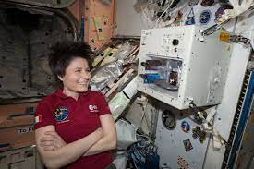
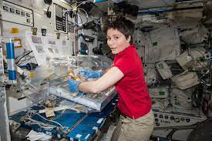
Her work on the ISS and ESA
She was sent into space On 23 November, 2014 she returned on 11 of June, 2015
Samantha was given technical and management duties at the European Astronaut Centre
It is planned that she will be the on sight leader of project "Minerva" which is set to depart on April 21
During her last mission, She became the first to brew coffee in space.

Slide 9
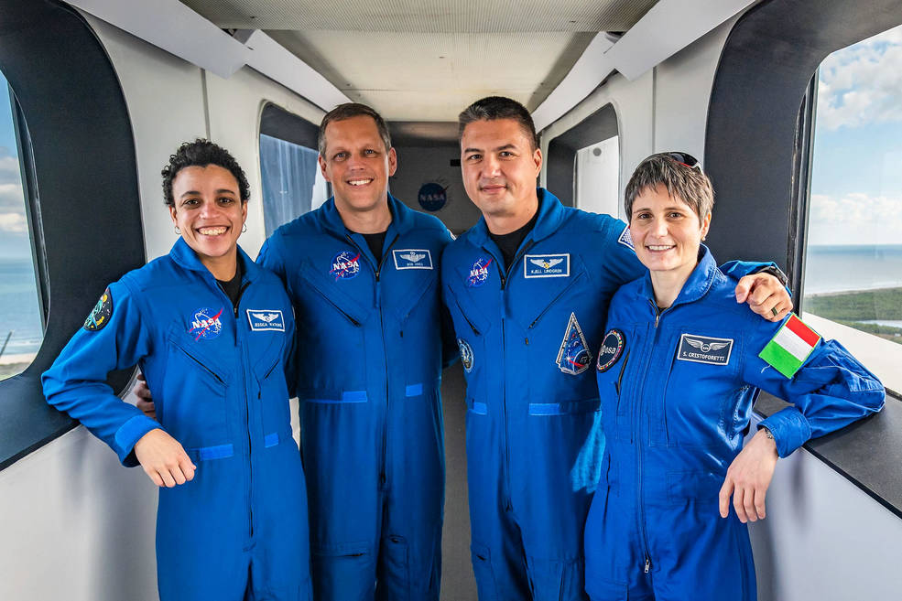
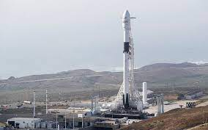
She's currently getting ready to go into space again!
NASA is planning to make a commercial crew space expedition "CREW 4"
This will be the 4th launch. They will go with a Falcon 9 rocket.
This mission is part of NASA’s Commercial Crew Program.

Slide 10
Thank you for your attention!

Slide 11
Sources
https://www.esa.int/Science_Exploration/Human_and_Robotic_Exploration/Astronauts/Samantha_Cristoforetti?fbclid=IwAR2_ganro5A_ZDkZRkHu86dhaWOUTUUZE6mUgJJrDnA7Rg5HMugtH6Byy2g
https://www.nasaspaceflight.com/2019/06/cristoforetti-neemo-23-expedition-deep-space-training/?fbclid=IwAR3XmGeZCTxLcNgwSwrHJFYGFiqXnDZFCis_FuNESAxUluuohJa3TD1lwcs
http://www.iitaly.org/magazine/focus/life-people/article/italian-astronaut-samantha-cristoforetti-tweets-support-earth?fbclid=IwAR1CoEBk9Ki-hAvCoD5VjbJ5eujGbkSflRnmc2GlUECkg0XHgAJIYaNouHs
https://www.nasa.gov/press-release/nasa-invites-media-to-next-spacex-commercial-crew-space-station-launch-0
https://en.wikipedia.org/wiki/Samantha_Cristoforetti#Expedition_42/43

