Slide 1
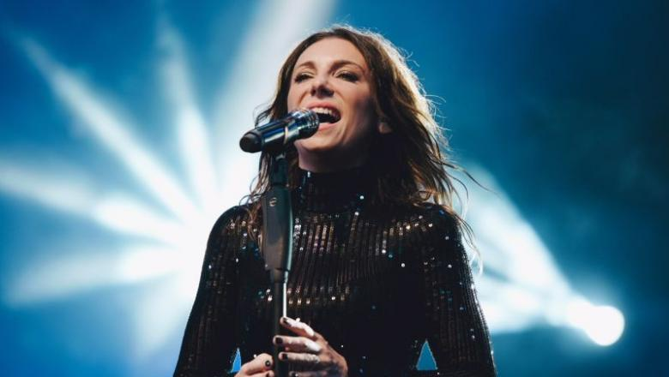
Rúzsa Magdolna

Slide 2
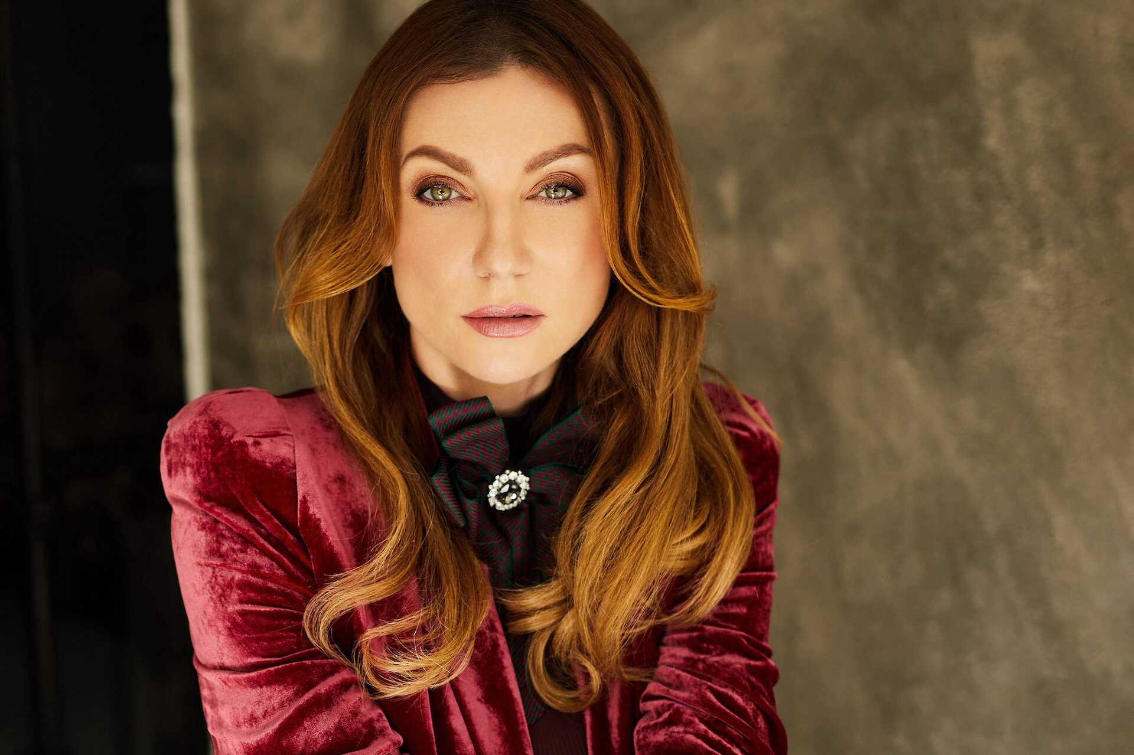
About her
Magdolna Rúzsa 37 years old, Péter Máté award-winning Hungarian singer, songwriter and songwriter.
She became known as the third winner of the TV2 talent show Megasztár.
He also held Arena concerts on 24 and 25 February 2023. On 24 February he released a new song called Elmegyek.

Slide 3
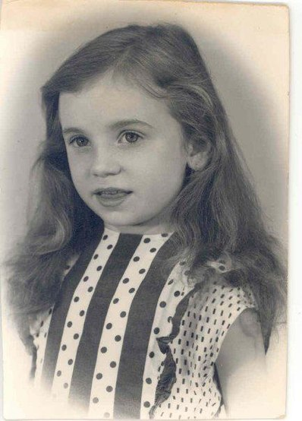
Childhood
She was born in Verbas, Yugoslavia, born on 28 November 1985.
She finished primary school in his village, Kishegyes, at the Ady Endre Experimental Primary School.
She was granted Hungarian citizenship on 17 September 2009.
In 2010, she released her song Gábriel, originally a Croatian song and the Hungarian version is also spiced up with a South Slavic sound and some guitar playing.

Slide 4
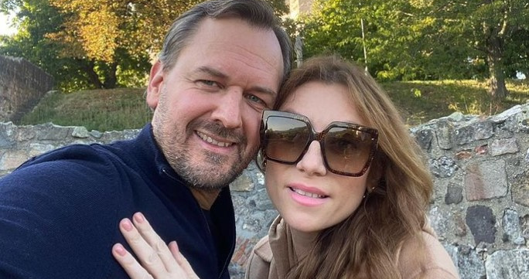
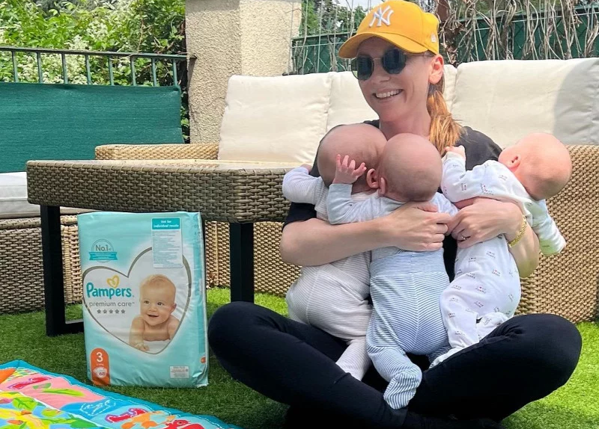
Her family
Her husband is Vilmos Simon, electrical engineer and university professor.
They married in 2017. In February 2022, they had triplets, Lujza, Keve and Zalán.

