Slide 1
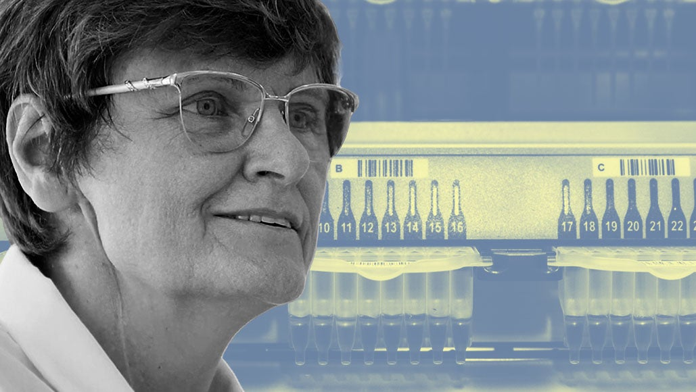
Katalin Karikó

Slide 2
Katalin Karikó is a Hungarian-American biochemist who specializes in RNA-mediated mechanisms.
She was born on the 17th of January, 1955.

Slide 3
Her research has been the development of in vitro-transcribed mRNA for protein therapies.
Since 2013, she has been associated with BioNTech RNA Pharmaceuticals, first as a vice president and promoted to senior vice president in 2019.
She also is an adjunct professor at the University of Pennsylvania.

Slide 4
Together with Weissman, she holds U.S. patents for the application of non-immunogenic, nucleoside-modified RNA.
This technology has been licensed by BioNTech and Moderna to develop their protein replacement technologies but was also used for their COVID-19 vaccines.
Karikó and Weissman have received many awards, including the prestigious Lasker-DeBakey Clinical Medical Research Award, Time Magazine's Hero of the Year 2021 and Tang Prize Award in Biopharmaceutical Science in 2022.

Slide 5
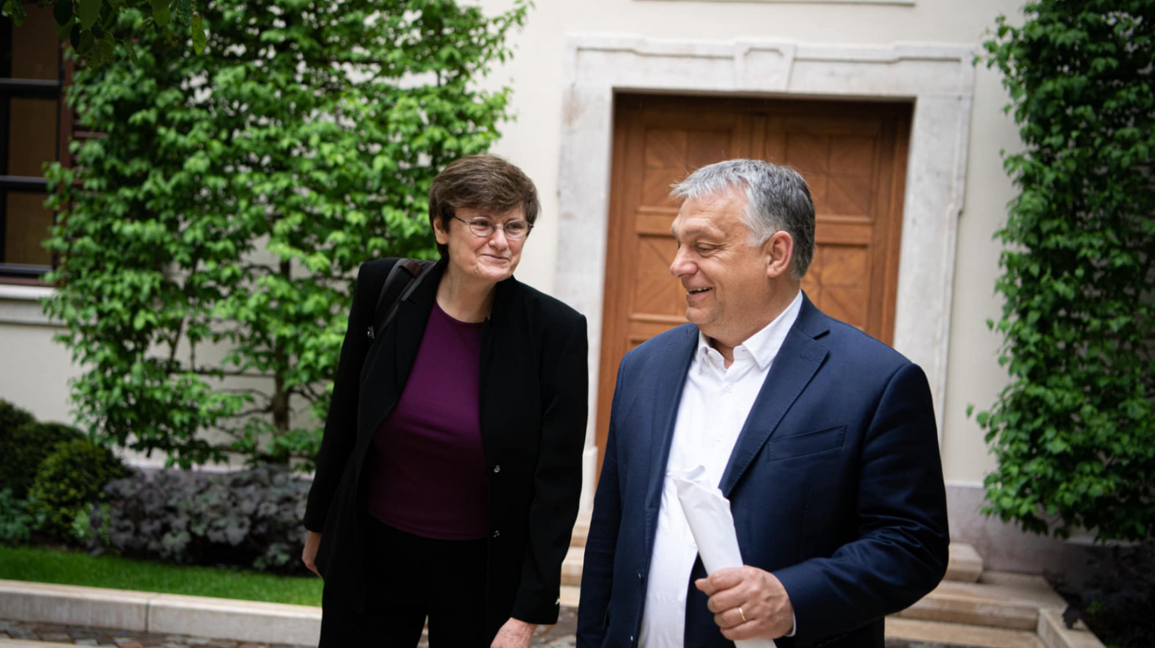
Thank you for watching!
☺

