Slide 1
Campaigns Connect Past and Future
Hungarian Heroe Proposals

Slide 2
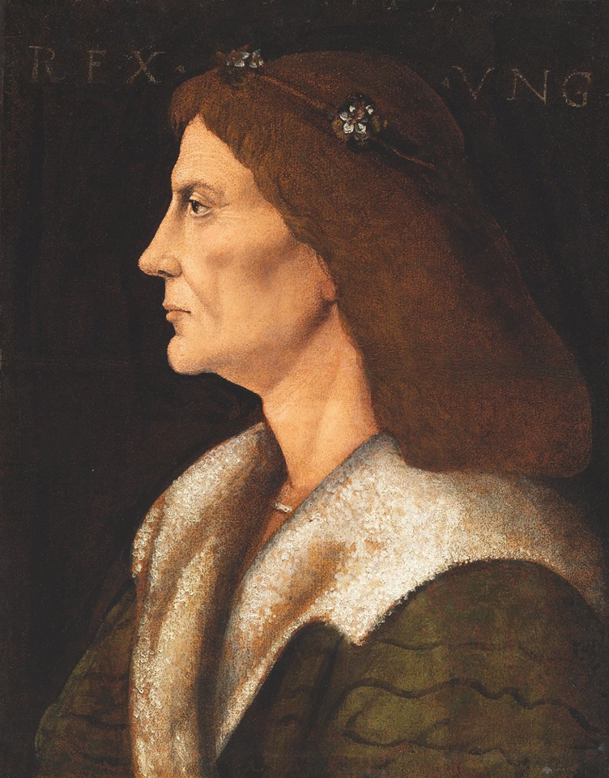
1. King Matthias Corvinus
Hungarian king born in 23 February 1443 in Kolozsvár (Cluj Napoca RO today). He died on 6 April 1490. He was the king of Hungary, Croatia, Bohemia, Duke of Austria. His father was Janos HUNYADI, mother was Erzsebet SZILAGYI. He is one of the best known and beloved Hungarian king. He is a member of the HUNYADI family which was one of the most outstanding distany of the Medieval Age in the whole continent and Christianity regarding their historical role.
Picture 1. King Matthias Corvinus

Slide 3
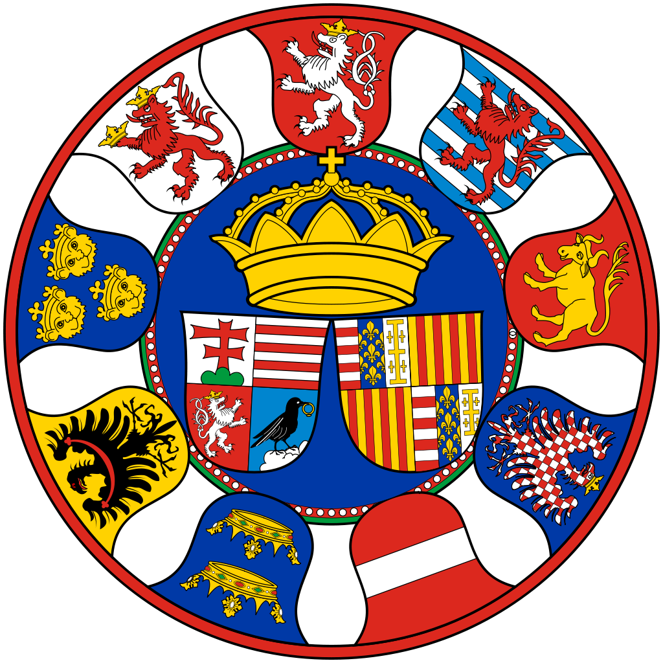
Matthias established one of the earliest professional standing armies of medieval Europe (the Black Army of Hungary).
Reformed the administration of justice.
Reduced the power of the barons.
Promoted the careers of talented individuals chosen for their abilities rather than their social statuses.
Matthias patronized art and science; his royal library, the Bibliotheca Corviniana, was one of the largest collections of books in Europe.
With his patronage, Hungary became the first country to embrace the Renaissance from Italy.
As Matthias the Just, the monarch who wandered among his subjects in disguise, he remains a popular hero of Hungarian tales and legends.
Picture 2. King Matthias’s Coat of Arm

Slide 4
Connection to Romania:
He was born in Kolozsvár, which is in Transylvania that is today Cluj Napoca city in Romania.
Hunyadi family received their eponymous Hunyadi Castle (today Hunedoara, Romania) in Transylvania, so the dynasty has may have a Transylvanian or a Wallachian anchestors, the ethnicity is a subject of scholarly debate.
Connection to Bulgaria:
His title in the 1486 law: King of Hungary, Bohemia, Dalmatia, Croatia, Rama, Serbia, Lodomeria, Cumania and Bulgaria, Prince of Silesia and Luxembourg, Margrave of Moravia and Lusatia

Slide 5
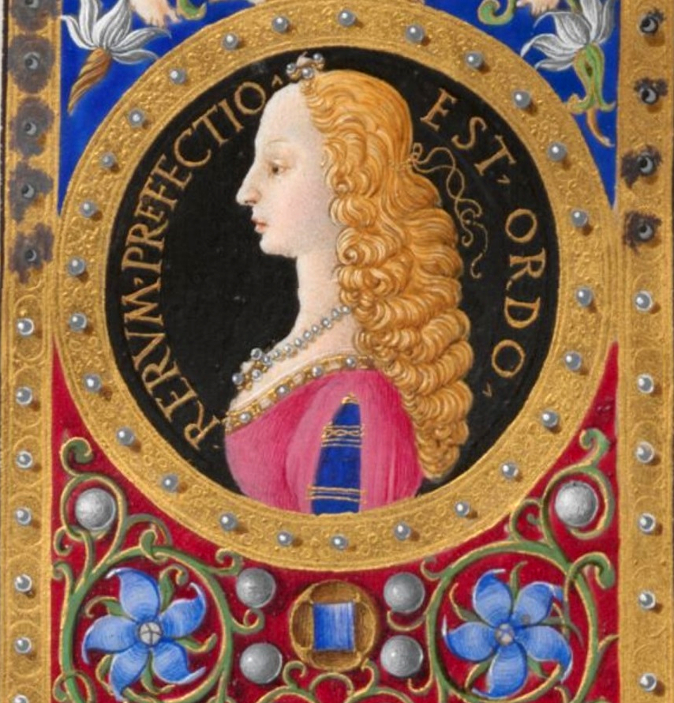
Connection to Italy:
The wife of King Matthias Corvinus was Beatrice of Naples, the daughter of Ferdinand I of Naples and Isabella of Clermont.
Hungary was the first country by Matthias Corvinus to embrace the renessaince from Italy.
King Matthias kept fruitful connections with Italian humanists and scientists.
Picture 3. Beatrice of Naples
We truly think that King Matthias Corvinus, who was one of the most outstanding person in the 15th century shall be a perfect applicant for the project heroe title. Having a connection with every participating countries, he could be introduced and presented from each country’s aspect, which would give all of us the understanding that such a heroe connects not only past and future, but connects people, connects Europe.

Slide 6
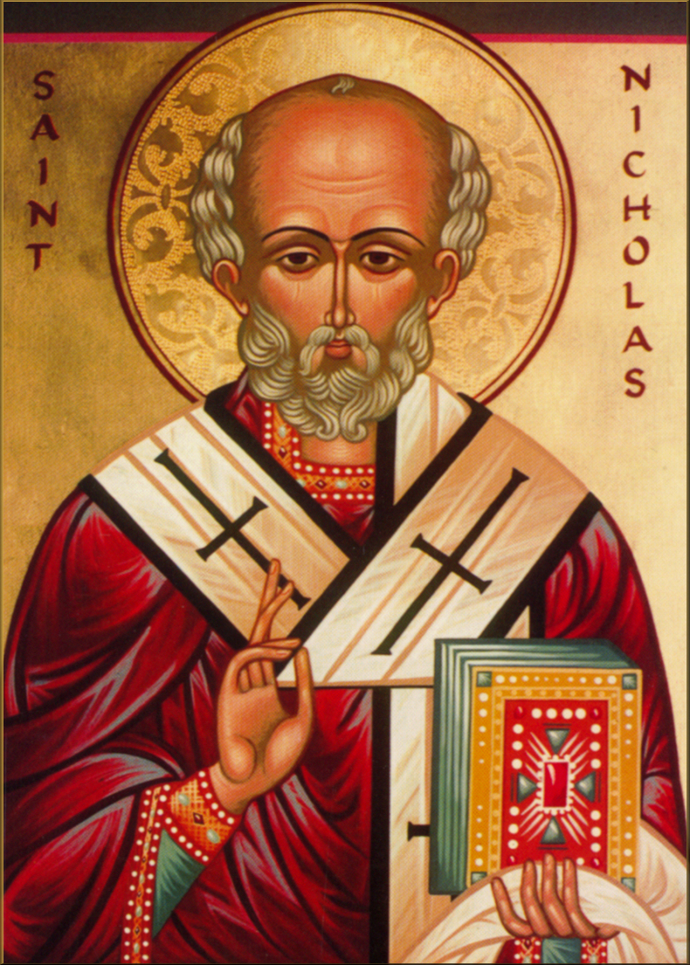
2. Saint Nicholas
Saint Nicholas, archbishop of the Greek Orthodox Church, another name Nicholas of Bari or Nicholas the Wonderworker. (born 15 March 270 – died 6 December 343).
Saint Nicholas is the patron saint of sailors, merchants, archers, repentant thieves, children, brewers, pawnbrokers, unmarried people, and students in various cities and countries around Europe. His reputation evolved among the pious, as was common for early Christian saints, and his legendary habit of secret gift-giving gave rise to the traditional model of Santa Claus.
Picture 4. Saint Nicholas

Slide 7
We do not need to introduce Saint Nicholas, he has a role in our present as Santa Claus. Although the two symbolic personalities has a very little in common, it would be interesting and exciting to look after, how Saint Nicholas is alive in the history of the participating countries, and when and how Santa Claus embedded into each country folklore. We know he is still an important saint of the Orthodox Church, and that he was buried in Bari. There are also connection points that makes him appropriate for a multicultural project.
We think that Saint Nicholas, shall be another perfect applicant for the project heroe title. Having a strong connection with the past and also a strong connection with the present, it would be very interesting to look after, how mass communication have been working throughout the centuries.

Slide 8
Sources:
Picture 1.: King Matthias Corvinus by a Lombardian painter, Museum of Fine Arts
https://www.szepmuveszeti.hu/mutargyak/matyas-kiraly-arckepe/
Picture 2.: King Matthias and Beatrice of Naples coat of arms in the Chronicles of Janos Thuroczi
Picture 3.: Beatrice of Naples, Múlt-kor Historical Magazine
https://m.mult-kor.hu/az-arpadok-vere-csorgedezett-aragoniai-beatrix-ereiben-20211222?fbrkMR=mobile
Picture 4.: Saint Nicholas, Saint Nicholas Center https://www.stnicholascenter.org/how-to-celebrate/resources/music/hymns/hymns-orthodox-byzantine/great-vespers-chant

