Slide 1
Our HighSchool Colegiul Economic ‘’Maria Teiuleanu’’
Our work in this project Campaigns Connect Past and Future
Made by : Necula Cristian – Radu Chiminjer Adrian
Ref.No: Erasmus KA229: Ref.no 1-IT02-KA229-079518

Slide 2
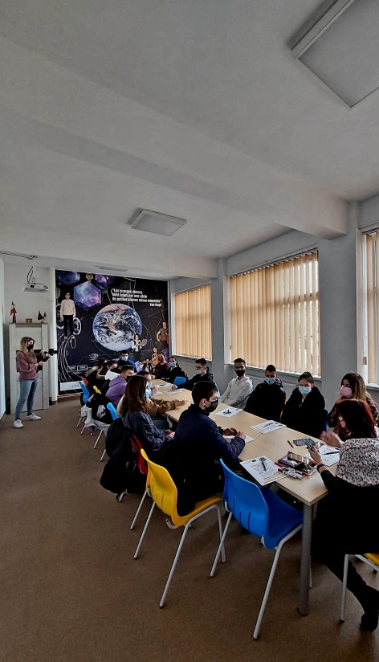
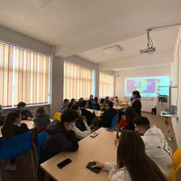
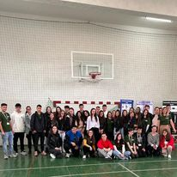
Our HighSchool Colegiul Economic ‘’Maria Teiuleanu’’
Our work in this project Campaigns Connect Past and Future
Our beginning in this adventure

Slide 3
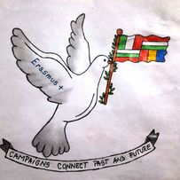
Our HighSchool Colegiul Economic ‘’Maria Teiuleanu’’
Our work in this project Campaigns Connect Past and Future
First mission in our journey was to make a logo for our project

Slide 4
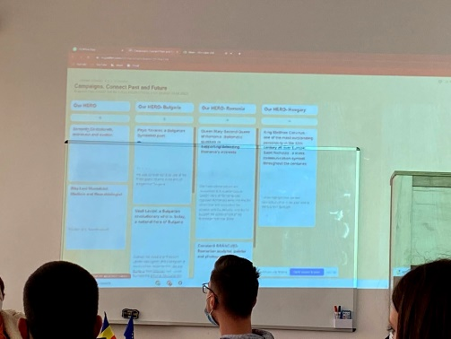
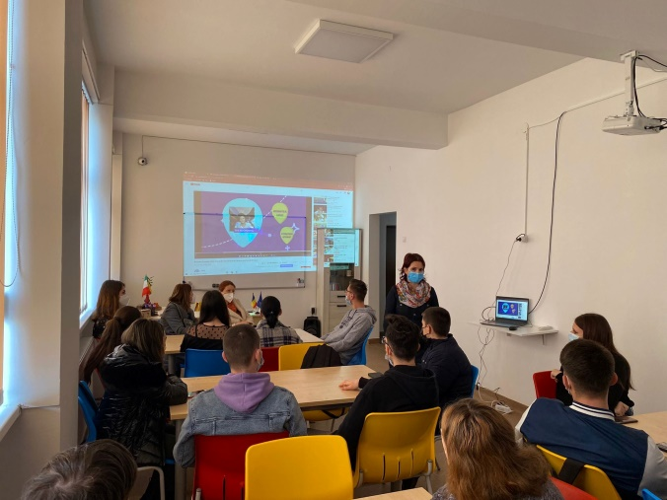
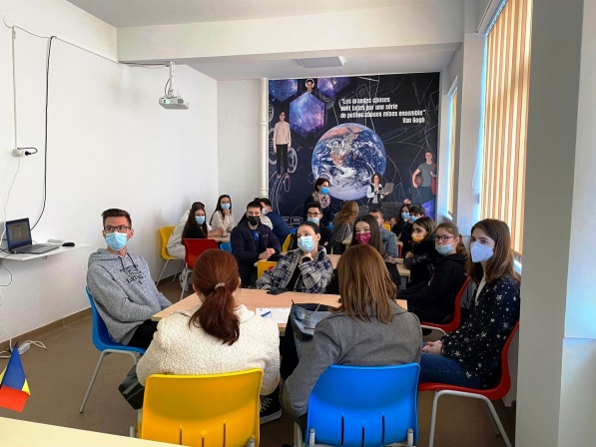
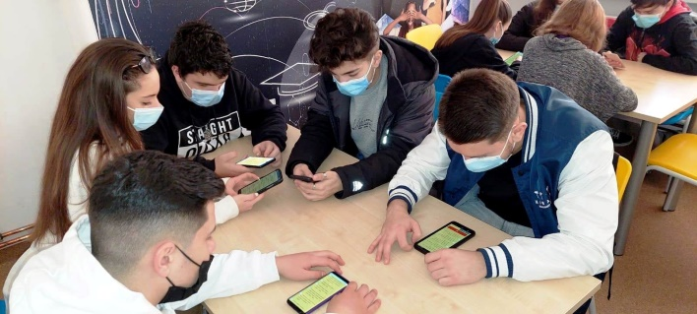
Our HighSchool Colegiul Economic ‘’Maria Teiuleanu’’
Our work in this project Campaigns Connect Past and Future
Meeting- when we decided about our Hero

Slide 5
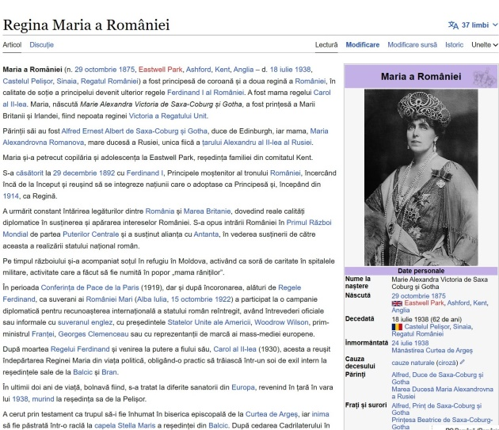
Our HighSchool Colegiul Economic ‘’Maria Teiuleanu’’
Our work in this project Campaigns Connect Past and Future
Queen Mary – Our Hero

Slide 6
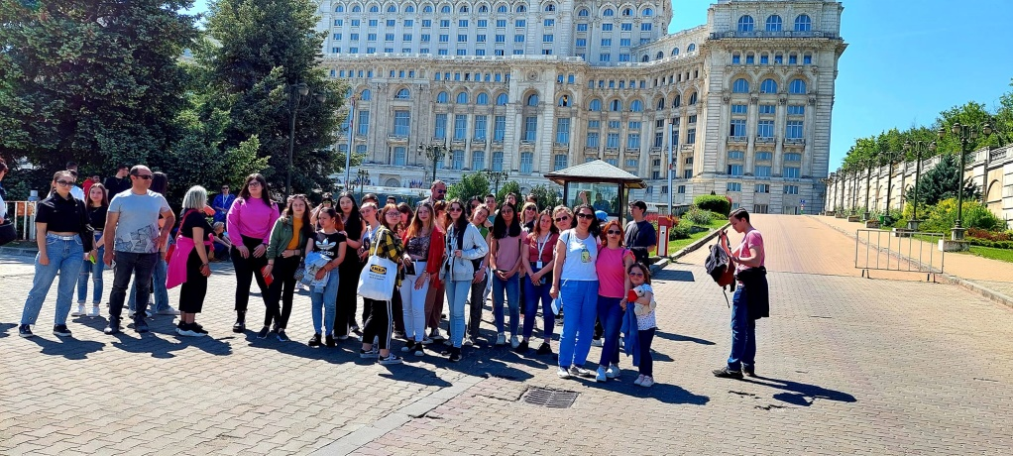
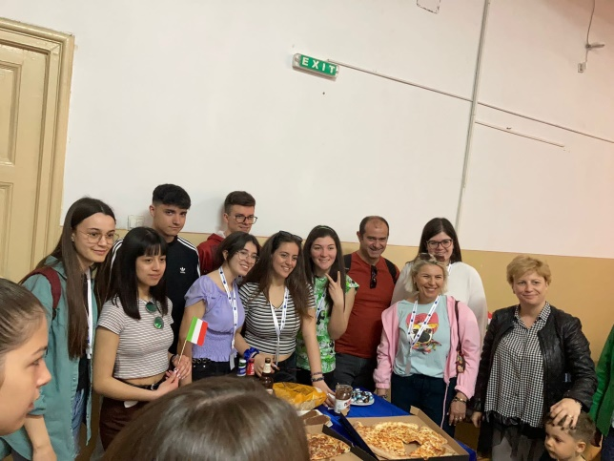
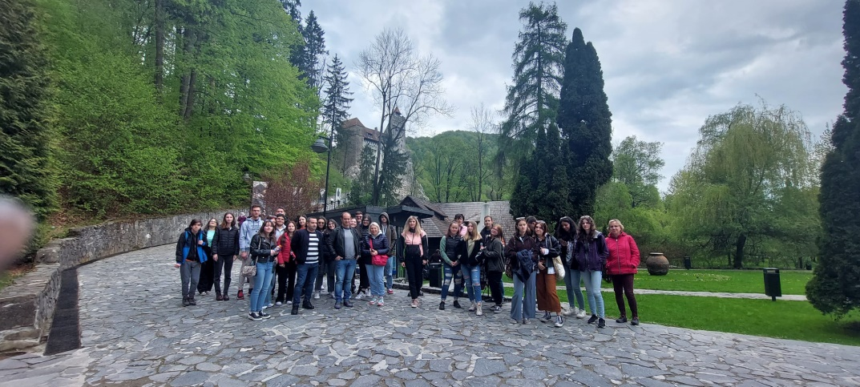
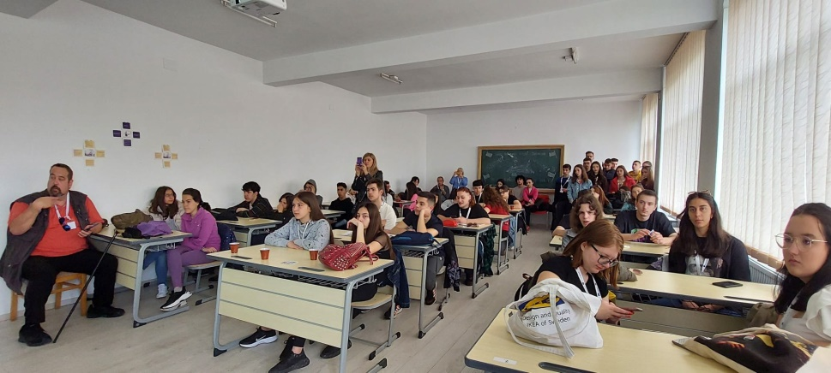
Our HighSchool Colegiul Economic ‘’Maria Teiuleanu’’
Our work in this project Campaigns Connect Past and Future
New friends

Slide 7
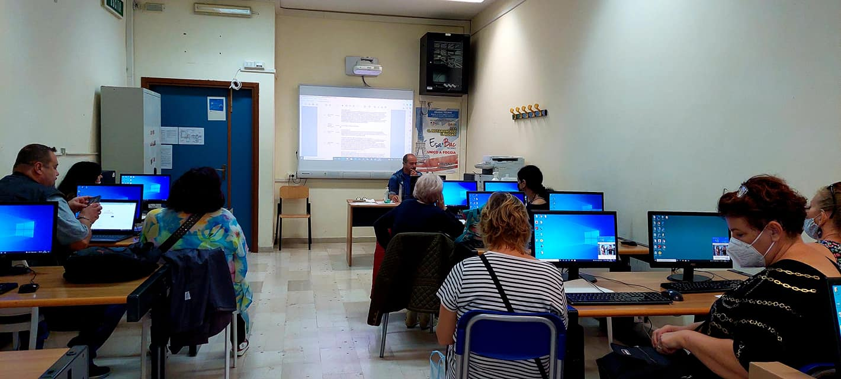
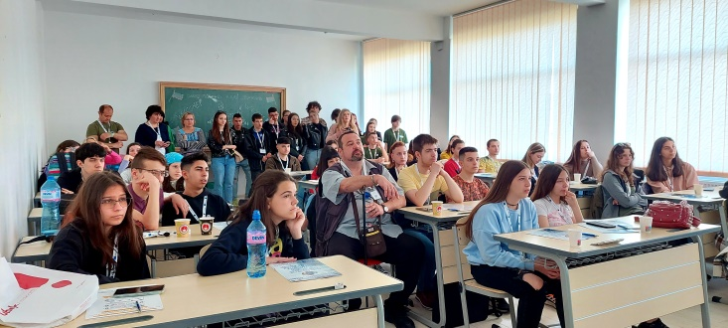
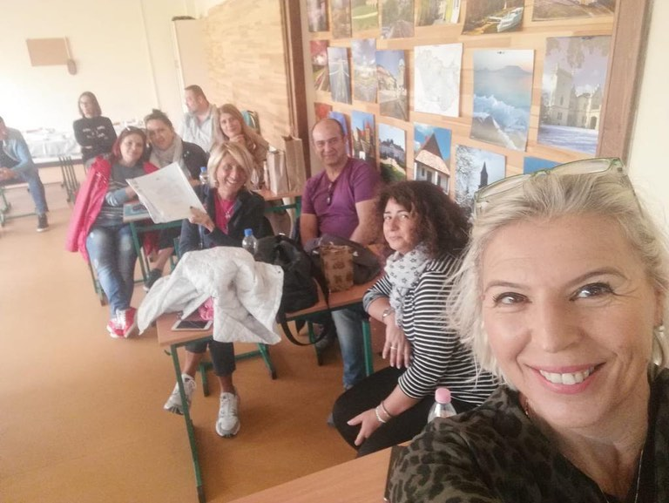
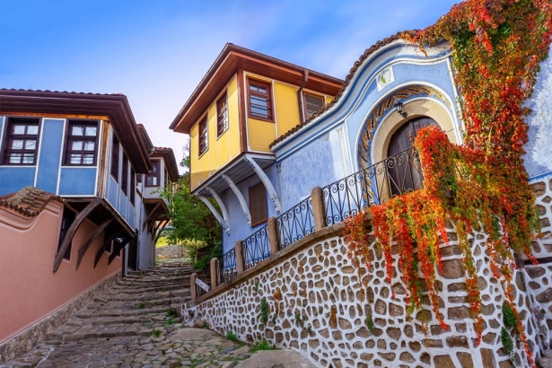
Our HighSchool Colegiul Economic ‘’Maria Teiuleanu’’
Our work in this project Campaigns Connect Past and Future
Learning Teaching Activities in Italy, Romania, Hungary & Plovdiv(now)
?

Slide 8
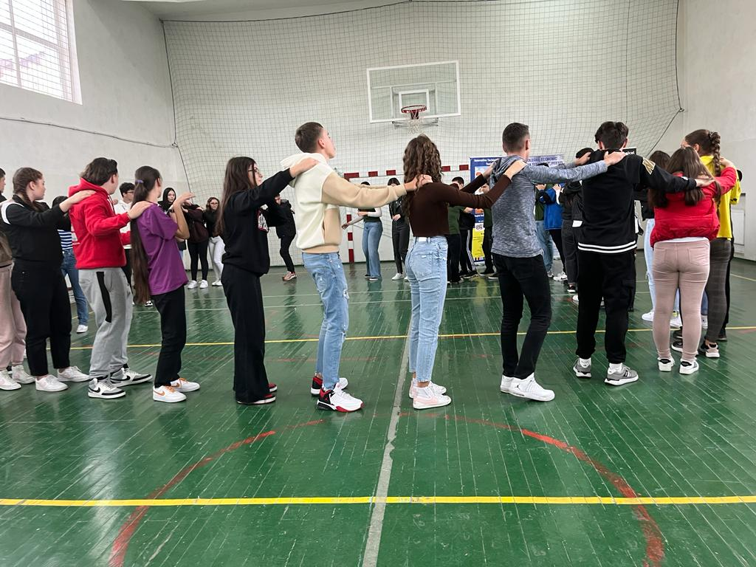
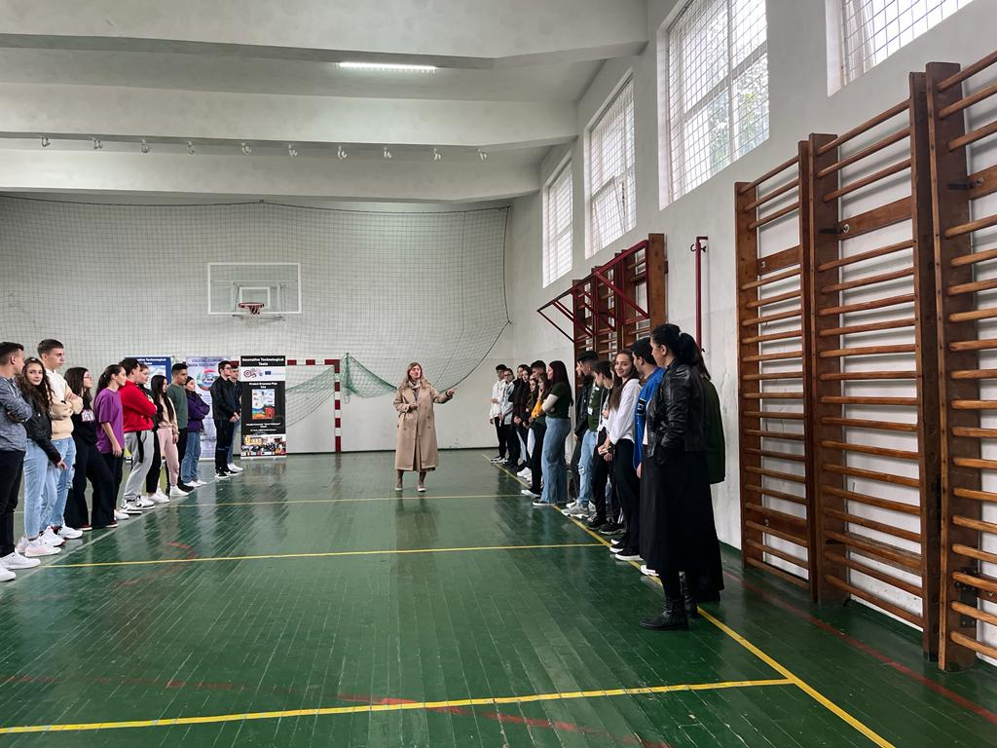
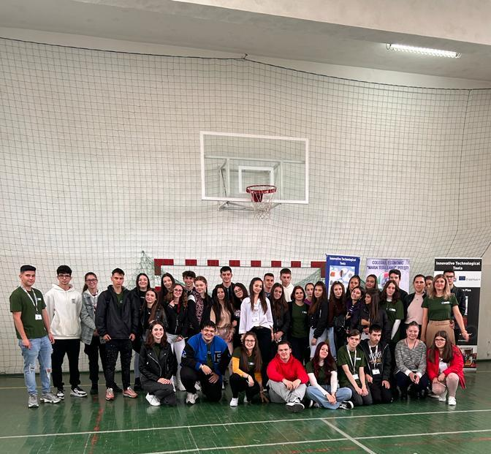
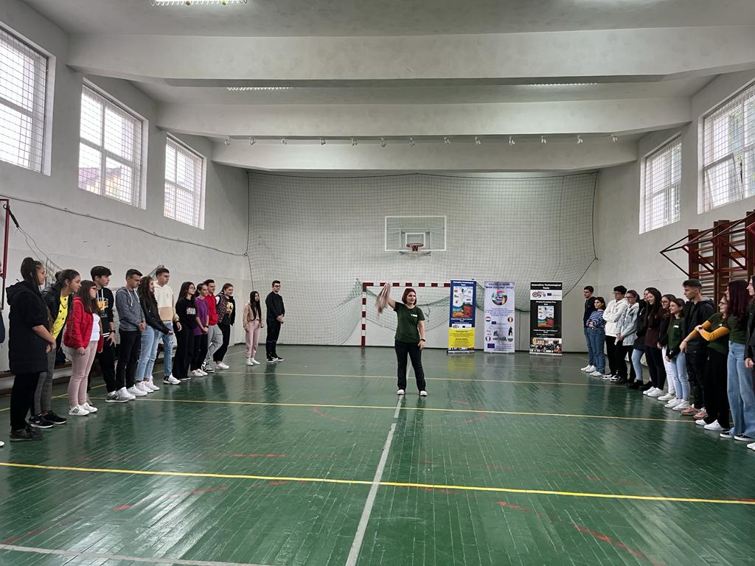
Our HighSchool Colegiul Economic ‘’Maria Teiuleanu’’
Our work in this project Campaigns Connect Past and Future
Erasmus Days in our College

Slide 9
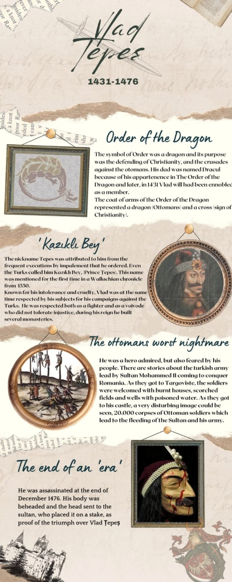
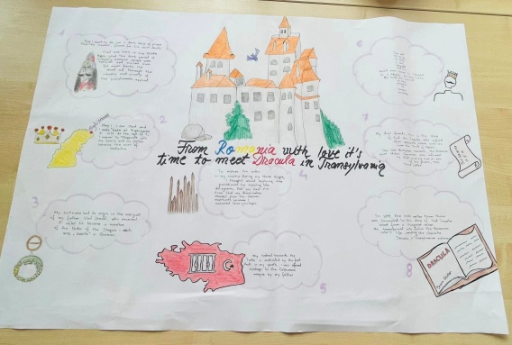
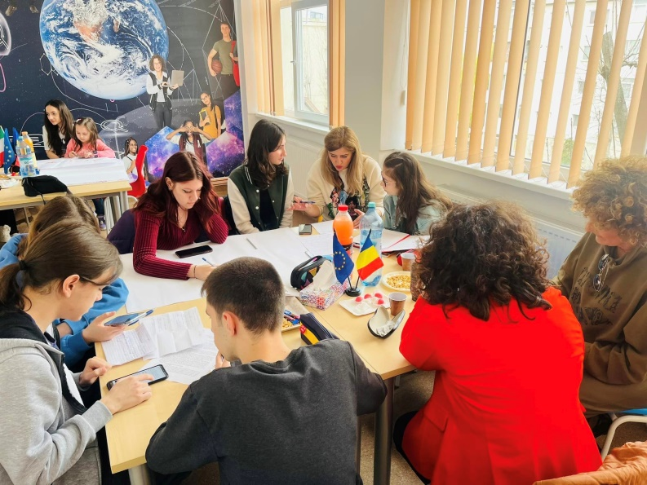
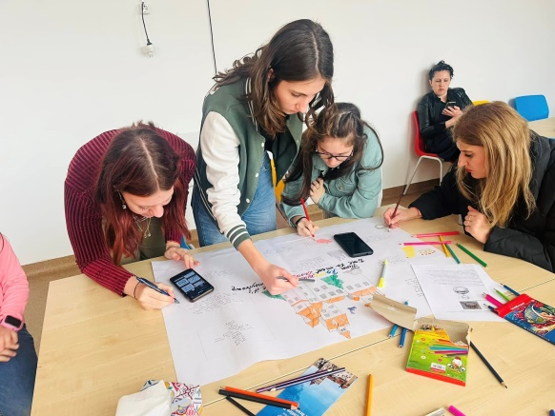
Our HighSchool Colegiul Economic ‘’Maria Teiuleanu’’
Our work in this project Campaigns Connect Past and Future
The second Hero we chose- Vlad Țepeș

Slide 10
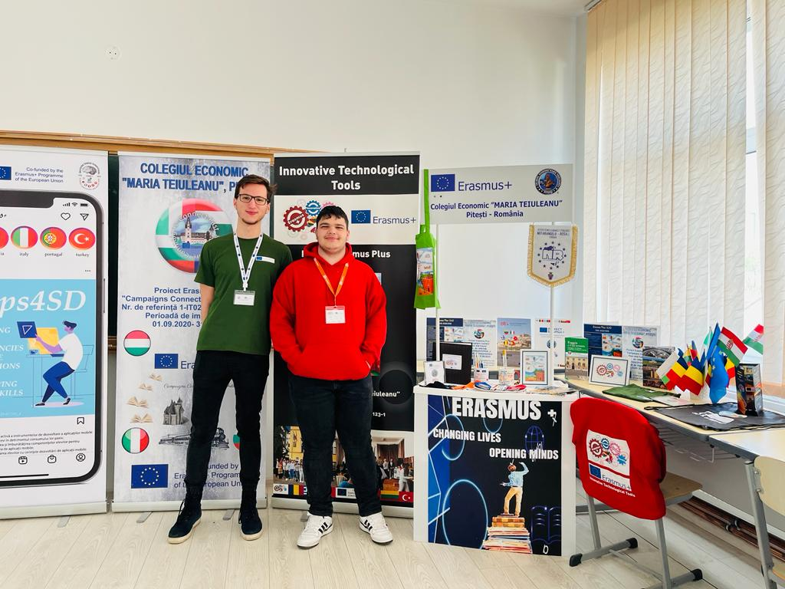
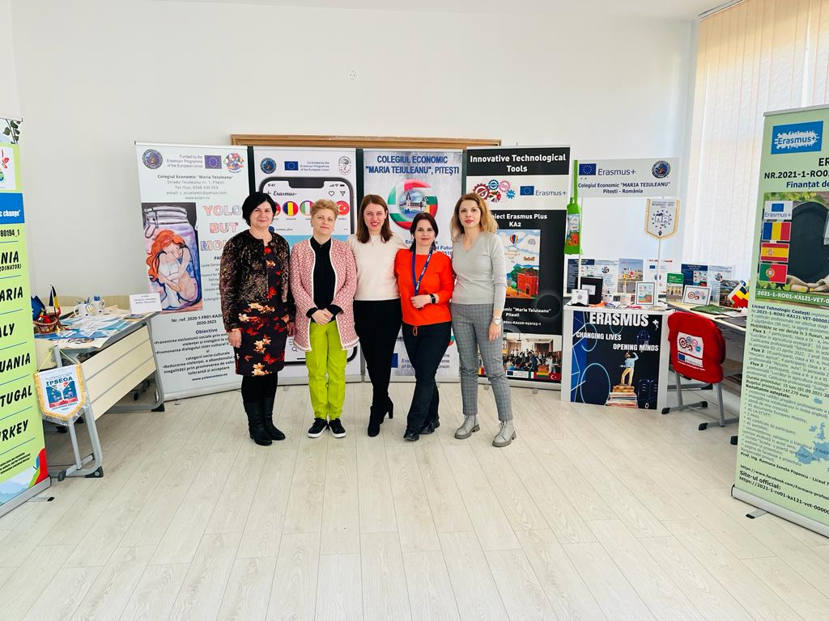
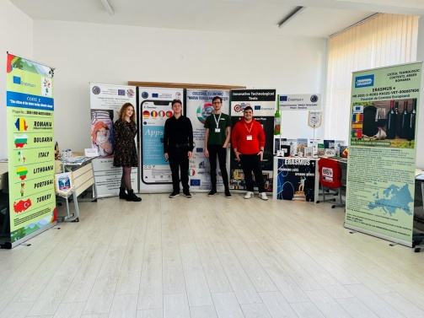
Our HighSchool Colegiul Economic ‘’Maria Teiuleanu’’
Our work in this project Campaigns Connect Past and Future
National Contest- Made for Europe

Slide 11
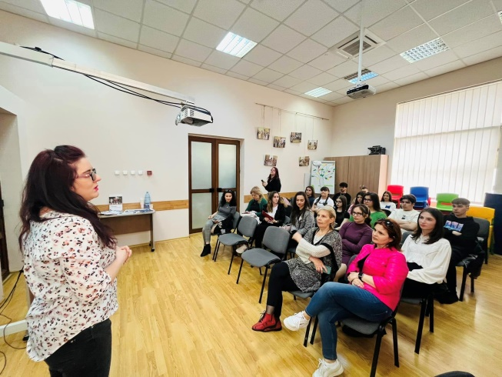
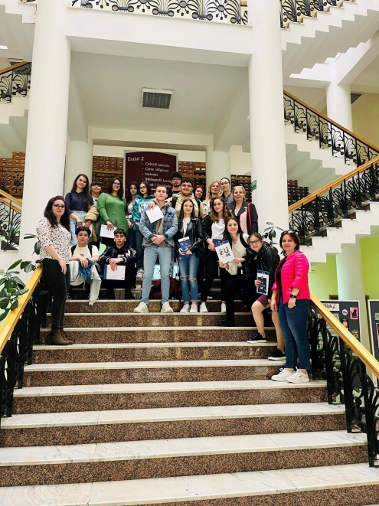
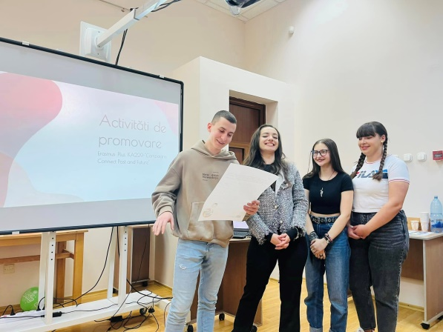
Our HighSchool Colegiul Economic ‘’Maria Teiuleanu’’
Our work in this project Campaigns Connect Past and Future
Teenagers in Action- Europe Direct, Pitești

Slide 12
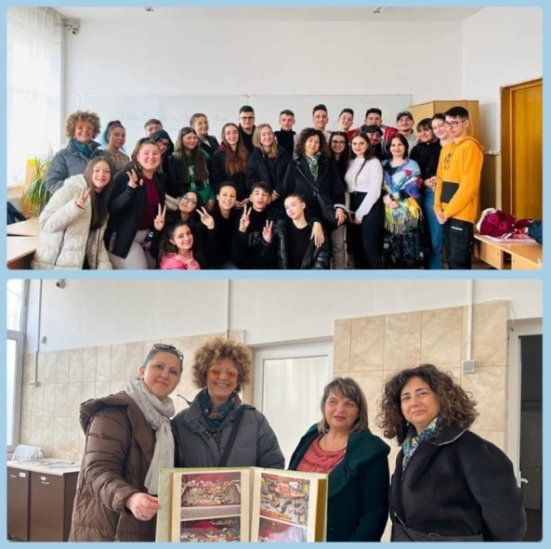
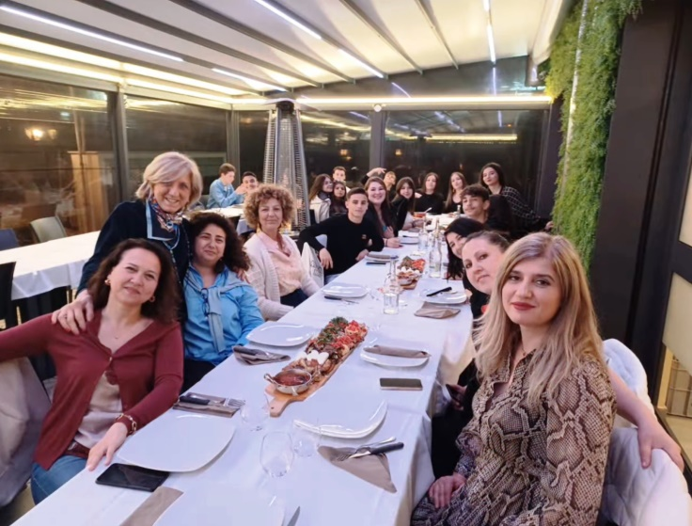
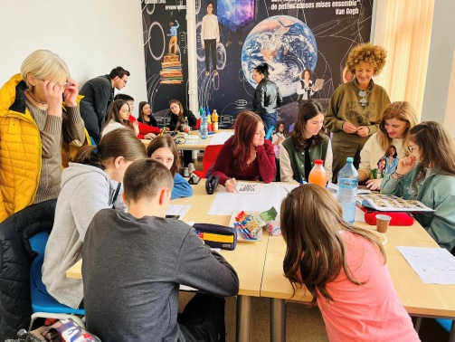
Our HighSchool Colegiul Economic ‘’Maria Teiuleanu’’
Our work in this project Campaigns Connect Past and Future
Friends for life due to C.C.P.F. Project
Italy-Romania Partnership

Slide 13
Our HighSchool Colegiul Economic ‘’Maria Teiuleanu’’
Our work in this project Campaigns Connect Past and Future
Coming soon…
So, Stay Close!

Slide 14
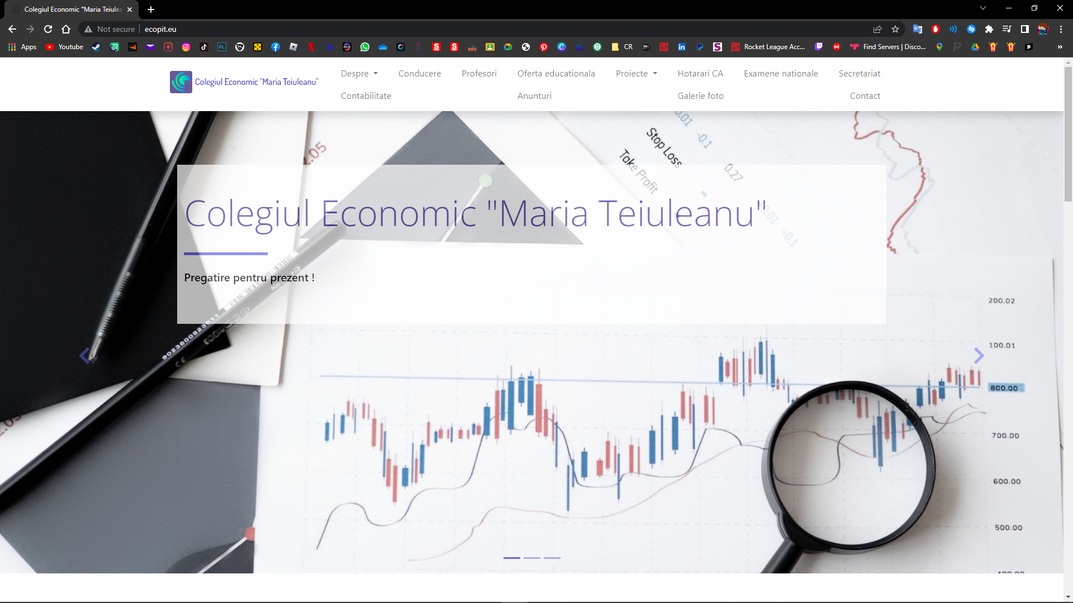
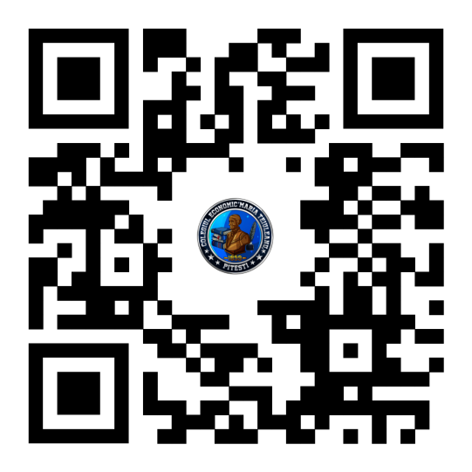
Our HighSchool Colegiul Economic ‘’Maria Teiuleanu’’
Our work in this project Campaigns Connect Past and Future
www.ecopit.eu

Slide 15
Our work in this project Campaigns Connect Past and Future
Our HighSchool Colegiul Economic ‘’Maria Teiuleanu’’
HighSchool history
,,Maria Teiuleanu” Economic Highschool, one of the most representative schools for the city’s life, has its origin in the former century, being the only commercial highschool in Arges county.
Over 900 students aged 14-18 study in 22 halls, 17 laboratories, 3 computer labs, having access to the Internet. Along the years our higschool has continuously upgraded and modernized the educational process.
The carrying out of the Educational Process is ensured by a teaching staff consisting of about 60 members.
The main form is full-time courses (4 years) in the following departments: Finance-Accounting, Tourism, Commerce, Gastronommy, Public Administration, Mathematics and Computer Studies.

