Slide 1




IPO Practices and Valuation; In the emerging Security Exchange in Ethiopia
Tamirat M.
(CMSA, ACCA)
Yonas E.
(MCSI, FCCA)
Ayele K.
(CMSA,DipIFR)
Netsanet T.
(MRICS)

Slide 2
Disclaimer: The views reflected in this slide deck are personal view of the presenters and by no means represent those of the institutions

Slide 3



Keffa Bunna
ኑ ቡና ጠጡ

Slide 4


Keffa Bunna
Wi-Fi
Keffa Bunna-Bole
Bunna Tetu

Slide 5
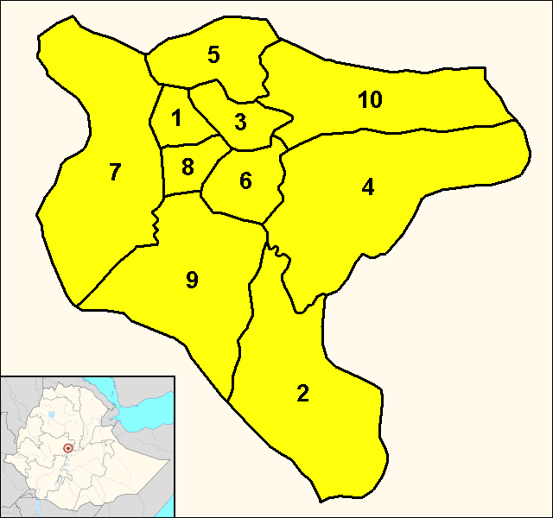


Keffa Bunna
10 Branches
Bunna Tetu

Slide 6


Keffa Bunna
Listing on Stock Exchange
2000 Branches

Slide 7
Listing
Option 01
Option 02
Admission of Securities of Keffa for trading on Ethiopia Stock Exchange
IPO
LBI
DPO
FPO

Slide 8
01
Raising Funds
Capex, New Project, Debt repayment
IPO
Primary Objectives
Planning
Marketing is the study and management of exchange relationships.
Cash Out Opportunity
For Early Stage Investors and employees
02

Slide 9

Find & Hire Investment Bank
File Registration Statement @ ECMA
The IPO Process
Prepare & Publish Prospectus
Marketing- with a PR Agency
Valuation & Price Determination

Slide 10




Investment Banker
Documentation & IPO admin
Marketing
Underwriting

Slide 11
Registration Statement
Submitted thru an electronic system and Reviewed by the ECMA
Company Operation
Finances
Management

Slide 12
Company & Its Industry
Management & Board
Creating Prospectus
Prospectus
Product & Technology
Purpose of Raised Funds
Past Restated Financials & Analysis
Industry Analysis (Risk Analysis)

Slide 13
Marketing
P
Pilot Fishing
One-on one with limited investors
PR
Press Releases
R
Road Shows
Like Political Campaign
I
Interviews
S
Sell and Trade

Slide 14
Valuations and Price Determination
Valuation
Price Determination

Slide 15

Considerations prior to Listing-NSE Case
CG Considerations
Other Considerations
Appointment of Transaction Advisors
1/3 NEDs
AC is a must
Chair-<=2 listed
CFO & Acct Head-CPA
Auditor-CPA and ISA
Share capital, NA
Based on Market Segments
  GEMS-SMEs
  AIMS- Mid Cap
  MIMS- Large Institutions

Slide 16





Keffa Bunna …
1. Shares in Private Company
3. Can Shares be issued at a Discount?
Transactions
4. Financial Reports
2. Can Shares be issued in excess of their Nominal Value?
Assets
7. Shares in Public Company
Incomes
Trading Potential
COST
PRICE
VALUE
WORTH

Slide 17
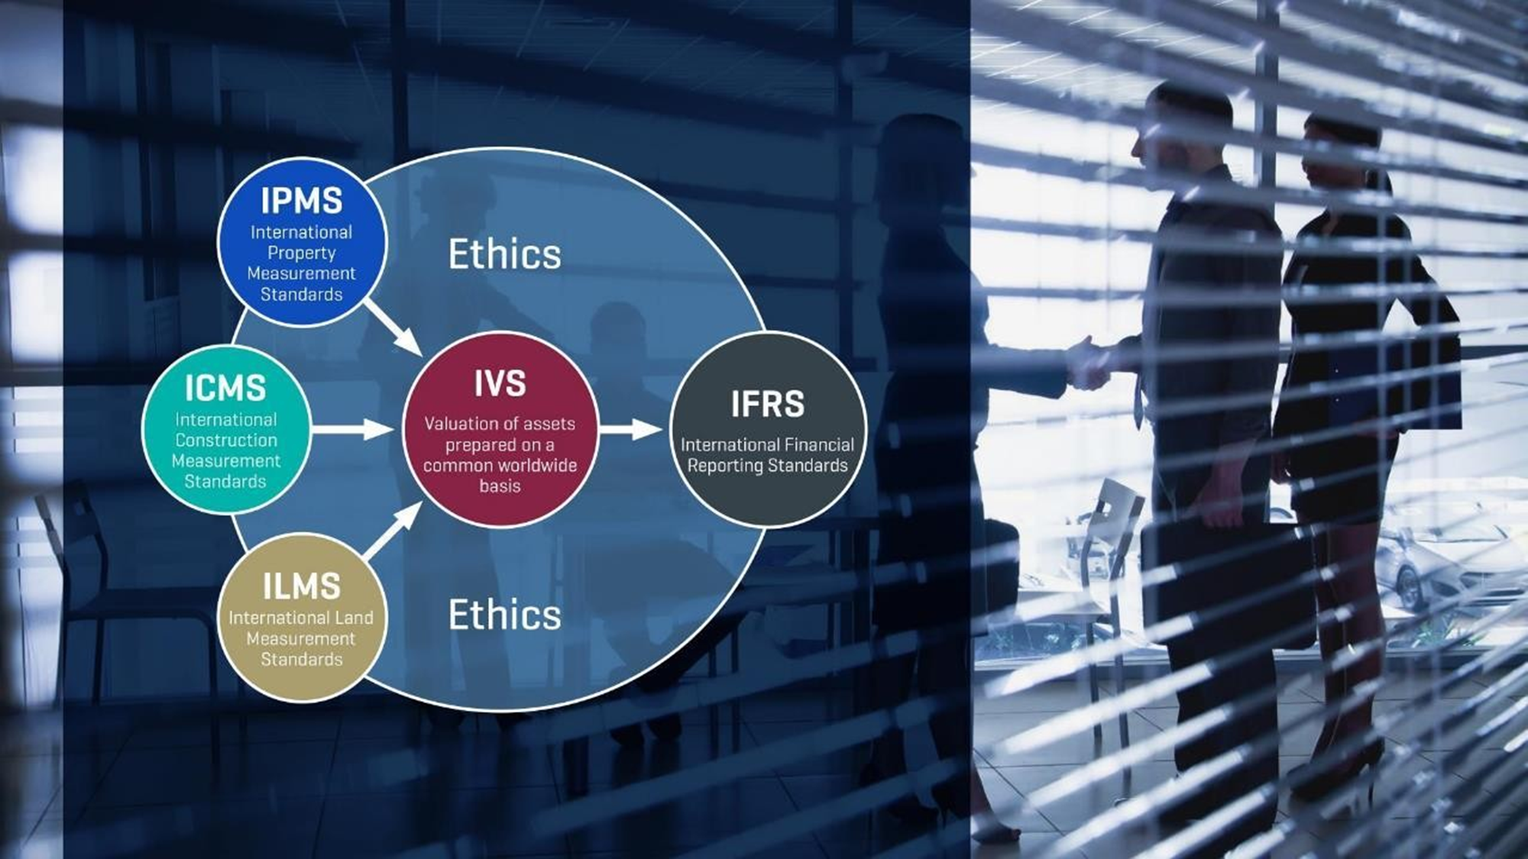

Slide 18

Final words ….
All (Written) Valuations including those for Business and Business Interests require:
Term of Engagement
Information
Investigations
Reports
Basis of Value
Assumptions
Specialism

Slide 19
Buy and Sell Side Actors
Portfolio Management
P
HNI
High Net worth Investors
Private Equity
PE
Buy Side
RI
Retail Investors
Hedge Funds
HF
I
Institutional Investors

Slide 20
Buy and Sell Side Actors
Information Technology
IT
Corporations
C
S&T
Brokers
Auditors
A
Sell Side
ER
Equity Research
PR Advisors
PR
I
Investment Banks

