Slide 1

10th Grade Core Curriculum Lesson Bridge Law
2022-2023

Slide 2




Who is your school counselor?
Notes:
Laura Potts: A-Ga
Holly Von Lanken: Ge-M
Kendrah DeGruy: N-Z
Dr. Brian Fenner- College & Career; works with all students to prepare for life after high school.

Slide 3



Reasons you might see your counselor
ACADEMIC
SOCIAL/EMOTIONAL
CAREER
To make an appointment with your counselor visit:
Notes:
Kell High School Counseling Website
-Select Appointments/Counselors from drop down menu
-Select “Read More” under your assigned counselor’s picture
-Select appointments
-Complete form and submit

Slide 4
Essential Question
How do I plan for my future?

Slide 5
Let’s talk about…
Graduation requirements – where do you stand?
Reading your transcript
Knowing your HOPE status
Naviance
Dual Enrollment
How do my interests relate to careers?
Naviance’s Career Interest Profiler
Notes:
This is your agenda for the lesson.

Slide 6
Graduation requirements
Are you on track
to graduate?
Promotion
Requirements

Slide 7
Graduation requirements
Subject Area​ | # of Credits Needed​
English​ | 4​
Math​ | 4​
Science​ | 4​
Social Studies​ | 3​
Health/Personal Fitness ​ | 1 (0.5 Health/0.5 PE)​
Career Tech and/or​ Fine Arts and/or​ World Language (WL)*​ ​ (any combination will do) ​ | 3 ​ ​ *2 credits of the same WL are required for college entrance ​
Electives​ | 4​
Total​ | 23​

Slide 8
Do You Want To Be A Junior?
You can earn up to 8 credits per year, but you need specific credits to promote.
Must earn a total of 10 total credits to promote to 11th:
  Must pass 2 Required English
  Must pass 2 Required Math
  Must pass 2 Required Science
  Must pass 4 more classes

Slide 9
Transcripts ccsd & HOPE
TYPES OF
TRANSCRIPTS
GPA’s
HOPE INFO

Slide 10
Types of Transcripts
You have 2 types of transcripts:
Cobb County
&
HOPE
​There are some differences between these 2 documents.

Slide 11
What’s on your Cobb County transcript?
  PERSONAL INFORMATION
  CUMULATIVE GPA
    weighted & unweighted
  CREDITS EARNED & ATTEMPTED
  ATTENDANCE INFORMATION
  EOC SCORES
Notes:
Cumulative – includes all classes taken in high school and quality points for honors and AP/IB; Core – includes classes taken in English, math, science, social studies, and foreign language and quality points for honors and AP/IB; HOPE – includes classes taken in English, math, science, social studies, and foreign language and quality points (.5) for AP/IB if you made below an A; College – varies from school to school (students should check with individual schools)

Slide 12
Cobb County transcript
Cumulative Grade Point Average=
The average of ALL grades earned in high school​.
Includes Electives (PE, CTAE, Fine Arts, etc.)​
Includes ALL grades (PASSED OR FAILED)
​
​
Letter Grade​ | On-Level​ | Honors​= 0.5 Extra Quality Points | AP= 1.0 Extra Quality Points​
A​ | 4.0​ | 4.5​ | 5.0​
B​ | 3.0​ | 3.5​ | 4.0​
C​ | 2.0​ | 2.5​ | 3.0​
D​ | 1.0​ | 1.5​ | 2.0​
F​ | 0.0​ | 0.0​ | 0.0​

Slide 13
Let’s talk about Hope!
What are the different types of HOPE?
What is HOPE Rigor?
How is my HOPE GPA calculated?

Slide 14
Zell miller
Zell Miller Scholarship
Requires 3.7 core high school (HOPE) GPA as calculated by GSFC
Requires 1200 SAT Math and Reading or 26 ACT composite
Must earn a minimum of 4 credits from the academic rigor course list prior to graduating from high school.
Pays for two year or four-year degree
Must graduate from a GA high school
Must be GA resident for at least one year (Green Card or citizenship)
Covers FULL tuition
Applies automatically for Valedictorian or Salutatorian
Must maintain 3.3 GPA while in college
Zell Miller Grant
Requires 3.5 college GPA for grant eligibility
Does not require minimum test score
Pays for certificate or diploma
Must graduate from a GA high school
Must be GA Resident for at least one year (Green Card or citizenship)
Covers FULL tuition (retroactively covers previous semester once 3.5 GPA is earned)
Must maintain 3.5 GPA while in college

Slide 15
HOPE Scholarship
Scholarship
3.0 core GPA as calculated by GSFC (can be earned in college)
Must earn a minimum of 4 credits from the academic rigor course list prior to graduating from high school. (Review your HOPE transcript on GAfutures.org)
Two year or four-year degree
Must graduate from a GA high school
Must be a GA resident for at least one year (Green Card or citizenship)
Covers a percentage of tuition
Grant
No initial GPA requirement
Technical certificate or diploma
Must have a high school diploma or GED
Must be a GA resident for at least one year (Green Card or citizenship)
Covers a percentage of tuition
Your SSN must be updated in the Cobb student record system for you to receive HOPE funds!

Slide 16
HOPE gpa
HOPE GPA=
The average of your core classes, which include English, math, science, social studies, & world languages.
Includes Academic Electives (ex. Algebra Support, Psychology, Yearbook, etc.)​
Includes ALL grades in these areas (PASSED OR FAILED)
ONLY SOME AP/DE earn Extra Quality Points up to a 4.0
Regular On-Level | Honors Level | AP/DE
A=4.0 | A=4.0 | A=4.0
B=3.0 | B=3.0 | B=3.5
C=2.0 | C=2.0 | C=2.5
D=1.0 | D=1.0 | D=1.5
F=0.0 | F=0.0 | F=0.0
Notes:
Allow students time to look at their HOPE transcripts. Discuss the differences between the CCSD transcript and the HOPE transcript.
Explain that the purpose of removing weight from HOPE is to level the playing field, so everyone in GA can have access to the scholarship. Many counties in GA don’t have the same options that our kids do such as Honors, AP, Magnet, IB, & DE. HOPE does not determine college admissions, it just determines if they will receive help paying for school from the state.

Slide 17
Hope rigor
In order to be HOPE eligible, the
class of 2023
must earn at
least four credits
in courses from the following categories: ​
Advanced math
Algebra II
Pre-Calculus
Advanced science
Chemistry, Physics
Advanced Placement
in core subjects
University System of Georgia
in core subjects
Dual enrollment
Advanced world language
Level 2 and higher
AMDM

Slide 18
DUAL ENROLLMENT
Who can do it?
What is it?
How to apply?

Slide 19
Dual Enrollment (DE)
DE is a state funded program that allows 11th and 12th graders to take college classes while completing their high school diploma.
DE also provides limited options for 10th graders
Any 10th grader can take CTAE classes at a Technical College
10th graders who have earned a 1200 SAT or 26 ACT (in one sitting) are eligible to apply to any DE program
DE pays for 100% tuition, mandatory fees, and required textbooks up to a maximum cap of 30 hours (this equates to roughly one year of full-time college enrollment or around 10 courses)
Notes:
Each school can edit the 4th bullet to add their school-specific next steps for interested students (i.e., talk to counselor, attend information session, etc.)
Here are the benefits to DE – you can present these to your students as appropriate:
Introduces students to college-level coursework.
• Earning college credits while still in high school may enable students to graduate early and/or possibly even earn an associate degree, diploma or certificate.
• Helps students adjust to certain aspects of the college experience (e.g., classes, coursework, and instruction, being on a college campus) so the transition from high school to college may be easier.
• Students who participate in a dual enrollment program are more likely to go to college and get a college degree.
• Students may be able to take classes that are not offered at their high school, especially in subject areas they are interested in for a potential career.
• Participating in a dual enrollment program demonstrates a student’s ability to handle more difficult coursework which is something college admissions officers may look upon favorably during admissions and recruiting.
• Taking college-level classes while still in high school may build confidence and encourage those students who may not be thinking about college to reconsider.

Slide 20
Dual Enrollment
DE students can take approved courses in:
English, math, science, social studies, or world/foreign languages (11th and 12th)
AND/OR
Career Tech (CTAE) classes (10th Grade)
The goal of Dual Enrollment is to increase college access and completion; and prepare students to enter the workforce with the skills they need to succeed.
If you’re interested in Dual Enrollment, speak with your school counselor.
Notes:
Be sure to share that only students in 11th and 12th Grade can take core courses via Dual Enrollment. 10th Graders can only take CTAE elective courses through a technical colleges.

Slide 21
Naviance
What is it?
How to login?
Bridge Law
Naviance is a delivery system and college/career search engine, but it also how we communicate with YOU and your parents, throughout the year.
Notes:
10th CC handout

Slide 22
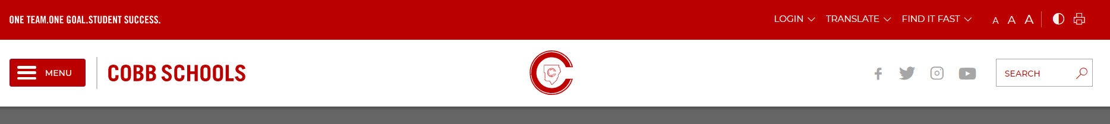

Logging into Naviance
Go to www.cobbk12.org
User Name: | Password:
Microsoft 365 User Name | Microsoft 365 Password
Go to “Find it Fast”
Go to “Naviance”
Continue with CLEVER

Slide 23
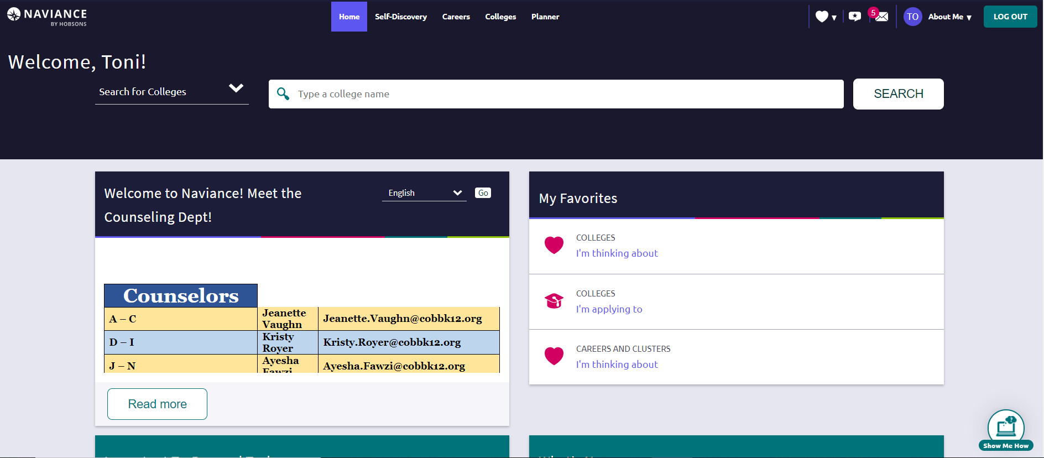
Naviance Student homepage

Slide 24
You can also use Naviance for…
College and Career Planning
Resume Builder
Communicating with your Counselor
Scholarship Searches

Slide 25
Bridge Law
Scroll down to “Tasks You Need to Work On”
1
Select “10th Grade - Dual Enrollment Survey”
2
Select “Take this survey” on the right side of your screen to begin the survey
3
Answer the question and click “Save and Finish”
4

Slide 26
“Education is the passport to the future, for tomorrow belongs to those who prepare for it today.”
- Malcolm X

