Slide 1
9th Grade Bridge Law Counseling Lesson
Your School Counselors

Slide 2
Who is your school counselor?
Notes:
Add your counselor’s names and alpha. Also add your link to your website.

Slide 3
Reasons to see your counselor
CAREER
ACADEMIC
SOCIAL/EMOTIONAL
To make an appointment with your counselor visit:
Notes:
Include your department’s. process for requesting appointments

Slide 4
How can you talk to your school counselor?
Please select Counselors from the dropdown menu.
Select “Read Moore” under your counselor’s picture
Select Appointments
Complete Form and Submit
Notes:
Explain how to make an appointment with counselor and add email as well any link to an online program that your department is using such as, youcanbookme.com.

Slide 5
Things to Know
Safety
Harassment & bullying policy
Tell an adult (teacher, counselor, assistant principal) if you’re being harassed/bullied or know of others
Crisis
A life-threatening situation
Tell an adult immediately
Confidentiality
Limits of confidentiality

Slide 6
Essential Question
What do you need to know to be successful in 9th grade and beyond?

Slide 7
Let’s talk about…
GPA
Course Rigor
Transcripts
Promotion Requirements
Graduation Requirements
Dual Enrollment
Your Responsibilities in the Classroom
Notes:
This is your agenda for the lesson.

Slide 8
What is GPA?
Grade Point Average (GPA):
A = 4.0 90-100
B = 3.0 80-89
C = 2.0 74-79
D = 1.0 70-73
F = 0.0 69 and ↓
Different kinds of GPA
Weighted vs. Unweighted
Cumulative vs. Core
HOPE
College
Notes:
Talking points: Cumulative – includes all classes taken in high school and quality points for honors and AP/IB; Core – includes classes taken in English, math, science, social studies, and foreign language and quality points for honors and AP/IB; HOPE – includes classes taken in English, math, science, social studies, and foreign language and quality points (.5) for AP/IB if you made below an A; College – varies from school to school (students should check with individual schools)
Refer to brochure on HOPE GPA. Make copies of the included PDF brochure or order brochures for free from Georgia Student Finance Commission at:
https://www.gsfc.org/gheac/order_loan/index.cfm?guid=&returnurl=https%3a%2f%2fsecure.gacollege411.org%2fHome%2fEducator.aspx

Slide 9
How do I calculate a GPA?
Step 1: Assign each grade a numeric value
A=4 (90-100%)
B=3 (80-89%)
C=2 (74-79%)
D=1 (70-73%)
F=0 (0-69%)
Step 2: Multiply the numeric point value by the units of credit attempted
Step 3: Total the values from step 2 & divide by the total number of credits attempted
AP and honors courses earn quality points
AP = +1 quality point
Honors = +0.5 quality point
Notes:
Explain how to calculate the GPA
Use this opportunity to discuss quality points and how they are added.
Refer to Board rule for which courses receive quality points.

Slide 10
GPA Examples
Example 1
Algebra I - B = 3.0
Humanities – A=4.0
Intro to Culinary Art – B = 3.0
Weight Training – B = 3.0
3.0 + 4.0+ 3.0+ 3.0= 13
13/4 = 3.25 GPA
Example 2
H Algebra I – C = 2.5
H Biology – B = 3.5
Marketing Principles – B = 3.0
Chorus – A = 4.0
2.5 + 3.5+ 3.0 +4.0= 13
13/4 = 3.25 GPA
Notes:
Can use this or make up your own examples. May want to ask a student to come to the whiteboard and assist you.

Slide 11
Why take Honors and AP classes?
Provides opportunities to improve study skills
Familiarizes you with college level work
Can boost your cumulative GPA
Prepares you for big tests (ACT, SAT, ASVAB, Accuplacer, Milestones)
Gives you an advantage in college admissions
Allows you to expand your interests
May be eligible for college credit (AP Exam)
Improves work ethic and critical thinking skills for workforce
BUT… you must find the right balance for YOU; don’t compare yourself to others
Notes:
May want to discuss different colleges and the Freshman Student Profile for UGA and GA Tech vs. other colleges if you are discussing in state. Let them know how many AP classes they are looking for.

Slide 12
Report Card versus Transcript?
Report Card
Transcript
Grades from one semester
Unofficial document
Used by parent or guardian
Includes some personal information (address, Cobb ID)
Record of all high school final grades
Official legal document
Used by colleges, military, and employers
Includes identifying personal information (SS#, DOB, address)
Includes cumulative GPA
Notes:
Report Cards are now on studentVUE and parentVUE at the end of the semester. It is no longer handed out.
You can discuss that you get a transcript at the beginning of every semester and what you need to do to get a copy of your transcript at other times.

Slide 13
How Many Credits Do I need for Graduation?
Area of Study | Required Credits
English/Language Arts | 4 credits
Mathematics | 4 credits
Science | 4 credits
Social Studies | 3 credits
World Language/Technical/Fine Art | 3 credits
Personal Fitness | 0.5 credit
Health | 0.5 credit
Electives | 4 credits
TOTAL CREDITS: | 23
Notes:
In English – You must have 9th Lit and American Lit
Math – Must have through Algebra II
Science – Bio
Chemistry, Environmental, or Earth Sci
Physics or Physical Science
4th Science
Social Studies
World History
US History
Government/ Econ
Refer to handout of graduation requirements
Refer to Administrative Rule IKE for detailed promotion requirements

Slide 14
Promotion Requirements
Grade Level | Required Credits
10th | 5 credits (1 credit each in core English, Math and Science)
11th | 10 credits (2 credits each in core English, Math, and Science)
12th | 16 credits

Slide 15
Dual Enrollment (DE)
DE is a state funded program that allows 11th and 12th graders to take college classes while completing their high school diploma.
DE also provides limited options for 10th graders
An eligible 10th grader can take CTAE classes at a Technical College
10th graders who have earned a 1200 SAT or 26 ACT (in one sitting) are eligible to apply to any DE program, You must have also met the college’s requirements for admission
DE pays for 100% tuition, mandatory fees, and required textbooks up to a maximum cap of 30 hours (this equates to roughly one year of full-time college enrollment or around 10 courses)
Notes:
Each school can edit the 4th bullet to add their school-specific next steps for interested students (i.e., talk to counselor, attend information session, etc.)
Here are the benefits to DE – you can present these to your students as appropriate:
Introduces students to college-level coursework.
• Earning college credits while still in high school may enable students to graduate early and/or possibly even earn an associate degree, diploma or certificate.
• Helps students adjust to certain aspects of the college experience (e.g., classes, coursework, and instruction, being on a college campus) so the transition from high school to college may be easier.
• Students who participate in a dual enrollment program are more likely to go to college and get a college degree.
• Students may be able to take classes that are not offered at their high school, especially in subject areas they are interested in for a potential career.
• Participating in a dual enrollment program demonstrates a student’s ability to handle more difficult coursework which is something college admissions officers may look upon favorably during admissions and recruiting.
• Taking college-level classes while still in high school may build confidence and encourage those students who may not be thinking about college to reconsider.

Slide 16
Dual Enrollment Information Sessions
https://sites.google.com/view/khs-dual-enrollment/home
CCSD Summit September 2nd - Virtual
Notes:
https://sites.google.com/view/khs-dual-enrollment/home

Slide 17
Tips for Success in High School
Basic Requirements
Going Above and Beyond
Come to school
Be on time
Have your materials
Pay attention
Complete and submit your assignments
Find out what you missed when absent and make up work in a timely manner
Check your grades
Review & preview notes
Attend tutoring
Communicate with your teachers
Take detailed notes
Study nightly
Keep a calendar
Stay organized

Slide 18
Pop Quiz!

Slide 19
If you earned a 95 in every class, what would your GPA be?

Slide 20
How many quality points do AP classes get?
Notes:
1.0 – feel free to follow up about honors classes

Slide 21
What is one reason to take an honors or AP class?
Notes:
Possible answers:
Provides opportunities to improve study skills
Familiarizes you with college level work
Can boost your cumulative GPA
Prepares you for big tests (ACT, SAT, ASVAB, Accuplacer, Milestones)
Gives you an advantage in college admissions
Allows you to expand your interests
May be eligible for college credit (AP Exam)
Improves work ethic and critical thinking skills for workforce
BUT… you must find the right balance for YOU; don’t compare yourself to others

Slide 22
How many credits do you need at minimum to be considered a 10th grader?
Notes:
5 (1, English, 1 math, 1 science) – feel free to ask follow up questions

Slide 23
How many credits do you need to graduate from high school?
Notes:
23 – feel free to ask follow up questions

Slide 24
What are some tips to be successful in high school?
Notes:
Come to school
Be on time
Have your materials
Pay attention
Complete and submit your assignments
Find out what you missed when absent and make up work in a timely manner
Check your grades
Review & preview notes
Attend tutoring
Communicate with your teachers
Take detailed notes
Study nightly
Keep a calendar
Stay organized

Slide 25
Naviance
Naviance is a delivery system and college/career search engine. We use it to communicate with you and we will use it throughout the year for various activities.
You can access Naviance from the CCSD homepage, your school’s website, as well as your school counseling department’s website.
Notes:
You can include graphics of where on the websites the icons are, if you chose.

Slide 26
Logging into Naviance
Go to www.cobbk12.org
User Name: | Password:
Microsoft 365 User Name | Microsoft 365 Password
Go to “Find it Fast”
Go to “Naviance”
Continue with CLEVER

Slide 27
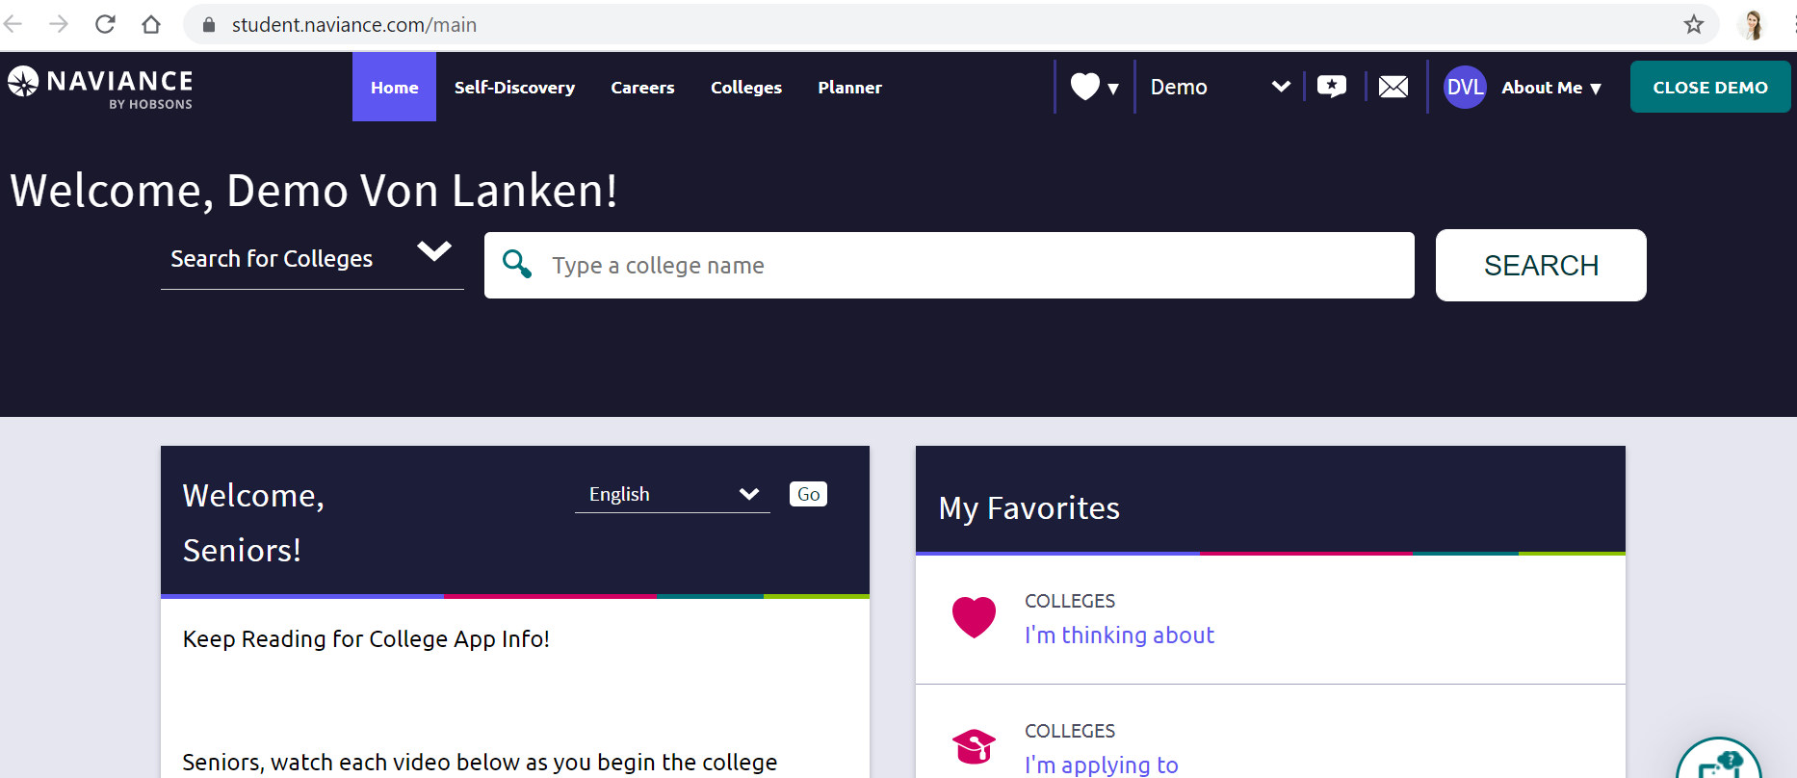
Adding STUDENT E-MAIL ADDRESS
Click on “About Me”
Choose “My Account”
Click the Pencil Icon/Edit under “Contact”
Scroll & enter student email address **This is the email that you use the most.
Press Save

Slide 28
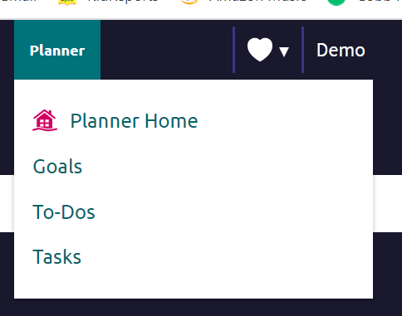
Locating Tasks to Complete
Click on “My Planner” then Click off “Tasks”
3 Tasks to complete
9th Grade Dual Enrollment Survey
9th Grade Career Interest Profiler
Save 3 Careers to my list

Slide 29
9th Grade bridge law Task 1
Scroll down
Scroll down to “Tasks You Need to Work On”
Select
Select “9th” Grade - Dual Enrollment Survey”
Select
Select “Take this survey” on the right side of your screen to begin the survey
Answer
Answer the question and click “Save and Finish”

Slide 30
9th Grade bridge law Task 2
Scroll down to “Tasks You Need to Work On”
1
Select “Career Interest Profiler”
2
Select “Take
Assessment.”
3
Answer the question and click “Save and Finish”

Slide 31
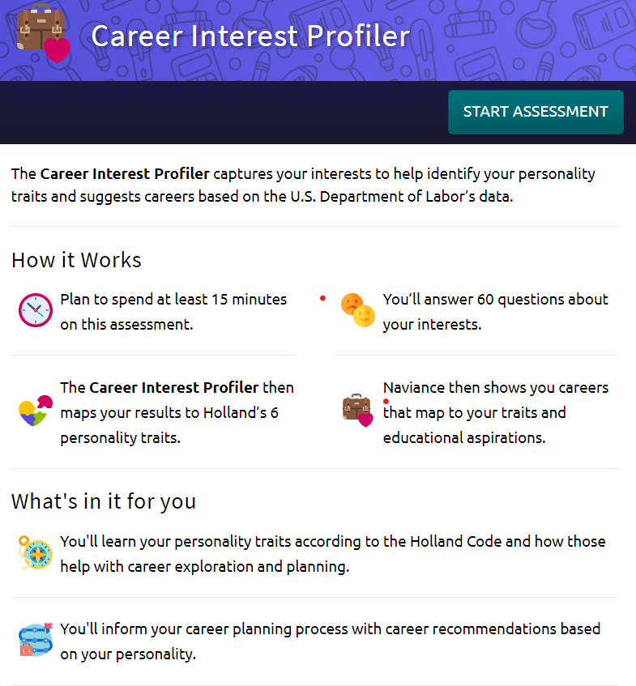
Career Interest Profiler Assessment

Slide 32
Things to Think About In
Your Career Selection
Personality
Interests
Skills
Career Options
Notes:
*Personality, Skills, and Interests all help us determine our career goals and path
*In order to help us map our path out, we need to explore the different careers and what interests best suit certain careers

Slide 33
9th Grade bridge law Task 3
Scroll down
Scroll down to “Tasks You Need to Work On”
Select
Select “Choose Save 3 Careers ”
Select
Select “Save careers by favoring the pink heart icon
Answer
Answer the question and click “Save and Finish”

Slide 34
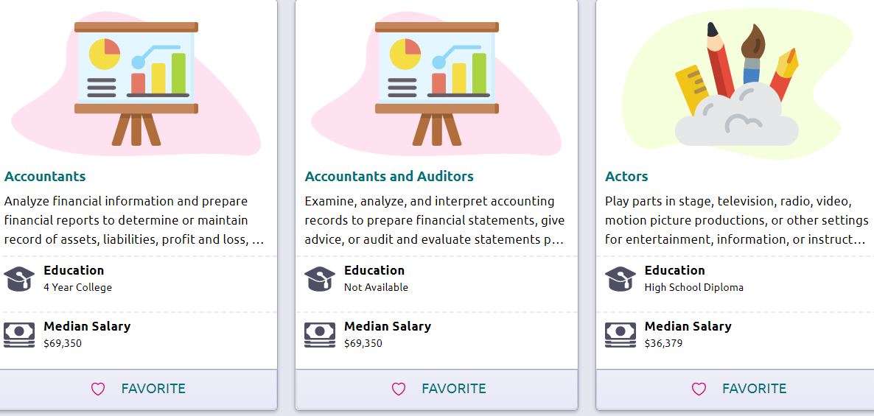
Save Careers By Clicking the Favorite Icon
Click Here to Add to List

Slide 35
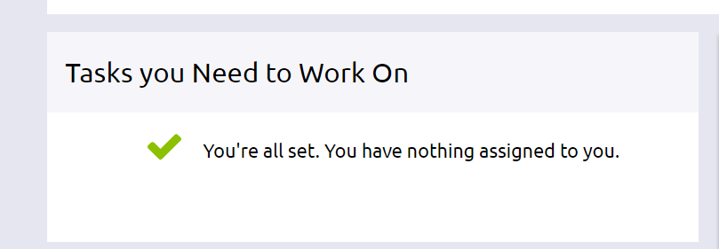
Don’t log out!
Verify all 4 Tasks have been completed
Click “My Planner”
Choose “Tasks”
You will see a message when finished

Slide 36
“The future belongs to those who believe in the beauty of their dreams.” - Eleanor Roosevelt
Something to think about…

