Slide 1
The Gobbles Movement
a powerpoint by John Tvs.

Slide 2
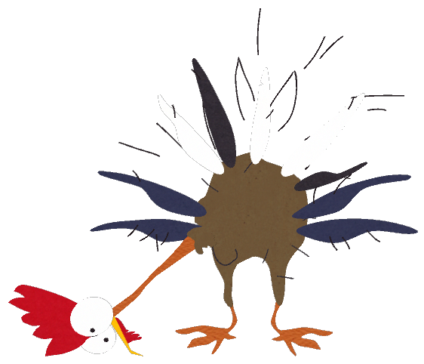
Who is Gobbles?

Slide 3
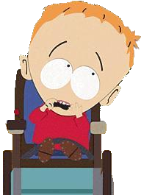
Who is Gobbles?
Gobbles is a turkey who appeared in the South Park episode “Helen Keller! The Musical”, which is his only appearance. He is a crippled turkey, who is taught by character Timmy Burch to be his pet for the Thanksgiving school play.

Slide 4
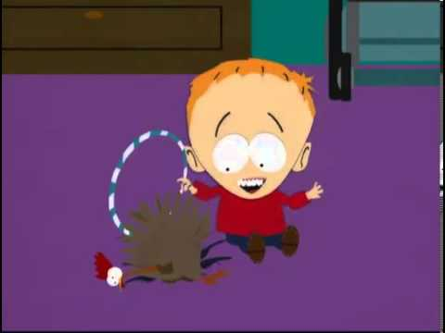
Gobbles and Timmy.

Slide 5
What is “The Gobbles Movement”?
“The Gobbles Movement” is a movement dedicated to bringing back Gobbles through art and other forms of media, including the hashtag, “#BringBackGobbles2020”. He might be a one-time character at the moment, but in the future, we will see him again if you use this hashtag. His legacy will be remembered through the following forms:

Slide 6
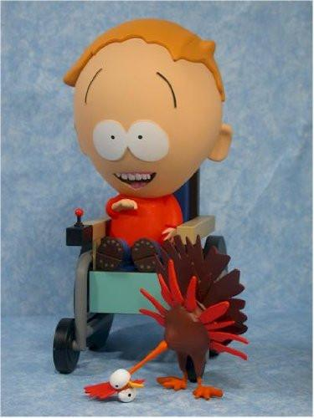
Merchandise

Slide 7
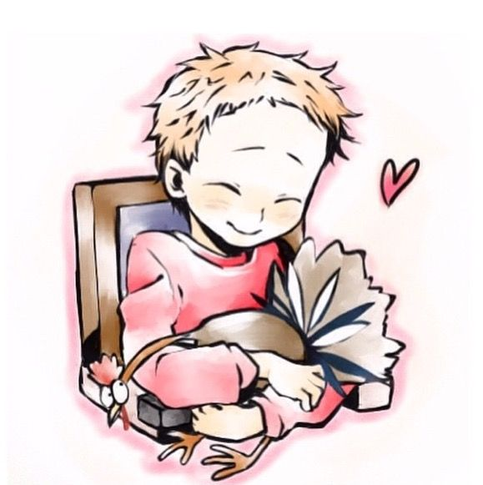
Fanart

Slide 8
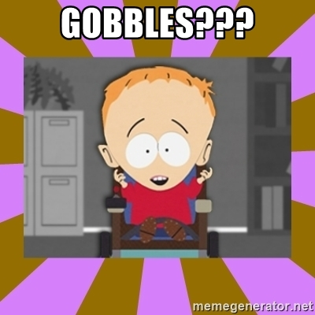
...and Memes.

Slide 9
Why is Gobbles so important?
For one, it’s “taboo” for a show to have a Thanksgiving special, since Thanksgiving is only a thing in the U.S and Canada. Barely any shows have Thanksgiving specials. Aside from ATHF and Charlie Brown.
Gobbles debuted before Jimmy Valmer. He debuted in the same season as Timmy, and he is a symbol to fans everywhere about the Thanksgiving holiday.
He is a really underappreciated character, due to only appearing in one episode. Fans always wanted him back. This will be the perfect time to do so.

Slide 11
The End!
#BringBackGobbles

