Slide 1
Characters and Overview
Notes:
The whole joke of the presentation is that it is themed around laws.

Slide 2
What is “Workin’ Stiff and Friends”?
Workin’ Stiff and Friends is a show that debuted on February 8th, 2019 that focuses on the adventures of 3 look-alike characters and others trying to stop the evil Ronald McDonald and Company Industries. The show uses a unique writing style, inspired by many different media properties. It also has a unique “animation” style.
Notes:
Warning: This presentation has spoilers for upcoming episodes!

Slide 3
First, we’ll cover the writing of the show.
After that, we’ll talk about the voices and how they are made.
Lastly, we’ll talk about the legacy of the show on John Tvs.
Writing
“Animation”
Voices
Characters
Legacy
Next, we’ll talk about the “animation”.
Next, we’ll talk about some of the characters.

Slide 4
Writing
of Workin’ Stiff and Friends.

Slide 5
The Writing of Workin’ Stiff and Friends
As mentioned before, the show has a very unique writing style. The show’s writing style is based on many different things, including cartoons, books, music, video games, and other things.

Slide 6
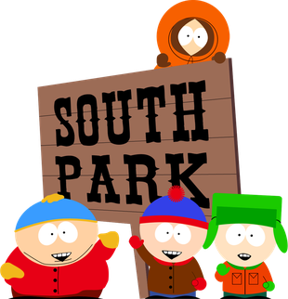
South Park
South Park has a huge emphasis on the writing for Workin’ Stiff and Friends. It is a show about 4 children, who are named Eric Cartman, Kyle Broflovski, Stan Marsh, and Kenny McKormick. Each of them have their own personality, which is a common writing trope for characters in TV shows. The writing is very crude and lowbrow, but it is intentional, as the main characters are children, who do not have very good manners just like real children do. The show is known for its rather topical humor, which mainly makes fun of topics like politics, companies, and more. Given how the show makes fun of companies, this subject matter is also incorporated in Workin’ Stiff and Friends, with the main characters going after the fictional company, Company Industries.
The show is also known for getting away with parody. The show makes fun of many popular franchises, like Pokémon, with its parody, Chinpokomon. They have got away with this ever since the first episodes. Workin’ Stiff and Friends also gets away with parody, by using many different copyrighted characters.

Slide 7
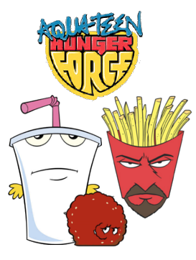
Aqua Teen Hunger Force
Aqua Teen Hunger Force is a show about 3 characters, Master Shake, a selfish, pathogetically lying milkshake, Meatwad, a childish ball of meat with little to no intelligence, and Frylock, an intelligent, down to earth box of french fries with a beard. Together, these 3 deliver some truly odd comedy. Its writing style is very random, often throwing in things that don’t make sense to the plot of the episode. The episodes usually end abruptly when something big is about to happen in the plot. The show is a spin off of Space Ghost Coast to Coast, a comedy show which is also about 3 characters. You want to know what show also has 3 characters? You guessed it. Workin’ Stiff and Friends. Just like Aqua Teen Hunger Force, the show not only has 3 main characters, but it also has many odd jokes and humor.

Slide 8
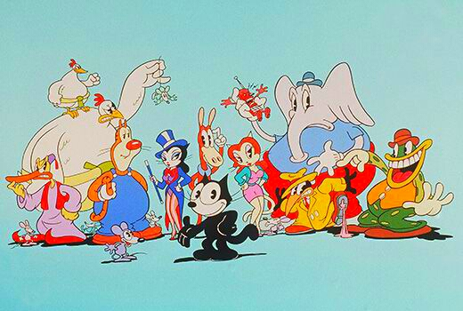
The Twisted Tales of Felix The Cat
The Twisted Tales of Felix the Cat is just, well, twisted. The show focuses on the world famous cartoon character, Felix The Cat and his many friends and foes. The show isn’t that well known, but it is well-known by many fans of Felix The Cat. The show has many odd jokes and gags involving the characters, plots, and the animation. Felix is more of a trickster-type character, being less of a hero like how he was in the 1960’s Felix The Cat series. He is met with very strange situations, from being held captive in a land of dairy from stopping a stupid Bermuda Triangle from destroying a city. The show was very well received, but unfortunately not being popular enough to get a 2nd season. Workin’ Stiff and Friends also has many odd jokes and gags involving the characters and the plots, going all out random sometimes like Aqua Teen Hunger Force.

Slide 9
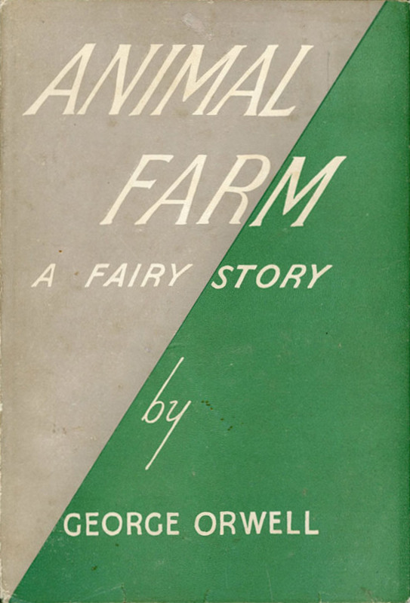
Animal Farm
Animal Farm is an allegorical, highly satirical novel about a farm of animals in a totalitarian government ruled by 3 pigs named Snowball, Napoleon, and Squealer. The book uses allegories to the Russian Revolution a lot, with many different character representations. The pigs represent greedy, rich dictators. The dogs represent the police, given how they are rich as well as being predatory. The sheep represent the easily controlled citizens, as they are very easily controlled by Napoleon and Squealer. Boxer, one of the many horses in the book, is a representation of Aleksey Stakhanov, who was seen as a role model during the Russian Revolution. Moses, the raven, represents religion due to the fact that he constantly talks about “Sugarcandy Mountain”, a place that is reminiscent of Heaven from many different religions, most notably, the Abrahamic religions, Judaism, Christianity, and Islam. Additionally, Moses’ name comes from the biblical prophet Moses, who is mentioned in Judaism, Christianity, and Islam. Workin’ Stiff and Friends is very inspired by Animal Farm because every character, episode, and even sometimes plots, are all symbolical if you choose to look hard enough.

Slide 10
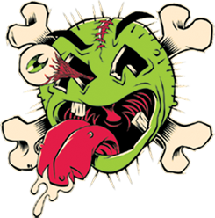
Green Jell-Ö
Green Jell-Ö is a comedy-rock band founded in 1981 by Bill Manspeaker. The band is primarily known for its 1992 hit single, Three Little Pigs, which is a re-recording of the 1989 song of the same name. The band, rather than bragging about how they are the best, brags about how they are the absolute worst band ever. And if you’re a fan, you’ll have to admit that they’re right in terms of musical talent. The band is known for its low-budget, often badly-made music videos. Unlike the other influences on this list, this one has sort of always been an influence for Workin’ Stiff and Friends due to the badly-made and low-budget atmosphere that the series inhibits. The band is also known for their comedy songs. As mentioned before, Three Little Pigs is a prime example of a comedy-rock song. But most people don’t know about some of their other stuff. Cereal Killer is a song about a crazed serial-killer named “Toucan Son Of Sam” who kills other cereal mascots. The Bear Song is a rock version of The Bear Went Up To The Mountain. They have even made some non-comedy songs like Orange Krunch, a rather brutal song about a strange, orange creature named “Orange Krunch”. Their comedy vibe and their general oddness has been an inspiration to the show ever since the beginning. Additionally, they have also gotten away with copyright. Which is something we do often on Workin’ Stiff and Friends.

Slide 11
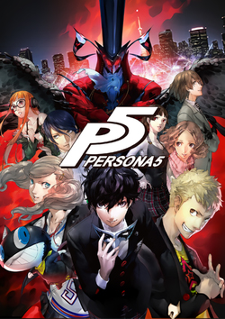
Persona 5
Persona 5 is a 2016 JRPG game about a vigilante group known as “The Phantom Thieves”. The game goes in-depth about the many wrong things that humanity always tries to commit, like pride, greed, wrath, envy, lust, gluttony, and sloth. These are called the 7 deadly sins, which are primarily found in Christianity, something that Persona 5 references often. Additionally, it also goes into acedia, which is constant depression. The game’s writing is very deep, often going into the characters’ motivations and what they stand for. The game is very critically received due to this aspect and it also has many sequels and spinoffs.
In Workin’ Stiff and Friends, some of the seven deadly sins, although not explicitly mentioned, are covered, like gluttony, greed, sloth, pride, envy, and wrath.
Additionally, Workin’ Stiff and Friends also has deep character plots in its upcoming 2nd season.

Slide 12
“Animation” and Voices
in Workin’ Stiff and Friends.

Slide 13
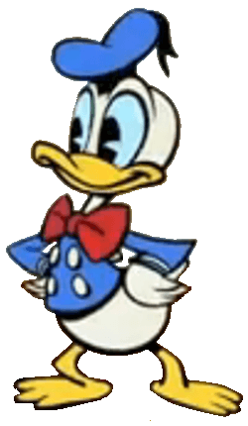
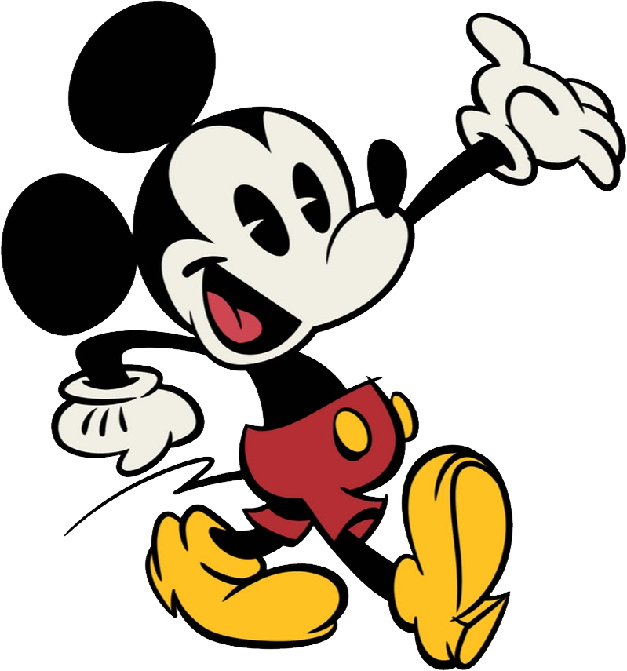
The “animation” and voices in Workin’ Stiff and Friends
The show, in its first season, was intentionally supposed to be badly made. However, for the upcoming 2nd season, many new changes will be made, although the “animation” style will be the same. You might be asking, “Why are there quotation marks around the word animation?” Because the animation in the series isn’t actually real animation. It kind of looks like this:

Slide 14
The “animation” and voices in Workin’ Stiff and Friends
And then, you might be asking “Why is it like that?” Because the series’ animation style is intentionally low-budget just like Green Jell-Ö music videos. The animation is based on shows like Hopla, a “cartoon” meant for babies and preschoolers that uses rather “primitive” animation. Additionally, it is also based on programs like Microsoft PowerPoint’s and Google Slides’ transitions.
Most of the voices are intentionally crude impressions of famous (or rather infamous) characters. For example, Ronald McDonald’s voice is an intentionally crude impression of the actual Ronald McDonald’s voice. For some characters, like Heavy the Mechanic, Bomb the Mechanic, and BonziBUDDY, text-to-speech voices are used. For BonziBUDDY, his actual voice is used. This is also true for Timmy Burch, whose voice samples are actually from South Park.
The series is made in FilmoraGo, which is a great app for video editing.

Slide 15
Characters
of Workin’ Stiff and Friends.

Slide 16
Who are the characters and where are they from?
The characters come from various different properties, from video games to cartoons, the show has many wacky and diverse characters. Most characters live in a fictional town called Weirdtown in the state of Arizona. Please note that the following characters that are about to mentioned are main characters and side characters, not any background characters. Additionally, some characters are from the upcoming 2nd season.
Notes:
SPOILERS AHEAD! Skip slide #21 if you don’t want any spoilers.

Slide 17
Workin’ Stiff
Is the main character of the show that appears in almost every episode. He lives in Weirdtown and was born there, which makes him one of the true residents. He is always boasting and bragging, but at the end of every episode, he learns a lesson and changes later on.

Slide 18
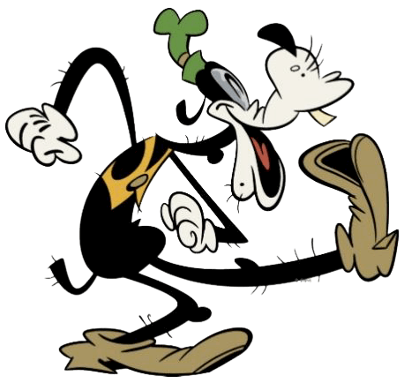
Workin’ Lazy
Is a dog that enjoys life by doing not much of anything. He is always simple-minded and is not very smart, but despite that, he is a good friend and is usually always happy. He is also born and raised in Weirdtown as well as being a true resident.

Slide 19
Workin’ Hard
Is a wild card when it comes to living life. He is mostly good hearted, but suffers from being impatient. He was born in raised in Nashville, TN which explains why he is a Titans fan and not a Cardinals fan. Despite that, he lives in Weirdtown, AZ with Workin’ Stiff and all his friends.

Slide 20
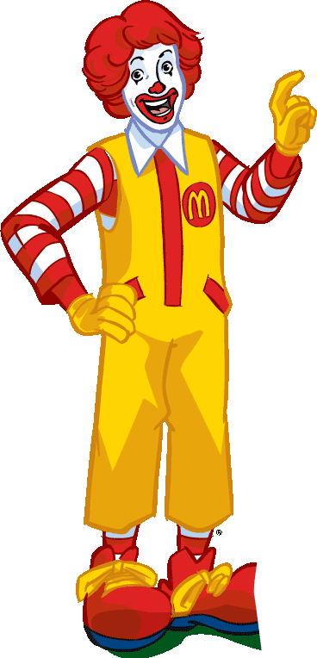
Ronald McDonald
Is the ideal depiction of greed. He is a character that is known to verbally harass people with forcing them to pay $39 for a simple McChicken sandwich. He worked with Workin’ Stiff, but only once because they formed a squad specifically made to fight the Toronto Raptors owner, Barney the Dinosaur. He was born and raised in New York, which explains why he is so greedy.

Slide 21
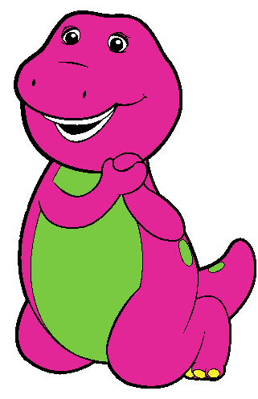
Barney The Dinosaur
Is a flat out douche. He used to be the main character of the famous children's show, Barney and Friends, before he turned back into a plush toy. BugGuy, The Fat Cat, and Ronald McDonald resurrected him by visiting SpaceGodzilla, the monster from the 1994 film, Godzilla VS. SpaceGodzilla, by giving him a Barney costume and the Eggmobile, Dr. Robotnik’s vehicle from the Sonic The Hedgehog series. After that, he became the owner for the NBA basketball team, the Toronto Raptors. He decided to take a reckless approach to owning by giving the teams’ players drugs. Workin’ Stiff, Workin’ Hard, and Workin’ Lazy formed the Hero Squad, a team dedicated to fighting Barney. The team was able to defeat him by using their abilities. After Barney was defeated, he was revealed to be SpaceGodzilla, who got flung into space with a ball of psychic energy. After that, Barney was officially declared dead.
Notes:
Told you it would have spoilers.

Slide 22
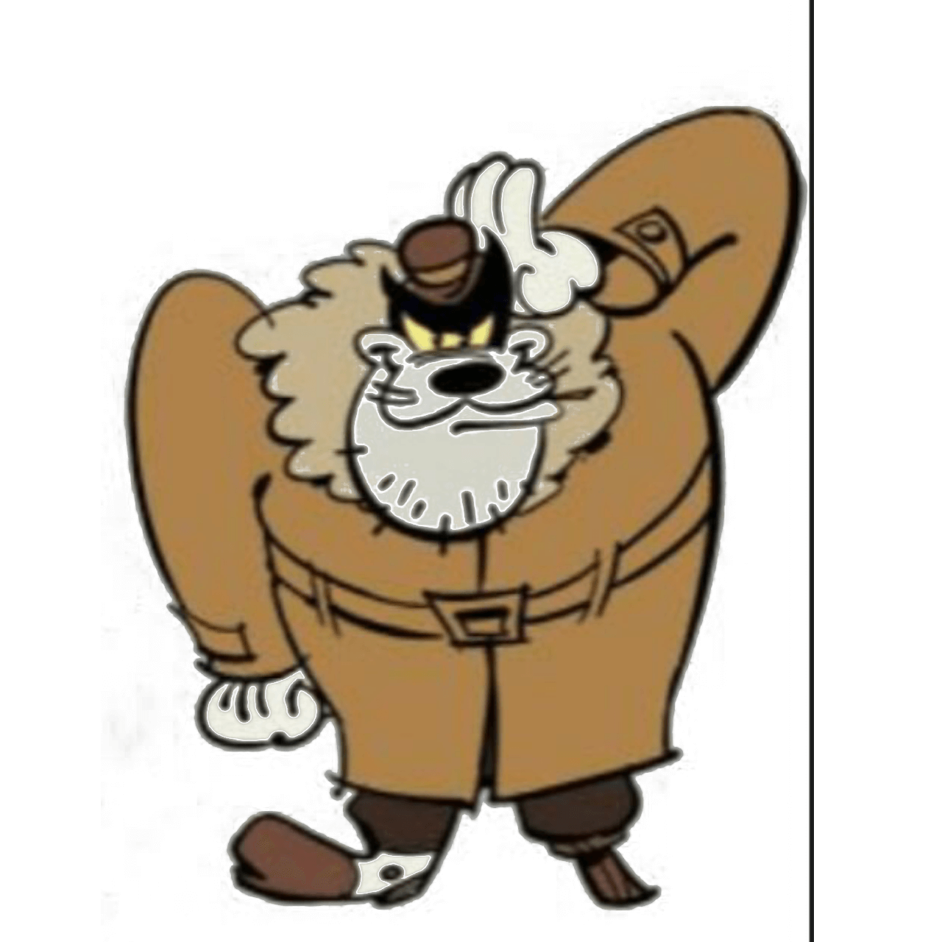
The Fat Cat
Is a really fat cat from the alleys of Weirdtown. He is known to beat up people for no real reason and he really hates Workin’ Stiff. He has a big ego, and is usually seen working with Company Industries. He is a great engineer, and has built many robots.

Slide 23
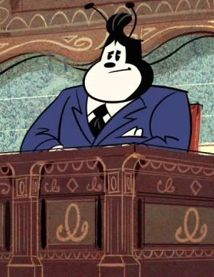
BugGuy
Is a character from the original Mickey Mouse shorts episode, “Workin’ Stiff”, which is the episode that inspired the creation of Workin’ Stiff and Friends. He is the C.E.O of Company Industries, the hugest company company in the world. He is depicted as being very greedy, only donating thousands of dollars to increase the good reputation of Company Industries. Because he is the C.E.O, he doesn’t move out of his chair most of the time. If he does, it is seen offscreen. Also, he has many workers, including Ronald McDonald, The Fat Cat, Toby The Blaster Tron, Quisp, and more. He is also the most richest person in the world, and heavily suffers from a lack of values and a lack of understanding of poor people.

Slide 24
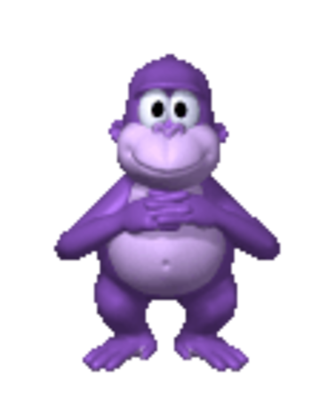
Bonzi Buddy
Is a character from the program BonziBUDDY. After retiring from the desktop business, he decided to become the mayor of a small town. He decided to pick Weirdtown, because Weirdtown only has 10 people living there. As the mayor of Weirdtown, he is kind and usually does acts of kindness, including giving Workin’ Stiff and Workin’ Hard 2 tickets to go to Weirdtown. Unlike world leaders, Bonzi knows what the people wants, and he will always try to do what’s right.

Slide 25
The Legacy
of Workin’ Stiff and Friends.

Slide 26
The Legacy of Workin’ Stiff and Friends on John Tvs
The show has done a lot for John Tvs. Not a whole lot, but still a considerable amount. For one, the show has helped John Tvs become more than just “toy videos for children” due to how the show has “animation” and a rather edgy tone. Another reason why it has helped John Tvs is due to the series being more like a cartoon. Third, it has helped John Tvs convert to a “not for kids” channel on YouTube due to the fact that the upcoming 2nd season will be much more edgier and more comedy and parody-based. Of course, the series has also spawned a spin-off series on John Tvs called JT Gaming, which is a gaming news show about Workin’ Stiff, Workin’ Hard, and Oddify from JT Plushies rambling about the video game industry.

Slide 27
The End!

