Slide 1
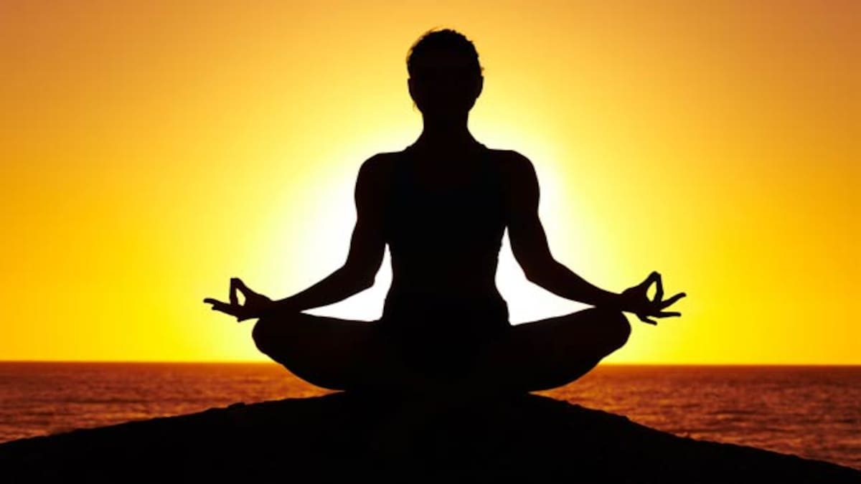
YOGA PRESENTATION
Y
PRIYANSHI

Slide 2
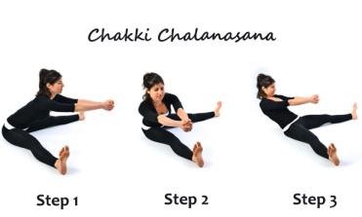
sit in a comfortable position & spread your legs straight in front of you. Keep your legs together in a straight position without bending your knees. After that join your hands & move it in circular motion over your legs. The circular motion will provide a good massage and will help in stretching your stomach, hands, and legs. Do it 10 times in clockwise position & 10 times in anti-clockwise position.

Slide 3
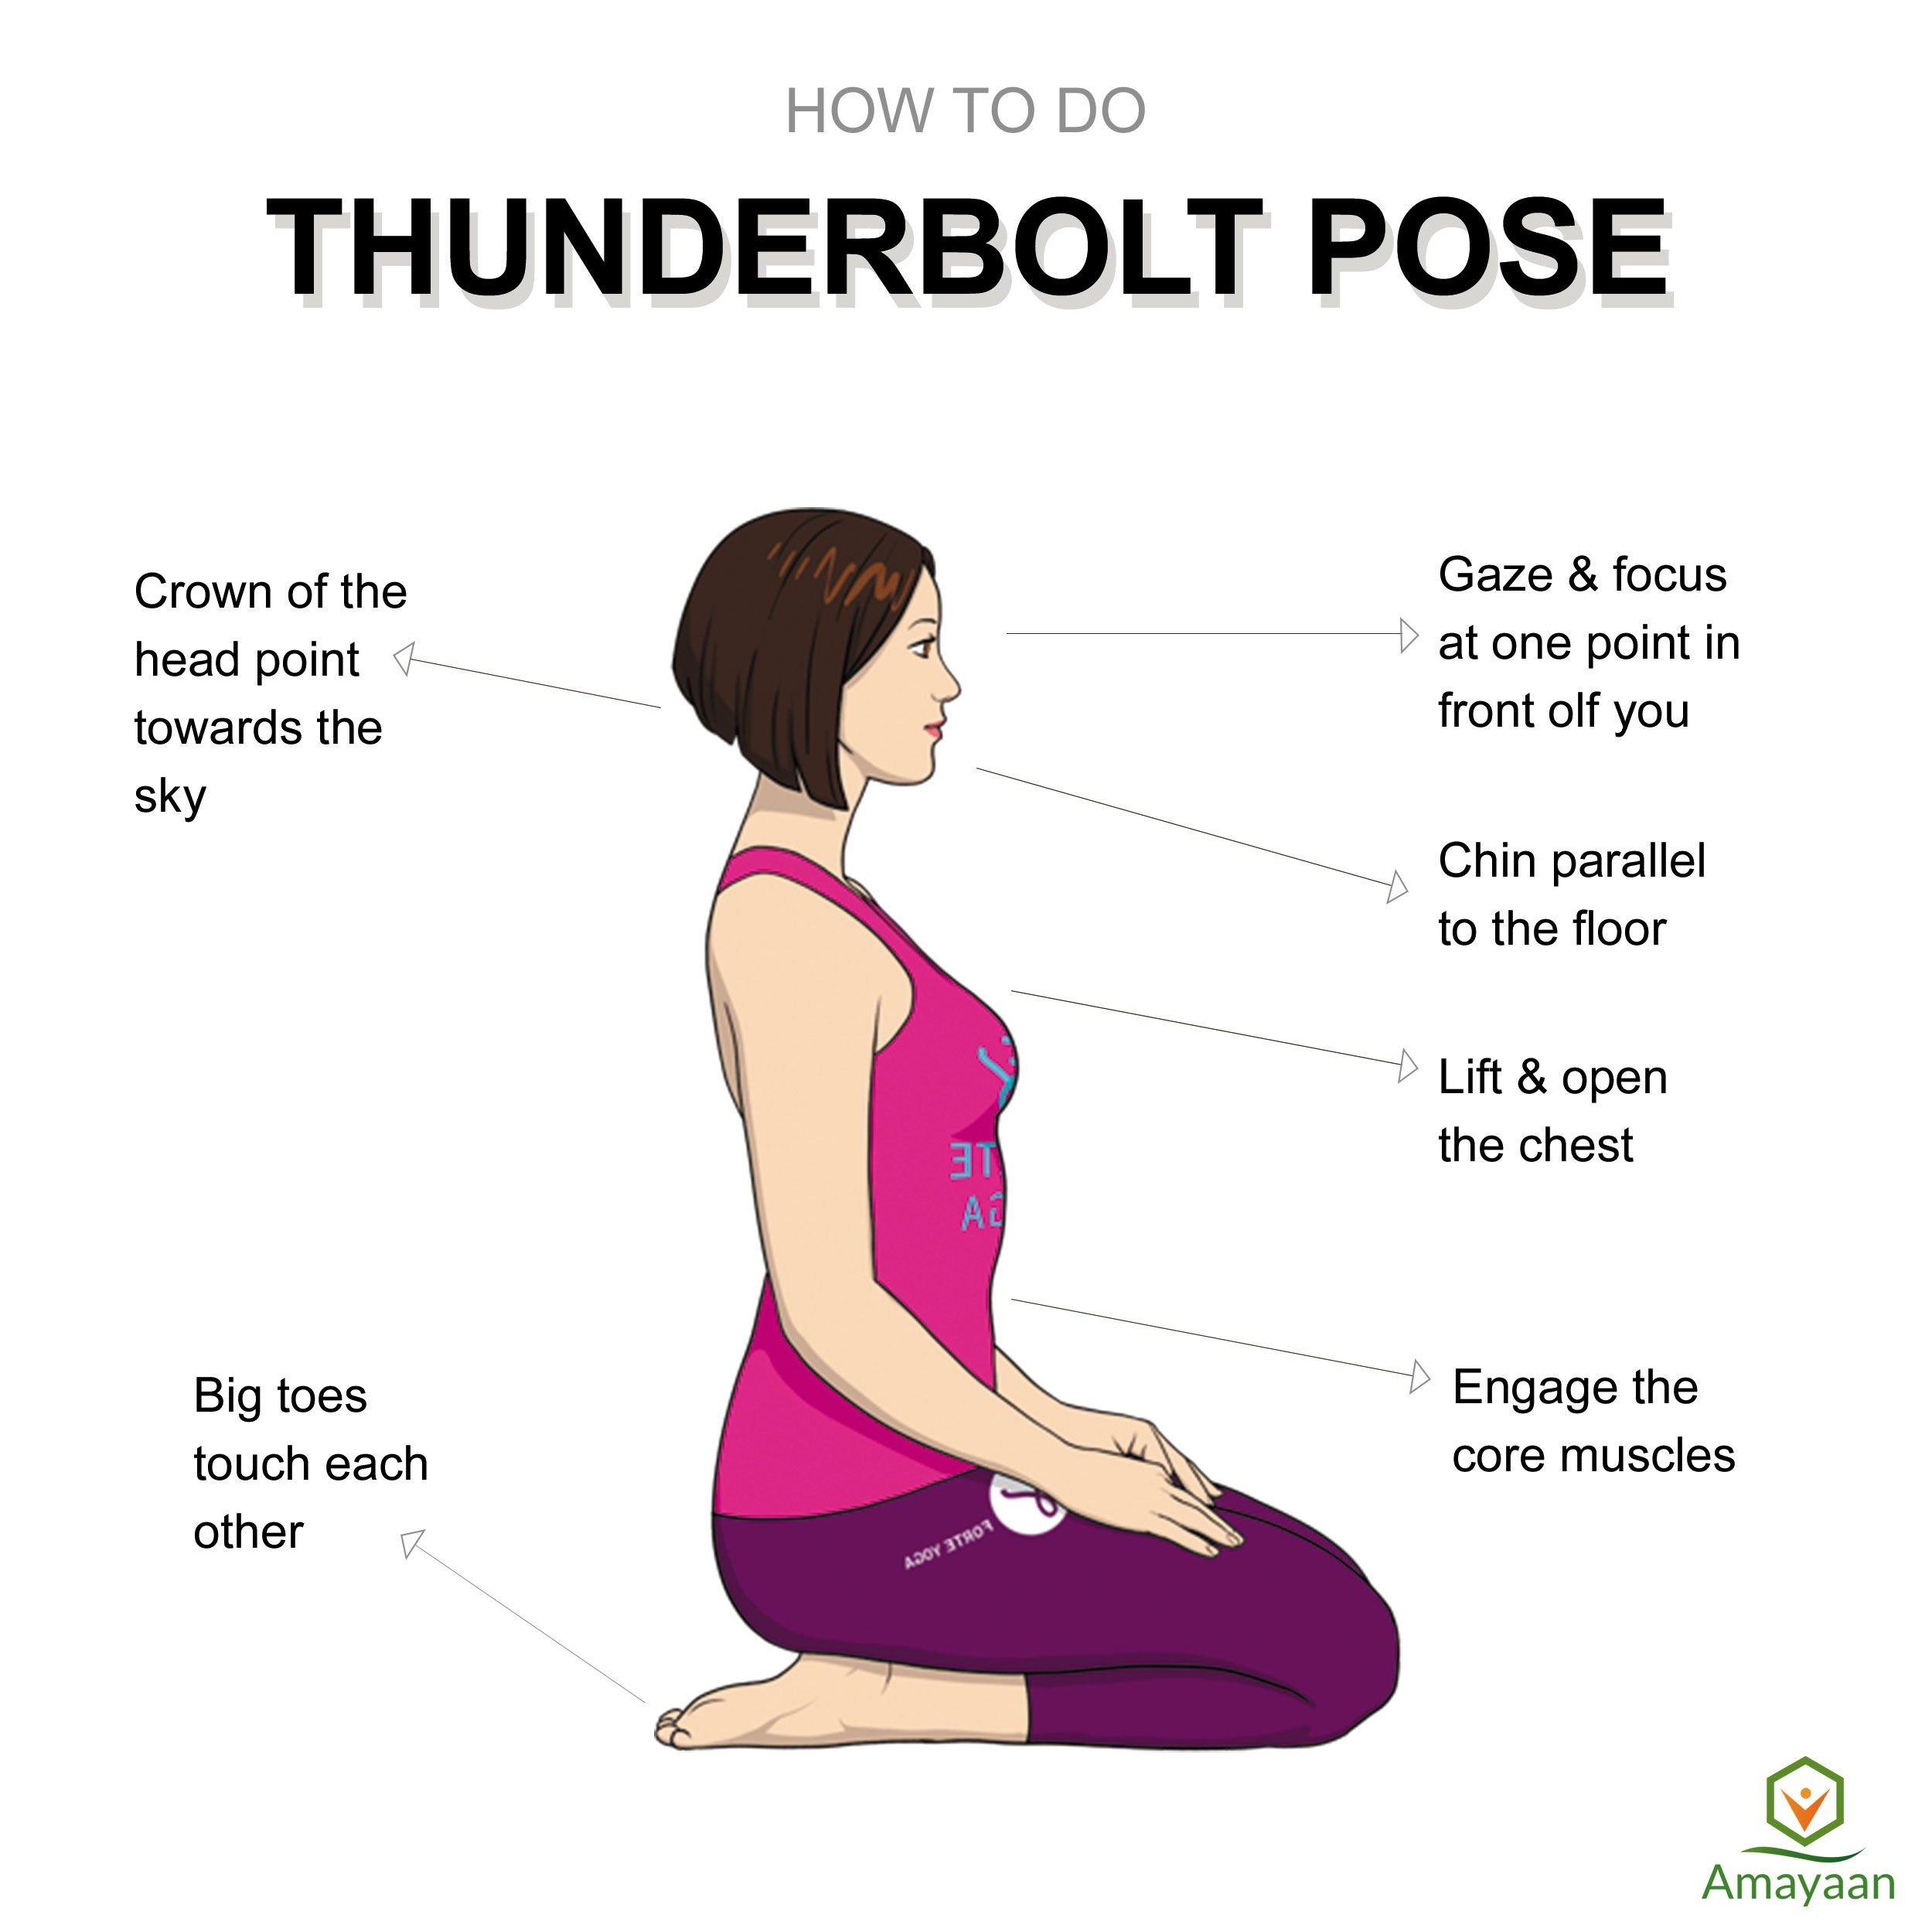
Sit on the flat floor in Dandasana or fold your both legs and place your feet under the hips.
Keep your spine and head erect with closed eyes.
Your knees should be touching each other.
Keep your right palm on the right knee and left palm on the left knee.
After that inhale slowly and exhale slowly by both nostrils. (Normal breathing).
When you breathe out try to assume that all your disorders are coming out from your nostrils.

Slide 4
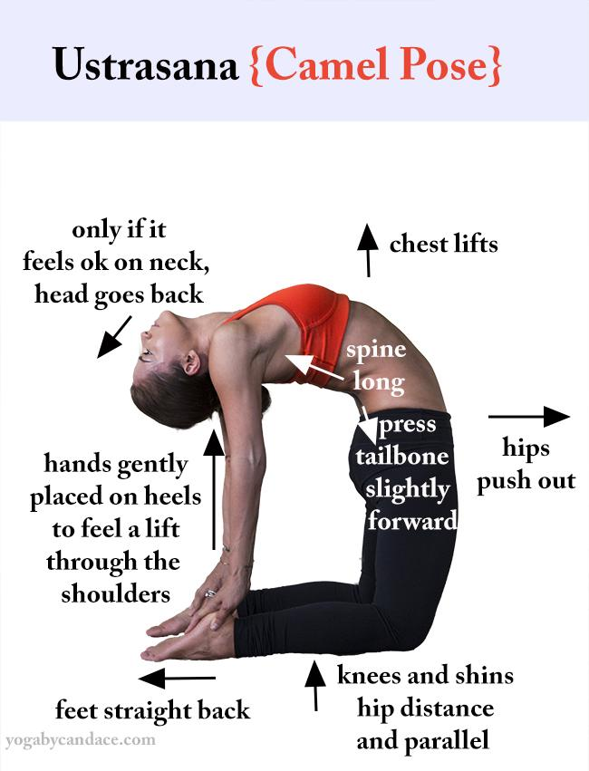
Stand on the knees. Keep the thighs fully straight.
Keep the knees and feet together. But if one feels more comfortable with maintaining a little distance between them, they may do so.
Lean in the backward direction. Slowly move more backward. Reach the right heel with the right hand, and the left heel with the left hand. Avoid straining the body.
Push the hips in the forward direction. The thighs should be kept vertical.
Then bend the head and the spine as backward and as farther as possible without straining.
Relax the body and the muscles of the back.
Support the body weight equally on the legs and arms.
Keep the arms in such a way that they anchor the shoulders to maintain the back arch.
Stay in the same position for as long as you find it comfortable.
Then release the hands from the heels one by one and return to the starting position. Relax and take deep breaths.
Notes:
Hi

Slide 5
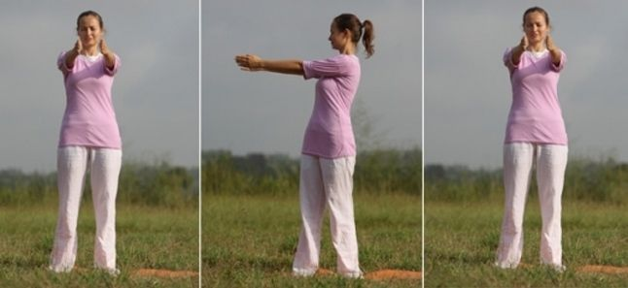
Begin by standing straight, feet together, and spine erect i.e. in simple tadasana. Here, adjust your weight evenly on both feet.
Now, spread up your legs at a shoulder-width distance and with inhalation, stretch your arms forward in front of the chest. It’s the centre position.
Here, palms should be facing each other and hands at the shoulder-width distance, parallel to the floor.
From the centre position, twist your trunk from the waist toward the right side with a gentle exhalation. Fix your gaze in direction to the right shoulder and keep twisting further with breathing out.
Here, maintain the gap between hands and keep your hips facing towards the front.
After a complete twist on the right side, inhale, free the twist lock, and come to the center position.
Again, with an exhalation, repeat in the same manner to the left side and come back to the center with inhalation.

Slide 6
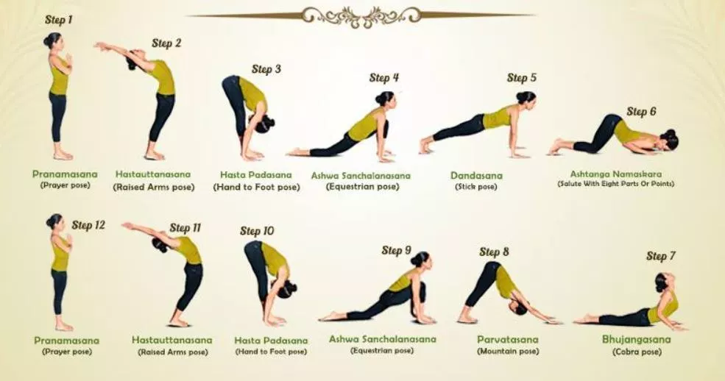

Slide 7
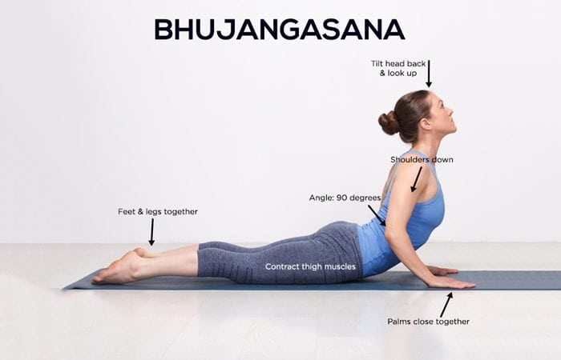
Place your palms flat on the ground directly under your shoulders. Bend your elbows straight back and hug them into your sides.
Pause for a moment looking straight down at your mat with your neck in a neutral position. Anchor your pubic bone to the floor.
Inhale to lift your chest off the floor. Roll your shoulders back and keep your low ribs on the floor. Make sure your elbows continue hugging your sides. Don't let them wing out to either side.
Keep your neck neutral. Don’t crank it up. Your gaze should stay on the floor.

Slide 8
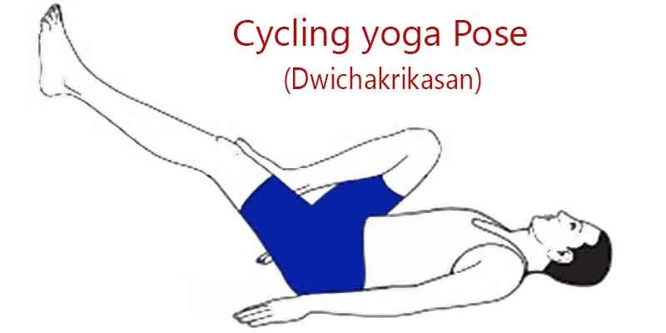
• Just lie down on your back, keep your hands besides your hips and stop your breath.
• After that lift your one leg and bend up at the knee, bring your ankle near the hip and rotate same like as paddling bicycle. (At first start rotating with your one leg at a time and your opposite leg is bends up at the knee).
• Repeat this exercise from 10 to 30 times as per the capacity.
• Similarly repeat this with your opposite leg.
• After doing with your both leg one by one, then start rotating continuously both legs same like as paddling bicycle. Also repeat this 10 to 30 times (don’t touch the ground during the process).
• When tired, lie down in Savasana and rest for some time.
• Now prepare for next level
• Fold your both legs and bend up at the knee and start rotating your both legs together at a time try to make a circle during paddling. During the process exhale, when one rotation is complete then inhale.

Slide 9
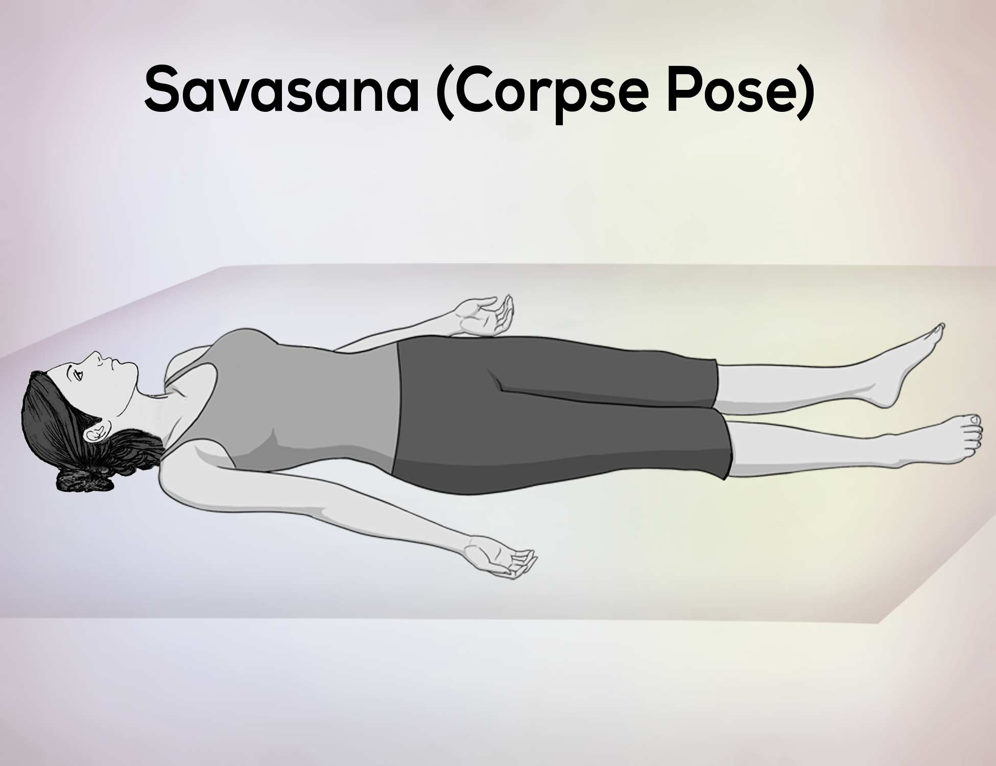
Lie on your back with your legs straight and arms relaxed at your sides. Let your feet fall to a natural position and rest your palms facing up. Close down your eyes.
Breathe naturally.
Allow your body to feel heavy on the ground.
Begin to release each part of your body, organ and cell, consciously working from the soles of your feet to the crown of your head.
Relax your face, feeling your eyes drop into your sockets and the softening of your jaw.
Tune in. If your mind starts to wander, bring your awareness to the sounds around you and then try to find the most distant sound until you find the sound closest to you. Then tune into your breath. Once we acknowledge the sounds from outside, the mind is more able to let go.
To exit the pose, gently bring your awareness back to your body. Start to wriggle your fingers and toes. With your eyes closed, draw your knees in and slowly roll over to your left or right side. Rest there for a moment and with an inhale, find a comfortable seated position.
Take the peace and stillness found in this pose with you for the rest of your day.

Slide 10
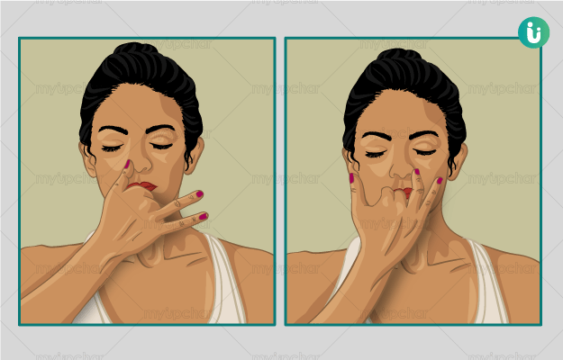
Anulom Vilom Pranayama is very easy to do, first of all, close your eyes and sit in Padmasana and rest your hands on your knees.
Close the right nostril with the right thumb. Inhale slowly through the left nostril, inhale the oxygen as much as you can, this will fill your lungs with air.
Remove your thumb from your right nostril, as you remove your thumb from right nostril just exhale.
When you exhale use your middle finger to close your left nostril then inhale with our right nostril and remove the thumb from the right nostril then exhale. Repeat this process for 5 minutes.
Be focused and concentrate on your breathing.

