Slide 1
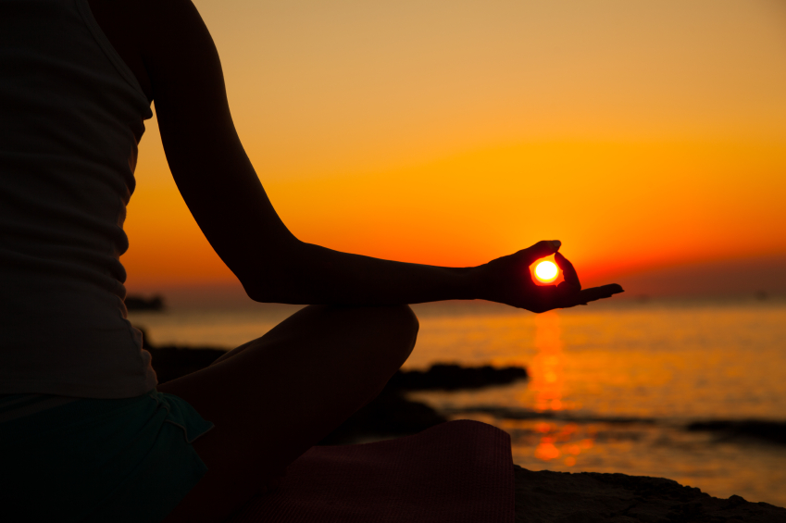
NCC YOGA CLASS PRESENTATION
BY:- CADET MUSKAN DIXIT
SATYAWATI COLLEGE
{B.A. PROGRAMME}

Slide 2
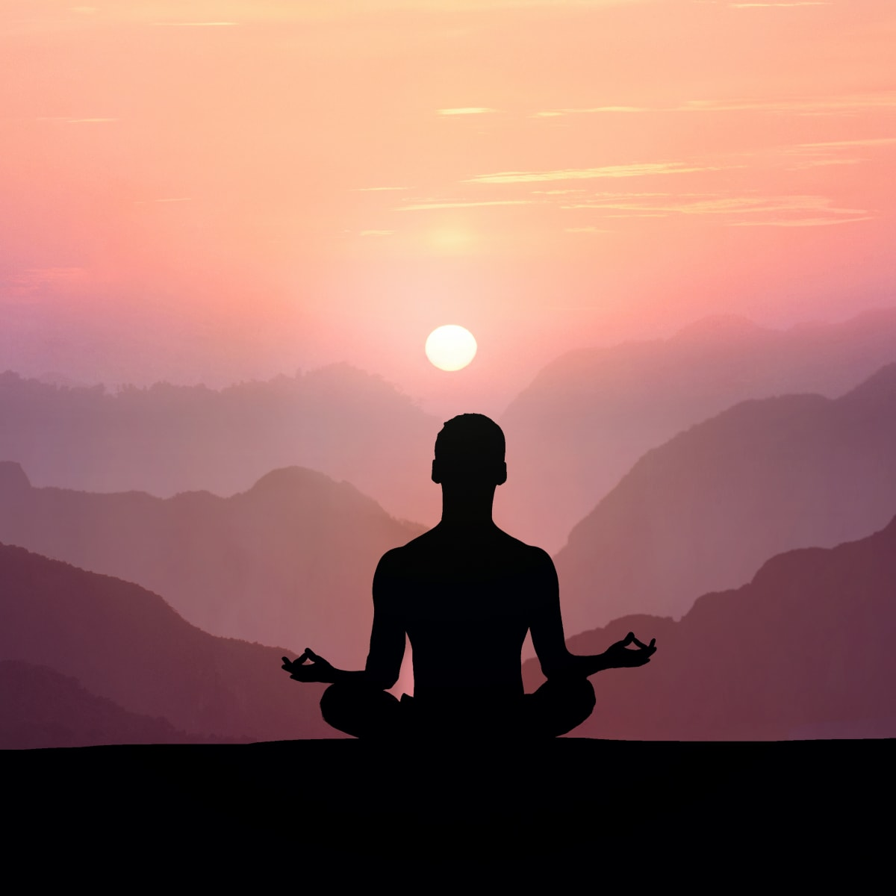
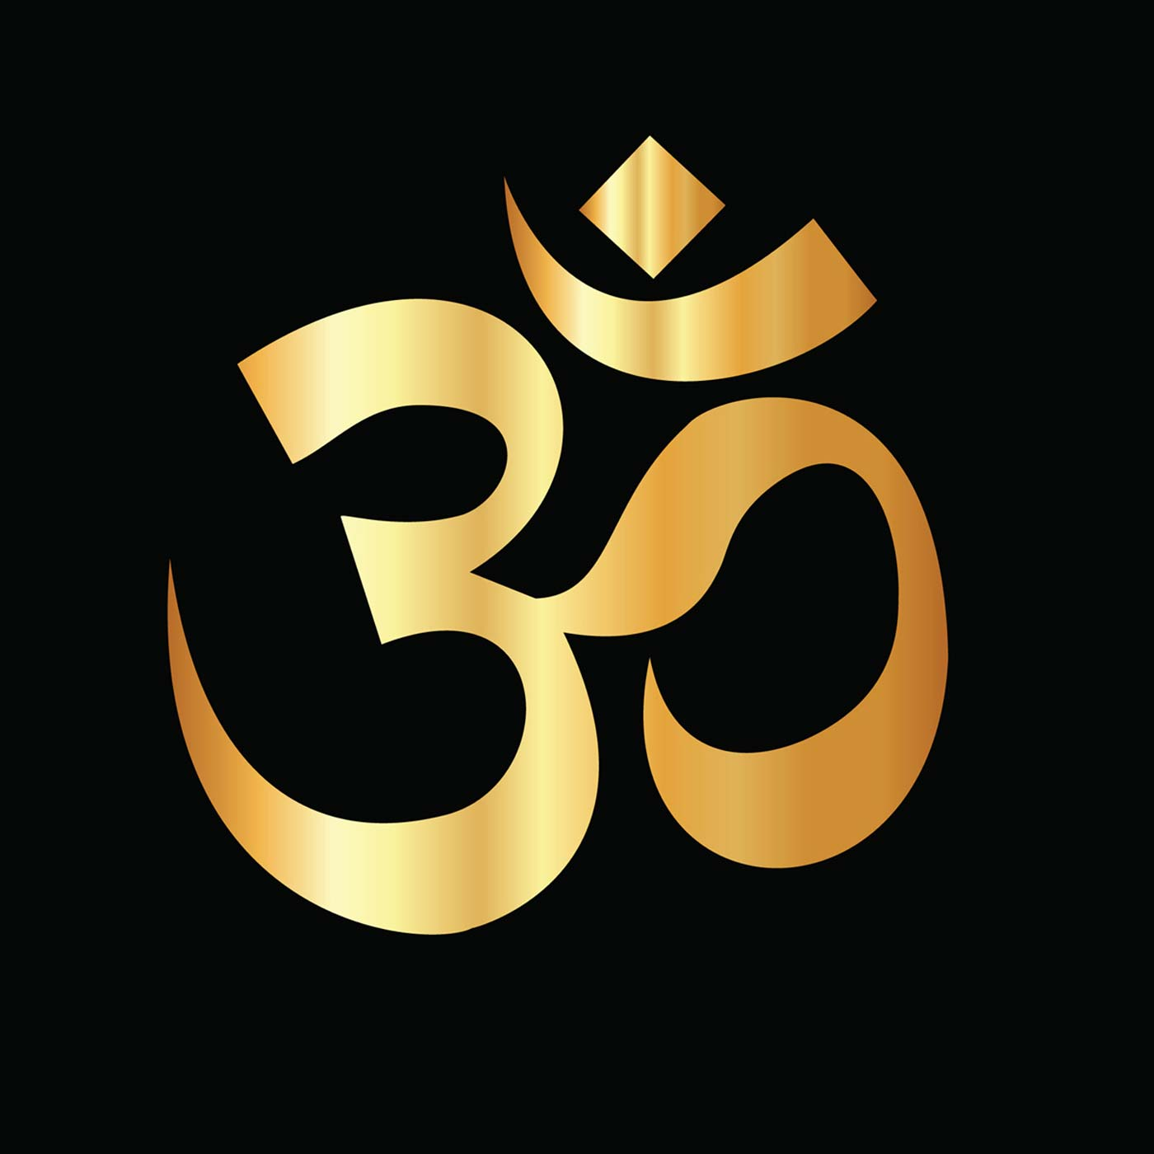
OM UCCHARAN FOR 5 MINUTES

Slide 3
COBBLER’S POSE
Instructions
Begin seated in Staff Pose (Dandasana) with your legs outstretched straight in front of you.
Bend your knees and bring the soles of your feet together as you let your knees fall out to either side.
Draw your feet in as close to your body as is comfortable. Back off if you feel any pain in your knees.
Press the outer edges of your feet together strongly. The feet may begin to open like a book. You can encourage this with your hands or hold onto your big toes in a yogi toe lock.
Sit up tall with a long spine while keeping your shoulder blades on your back and your shoulders moving away from your ears.

Slide 4
BENEFITS OF COBBLER’S POSE
Cobbler's Pose opens the hips and groin. Babies and young children often sit on the floor in this position. Adults often lose the habit, tending instead to spend more time sitting in chairs with legs together. Postural problems, including back pain, can result.
Stretching the hips and inner thighs in Baddha Konasana can begin to counteract the effects of spending too much time sitting at a desk or in a car. It will also help prepare you for other meditative seated poses, which require good flexibility in the hips and groin.

Slide 5
2. HAPPY BABY POSE
Instructions
1. Lie on your back and find a neutral spine position where the natural curves of your spine are present but not exaggerated.
2. Bring your knees toward your chest. As you bring your knees up, keep your hip sockets soft so that your legs come up but your hips stay down. Keep your neutral spine with your tailbone on the mat.
3. Flex your feet and show the soles of your feet to the ceiling.
4. Wrap your first two fingers around your big toes and pull lightly down. Your feet stay flat to the ceiling but your hips release allowing your knees to come closer to your chest as you relax. You can also bring your hands up to the outside of the foot and grasp the foot around the arch.
5. Take your time and breathe deeply. Enjoy the easy stretch in your hamstrings.
6. Let your back relax into the floor—don't push it down, just allow it to release naturally. Be a happy baby.

Slide 6
BENEFITS OF DOING HAPPY BABY POSE
With this pose, you open the hips and give a stretch to your inner thighs, hamstrings at the back of the thighs, and groin. It releases the back and the sacrum. You may notice one hip is tighter than the other and then know which to target for better flexibility and mobility.
In yoga, this move is recommended for relief of stress and fatigue, to calm and center you. You have probably watched a baby grab its toes and play with them, perhaps envying that simple motion and sense of wonder. Grabbing your toes as a baby does brings you back to the flexible spine you had as a baby. The founder of Pilates, Joseph Pilates, was much inspired by the movement of babies. There is much to learn in this simple exercise.

Slide 7
3. PIGEON POSE
INSTRUCTIONS
Begin in Pigeon prep with your right leg forward.
Bend your back knee (the left side in this case) and grab hold of your left foot with your left hand.
Slide your foot into the crook of your left elbow. You can stop here or progress to the next step.
Reach your right arm straight up toward the ceiling. Bend your elbow, drop your right hand behind your head
Bring your hands to meet. Press the back of your head into your right arm.
Try not to fall over onto the right side of your hip. Keep your chest pointing toward the front of your mat.
Release your foot, slowly lower your leg with control, and repeat the pose with the left knee forward.

Slide 8
BENEFITS OF PIGEON POSE
This pose stretches the hips, quads, groin, and shoulders. It is also a backbend that opens the heart. In preparing for this pose, you will develop great flexibility in your hips, shoulders, and back. You will also challenge your balance. Practicing this pose will help you build even greater flexibility, which will help you throughout your daily life.
AVOID:-
Avoid this pose if you have any knee, ankle, hip, or shoulder. You should not feel any stress on the knee. If you feel any joint or back pain during this pose, release the pose.

Slide 9
4. HANDS AND KNEES BALANCE
INSTRUCTIONS
Come on to all fours with the wrists underneath the shoulders and the knees underneath the hips.
Extend your right foot to the back of your mat and flex your foot.
Lift your right leg up to hip level, keeping your hips squared towards the floor and your foot flexed.
Lift your left arm up to shoulder level, keeping the arm straight. Point your thumb toward the ceiling as if you were going to shake someone's hand or turn your palm to face the floor.
Balance on the left knee and right hand, keeping the spine neutral and the neck long. Your gaze should be on the floor.
Stay five to 10 breaths before lowering the lifted hand and knee. Spend a few breaths on all fours to get your solid foundation back, then do the pose on the other side.

Slide 10
BENEFITS OF HANDS AND KNEES BALANCE
This pose improves balance and core strength. You will stretch and strengthen your gluteus maximus, hamstrings, quadriceps, calves, biceps, triceps, and core muscles. The balance and stability challenge engage your core muscles. This pose can help you improve your body awareness and posture. It also provides a good foundation for other yoga poses that require balance
Hands and Knees Balance Pose is a great place to start to work on that all important yet elusive key to so many yoga poses—core strength. It's low to the ground and easy to release quickly if you feel like you're going to fall, which takes care of a lot of the uneasiness people feel around balance challenges. It's also easy to scale it up into a backbend or by throwing in some crunches when you are ready. and stability.

Slide 11
5. BOW POSE
INSTRUCTIONS
Lie flat on your stomach. Keep your chin on the mat and your hands at your sides. Your hands should be palm up.
Exhale while you bend your knees. Bring your heels as close as you can to your buttocks. Your knees should be hip-width apart.
Lift your hands and take hold of your ankles. Be sure to grab the ankle and not the top part of the feet. Your fingers should wrap around the ankles, but your thumb does not. Keep your toes pointed.
Inhale and lift the heels away from the buttocks, keeping a hold of your ankles. Simultaneously, lift your head, chest, and thighs away from the mat. As you lift, rotate your shoulders safely and comfortably. At this point, only your core should touch the mat, while the rest of your body is lifted towards the ceiling.
Draw your tailbone into the mat to deepen the stretch. You should feel the stretch in your back as the weight and balance shifts to your core. Your chest and shoulders should feel open.
Look straight ahead and hold the pose for about 15 seconds while you focus on stretching, breathing, and balancing.
Exhale and release the pose. Lower your head, chest, thighs, and feet back towards the mat. Let go of your ankles and return to your hands to your side. Relax for a few seconds and repeat the pose as needed or continue to your next pose.

Slide 12
BENEFITS OF BOW POSE
Bow Pose primarily benefits the chest and back. It’s natural for the body to bend backward, but this is rarely a position we find ourselves in.
Bow Pose can be used to open up the chest and stretch out the back, which is especially beneficial for people who sit or stand for long periods of time.
This yoga pose also opens up the neck, shoulders, and abdomen. It improves flexibility in the back and encourages balance in the core and chest.
If you have a stiff back, Bow Pose may be beneficial. For people with a desk job, Bow Pose can help improve posture and alleviate the discomfort that slouching may cause.

Slide 13
6. DOLPHIN PUSHUPS
INSTRUCTIONS
Move your forearms to a V position so that you can interlace your fingers the way you would in preparation for a Headstand. This gives you a little more traction as you begin to move, but you can also leave the hands separate and arms parallel if you prefer.
Move your torso forward so that your face comes over your hands, while inhaling. The elbows will be lined up under your shoulders. Keep your body straight as you would in a plank position. In fact, this is basically a forearm plank with the hands clasped.
Push the hips back to Dolphin while exhaling. This is the basic back and forth motion of the Dolphin Pushup.
Try to do 10 reps, moving the torso forward to a plank position on the inhale and pushing your hips back to dolphin on the exhale.
When your set is complete, come down and rest in Child's Pose. Depending on your stamina, you could try to go for one or two more sets of 10. If that's not possible yet, work up to it.

Slide 14
BENEFITS OF DOLPHIN PUSHUPS
Core strength is at the heart of an advancing yoga practice. Inversions, arm balances, and standing balances all require power that radiates from the core. This exercise combines the stretch and inversion of Dolphin Pose (Ardha Pincha Mayurasana) with a pushup. It is great for strengthening your arms and shoulders but you must use your abs and core muscles to stabilize your torso. The hamstrings and calves get a good stretch. The upper body muscles that come into play in the pushup are the deltoids, pectorals, triceps, biceps, and erector spinae. The abdominal muscles used to hold the body rigid during the pushup are the rectus abdominis and the transversus abdominis. As the pushup involves multiple joints, it is a compound exercise. The functional fitness you develop with pushups will serve you well in all of the pushing activities of daily life. Changing your pushup regimen with variations such as the Dolphin Pushup will challenge you in new ways.

Slide 15
THANK YOU
THANK YOU
WELL DONE CADETS
STAY HEALTHY
STAY HOME
STAY SAFE
WELL DONE CADETS
STAY HEALTHY
STAY HOME
STAY SAFE

