Slide 1
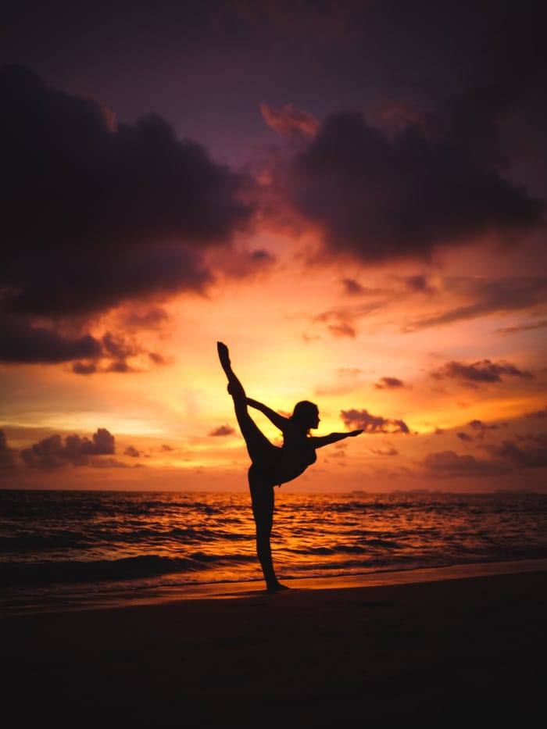
NCC YOGA CLASS
PRESENTATION
- MANISHA KUMARI
SATYAWATI COLLEGE

Slide 2
HOW TO DO
Stand straight like Tadasana (Mountain Pose).
Now while inhaling raise your hand up straight and bend backward as shown in above image.
You can hold your hips with your hands and bend backward without bending knees.
Hold this position for few seconds and continue breathing slowly.
Now while exhaling, come back to the starting position.
Repeat this cycle for 3-5 times.

Slide 3
TRIKONASANA
Stand straight with your legs apart. The distance between your legs should be a little more than the span of your shoulders.
Inhale. Raise your right hand straight above your head. The right arm should be parallel to the right ear.
Exhale. Bend your torso at the waist, to your left side.
Simultaneously, slide your left arm down along your left leg till your fingers are at your ankle.
At this point, your right arm must be horizontal as your head is tilted left.
Hold the pose with your knees and elbows straight. Hold the position for 30 seconds.
Inhale. Straighten yourself and stand erect. Repeat the posture on the other side.

Slide 4
USTRASANSA
1.Stand on the knees. Keep the thighs fully straight.
1. Keep the knees and feet together.
2. Lean in the backward direction. Slowly move more
backward. Reach the right heel with the right hand, and the
left heel with the left hand. Avoid straining the body.
3. Push the hips in the forward direction. The thighs should
be kept vertical.
4. Then bend the head and the spine as backward and as
farther as possible without straining.
6. Support the body weight equally on the legs and arms.
7. Keep the arms in such a way that they anchor the shoulders
to maintain the back arch.

Slide 5
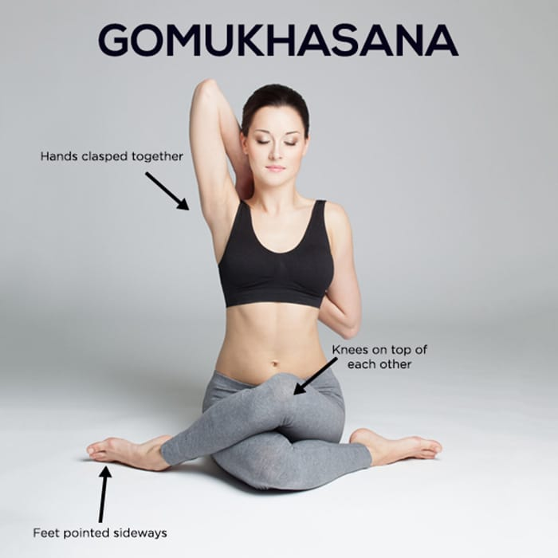
Start the asana by sitting cross-legged on the surface of the floor
Bring the right foot over the left thigh; slide your thigh as close as you can to left hip
Bring the left ankle around the side of the right hip. Make sure that first knee is placed over the other
Gently slide your both feet far behind your hip area while making sure that you are comfortable in this position
Maintain your spine in a straight and vertical position while you keep your head facing forward
Raise the right arm and gently bring it over the shoulder
Now wrap the left arm around your back and try to grasp the left hand with your right hand behind your back. Clasp the fingers of both hands together.
Stay in this pose for around 10 to 12 breaths.
Next, release your hands and stretch both your legs straight; bounce your knees a couple of times.
Once you are done, repeat this asana by using your opposite limbs
Finally, relax your body by sitting in a nice and comfortable cross-legged posture.

Slide 6
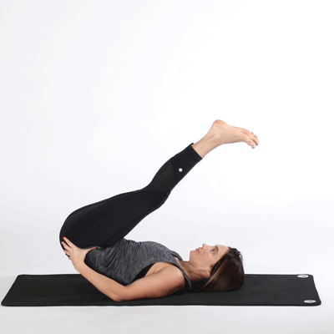
HALASANA
1. Lie on your back. Join the legs together. Relax the whole body
(Shavasana position).
2. Keep the palm flat on the ground. Keep breathing normally.
3. While exhaling press the palm on the ground and raise both
the legs upwards straight then try to touch the ground just
behind.
4. Breathe slowly and hold the posture for several minutes (1-2
minutes).
5. Now slowly release the pose to return to Shavasana.
6. Repeat this for 3-5 times.
.

Slide 7
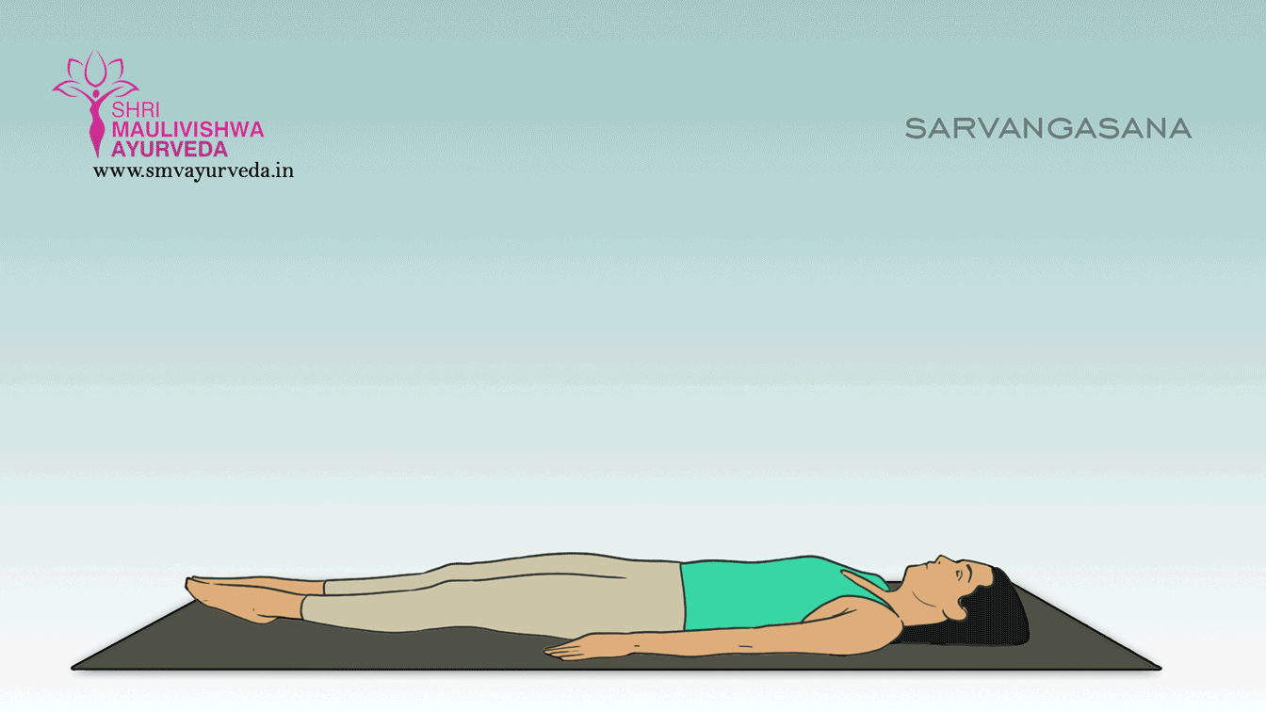
SARVANGASANA
Lie down in the supine position or lying on your stomach.
Raise your legs slowly upward and bring it to a 90° angle.
Bring the legs towards the head by raising the buttocks up.
Raise the legs; abdomen and chest try to form a straight line.
Place the palms on your back for support.
Place the chin against the chest.
Maintain the position as long as comfortable.
Try to maintain the pose for up to 30 seconds or more.
Slowly return back to the original position.
While doing this, first lower the buttocks with hands supporting the back and slowly come to the surface or in the original position.
Perform it twice or thrice.

Slide 8
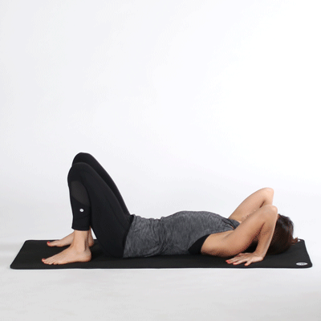
CHAKRASANA
1 Lie flat on your back like Shavasana on the ground.
2 Bend your knees and bring your heels closer to touch your hips. Keep some distance between your feet.
3 Now raise your hands and bring your palms under your shoulders.
4Now while inhaling press your palms and feet on the ground and lift your body up.
5Try to raise your hips as much you can.
Hold this position for few seconds (according to your capacity)

Slide 9
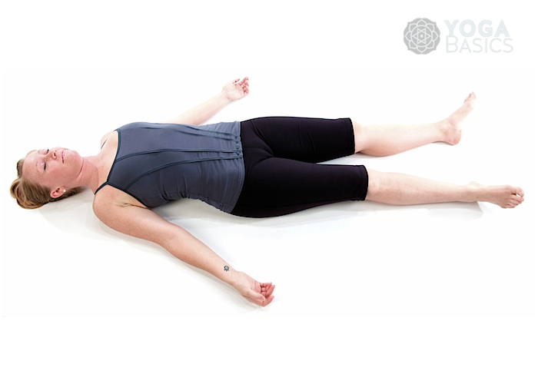
SHAVASANA
CLOSE YOUR EYES
RELAX YOUR BODY
BE CALM

Slide 10
STAY HAPPY
STAY SAFE
STAY HEALTHY
THANK YOU
HAVE A CHEERFUL DAY!

