Slide 1
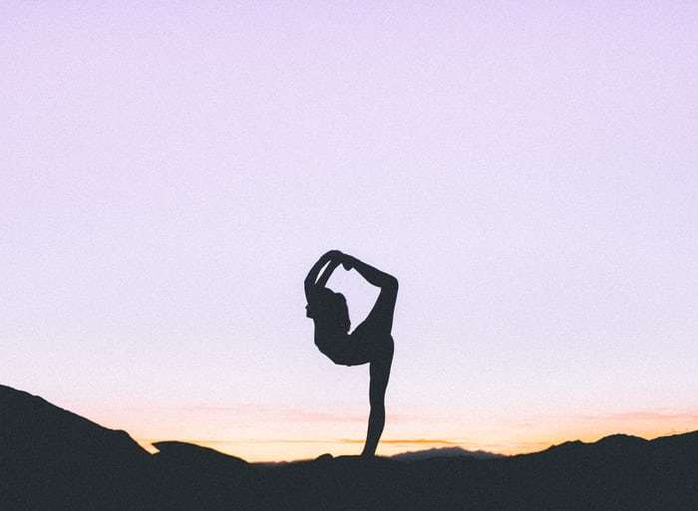
NCC YOGA CLASS PRESENTATION
By:- CADET NEHA VASHISHT
(2DGBN)

Slide 2
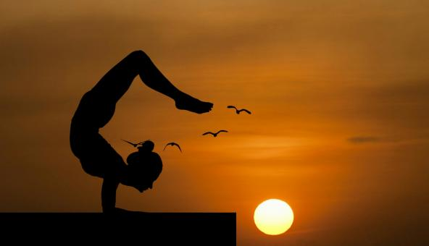
START YOUR DAY WITH POSITIVITY
AND
A HAPPY SMILE ON YOUR FACE.
WE WILL BEGIN NOW.

Slide 3
content
Bhujangasana
TADASANA
TRIKONASANA
DHANURASANA
CHAKRASANA
SAVASANA
VRIKSHASANA

Slide 4
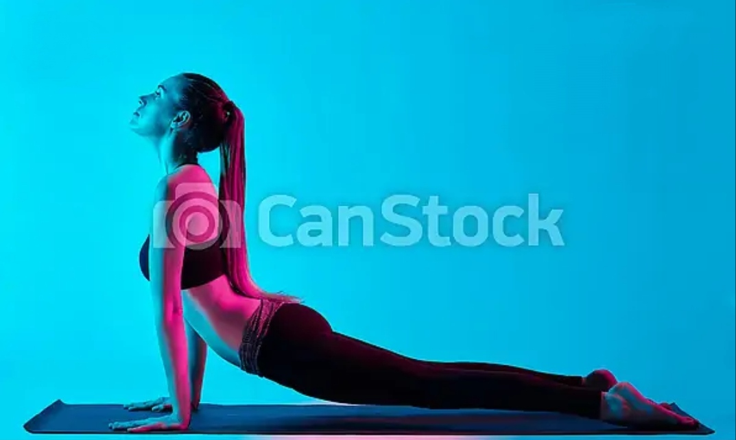
Bhujangasana
It is a recycling back BENDING ASANA IN HATHA YOGA AND MODERN YOGA AS EXERCISE. IT ALSO KNOWN AS COBRA POSE .
BENEFITS –
STRENGTHENS THE SPINE.
STRETCHES LUNGS ,SHOULDER,AND ABDOMEN.
HELPS IN RELIEVE STRESS.
STIMULATES ABDOMINAL ORGANS.
OPENS THE HEART AND LUNGS.
THERAPEUTIC FOR ASTHMA.
INCREASE FLEXIBILITY.

Slide 5
tadasana
IT IS A STANDING ASANA IN MODERN YOGA AS EXERCISE.IT ALSO PERFORMED AT THE BEGINNING AND END OF SURYA NAMASKAR .
BENEFITS-
HELPS IN CORRECTING THE POSTURE.
HELPS IN INCREASE FLEXIBILITY OF THIGHS AND JOINTS
STRENGTHENS LEGS.
IMPROVE BALANCE OF THE BODY.
HELPS IN CORRECT POSTURE.
CREATES STABILITY IN SHOULDER JOINTS.

Slide 6
trikonasana
IT IS A TRIANGULAR POSE. IT IS A STANDING ASANA IN MODERN YOGA AS EXERCISE.
BENEFITS –
HELPS IN RELIEVE STRESS.
IMPROVES DIGESTION.
STIMULATES THE ABDOMINAL ORGANS.
STRETCHES THE THIGHS,KNEES AND ANKLES.
ACTIVATES YOUR CORE MUSCLES.

Slide 7
Dhanurasana
IT IS AN ASANA IN WHICH THE BODY RESEMBLES THE SHAPE OF A BOW IN THE FINAL POSITION .THIS ASANA IS ALSO KNOWN AS BOW POSE .
BENEFITS-
STRETCHES THE ENTIRE FONT OF BODY .
STRENGTHENS THE BACK MUSUCLES.
IMPROVES POSTURE.
STIMULATES THE ORGAN OF THE ABDOMEN AND NECK .
IMPROVES FLEXIBILITY OF SPINE.

Slide 8
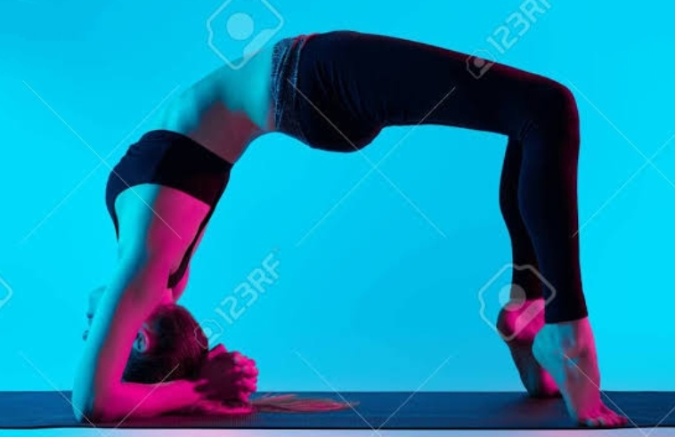

Slide 9
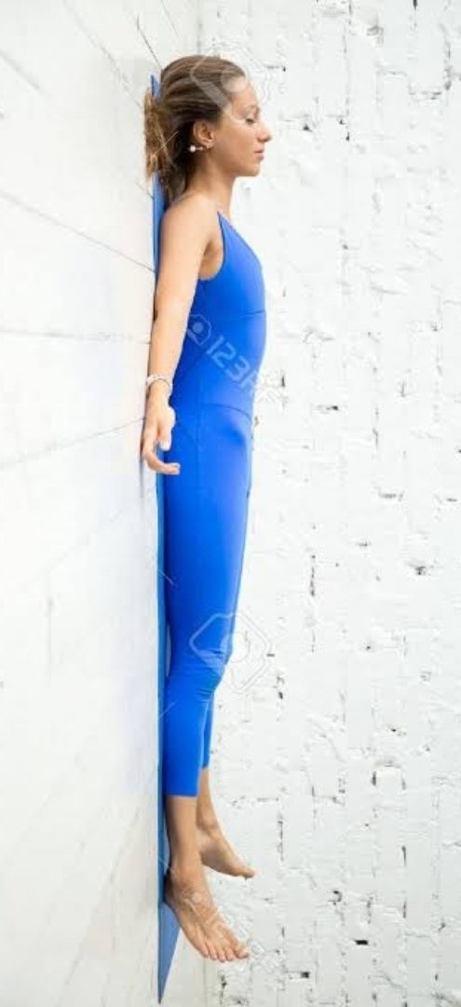
SHAVASANA
SHAVASANA IS AN ASANA IN HATHA YOGA AND MODERN YOGA AS EXERCISE ,OFTEN USED IN FOR RELAXATION IN YOGA.IT IS THE USUAL POSE OF NIDRA PRACTICE.
BENEFITS-
CALMS THE MIND AND REDUCE STRESS.
REDUCE HEADACHE AND FATIGUE.
REDUCES ANXIETY.
HELPS IN LOWER BLOOD PRESSURE.
PROMOTES SPIRITUAL AWAKENING ,AND AWARENESS OF HIGHER CONSCIOUSNESS.

Slide 10
Vrikshasana
IT ALSO KNOWN AS TREE POSE .IT IS A BALANCING ASANA.IT IS ONE OF THE VERY FEW STANDING POSES IN MEDIEVAL HATHA YOGA ,AND REMAINS POPULAR IN MODERN YOGA AS EXERCISE.
BENEFITS-
STRENGTHENS THE LEGS .
IMPROVES YOUR NEUROMASCULAR COORDINATION.
HELPS IN BALANCE AND ENDURANCE.
IT IMPROVES ALERTNESS AND CONCENTRATION.
HELPS THOSE WHO SUFFER FROM SCIATICA.

Slide 11
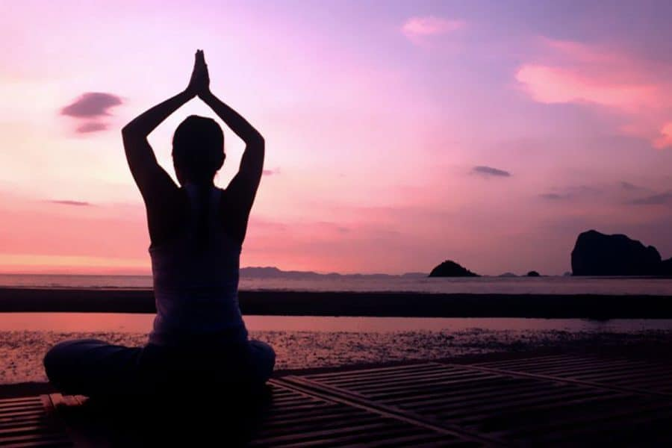
WE HAVE COMPLETED TODAY’S YOGA SESSION TOGETHER.
THANK YOU ALL🌸
JAI HIND

