Slide 1
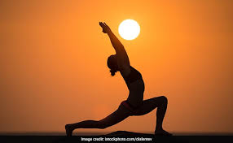
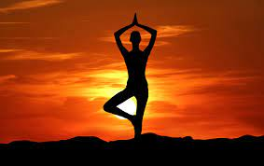
What is YOGA ?
Yoga is essentially a spiritual discipline based on an extremely subtle science , which focuses on bringing harmony between mind and body.It is an art and science of healthy living .The word ‘ YOGA’ is derived from Sanskrit root ‘yuj’ meaning ‘to join’ or ‘to yoke’ or ‘to unite’.

Slide 2
BHUJANGASANA
PROCEDURE
LIE DOWN ON YOUR STOMACH.
BEND YOUR ARMS AT THE ELBOWS.
ARCH YOUR NECK AND LOOK UPWAED GENTLY.
MAKE SURE THAT YOUR STOMACH IS PRESSED ON THE FLOOR .
PUT PRESSURE ON YOUR TOE BY PRESSING THEM ONTO THE FLOOR.
HOLD ASANA FOR 5 SEC.
BENEFITS
IT TONES YOUR BODY AND THE SPINAL NERVE ,KEEPING THE SPINE STRONG AND AGILE.
IT TONES THE ABDOMINAL.
IT IMPROVES DIGESTION NATURALLY.

Slide 3
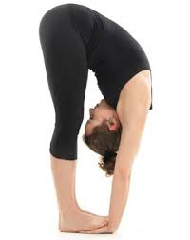
PADAHASTASANA
PROCEDURE
DISTANCE YOUR LEGS HIP-WIDTH APART.
INHALE AND SLOWELY RAISE YOUR ARMS UPWARDS .STRETCH YOUR BODY UPWARDS AS WELL.
EXHALE AND SLOWLY BEND THE TRUNK FORWARD FROM YOUR HIP TILL YOUR HANDSREACH YOUR FEET.
NEXT PLACE THE PALMS OF YOUR HANDSUNDER THE SOLE.
TAKE A LONG AND DEEP BREATHS.RELAX THE BODY .STAY IN THIS POSITION FOR AS LONG AS YOU FEEL COMFORTABLE.
BENEFITS
TONES AND ENERGIZES SPINAL MUSCLES AND NERVES.
INCREASES CONCENTRATION AND SPEEDS UP METABOLISM.

Slide 4
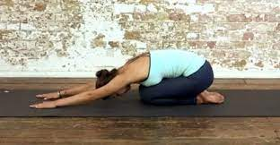
SHASHANKASANA
PROCEDURE
SIT IN VAJRASANA.
STRAIGHTEN THE BACK.INHALE AND SLOWLY RAISER THE ARMS,KEEPONG THEM STRAIGHT.
NOW EXHALE AND BEND FORWARD.
THE ARMS,TRUNK,AND HEAD SHOULS REMAIN IN ONE LINE .
THE FOREHEAD AND ARMS SHOULD REST ON THE FLOOR IN FRONT OF THE KNEES. RELAX THE WHOLE BODY.
INHALE AND EXHALE SLOWLY.
INHALE AND RAISE YOUR ARMS UP AND SLOWLY BRING IT DOWN.
BENEFITS
REDUCE STRESS.
HELP IN REDUCING PAIN DURING YOUR MENSURATRION.

Slide 5
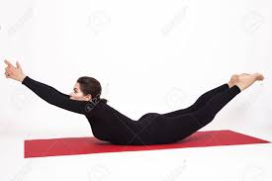
VIPREET NAUKASANA
PROCEDURE
LIE ON THE FLOOR ON THE STOMACH,STRETCH YOUR ARMS BACK ALONG THE SIDE OF YOUR BODY.
EXHALE AND LIFT THE HEAD,CHEST AND LEGS OFF THE FLOOR SIMULTANEOUSLY AS HIGH AS POSIBLE.THE HAND SHOULD NOT BE PLACED ON THE GORUND.ONLY THE ABDORMINAL FRONT PORTION SHOULD REST ON FLOOR.
CONTRACT THE BUTT AND STRETCH THE THIGH MUSCLES. KEEP BOTH LEG FULLY EXTENDED AND STRAIGHT AND TOUCHING AT THE THIGH KNEES AND ANKLE .
STAY IN THE POSTURE FOR AS LONG YOU CAN WITH NORMAL BREATHING .
BENEFITS
HELPS IN DIGESTION,RELIEVES GASTRIC TROUBLES AND FLATULENCE.
ITS PRACTICE RELIEVES PAIN IN THE LUMBAR THE SACRAL REGION AND LOWER BACK.

Slide 6
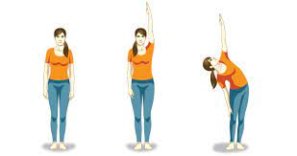
KONASANA
PROCEDURE
STAND STRAIGHT WITH FEET ABOUT HIP WIDTH DISTANCE APART AND ARMS ALONG SIDE THE BODY.
BREATHE IN AND RAISE THE LEFT ARM UP SO THAT THE FINGERS POINT TOWARDS THE CEILING .
BREATHE OUT AND BEND TO THE RIGHT ,FIRST FROM THE SPINE AND THEN MOVE YOUR PELVIS TO THE LEFT AND BEND A LITTLE MORE.KEEP YOUR LEFT ARM POINTING UP.
TURN YOUR HEAD TO LOOK UP AT THE LEFT PALM,STRAIGHTEN THE ELBOWS.
BREATHING IN,STRAIGHTEN YOUR BODY BACKUP.BREATHING OUT , BRING THE LEFT ARM DOWN.
REPEAT WITH THE RIGHT ARM.
BENEFITS
IT HELPS STRETCH THE SIDES OF THE BODY AND THE SPINE.

Slide 7
SETU BANDHA SARVANGASANA
PROCEDURE
LIE DOWN ON YOUR BACK,YOU CAN CUSHION YOUR SHOULDERS AND NECK WITH A FOLDED BLANKET AS WELL.
FOLD YOUR KNEES AND BRING YOUR FEET AS CLOSE TO YOUR HIPS AS YOU CAN,KEEP YOUR FEET HIP WIDTH APART FROM EACH OTHER.
KEEP YOUR HANDS ON THE FLOOR BESIDES YOUR BODY,PALMS FACING DOWN.
WITH INHALATION ,PRESS YOUR PALMS,SHOULDERS AND FEET ON THE GROUND AND SLOWLY LIFT YOUR HIPS, UP ,YOU CAN TIGHTEN YOUR HIPS SO THAT YOU DON’T PUT TOO MUCH PRESSURE ON YOUR BACK.
USING YOUR THIGHS ,KEEP YOUR KEEP YOUR NECK NEUTRAL .
YOU CAN CLASP YOUR HANDBEHIND YOUR BACK,KEEP YOUR ARMS STRAIGHT.
STAY FOR 5-8 BREATHS OR LONGER IF YOU ARE COMFORTABLE .
TO RELEASE ,SIMPLY EXHALE ,UNCLASP YOUR HANDS AND LOWER YOUR HIPS TO THE GROUND RELAX.

Slide 8
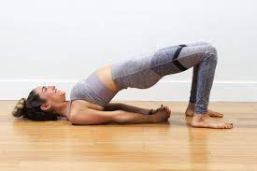
BENEFITS
RELIEVES BACKACHE.
GOOD FOR THYROID .
KEEPS SPINE HEALTHY .
IMPROVES DIGESTION AS IT STRECHES YOUR ABDOMINAL ORGANS.

Slide 9
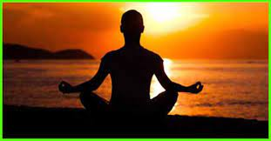
DHAYANA
Dhyana is the commonly used Sanskrit word that means meditation. Meditation is increasingly seen as an important practice, both by the religious and non-religious. Therefore, it is necessary to know the detailed meaning of this word. This is a Sanskrit word. Sanskrit is a classical language like Greek, Latin, and Persian. And in Sanskrit, as in most classical languages, most words are derived from a stem or root.
The word ‘dhyana’ can be derived from the root words dhi and yana. Dhi means to perceive, think, reflect, wish, or desire. Yana means path, course, journey, travel, going, moving, riding, marching, vehicle, carriage, wagon, vessel, or ship. Formed by the words dhi and yana, dhyana would mean a process, path, or vehicle to properly think or reflect. The word ‘dhyana’ can also be derived from the root dhyai, which means to think, imagine, contemplate, meditate, recollect, call to mind, and brood. Then the word ‘dhyana’ would mean to meditate or contemplate

Slide 10
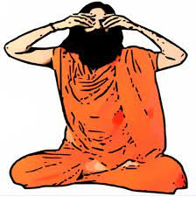
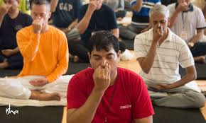
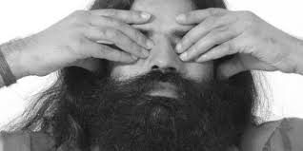
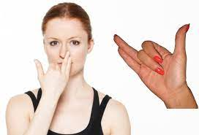

Slide 11
REPRESENTED BY ;CADET BAISHALI
THANK YOU ALL FOR YOUR KIND SUPPORT

