Slide 1
Disaster Management

Slide 2
What is disaster management?
We act before, during and after disasters strike, often providing assistance in some of the world’s most hostile environments.
Our disaster management activities seek to:
Save lives and reduce human suffering
Protect and restore livelihoods
Reduce the risks faced by communities affected by disaster and conflict.

Slide 3
DISASTER MANAGEMENT
DISASTER MANAGEMENT
Disaster Management is a strategic planning and procedure that is administered and employed to protect critical infrastructures (also known as "critical assets") from severe damages when natural or human made calamities and catastrophic even occur. In the United States, Executive Order 13407 is established as policy for the United States to have an effective, reliable, integrated, flexible, and comprehensive system to alert and warn the general public, which is called "Integrated Public Alert and Warning System (IPAWS) (FEMA, 2011). In the later year of 2010, Europe started to develop a strategic National Disaster Management after so many natural catastrophes happened in the year of 2010. According to European Academy (2010), there are 725 extremely weather phenomena caused billions of Euro damage and thousands of people's life.
Disaster management plans are multi-layered and are aimed to address such issues as floods, hurricanes, fires, bombings, and even mass failures of utilities or the rapid spread of disease (John, 2004). The disaster plan is likely to address such as important matters as relinquishing people from an impacted region, arranging temporary housing, food, and medical care (John, 2004).

Slide 4
Types of Disasters:
There are two types of disasters:

Slide 5
(i) Natural Disasters:
The disasters that are caused by nature are termed as natural disasters e.g., earthquake, cyclone etc.

Slide 6
(ii) Man-made Disaster:
The disasters which are caused as a result of human activities are termed as Man-Made Disasters e.g., Road accident, terrorist attack.

Slide 7
Natural Disasters:
. Earthquake:
Earthquake is a sudden and violent shaking of ground causing great destruction as a result of movement of earth’s crust. An earthquake has the potential to tsunami or volcanic eruption.

Slide 8
Earthquake mitigation strategies:
. Existing critical facilities built on reclaimed land should be inspected and retrofitted if necessary to ensure earthquake resistance.
b. Future critical facilities should not be located on reclaimed land because of the high potential for liquefaction.
c. Older unreinforced masonry buildings should be inspected and retrofitted if necessary to increase earthquake resistance.
d. Older unreinforced masonry buildings should not be used for critical functions.

Slide 9
. Cyclone:
Cyclones (or more properly called Tropical Cyclones) are a type of severe spinning storm that occurs over the ocean near the tropics.

Slide 10
Cyclone mitigation strategies:
The most significant aspect of structural damage to buildings by high velocity wind results from roof damage. The roofs of existing buildings should be inspected and if necessary retrofitted to adequate standards.
c. The roofs of existing critical facilities should be retrofitted to a higher standard to ensure wind resistance.
d. Building openings such as windows and doors also suffer damage from high velocity winds. These openings if not constructed of wood or metal should be protected with shutters or temporary covers of adequate design.

Slide 11
3. Tsunami:
Tsunamis are giant waves, initiated by a sudden change, usually in relative position of underwater tectonic plates. The sudden jerk is enough to propagate the wave; however, its power can be enhanced and fed by lunar positioning and boundaries that focus its energy.

Slide 12
Tsunami mitigation strategies:
a. In some tsunami-prone countries earthquake engineering measures have been taken to reduce the damage caused onshore.
b. Japan, where tsunami science and response measures first began following a disaster in 1896, has produced ever-more elaborate countermeasures and response plans. That country has built many tsunami walls of up to 4.5 metres (15 ft) to protect populated coastal areas.
c. Other localities have built floodgates and channels to redirect the water from incoming tsunami.

Slide 13
. Volcanic eruptions:
Volcanic disasters are caused by lava flows, volcanic mudflows and pyroclastic flows triggered by volcanic activities such as eruptions. It covers extensive areas; volcanic disasters can cause a large-scale damages and serious personal injury. Secondary disasters such as debris flows are often triggered by rainfall after a volcanic eruption.

Slide 14
Forest Fire

Slide 15
Man-made Disasters:
Road Accidents:
Road accidents are common in India due to reckless driving, untrained drivers and poor maintenance of roads and vehicles. According to Lifeline Foundation, the Ahmedabad based organization working for road safety, India accounts for 13 per cent of road accident fatalities worldwide.
With 130,000 deaths in 2007, India tops in the number of people killed in road accidents, surpassing China’s 90,000. Most of these deaths occurred due to bad road designs and lack of proper traffic management systems to separate different streams of traffic.

Slide 16
Road accident

Slide 17
Building and Bridge Collapse:
Building collapses are frequent in India where construction is often hastily done, with little regard for safety regulations, particularly in the western part of the country.

Slide 18
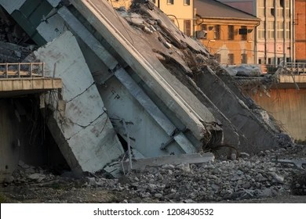
Building and Bridge Collapse:

Slide 19
Mitigation strategies for man-made disasters:
For road accidents, traffic rules and regulations need to be followed strictly.
b. For building and bridge collapse, standard building materials should be used.
c. Moreover, more and more public awareness should be made to minimize the effects of man-made disasters.

Slide 20
a Terrorism-Related Event Happens:
Stay calm and be patient.
b. Listen to a local radio or television station for news and follow the instructions of emergency service personnel.
c. Be vigilant. If the incident occurs near you, look out for secondary hazards such as falling debris or additional attacks.
d. Check for injuries and summon help for seriously injured people.

Slide 21
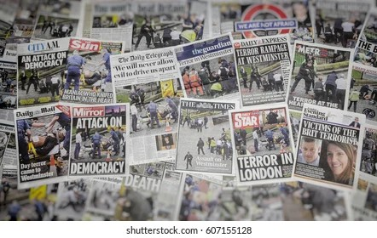
Terrorism

Slide 22
Awareness through Mass Media:
Media plays a significant role in educating the population about] disaster and its management.
b. Without media we could not aware people about disaster in remote areas of the country.

Slide 23
Central Sector Scheme for Disaster Management:
Human resource Development
b. Setting up of National Centre for Disaster Management (NCDM)
c. Setting up of Disaster Management Faculties in States
d. UNDP is a united nation’s global development programs working in 166 countries.
e. Programs for Community Participation and Public Awareness
f. Observing National Disaster Reduction Day

Slide 24
Related Articles:
Disaster Management: Hazards and Disasters, Vulnerabilities and Damages
Resettlement and Rehabilitation of People: Problems and Concerns | Disaster Management

