Slide 1
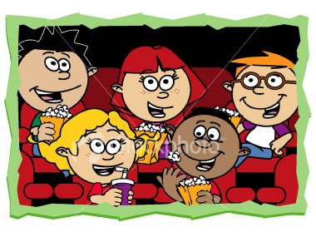
UNIT 6
MOVIES:

Slide 2
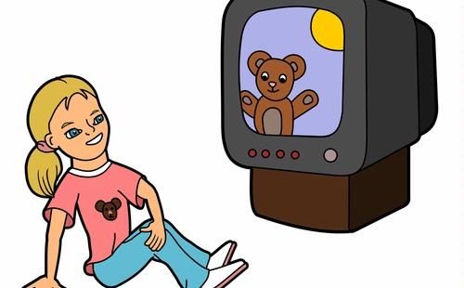
Types of programmes on TV:
Quiz show: yarışma
Stand up comedy: stand up
Western : kovboy
Thriller : gerilim
Documentary : belgesel
Action film : aksiyon film
Reality show : sıradan insanların yaşamlarını konu alan televizyon programı
Weather forecast: hava durumu
Sitcom : sitcom
Animation film : animasyon (canlandırma)
Cookery programme: yemek programı

Slide 3
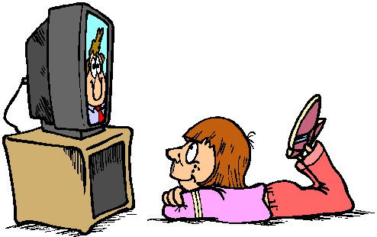
Types of programmes on TV:
Cartoons: çizgi film
Commercials / advertisement : reklamlar
Sports programme: spor programı
Police drama: polisiye
Music programme: müzik programı
Series: dizi film
News: haberler
Chat show: söyleşi programı
Horror film: korku filmi
Science fiction: bilim kurgu
Soap opera: dizi

Slide 4
Types of movies / films :
Cartoon: çizgi film
Horror film: korku filmi
Musical film: müzikal
Action film: aksiyon
Science fiction: bilim kurgu
Westren film: kovboy
Romantic film: romantik
Animation film: animasyon
Comedy film: komedi

Slide 5
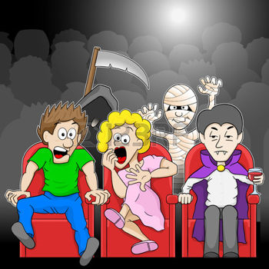
What kind of films/ movies do you like?
I like action films.
I like animation films.
I like horror films.
I like science fiction.
I like romantic comedies.

Slide 6
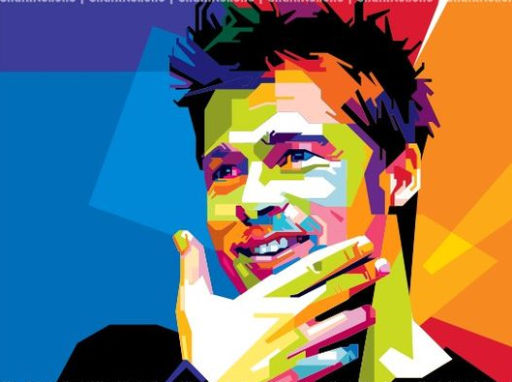
Who is your favourite actor?
A: Who is your favourite actor?
B: Brad Pitt is my favourite actor.
B: My favourite actor is Brad Pitt.
B: Brad Pitt.

Slide 7
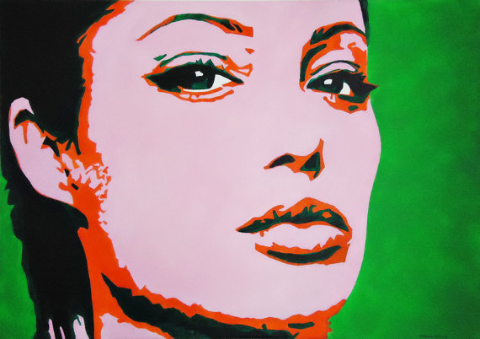
Who is your favourite actress?
A: Who is your favourite actress?
B: Angelina Jolie is my favourite actress.
B: My favourite actress is Angelina Jolie.
B: Angelina Jolie.

Slide 8
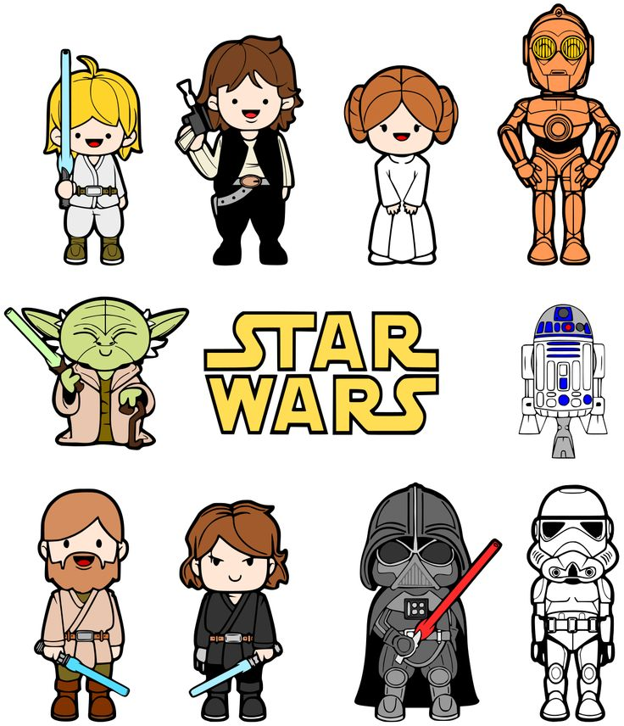
What is your favourite movie?
A: What is your favourite movie?
B: «Star Wars» is my favourite film.
B: My favourite film is «Star Wars»
B: «Star Wars»

Slide 9
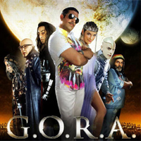
What kind / type of movie is ………?
1. A: What kind of movie is Mission Impossible?
B: It is an action film / movie.
A: What kind of movie is Gora?
B: It is a science fiction.
3. A: What kind of movie is Alvin and the Chipmunks?
3. B: It is an animation.

Slide 10
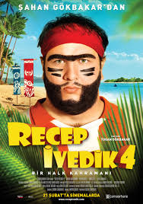
Recep Ivedik is a four series of a film. It is a comedy film. It is about Recep's adventures on an island. Toğan Gökbakar is the director. Şahan Gökbakar, İrfan Kangı and Cem Korkmaz are the starrings. It comes on 21 February.

Slide 11
Answer the questions:
1.) What is the name of the film?
- The name of the film is Recep İvedik.
2.) What kind of movie is this?
- It is a comedy.
3.) Who are the starrings?
- Şahan Gökbakar, İrfan Kangı and Cem Korkmaz
4.) When is it on ?
- It is on 21 February.
5.) What is the film about?
- It is about Recep's adventures on an island.

Slide 12
Adjectives:
fascinating: büyüleyici
exciting: heyecan verici,heyecanlı
pleasant: keyifli,hoş
scary: korkunç,korkutucu
funny: komik,gülünç,güldürücü
enjoyable: zevkli,eğlenceli
frightening:korkunç,korkutucu
boring: sıkıcı
interesting:ilginç,ilgi çekici
entertaining:eğlendirici,eğlenceli

Slide 13
1. Who are the starrings?
Ata Demirer& Demet Akbağ

Slide 14
2. Who is the director?
Nuri Bilge Ceylan is the director.

Slide 15
3. What time is Survivor on?
8 P.M.
It is on at 8 p.m.

Slide 16
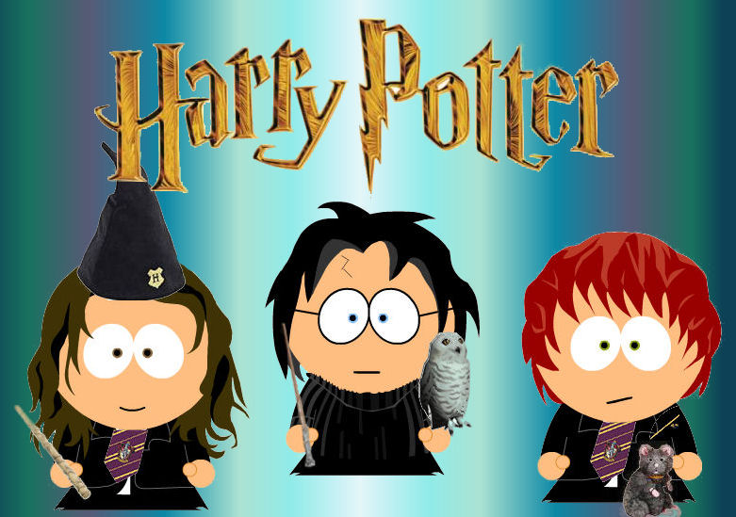
4. What is it on TV tonight? - Harry Potter is on tonight.

Slide 17
5. What is the film about? What is the topic of the film?
It is about withces and wizards

Slide 18
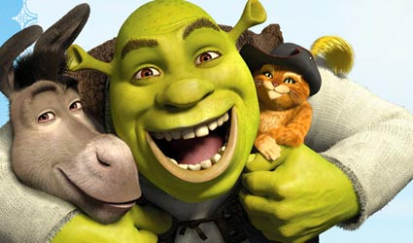
When is Shrek on?
On Monday.

Slide 19
Likes&Dislikes with adjectives:
I like cartoons. I think they are funny.
I like romantic films. I think they are pleasant.
I like western films. I think they are exciting.
I don’t like horror films. I think they are scary.
I don’t like musicals. I think they are boring.
I don’t like science fiction films. I think they are boring.

Slide 20
Let’s…..
Let’s go to the cinema.
Let’s watch a film.
Let’s go out.
Let’s have a rest.
Let’s study English.
Let’s drink Coke.
Let’s play dodgeball.
Let’s do origami.

Slide 21
Shall….?
Shall we go to the cinema?
Shall we watch a cartoon?
Shall we watch television?
Shall we play «silent movie»?
Shall we play dart?
Shall we do puzzles?

Slide 22
Would you lıke ….. ?
Would you like to go out?
Would you like to go to the cinema?
Would you like to listen to music?
Would you like to have a rest?
Would you like to drink herbal tea?
Would you like to watch a CD?

Slide 23
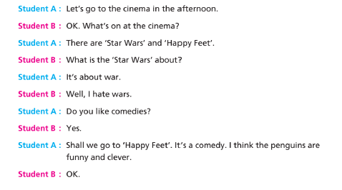

Slide 24
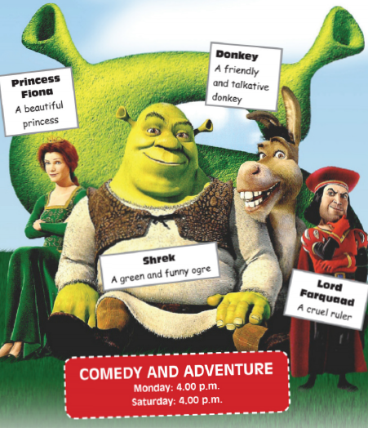
A: What time is Shrek on? B: At 4 p.m.
A: What is the name of the animation? B: Shrek
A: When is Shrek on? B: On Monday and Saturday
A: Who are the main characters? B: Shrek, Fiona, Donkey and Lord Farquaad
A: What is Shrek about? B: It is about love.
A: What kind of film is it? B: It is a comedy and adventure.

Slide 25
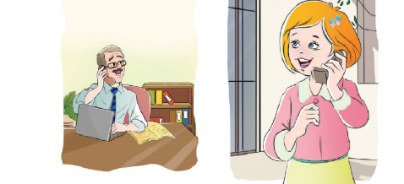
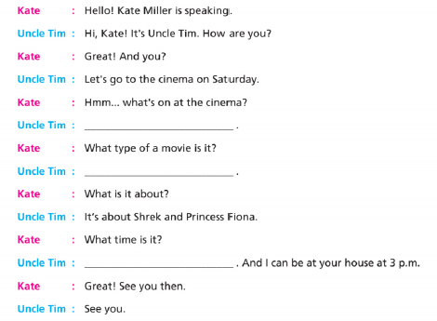
SHREK
It is a comedy and adventure.
At four o’clock.

Slide 26
STRUCTURES/KULLANILAN YAPILAR
I like cartoon
I don’t like musical.
I think it is……
What kind of movie is it?/ It is a western film
What is your favourite film?/ My favourite film is Recep İvedik 4.
What is your favourite movie type?/ My favourite movie type is horror film.
Who is your favourite actor?/My favourite actor is Çağatay Ulusoy.
Who is your favourite actress?/My favourite actress is Serenay Sarıkaya.
What kind of movies do you like?/I like action films.
What kind of movies do you hate/dislike? / I hate/dislike documentary.
What’s on tonight? /Shrek
What time is Shrek on? / It is at 07.00 p.m
How much is a ticket?/It is £7
I like this movie because it is funny/enjoyable/pleasant
I don’t like this film because it is frightening/scary/boring.
What type of film is it? It is a detective film
What is the topic of the film?/ It is about love.
Who is the director?/ Director is John Smith.
Who are the starrings?/ They are Jack London,Kate Austen and Tom Sawyer.

