Slide 1
Evaluation of online tools
Making videos
https://animoto.com/projects
++Animoto is a tool which helps to produce videos that blend photos, video clips, text and music.
In my view, it is much better than https://biteable.com/presentations/ in terms of ready-made templates. However, both these video makers need practice before using confidently in public.

Slide 2
Infographics and presentations
3. www.canva.com
+++Canva is a design software which helps to create quality and visually appealing graphic designs. It has a collection of free templates. It is an innovative tool which allows to create a range of documents, such as poster, infographics, scheme, etc.
-Free version has some limitations, like in all other apps. It requires time, patience, and skills to create your own design even if one already has found a template. Some free templates do not match the purpose of the presentation, and in this case one needs to spend more time on designing the poster.
4.https://www.easel.ly/create?id=https://s3.amazonaws.com/easel.ly/all_easels/6037618/1604134817&key=pri
This tool is similar to Canva in a way that it also creates infographics, but Canva has more options of instruments and icons.

Slide 3
Infographics and presentations
5.https://www.visme.co/
+++The purpose of Visme is to allow novices to create beautiful designs, such as a presentation, an infographic or a social media cover photo. It also requires time and practice to understand how things work.

Slide 4
Collaboration
6. www. mentimeter.com
+It is an interactive presentation software allowing in fun and entertaining manner to gather ideas people from all over the world. It is main advantage is involving people, giving an opportunity to everyone to participate
-The disadvantages are that people need to have high-speed internet to use this app and advanced options require subscription.
7.https://togethertube.com/
TogetherTube allows watching online video clips simultaneously with other people, and the chat option enables discussion of the content. It can be used for online teaching or film clubs.

Slide 5
Collaboration
8. https://awwapp.com/
+++It is a great tool for online collaboration. For example, when we celebrated Erasmus Day, Kathren used it so that participants all over the world could share their ideas and drawings on one page.It gives the opportunity to work together on one page by adding texts, drawings, and images.
-The only minus I see is that it is not free. Also, one needs to practise how to use all icons. For example, I inserted the same image twice and then I struggled with how to find a tool to delete it. It is better to practise in advance before an important meeting starts

Slide 6
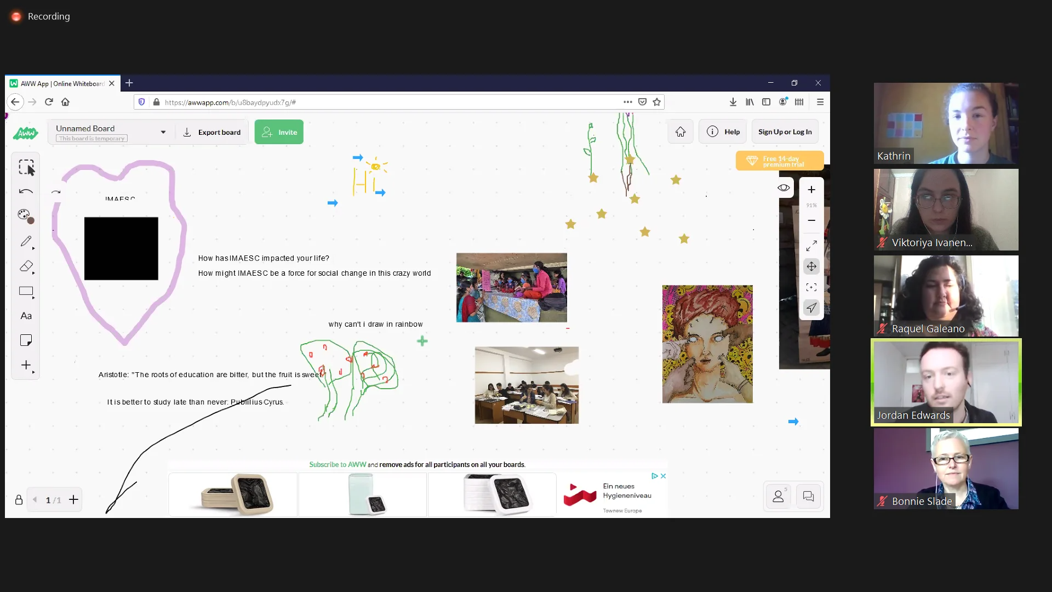
The example of mentimeter

Slide 7
Learning resource
9 +++++https://www.eventbrite.com/
This site contains tickets to a variety of live and online events, which are extremely useful for any learner, and educator. Any topics from how to make a blog, language courses, conferences, seminars are offered on this platform. It has more advantages than disadvantages. The things that a learner must know before is that events are held at different time zones and some events request payment although free events are abundant.

Slide 8
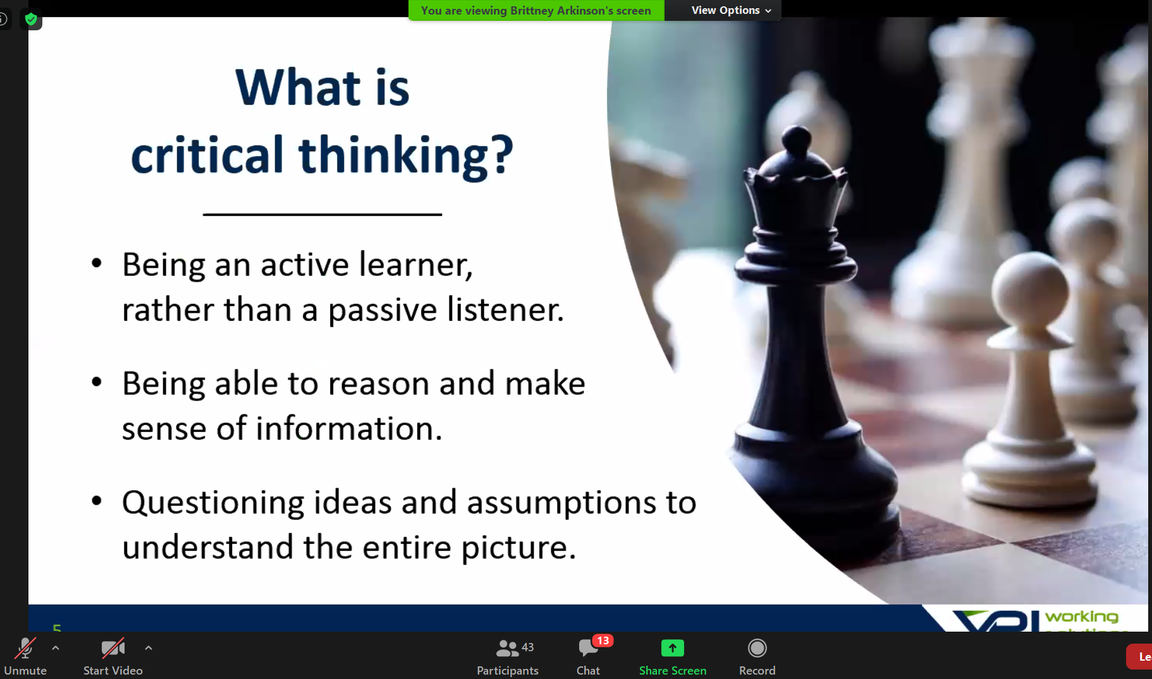
Example of a seminar in eventbrite

Slide 9
A blog platform
10.https://wakelet.com/
++It is an alternative to padlet, like a platform to create and share information. Wakelet allows educators to collect, organize and share multimedia resources with students, coworkers, and learning communities.

Slide 10
Podcast app
11. https://anchor.fm/dashboard/episodes
+++It is a powerful tool to create podcasts. It has some issues in design, but in general it is easy to use.

Slide 11
Text-to-speech
12. https://www.naturalreaders.com/online/
is a professional text to speech programme which converts any written text into spoken words. Only limited features are available for free, but it can be a great tool for language teachers or people with poor eysight.

Slide 12
Concept maps software
13. https://gitmind.com/app/my
+++It is an excellent free tool on creating concept maps.
-It requests some training and patient from the user, like any other similar tool.
14. https://www.mindmeister.com/1670506445#
Similar to getmind, but more advanced options require payment.

