Slide 1
Constructivism: definition
‘an approach to learning that holds that people actively construct or make their own knowledge and that reality is determined by the experiences of the learner’ (Elliott et al., 2000, p. 256).

Slide 2
Constructivism: main principles
In elaborating constructivists’ ideas Arends (1998) states that constructivism believes in personal construction of meaning by the learner through experience, and that meaning is influenced by the interaction of prior knowledge and new events.
1. Learners construct meaning:
Students discuss The Year of Wonders by Geraldine Brooks
through Viber app

Slide 3
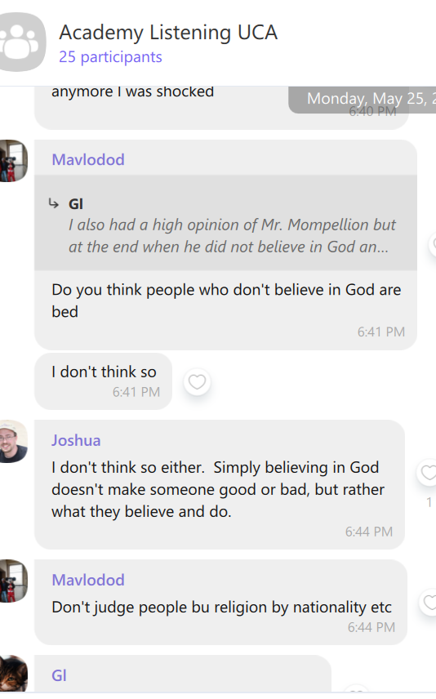

Slide 4
This prior knowledge influences what new or modified knowledge an individual will construct from new learning experiences (Phillips, 1995).
Mohinur is a medical student. Her prior knowledge of medicine helped her understand the personality of the father in the story-a cruel, sadistic man.

Slide 5
2. Learning is an active process.
“Learning is considered an active construction process, inseparable from doing, and a reflection about what learners are doing, not a passive reception of knowledge” (Mattar, J. ,2018)
Students are interviewing each other.

Slide 6
3. All knowledge is socially constructed.
Vygotsky (1978), believed that community plays a central role in the process of "making meaning.“
11 grader makes a poster about environmental pollution

Slide 7
4. Learning exists in the mind
The constructivist theory posits that knowledge can only exist within the human mind, and that it does not have to match any real world reality (Driscoll, 2000).
When learners perceive new experience, they will continually update their own mental models to reflect the new information, and will construct their own understanding of reality (McLeod, S. A. (2019). Academic English student makes an achievement board.

Slide 8
Pedagogical goals of constructivist classrooms
Honebein (1996) summarizes the seven pedagogical goals of constructivist learning environments:
1) To provide experience with the knowledge construction process (students determine how they will learn).
2) To provide experience in and appreciation for multiple perspectives (evaluation of alternative solutions).
3) To embed learning in realistic contexts (authentic tasks).
4) To encourage ownership and a voice in the learning process (student centered learning).
5) To embed learning in social experience (collaboration).
6) To encourage the use of multiple modes of representation, (video, audio text, etc.)
7) To encourage awareness of the knowledge construction process (reflection, metacognition).

Slide 9
3. authentic tasks are very important for language learners.

Slide 10
Traditional Classroom
Constructivist Classroom Source:McLeod, S. A. (2019, July 17).
Strict adherence to a fixed curriculum is highly valued. | Pursuit of student questions and interests is valued.
Learning is based on repetition. | Learning is interactive, building on what the student already knows.
Teacher-centered. | Student-centered.
Teachers disseminate information to students; students are recipients of knowledge (passive learning). | Teachers have a dialogue with students, helping students construct their own knowledge (active learning).
Teacher's role is directive, rooted in authority. | Teacher's role is interactive, rooted in negotiation.
Students work primarily alone (competitive). | Students work primarily in groups (cooperative).

Slide 11
3 Types of Constructivism (McLeod, 2019).
Cognitive
By Jean Piaget
Social by Lev Vygotsky
Radical

Slide 12
12 descriptors of constructivist teaching behaviors by Brooks and Brooks (1993).
1. Encourage and accept student autonomy and initiative. (p. 103)
2. Use raw data and primary sources, along with manipulative, interactive, and physical materials. (p. 104)
3. When framing tasks, use cognitive terminology such as “classify,” analyze,” “predict,” and “create.” (p. 104)
4. Allow student responses to drive lessons, shift instructional strategies, and alter content. (p. 105)
5. Inquire about students’ understandings of the concepts before sharing [your] own understandings of those concepts. (p. 107)
6. Encourage students to engage in dialogue, both with the teacher and with one another. (p. 108)

Slide 13
12 descriptors of constructivist teaching behaviors by Brooks and Brooks (1993).
7. Encourage student inquiry by asking thoughtful, open-ended questions and encouraging students to ask questions of each other. (p. 110)
8. Seek elaboration of students’ initial responses. (p. 111)
9. Engage students in experiences that might engender contradictions to their initial hypotheses and then encourage discussion. (p. 112)
10. Allow wait time after posing questions. (p. 114)
11. Provide time for students to construct relationships and create metaphors. (p. 115)
12. Nurture students’ natural curiosity through frequent use of the learning cycle model. (p. 116)

Slide 14
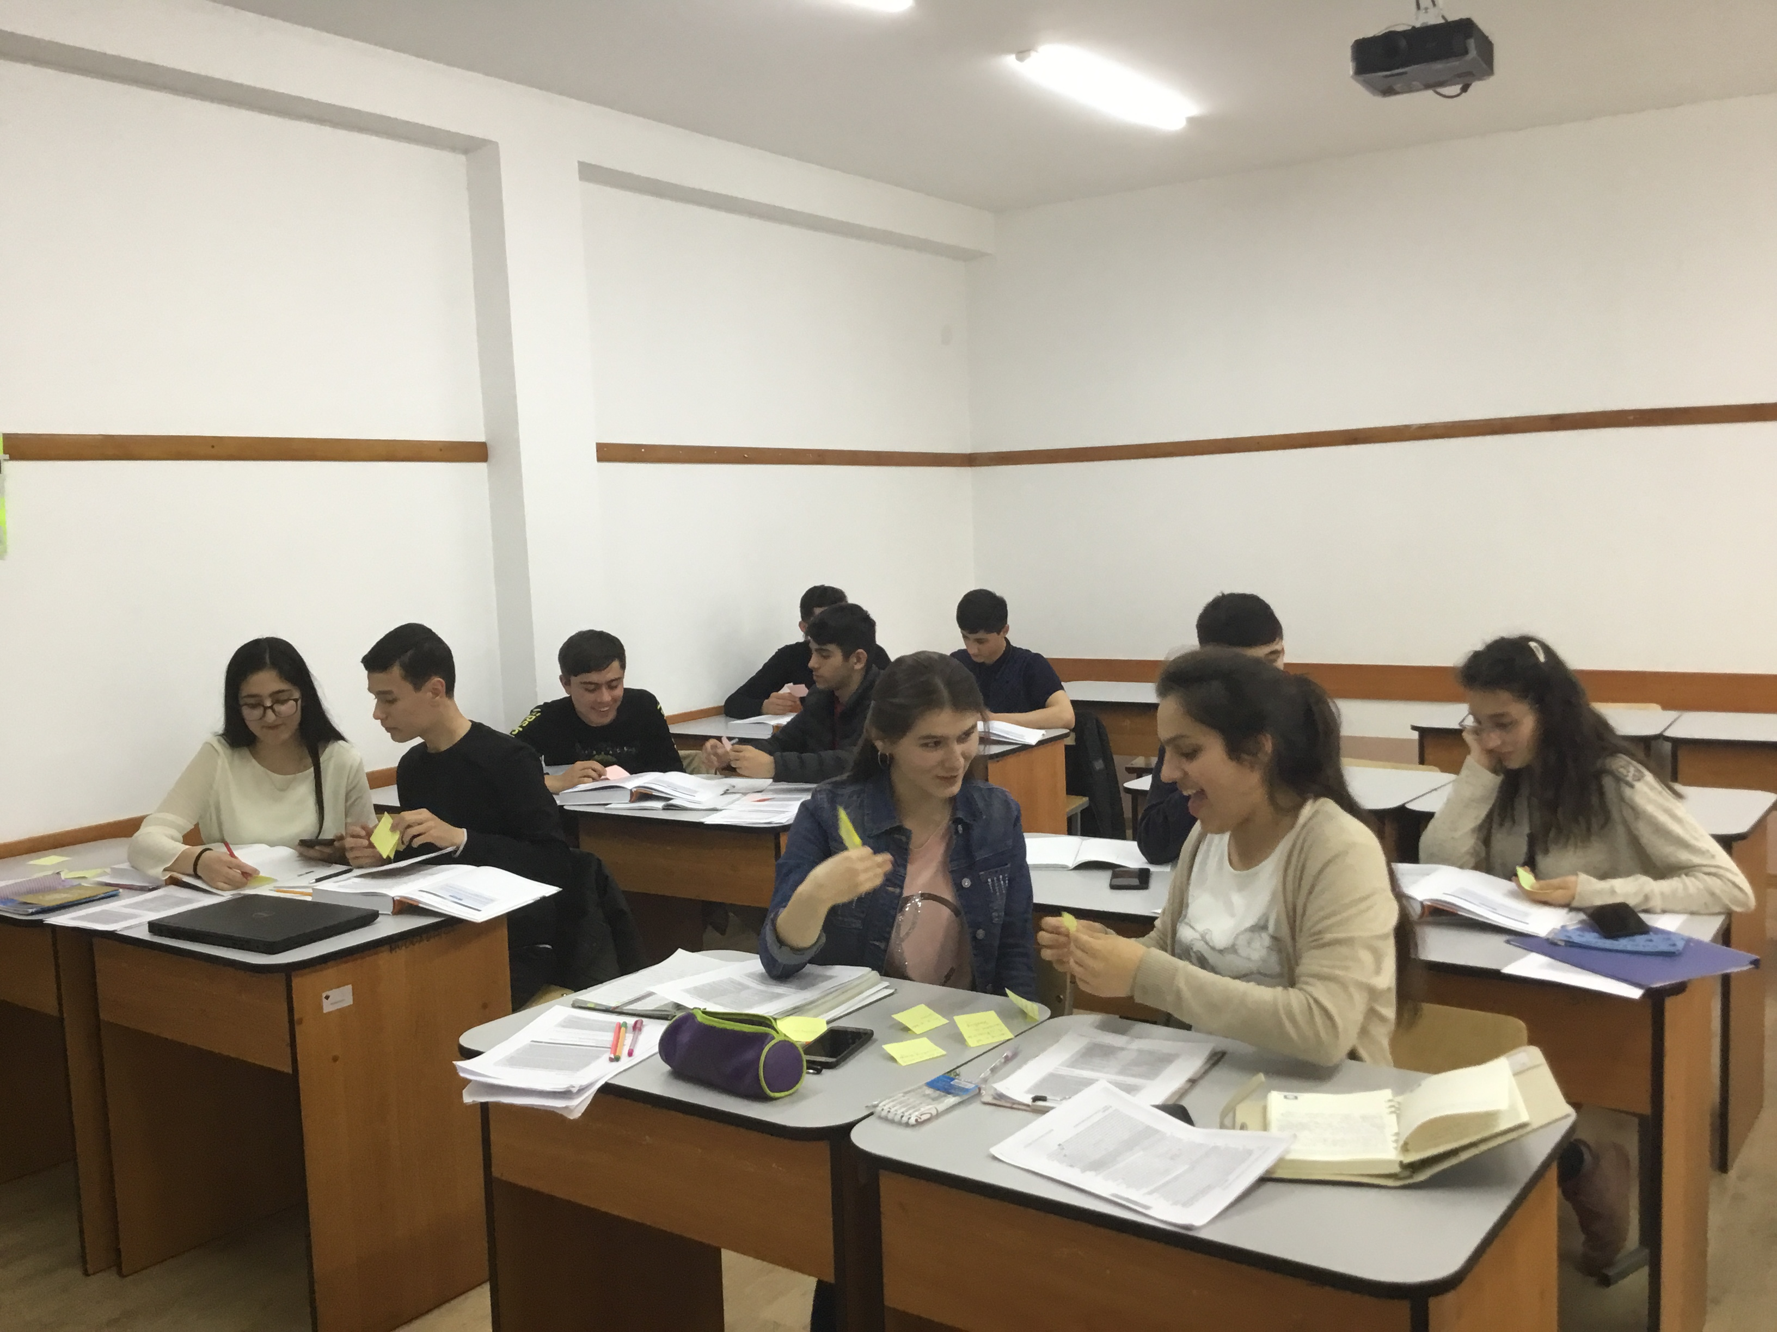
The role of the teacher in a constructivist classroom
A teacher acts as a facilitator of learning rather than an instructor. McLeod, S. A. (2019).
10 graders are playing vocabulary games.

Slide 15
References
Arends, R. I. (1998). Resource handbook. Learning to teach (4th ed.). Boston, MA: McGraw-Hill.
Brooks, J., & Brooks, M. (1993). In search of understanding: the case for constructivist classrooms, ASCD. NDT Resource Center database.
Elliott, S.N., Kratochwill, T.R., Littlefield Cook, J. & Travers, J. (2000). Educational psychology: Effective teaching, effective learning (3rd ed.). Boston, MA: McGraw-Hill College.
Honebein, P. C. (1996). Seven goals for the design of constructivist learning environments. Constructivist learning environments: Case studies in instructional design, 11-24.
Mattar, J. (2018). Constructivism and connectivism in education technology: Active, situated, authentic, experiential, and anchored learning. Revista Iberoamericana de Educación a Distancia, 21(2), 201-217.
McLeod, S. A. (2019, July 17). Constructivism as a theory for teaching and learning. Simply Psychology. https://www.simplypsychology.org/constructivism.html
Phillips, D. C. (1995). The good, the bad, and the ugly: The many faces of constructivism. Educational researcher, 24(7), 5-12.
Vygotsky, L. S. (1978). Mind in society: The development of higher psychological processes. Cambridge, MA: Harvard University Press.

