Slide 1

St. George’s College
School Library Media Center

Slide 2
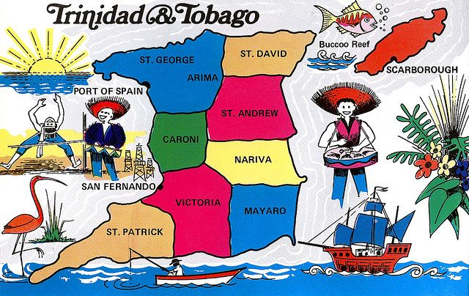
Happy 44th
Republic Day
T r i n i d a d a n d T o b a g o

Slide 3
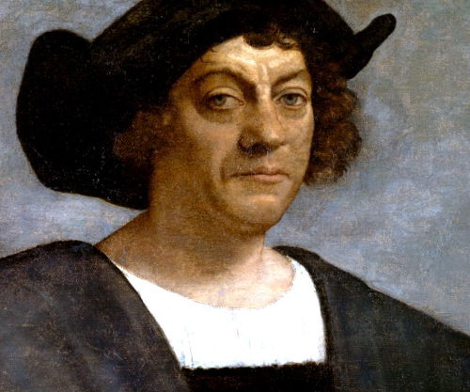
On becoming a Republic Nation…
Trinidad discovered in 1498 by Christopher Columbus, has been a colony under monarch rule. In 1899, Tobago was annexed to Trinidad .
Trinidad and Tobago has changed hands from being governed by the British and Spanish among other nations.
In 1962, the twin island nation gained her independence from Britain thus becoming an independent nation. Despite becoming independent, the British queen remained the head of state.

Slide 4
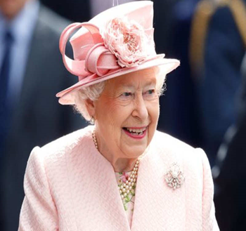
…On becoming a Republic Nation
Post 1962, many of the institutions and policies of being ruled under the British queen remained intact despite having independent nation status.
In 1976, Trinidad and Tobago became a Republic. The country now had its own head of state, and own constitution, Trinidad and Tobago had officially cut all ties with the British monarch.

Slide 5
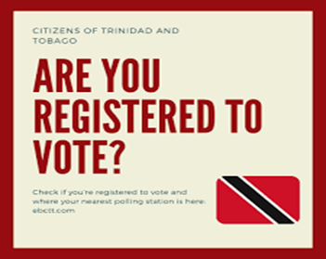
What does it mean to be a Republic Nation?
A Republic state or nation is one in which the supreme power rests in all the citizens entitled to vote. This right is exercised by representatives elected by them, and are responsible to them.
Being a Republic nation Trinidad & Tobago has her own national:
    Constitution
    Head of state
    Emblems - national flag, coat of arms,
    national flower, national birds
    Watch words & motto
    Money
    National instruments

Slide 6
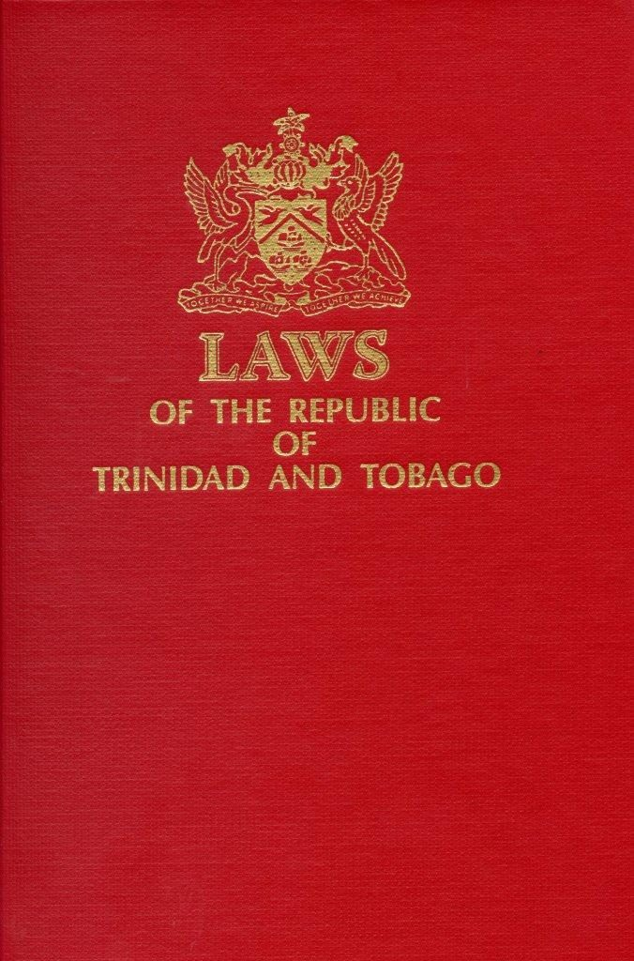
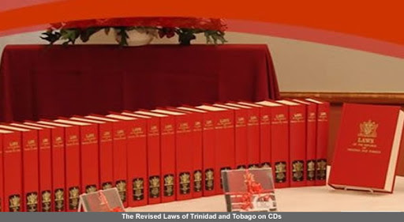
Constitution of Trinidad & Tobago
The constitution of the Republic of Trinidad & Tobago can be accessed at it’s Ministry of legal affairs website at:
https://rgd.legalaffairs.gov.tt/laws2/Alphabetical_List/lawspdfs/1.01.pdf

Slide 7
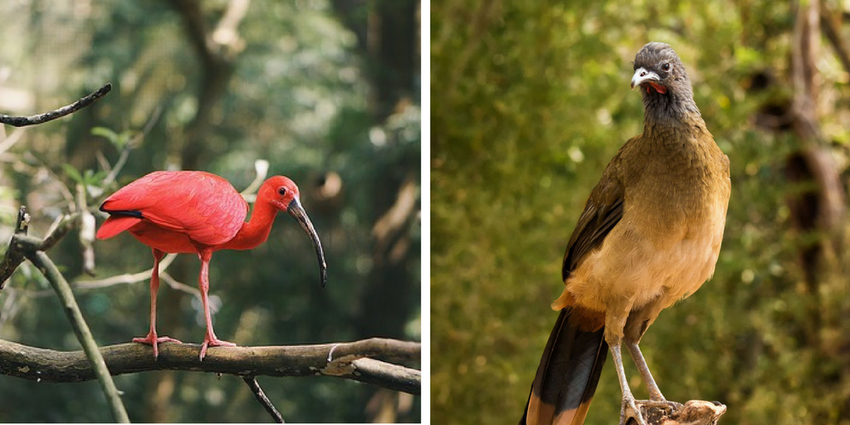
National birds of Trinidad & Tobago
Scarlet Ibis
Cocrico

Slide 8
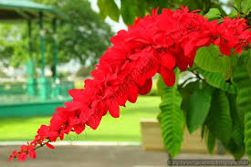
National flower of Trinidad & Tobago
Chaconia Flower

Slide 9
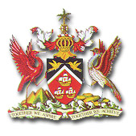
Coat of arms of the
Republic of Trinidad & Tobago

Slide 10
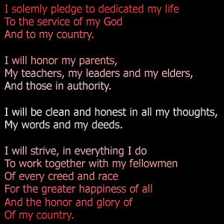
National Pledge of T&T
National Pledge

Slide 11
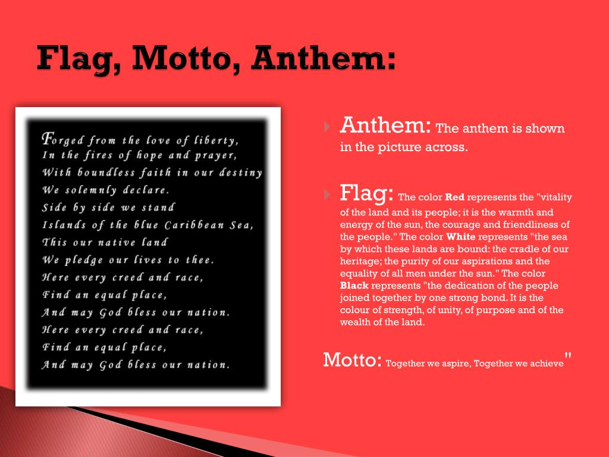

Slide 12
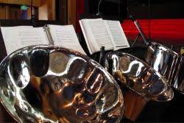
National Instrument of Trinidad & Tobago
Steelpan

Slide 13
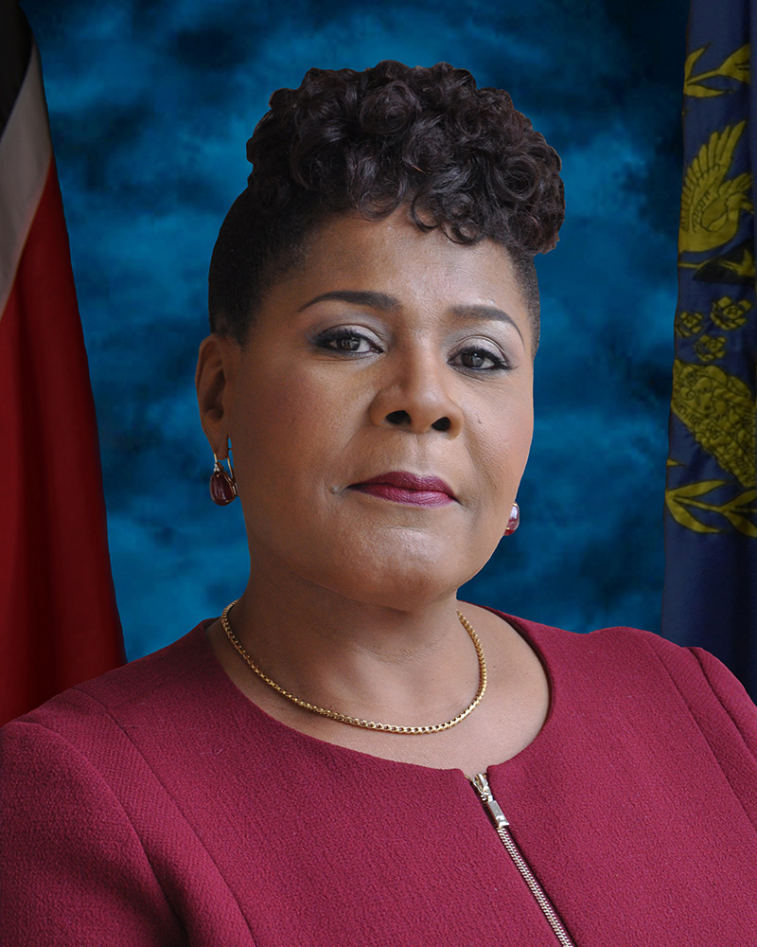
President of the Republic of
Trinidad & Tobago- her excellency,
Paula Mae-Weeks
(2018 to present)

Slide 14
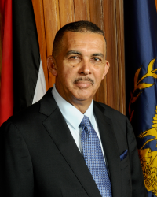
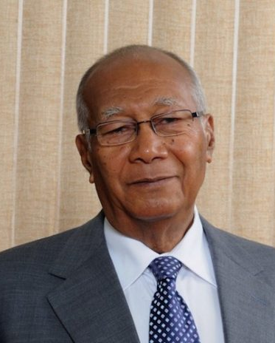
Past Presidents of Trinidad and Tobago
Anthony Carmona
2013 - 2018
George Maxwell Richards
2003 - 2008

Slide 15
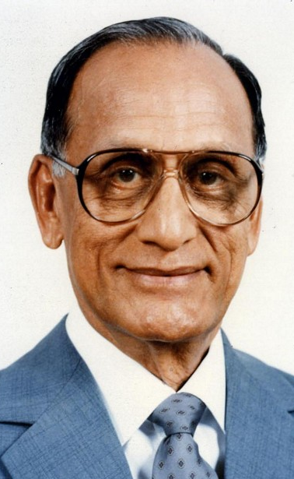
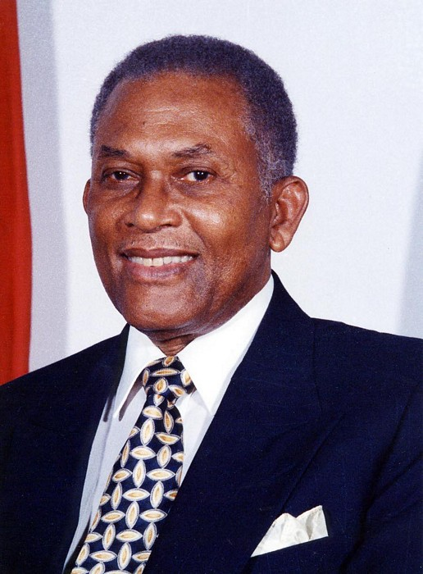
Past Presidents of Trinidad and Tobago
Noor Hassanali
1987 - 1992
A.N.R. Robinson
1997

Slide 16
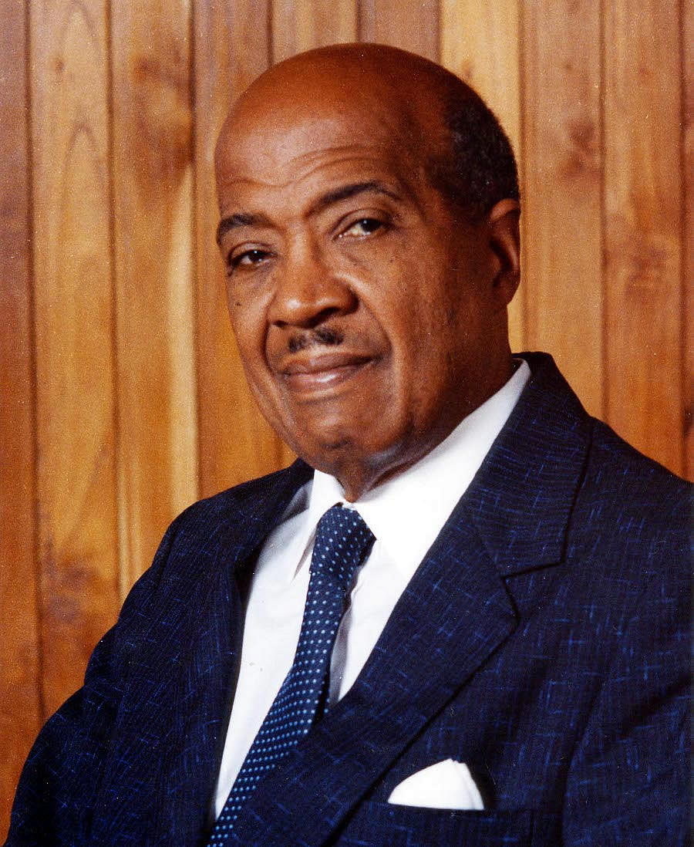
First President of the Republic of
Trinidad & Tobago- his excellency,
Sir Ellis Clark
(1976 - 1982)

Slide 17
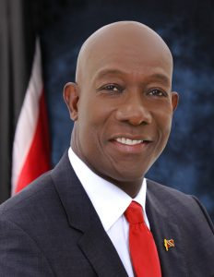
Prime Minister of Trinidad & Tobago
The honourable
Dr Keith Rowley,
Prime Minister of
The Republic of Trinidad & Tobago.

Slide 18
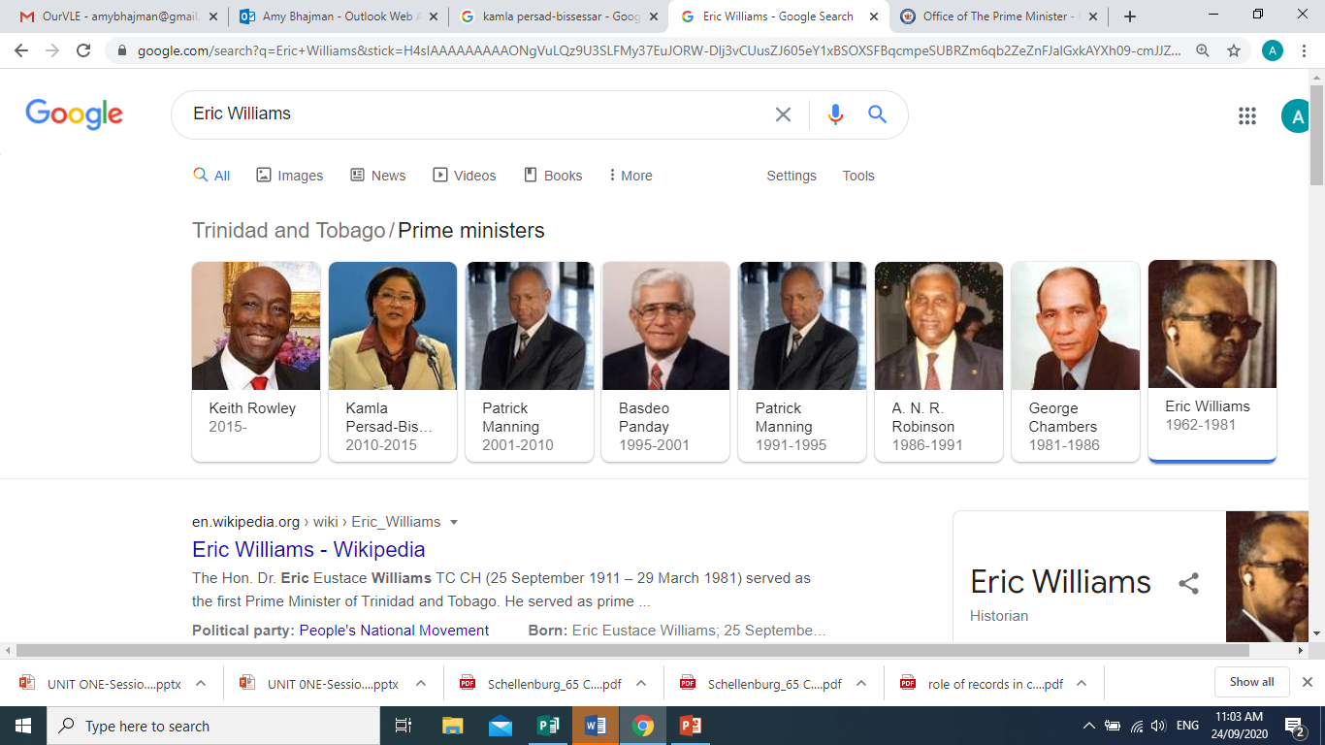
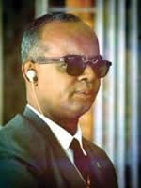
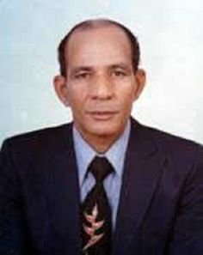
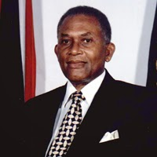
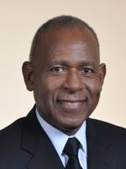
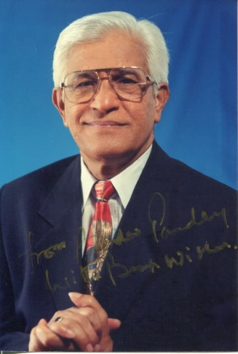
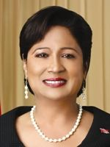
Past Prime Ministers of the
Republic of Trinidad & Tobago

Slide 19
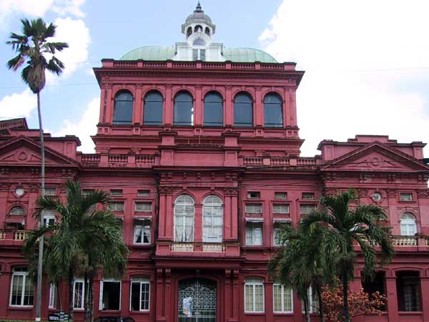
Why is Republic Day celebrated on 24 September?
Trinidad and Tobago became a Republic nation on
1 August 1976.
The first sitting of the Trinidad & Tobago parliament as a Republic nation, under her own constitution took place on 24 September 1976.
It is for this reason, that Republic Day is celebrated on the 24th September annually.
The Red House - The National Parliament House of the Republic of Trinidad & Tobago

Slide 20
What is the difference?
Independence Day
Republic Day
Independence refers to the day a country gained independence from colonial rule or freed from the rule of another nation.
A Republic refers to the form of government where the supreme power is held by its own people to elect their desired representatives

Slide 21
Happy Republic Day 2020 to
Staff and Students of St. George’s College

