Slide 1
0.5% Nyquist Noise-free Computational Ghost Imaging via non-Experimental Deep Learning
Haotian Song, Xiaoyu Nie, Hairong Su, Xingchen Zhao,
Hui Chen, Yu Zhou, Tao Peng, Marlan O. Scully
Xi’an Jiaotong University, Xi’an, Shaanxi, 710049, China
Texas A&M University, College Station, Texas, 77843, USA
University of Manchester, Manchester, M13 9PL, UK
Baylor University, Waco, Texas, 76706, USA
Princeton University, Princeton, New Jersey, 08544, USA
2020.12.28

Slide 2
Contents
WHAT is the Ghost Imaging?
--- explain the GI theory by Fourier transform (slide3~slide9)
--- introduce more types of patterns (orthogonal basis, color noise, and Walsh-Hadamard) (slide10~slide18)
WHEN do we break the Nyquist limit? (slide19~slide20)
WHY do we use Deep Learning with pink noise patterns? (slide21~slide28)
WHERE do we improve the imaging system? (slide29~slide37)

Slide 3
I. What is the Ghost Imaging?
Single pixel imaging!!!
In Physics:
Hanbury-Brown-Twiss Effect(1956) → Entangled Photon Pairs → 2nd Order Correlation (1995) → Ghost Imaging (2003)
Thousands words to be explained……..
Dame! Tooooo Physics!

Slide 4
I. What is the Ghost Imaging?
From Mathematical perspective: General Fourier Transform/Filter
Why? Let’s begin.
Written in the front: $∫{sin\left(ax+φ_{1}\right)}\sin\left(bx+φ_{2}\right)dx=0, if a≠b$
(Orthogonal feature of sinusoidal function)
For a wave packet $f\left(x\right)$containing multiple frequency,
$$\begin{aligned}f\left(t\right)=\sum_{ω_{i}}{A_{i}sin⁡(ω_{i}t+φ_{i})}\#(1)\end{aligned}$$
If we want specific frequency ratio in $f\left(t\right)$, we have to multiply this $\sin\left(ω_{i}t+φ_{i}\right)$ on $f\left(t\right)$and integrate in the full time-domain.

Slide 5
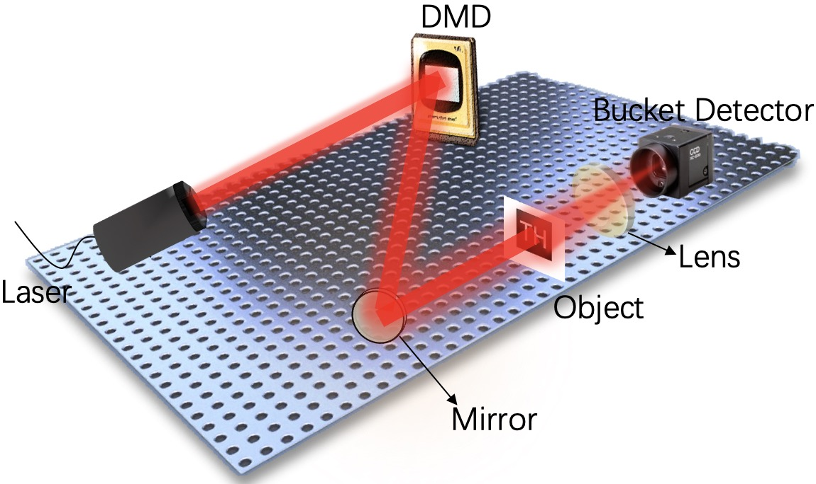
Based on this concept, we generate some patterns. These patterns will be used in imaging system.
Patterns will be applied on this device in sequence (digital micromirror device)
$$P_{N}$$
…………
…………
$$P_{2}$$
$$P_{1}$$
$$p_{w_{11}}(t)$$
$$p_{w_{12}}(t)$$
……
$$p_{w_{21}}(t)$$
$$p_{w_{22}}(t)$$
……
Here the time t can be analog to the t-th pattern.
We can define each pixel has unique frequency (one typical pattern).
…………
…………
…………

Slide 6
1. Laser shines on DMD →
2. Spatial distribution of light (due to patterns added on DMD) →
3. Light propagate to object →
4. Some pixels pass by objects →
5. Lens collects the light →
6. Bucket detector (single pixel detector) gets the light intensity sequence I(t).
Patterns will be applied on this device in sequence (digital micromirror device)
* I(t) = sum over all the pixels on the t-th pattern which pass the object

Slide 7
$$I\left(t\right)=\sum_{ω_{pass}}{P_{ω_{pass}}(t)}$$
We hope to know the shape of the object
=
We hope to know which pixels pass the object
=
We hope to know which frequencies are contained in I(t)
=
We use the Fourier filter/transform on I(t)
→ Those pixels/frequencies passing the object will be non-zero; those pixels/frequencies not passing the object will be zero;
$$p_{w_{11}}(t)$$
$$p_{w_{12}}(t)$$
……
$$p_{w_{21}}(t)$$
$$p_{w_{22}}(t)$$
……
…………
…………
…………

Slide 8
We use the Fourier filter/transform on I(t)
Those pixels/frequencies passing the object will be non-zero; those pixels/frequencies not passing the object will be zero;
Expressed by formula:
$$result\left(x,y\right)=\sum_{t}{P_{ω_{xy}}\left(x,y,t\right)×I\left(t\right)}=\sum_{t}{P_{ω_{xy}}\left(x,y,t\right)×\sum_{ω_{pass}}{P_{ω_{pass}}\left(t\right)}=\sum_{t}{P_{ω_{xy}}\left(x,y,t\right)P_{ω_{xy}}\left(x,y,t\right)}}$$
$$result=\sum_{t}{P\left(t\right)I\left(t\right)= <PI>}$$
Sometimes we add another term due to the non-uniform averaging of patterns.
$$result= <PI>−<P><I>$$
$$I\left(t\right)=\sum_{ω_{pass}}{P_{ω_{pass}}(t)}$$
$$p_{w_{11}}(t)$$
$$p_{w_{12}}(t)$$
……
$$p_{w_{21}}(t)$$
$$p_{w_{22}}(t)$$
……
…………
…………
…………
Result and P(t) are x*y matrix

Slide 9
Up to here, the theory for GI is explained by Mathematics !
Cheers !!!

Slide 10
However,
The weakness of sinusoidal function is that, only under infinite time-domain integration, their orthogonal feature can be displayed.
OR, those pixels/frequencies not passing the object will be non-zero (make some unnecessary fluctuations on the background).
We can call this ‘no infinite time filtering, no fully orthogonal’.
To ameliorate this weakness
orthogonal basis and Walsh-Hadamard patterns are invented

Slide 11
Orthogonal basis: we can define all the $P_{ω_{ij}}(t)$ orthogonal to each other.
According to the Euclidean space, the number of orthogonal basis must equals to dimension of space. Therefore, if the patterns have a columns and b rows, the t must be 1, 2, …, ab
Here we can imagine the $P_{ω_{ij}}(t)$ as vector (length=ab).
$$p_{11}(t)$$
$$p_{12}(t)$$
……
$$P_{ij}\left(t\right)·P_{ij}\left(t\right)=1, while i=m \& j=n ;$$
$$P_{ij}\left(t\right)·P_{mn}\left(t\right)=0, while i≠m or j≠n.$$
$$p_{21}(t)$$
$$p_{22}(t)$$
……
…………
…………
Finally, those pixels/frequencies not passing the object must be zero
…………

Slide 12
Recall the formula again
$$result\left(x,y\right)=\sum_{t}{P_{ω_{xy}}\left(x,y,t\right)×I\left(t\right)}=\sum_{t}{P_{ω_{xy}}\left(x,y,t\right)×\sum_{ω_{pass}}{P_{ω_{pass}}\left(t\right)}=\sum_{t}{P_{ω_{xy}}\left(x,y,t\right)P_{ω_{xy}}\left(x,y,t\right)}}$$
$$result=\sum_{t}{P\left(t\right)I\left(t\right)= <PI>}$$

Slide 13
Correlation → Fourier Filter
We choose one pixel to calculate the correlation (in Physics)
=
We choose one pixel (a , b) to calculate the ${∫p}_{ab}\left(t\right)p_{other}\left(t\right)dt→\sum_{t}{p_{ab}\left(t\right)p_{other}(t)}$
$$p_{11}(t)$$
$$p_{12}(t)$$
……
$$p_{21}(t)$$
$$p_{22}(t)$$
……
…………
…………
…………

Slide 14
One typical orthogonal patterns are Walsh-Hadamard patterns from Walsh-Hadamard matrix
Figure 2. An example for the “cake-cutting” Hadamard basis: (a) a 16 × 16 Hadamard matrix H16; (b) the basis patterns of H16 in the natural order; (c) the basis patterns of H16 in our optimized “cake-cutting” order;
Walsh-Hadamard matrix is usually applied in signal processing and compressive sensing due to its orthogonal feature and low computational complexity (N*log₂N).

Slide 15
In our project, we use pink noise. (white noise patterns are commonly used, so we make comparison with white noise results)
What is colored noise???
Follow me!
We must mention the Mr. Fourier Again!

Slide 16
1. Each picture has its unique Fourier Spectrum
2. Fourier spectrum represents the weight of frequency and their corresponding phase
3. Through the inverse FFT/DFT, we can retrieve the picture from the Fourier spectrum

Slide 17
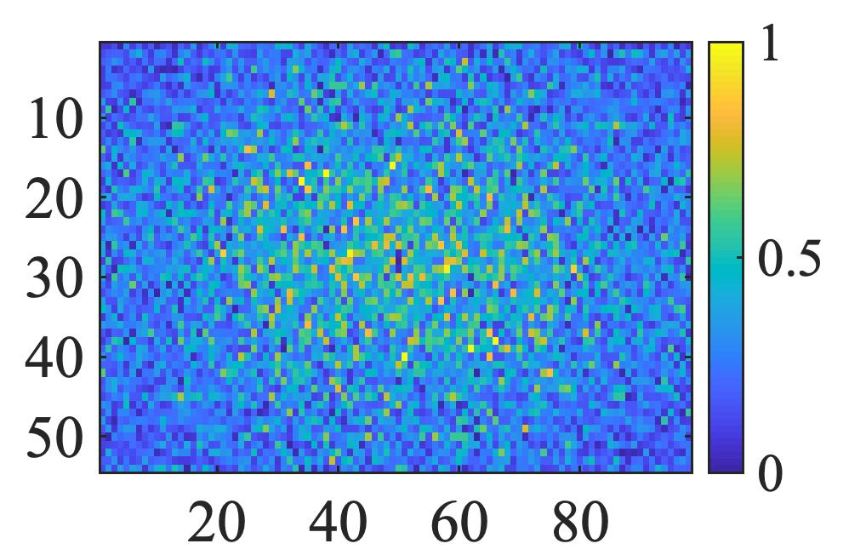
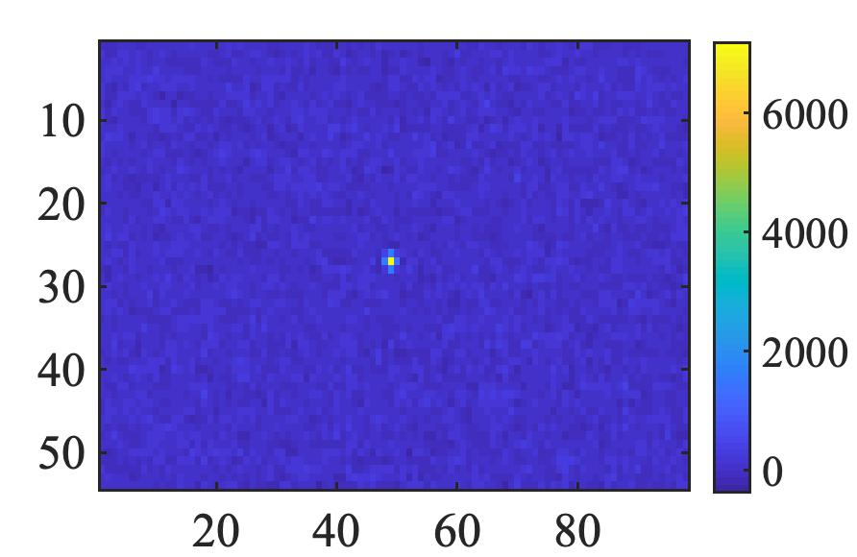
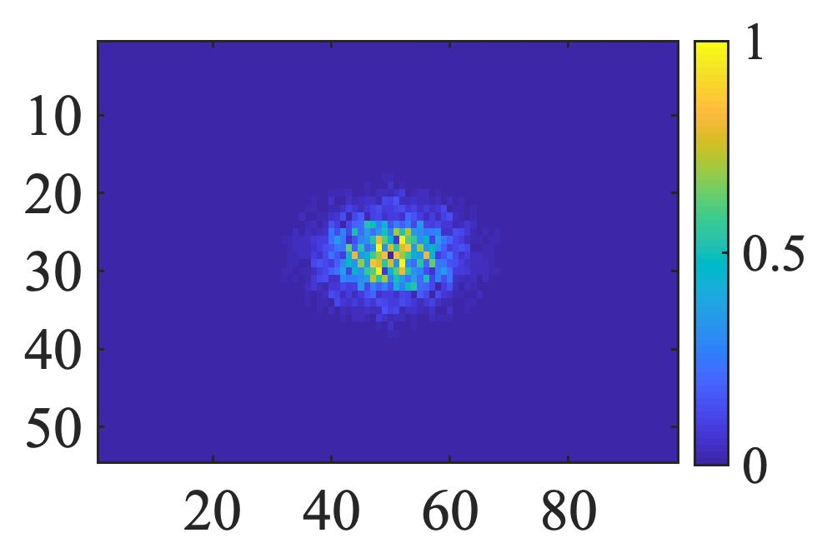
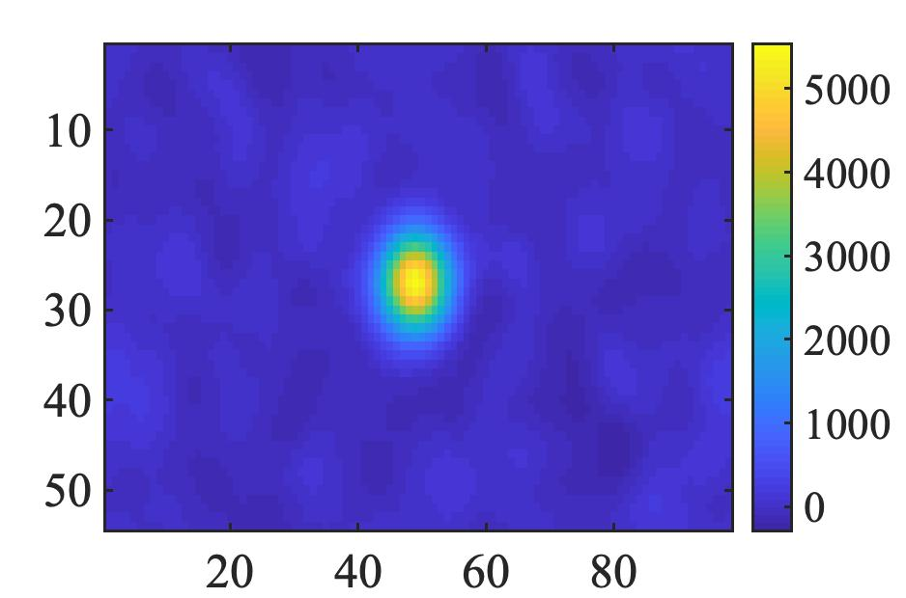
Typically,
White noise:
Pink noise:
Fourier Spectrum
Pattern
Correlation
Recall: correlation maps the vector inner product value
$$\overset{⃑}{P_{1}(t)}·\overset{⃑}{P_{1}(t)}=autocorrelation; \overset{⃑}{P_{1}(t)}·\overset{⃑}{P_{2}(t)}=crosscorrelation$$

Slide 18
Feature of the pink noise patterns
Positive cross-correlation → enhance the signal & suppress the environmental noise
→
→
reference:
[1]. X. Nie, X. Zhao, T. Peng, and M. O. Scully, “Sub-Nyquist computational ghost imaging with orthonormalized colored noise pattern,” arXiv preprint arXiv:2012.07250 (2020).
[2]. X. Nie, X. Zhao, T. Peng, and M. O. Scully, “Moving object captured with pink noise pattern in computational ghost imaging,” arXiv preprint
arXiv:2012.07284 (2020).
[3]. X. Nie, F. Yang, X. Liu, X. Zhao, R. Nessler, Z. Li, T. Peng, M. S. Zubairy, and M. O. Scully, “Noise-free computational ghost imaging with pink noise speckle patterns,” (2020).
Non-experimental Deep Learning
Sub-Nyquist sampling
See them again in next two sections

Slide 19
II. When do we break the Nyquist limit?
Orthogonal basis: we can define all the $P_{ω_{ij}}(t)$ orthogonal to each other.
According to the Euclidean space, the number of orthogonal basis must equals to dimension of space. Therefore, if the patterns have a columns and b rows, the t must be 1, 2, …, ab
This is the Nyquist sampling limit in the imaging system
Here we can imagine the $P_{ω_{ij}}(t)$ as vector (length=ab).
$$p_{11}(t)$$
$$p_{12}(t)$$
……
$$P_{ij}\left(t\right)·P_{ij}\left(t\right)=1, while i=m \& j=n ;$$
$$P_{ij}\left(t\right)·P_{mn}\left(t\right)=0, while i≠m or j≠n.$$
$$p_{21}(t)$$
$$p_{22}(t)$$
……
…………
…………
Therefore, the vector length(sampling times) has to equivalent to the total pixel in the image.
…………

Slide 20
Sub-Nyquist sampling
Positive cross-correlation → enhance the signal
Reference:
[1]. X. Nie, X. Zhao, T. Peng, and M. O. Scully, “Sub-Nyquist computational ghost imaging with orthonormalized colored noise pattern,” arXiv preprint arXiv:2012.07250 (2020).
[2]. X. Nie, X. Zhao, T. Peng, and M. O. Scully, “Moving object captured with pink noise pattern in computational ghost imaging,” arXiv preprint
arXiv:2012.07284 (2020).
Fig: Pink noise patterns’ correlation
(inner product mapping)
That means there is no need for full length orthogonal vectors (t=ab).
We can set a cutoff and just stop sampling while t << ab.
(in our paper, t/ab=5% in CGI, and 0.5% in CGI with Deep learning)
Another way of Compressive Sensing.

Slide 21
III. Why do we use Deep Learning with pink noise patterns?
Deep Learning in imaging system:
Ameliorate the quality of images.
Suppress the noise in the background.
Eliminate the sampling rate.
Pink noise enhancement for Deep Learning:
Let Deep Learning network universally applicable (particularly in noisy environment)
Enhance the signal, which is much easier to be recognized by Deep Learning

Slide 22
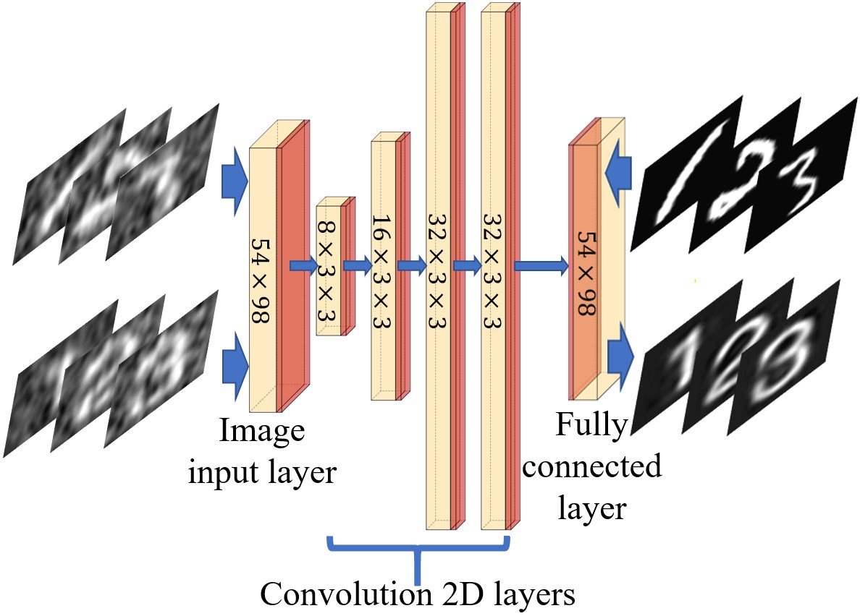
The tool in Deep Learning we apply: Deep Neutral Network (DNN)
Fig: Schematic of DNN. Our DNN consists of four convolution layers, one image input layer, one fully connected layer (in yellow), ReLU and BNL (in red). Patterns in the upper line are CGI results (training inputs) and handwriting ground truths (training outputs) respectively; Patterns in the bottom line are CGI results from the experiment (test inputs) and CGIDL results (test outputs) with printed body.

Slide 24
Better performance proved by Google-Net
Detailed information for Deep Learning:
[4]. C. Szegedy, W. Liu, Y. Jia, P. Sermanet, S. Reed, D. Anguelov, D. Erhan, V. Vanhoucke, and A. Rabinovich, “Going deeper with convolutions,” in Proceedings of the IEEE conference on computer vision and pattern recognition, (2015), pp. 1–9
1 input layer;
4 convolution layers (with small $3×3$ receptive fields);
1 fully connected layer;
Between each convolution layers:
Rectified Linear Unit (ReLU) Layer
(threshold operation to each element of inputs)
Batch Normalization Layer (BNL)
(avoid internal covariate shift & speed up)
[5]. V. Nair and G. E. Hinton, “Rectified linear units improve restricted Boltzmann machines,” in Proceedings of the 27th International Conference on International Conference on Machine Learning, (Omnipress, Madison, WI, USA, 2010), ICML’10, pp. 807–8
[6]. S. Ioffe and C. Szegedy, “Batch normalization: Accelerating deep network training by reducing internal covariate shift,” arXiv preprintarXiv:1502.03167 (2015)

Slide 25
Detailed information for Deep Learning:
Solver:
Stochastic Gradient Descent with Momentum Optimizer (SGDMO)
(reduce the oscillation via using momentum)
$$θ_{l+1}=θ_{l}−α∇E\left(θ_{l}\right)+γ(θ_{l}−θ_{l−1})$$
$θ$: image matrix/vector
$l$: iteration number in training
$α$: learning rate
$E\left(θ_{l}\right)$: loss function
$γ(θ_{l}−θ_{l−1})$: SGDMO (analog to the momentum, where $γ$ determines the contribution of the previous gradient step to the current iteration)
[7]. K. P. Murphy, Machine learning: a probabilistic perspective (MIT press, 2012)

Slide 26
Detailed information for Deep Learning:
Avoid Over-fitting:
1. Dropout Layer at the end of DNN
(reduce the connect between the convolution layers and fully connected layers)
2. Learning rate drop from 0.001 to 0.0001 after 75 epochs
(constrain the fitting parameters)
[8]. N. Srivastava, G. Hinton, A. Krizhevsky, I. Sutskever, and R. Salakhutdinov, “Dropout: A simple way to prevent neural networks from overfitting,” J. Mach. Learn. Res.15, 1929–1958 (2014)

Slide 27
Detailed information for Deep Learning:
Training Process:
----10000 handwriting digits from MNIST handwriting digit database;
----600 maximum epochs & 46800 training iteration;
----MATLAB R2019a Update 5 (9.6.0.1174912, 64-bit);
----MATLAB Deep Learning Toolbox;
----GPU-chip: NVIDIA GTX1050 (speed acceleration)
----Machines in National Engineering Laboratory for Big Data Analytics, Xi’an Jiaotong University.

Slide 28
Detailed information for Deep Learning:
Flow Chart:

Slide 29
IV. Where do we improve the imaging system
Results Evaluators:
----Mean Square Error: $MSE=\frac{1}{N_{pixel}}\sum_{i=1}^{N_{pixel}}{[\frac{G_{i}−X_{i}}{<G_{\left(0\right)}>}]}$
$$X_{i}=\left\{\begin{aligned}<G_{\left(0\right)}>, transmission=1; \\ <G_{\left(b\right)}>,transmission=0.\end{aligned}\right.$$
G(o) represents pixels in the correlation results that the light ought to be transmitted, i.e., the object area, while G(b) represents pixels in the correlation results that the light ought to be blocked, i.e., the background area.
----Sampling Rate: $β=N_{pattern}/N_{pixel}$

Slide 30
IV. Where do we improve the imaging system
Results:
----sub-Nyquist in the simulation without background noise;
----sub-Nyquist in the experiment with weak background noise (14.90dB);
----sub-Nyquist in the experiment with strong background noise (4.77dB).
*signal-to-noise ratio (SNR): $SNR=10×\log\left[\frac{P_{signal}}{P_{background}}\right]dB$

Slide 31
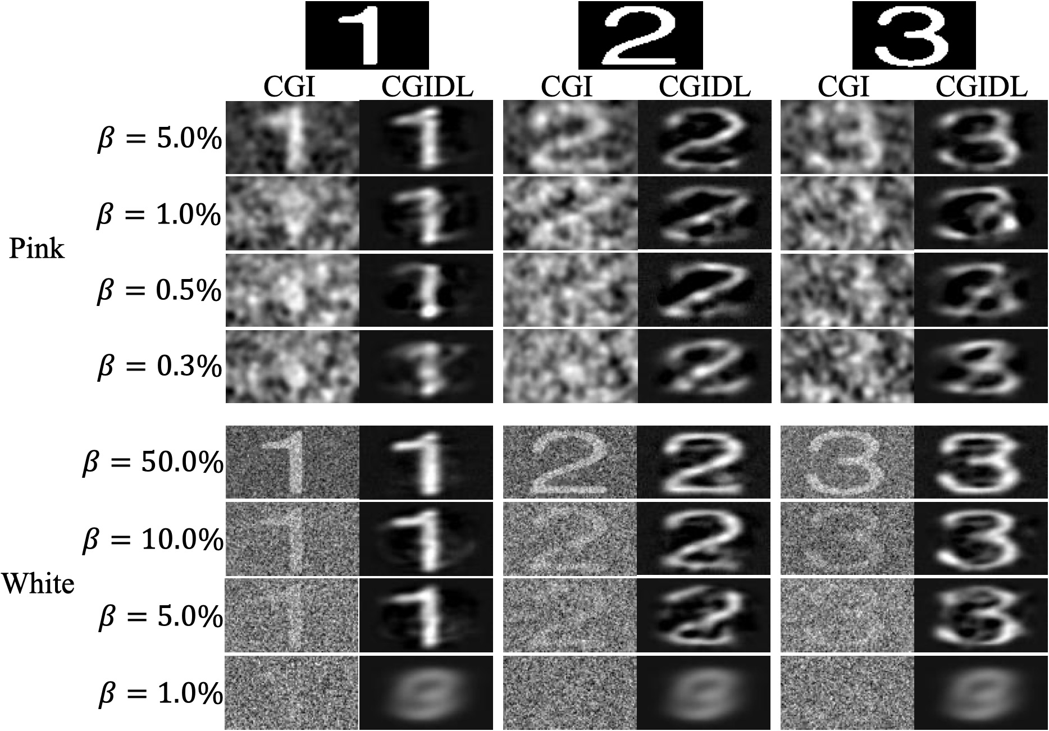
Sub-Nyquist: (0.3% in simulation)

Slide 32
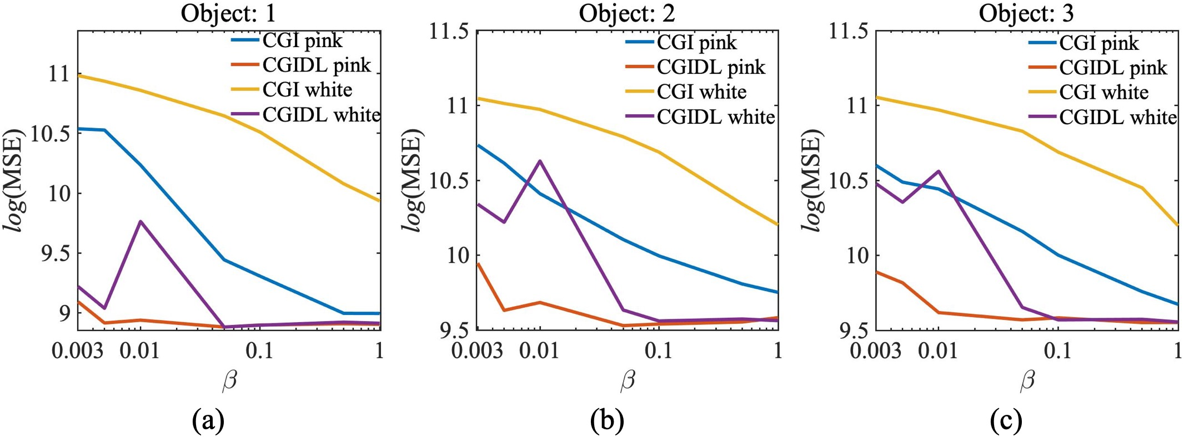
Sub-Nyquist: (0.3% in simulation)

Slide 33
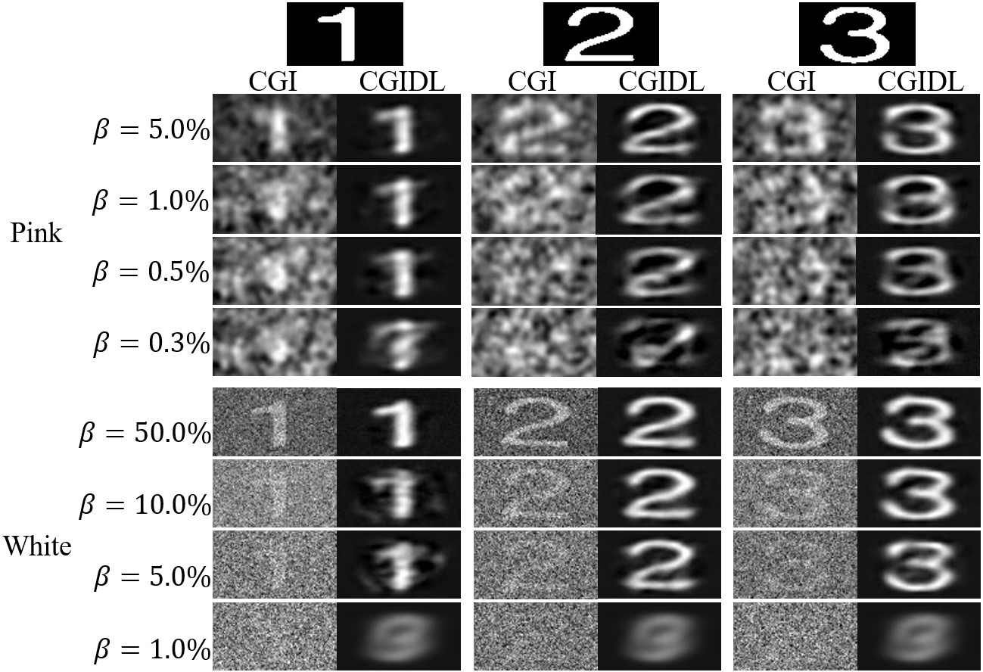
Sub-Nyquist: (0.5% in the experiment with weak background noise)

Slide 34
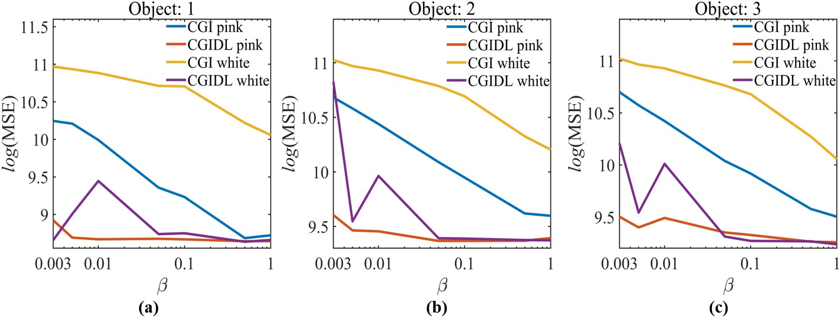
Sub-Nyquist: (0.5% in the experiment with weak background noise)

Slide 35
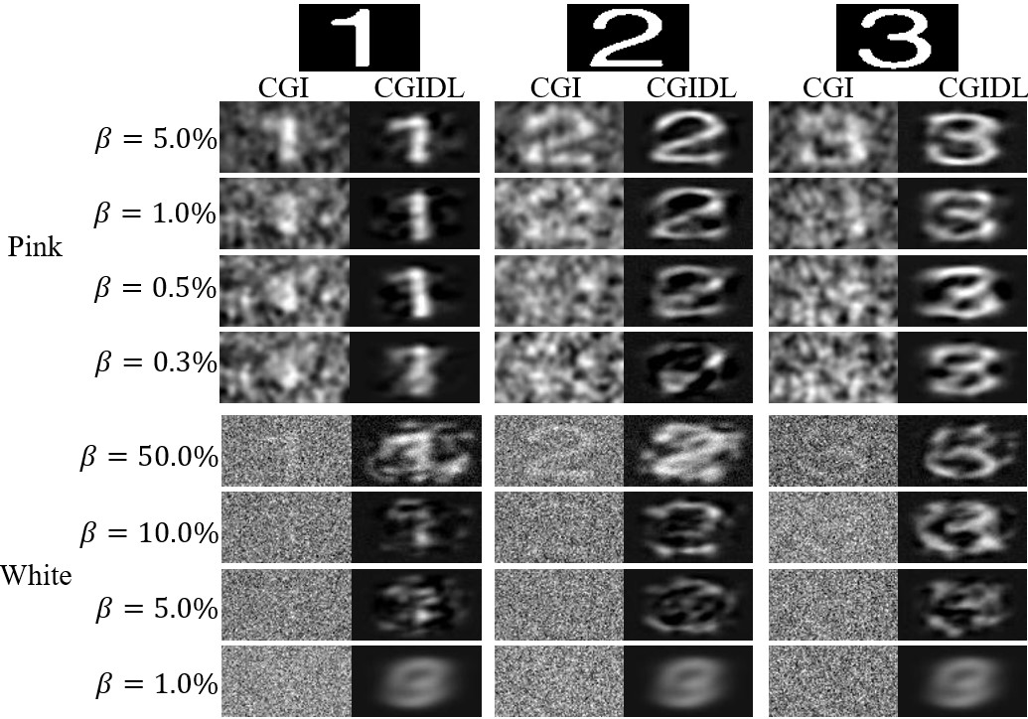
Sub-Nyquist: (0.5% in the experiment with strong background noise)

Slide 36
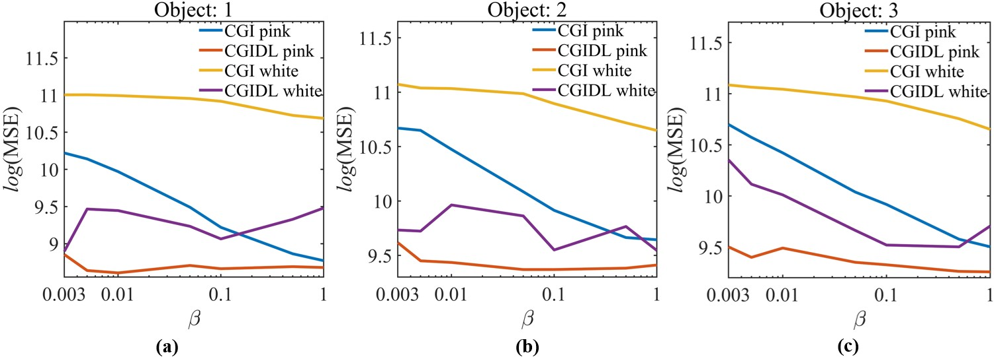
Sub-Nyquist: (0.5% in the experiment with strong background noise)

Slide 37
Comments:
----Conventional CGI with white noise patterns
Under weak background noise: 50% Nyquist
Under strong background noise: >50% Nyquist
----CGI with pink noise patterns
Under weak background noise: 5% Nyquist
Under strong background noise: 5% Nyquist
----Conventional CGIDL with white noise patterns
Under weak background noise: 5% Nyquist
Under strong background noise: >50% Nyquist
----CGI with pink noise patterns
Under weak background noise: 0.5% Nyquist
Under strong background noise: 0.5% Nyquist
Noise-free
Noise-free

Slide 38
In conclusion, our new method of CGIDL with pink noise patterns achieves one-tenth of the traditional CGIDL sampling rate both in simulation and experiments.
Rather than other previous works on CGIDL, our method does not require experimental training.
Besides, our work is robust to noise so one group of trained networks is eligible to be implemented in various situations.
The pink noise patterns, trained DNN with various sampling rates, and their raw encoding programs are encapsulated and uploaded: https://github.com/XJTU-TAMU-CGI/CGIDL

Slide 39
Thank you
FUNDING:
Air Force Office of Scientific Research (Award No. FA9550-20-1- 0366 DEF),
Office of Naval Research (Award No. N00014-20-1- 2184),
Robert A. Welch Foundation (Grant No. A-1261),
National Science Foundation (Grant No. PHY-2013771).

