Slide 1
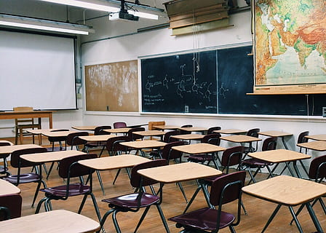

Mrs. Gaines
West Region Graduation Coach

Slide 2
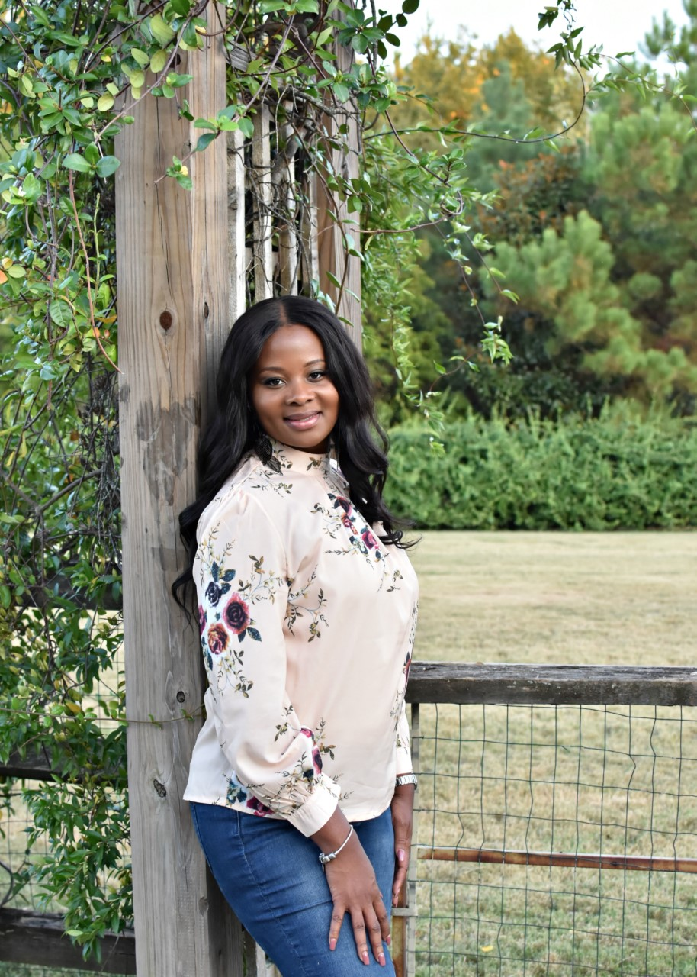
Who is your Graduation Coach?
Experience
A.Graduation Coach, West Region (Arnold, Double Churches, Veterans, Columbus, Jordan, Northside)
B.Guidance Director, W.H.Spencer High School
C. Professional School Counselor, Spencer High School

Slide 3
Essential Functions for Graduation Coaches per MCSD:
➮Collaborates with faculty, administrators, and teaching and learning district resources to adapt curriculum and instruction for the purpose of meeting the needs of identified at risk students.
➮Collaborates with school leaders, counselors, and teachers for the purpose of developing systemic strategies to identify and support students.
➮Communicates regularly with parents of students identified as being at risk of not graduating for the purpose of increasing their chance of graduating.
➮Coordinates transitions and monitors schedules for high school freshmen for the purpose of helping them successfully adapt to the rigor of high school.
➮Daily attendance and punctuality are required for the purpose of ensuring the goals of the work unit can be met.

Slide 4
Essential Functions for Graduation Coaches per MCSD con’t:
•Develops and implements individual intervention strategies and graduation plans for the purpose of increasing the likelihood that students will stay in school and graduate.
•Provides and submits reports as scheduled and requested for the purpose of providing information and monitoring results.
•Provides training to middle school and high school teachers on support measures that work with identified youth for the purpose of providing additional support.
•Tracks the progress of students for the purpose of monitoring their progress toward graduation.
•Utilizes early warning indicators for the purpose of identifying middle and high school students who are most at risk of not graduating.

Slide 5
Contact information
Curry-Gaines.Shantis.M@muscogee.k12.ga.us or you can follow my Google Classroom and request a
Google Meet https://meet.google.com/lookup/hv7ve3i62c?authuser=0&hs=179
Classroom Code: https://classroom.google.com/c/MTUxNzUyMzY5MzAz?cjc=is4xdm7

