Slide 1
Meet the new Central Region Graduation Coach

Slide 2
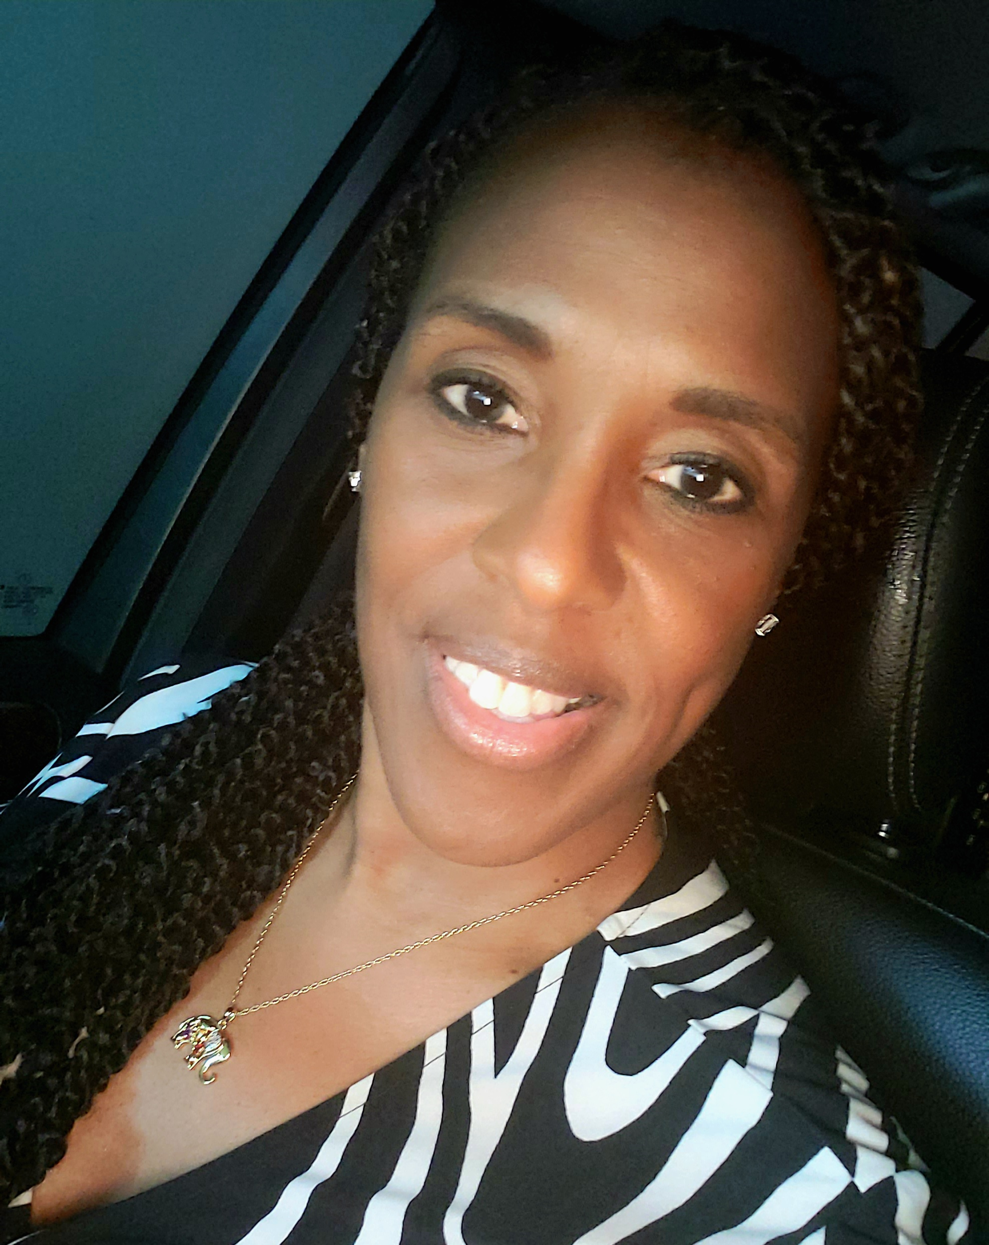
Who is the new Graduation coach?
Experience
Guidance Director, G.W. Carver High School
Graduation Coach, G. W. Carver High School
Professional School Counselor, Spencer High School
Professional School Counselor, Rothschild Middle School
Peer Helper Sponsor
Students Against Destructive Decisions (S.A.D.D. )Sponsor
Scholarship Coordinator
ACT Lead Test Coordinator - MCSD
Mrs. Walker-Banks, Ed.S, NCSC, NCC, YMHFA

Slide 3
Essential Functions for Graduation Coaches per MCSD:
Collaborates with faculty, administrators, and teaching and learning district resources to adapt curriculum and instruction for the purpose of meeting the needs of identified at risk students.
Collaborates with school leaders, counselors, and teachers for the purpose of developing systemic strategies to identify and support students.
Communicates regularly with parents of students identified as being at risk of not graduating for the purpose of increasing their chance of graduating.
Coordinates transitions and monitors schedules for high school freshmen for the purpose of helping them successfully adapt to the rigor of high school.
Daily attendance and punctuality are required for the purpose of ensuring the goals of the work unit can be met.

Slide 4
Essential Functions for Graduation Coaches per MCSD con’t:
Develops and implements individual intervention strategies and graduation plans for the purpose of increasing the likelihood that students will stay in school and graduate.
Provides and submits reports as scheduled and requested for the purpose of providing information and monitoring results.
Provides training to middle school and high school teachers on support measures that work with identified youth for the purpose of providing additional support.
Tracks the progress of students for the purpose of monitoring their progress toward graduation.
Utilizes early warning indicators for the purpose of identifying middle and high school students who are most at risk of not graduating.

Slide 5
Contact information
Email: Walker-Banks.Selena@muscogee.k12.ga.us or join Remind class, “Destined for Greatness”, Class code: @cgradcoach

