Slide 1

Planches acrosport
Lycée Renaudeau - Cholet

Slide 2
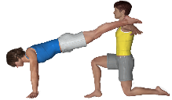
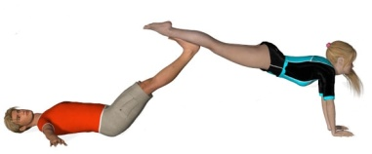
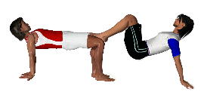
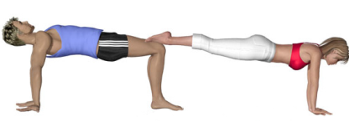

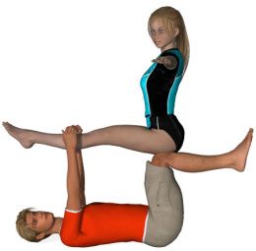
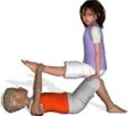
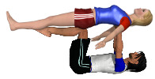
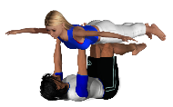
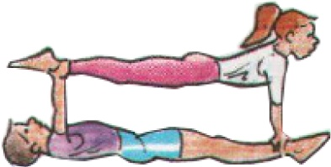

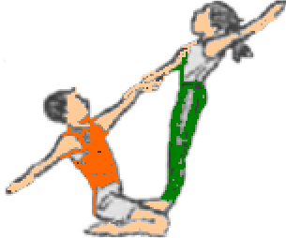
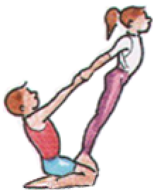
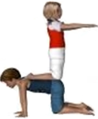
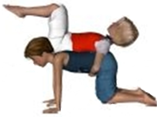
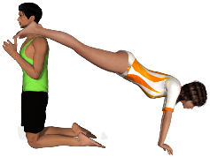
DUOS A- page 1
D 1
D 2
D 3
D 4 (unss A)
D 5
D 6
D 7
D 8
D 9
D 10
D 11
D 12
D 13
D 14
D 15
D 16 (unss A)
D 17

Slide 3
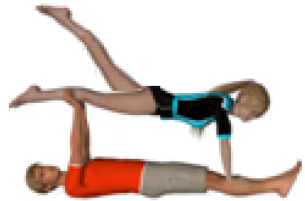
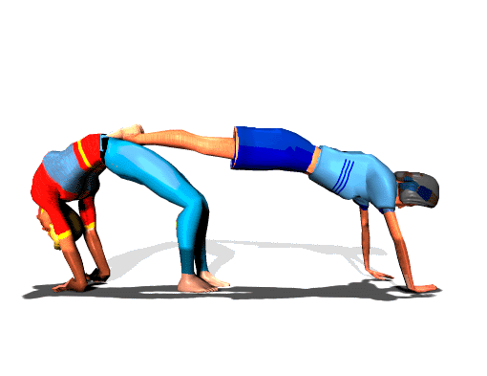
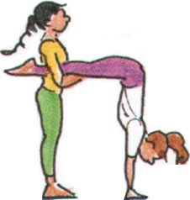
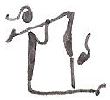
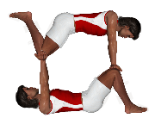
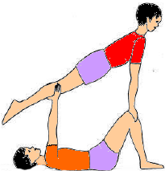
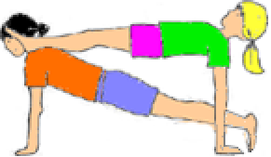
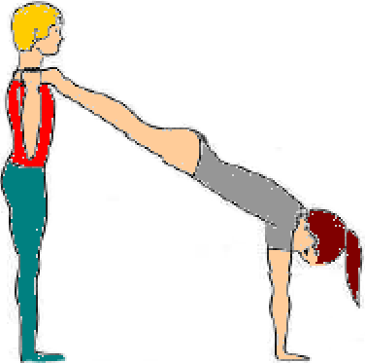
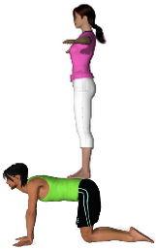
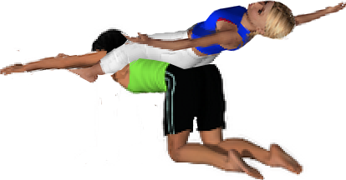
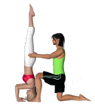
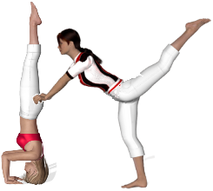
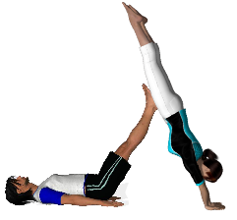
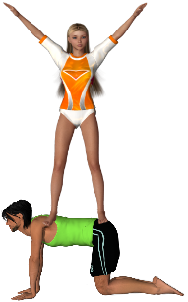
DUOS A- page 2
D 18
D 19
D 21 (unss A)
D 20
D 22
D 23 (unss A)
D 24 (unss A)
D 25
D 26
D 27
D 27
D 28
D 29
D 29 (unss A)
D 30
D 31

Slide 4
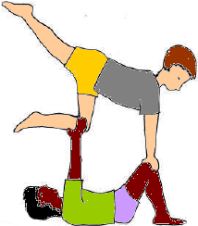

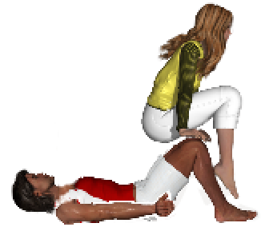
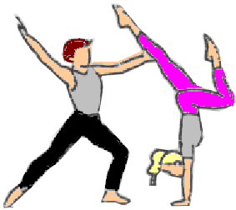
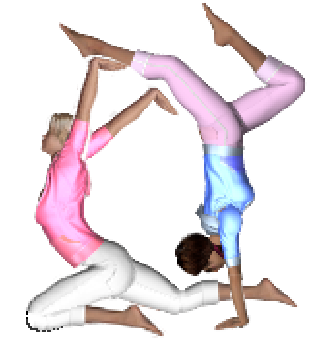
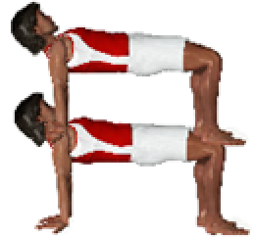
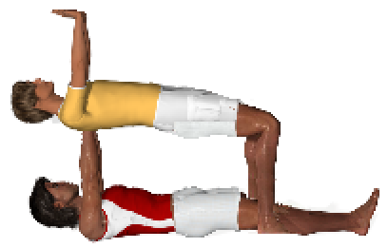
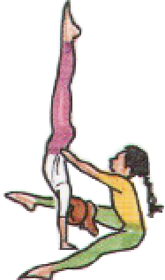
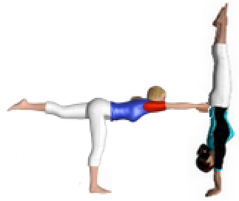
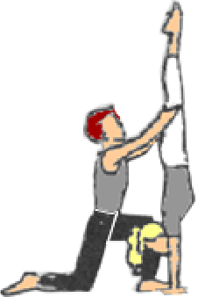
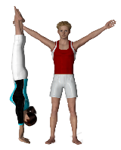
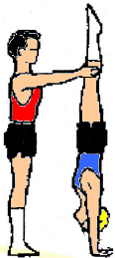
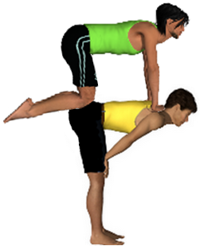
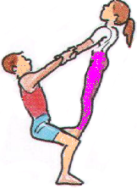

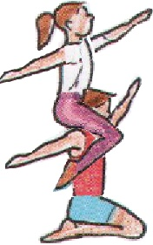
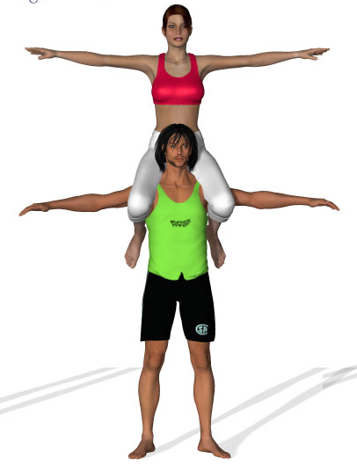

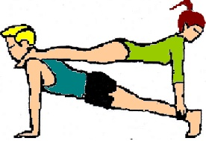
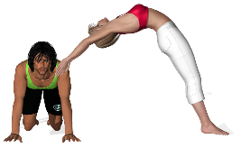
DUOS B- page 1
D 33
D 34 (unss A)
D 32
D 35
D 36
D 37
D 38
D 39
D 40
D 41
D 42
D 43
D 44
D 45
D 46
D 47
D 49
D 50 (unss A)
D 48

Slide 5
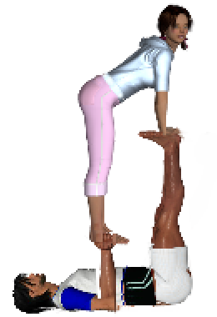
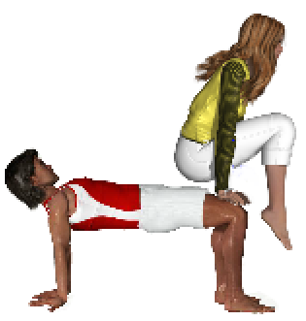
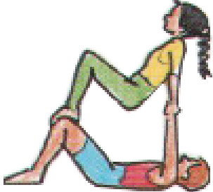
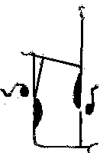
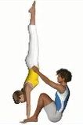










DUOS B - page 2
D 51
D 52 (unss B)
D 54 (unss B)
D 55 (unss B)
D 53
D 56 (unss B)
D 57
D 58 (unss B)
D 59 (unss B)
D 60 (unss B)
D 61 (unss B)
D 62
D 63 (unss B)
D 64 (unss B)
D 65 (unss B)

Slide 6












DUOS C
D 66
D 67
D 68 (unss C)
D 69
D 70
D 71
D 72
D 73
D 74 (unss B)
D 75 (unss B)
D 76 (unss B)

Slide 7














DUOS D – Page 1
D 77 (unss C)
D 78
D 79 (unss B)
D 80 (unss C)
D 81 (unss C)
D 82 (unss C)
D 83 (unss C)
D 84
D 85
D 86 (unss B)
D 87
D 88 (unss C)
D 89 (unss C)
D 90 (unss C)

Slide 8








DUOS D – page 2
D 91 (unss D)
D 92
D 93 (unss D)
D 94 (unss D)
D 95 (unss D)
D 96 (unss D)
D 97 (unss D)
D 98 (unss D)
D 99

Slide 9

















TRIOS A – page 1
T 3
T 1
T 2 (unss A)
T 7
T 4
T -5
T 6 (unss A)
T 2-10
T 8
T 9
T 10
T 11
T 12
T 13
T 14
T 15

Slide 10














TRIOS A – page 2
T 16
T 17
T 18
T 19
T 20
T 21
T 22 (unss A)
T 23
T 24
T 25
T 26
T 27
T 28
T 29

Slide 11














TRIOS B
T 30 (unss A)
T 31
T 32
T 33
T 38 (unss A)
T 34
T 35 (unss A)
T 36
T 37 (unss A)
T 39
T 40
T 41
T 42
T 43
T 44

Slide 12












TRIOS C – page 1
T 45
T 46 (unss B)
T 47 (unss B)
T 48
T 49 (unss B)
T 50 (unss B)
T 51
T 52
T 53
T 54
T 55 (unss B)
T 56

Slide 13














TRIOS C – page 2
T 57
T 58 (unss B)
T 59 (unss B)
T 60 (unss B)
T 61 (unss B)
T 62
T 63
T 6-8
T 64
T 66 (unss B)
T 68
T 70 (unss B)
T 67 (unss B)
T 69
T 65

Slide 14














TRIOS D
T 71 (unss C)
T 72 (unss C)
T 73
T 74
T 75 (unss C)
T 76 (unss C)
T 77 (unss C)
T 78 (unss B)
T 79 (unss C)
T 80 (unss C)
T 81 (unss C)
T 82 (unss C)
T 83 (unss C)
T 84 (unss C)

Slide 15











QUATUORS A
Q 1
Q 2
Q 3 (unss A)
Q 4
Q 5 (unss A)
Q 6
Q 7
Q 8
Q 9
Q 10
Q 11

Slide 16













QUATUORS B
Q 13
Q 1 4
Q 15
Q 12
Q 16
Q 17
Q 18
Q 19
Q 20
Q 21
Q 22
Q 23
Q 24

Slide 17










QUATUORS C
Q 25 (unss A)
Q 26 (unss B)
Q 4-3
Q 27
Q 28
Q 29
Q 30
Q 31
Q 32
Q 33
Q 34

Slide 18










QUATUORS D
Q 35
Q 36
Q 37
Q 41
Q 38
Q 39
Q 40
Q 42
Q 43
Q 44

