Slide 1
UV-visible molecular absorption spectroscopy
Chemistry 243

Slide 2
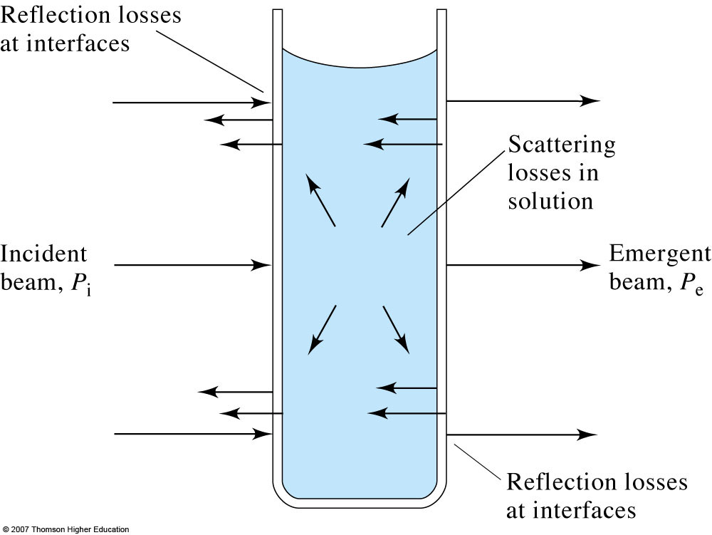
Transmission and absorbance and losses
The reduction in the intensity of light transmitted through a sample can be used to quantitate the amount of an unknown material.

Slide 3
Beer’s Law
Quantitative relationship between absorbance and concentration of analyte
  See derivation in text (Skoog: pages 337-338)
Absorption is additive for mixtures
Really: A_{λ} = ε_{λ}bc
Beer’s Law is always wavelength-specific

Slide 4
Limitations and deviations from Beer’s Law
Real limitations
  Non-linearities due to intermolecular interactions
    Self aggregation effects and electrolyte effects
Apparent
  Dynamic dissociation or association of analyte
Instrumental
  Polychromatic radiation
    Different molar absorptivities at different wavelength leads to non-linearities in Beer’s Law
  Stray radiation
  Mistmatched cells
    Non-zero intercept in calibration curve
How might one avoid?

Slide 5
How to make a UV-vis absorption measurement
Make a 0%T (dark current) measurement
Make a 100%T (blank) measurement
Measure %T of sample
Determine %T ratio and thus the absorbance value

Slide 6
Instrumental noise
Precision of measurement is limited by instrumental noise sources

Slide 7
Use proper slit widths
Resolution improves with narrower slit width, but power decreases as square of slit width.
  10-fold narrower slit gives 100x less radiant power
General rule: Use the widest slit that gives required resolution.

Slide 8
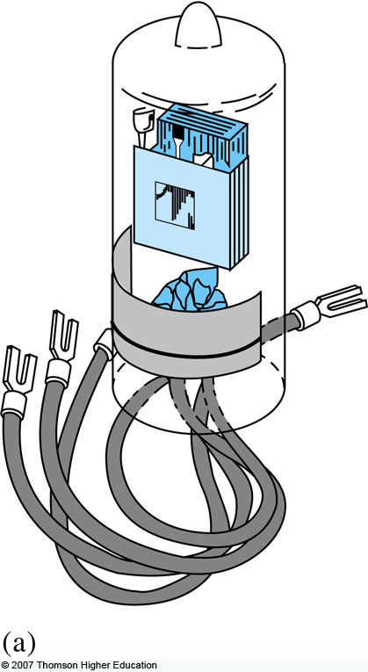
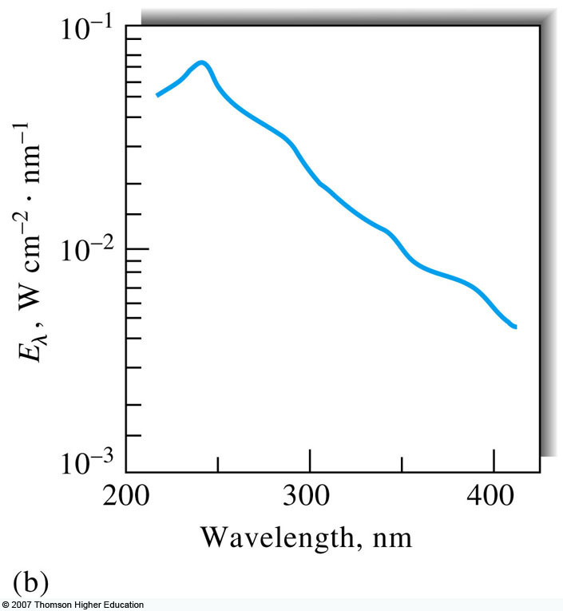
Light sources for UV-vis
Deuterium lamp
  Most common UV source
  Arc between oxide-coated filament and metal electrode
  Low voltage and low pressure of D₂
  Aperture gives 1-1.5 mm spot
  Continuum from 190-400 nm, emission lines >400nm

Slide 9
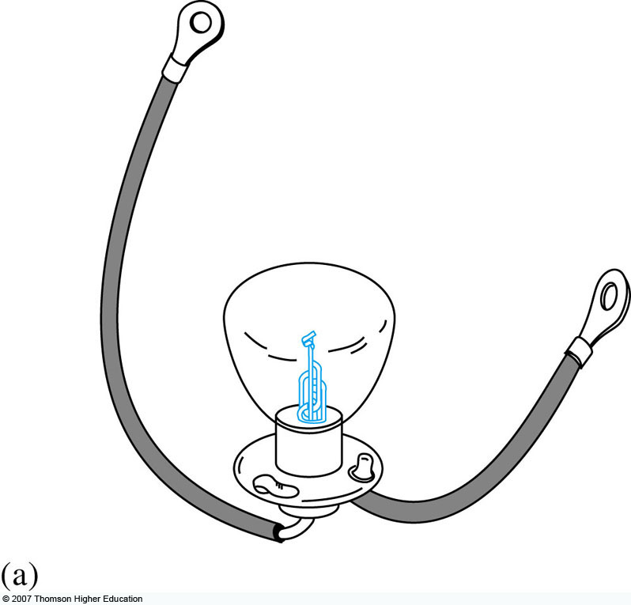
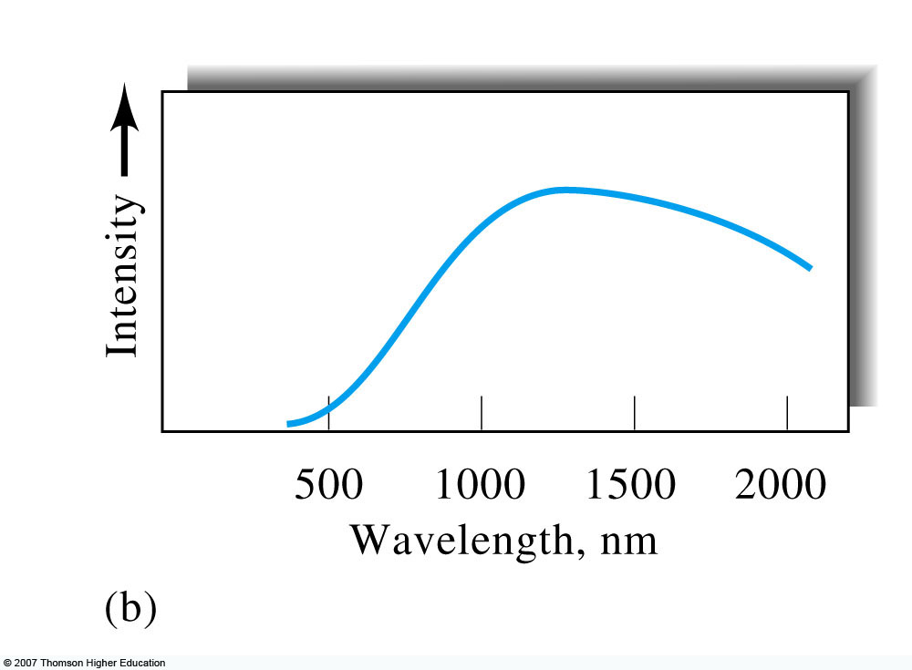
Light sources for UV-vis, continued
Tungsten filament
  Most common visible and NIR source
  Blackbody radiator useful from 350-2500 nm
  Power varies as (operating voltage)⁴; need stable power supply!
  Tungsten-halogen sources can operate at higher temperatures and give off more UV light.

Slide 10
Light sources for UV-vis, continued²
LEDs
  375-1000 nm
  Semi-monochromatic (20-50 nm FWHM)
  “White” LEDs use phosphor to give 400-800 nm continuum
    Keychain flashlights
Xenon arc lamps
  Very intense source
  Continuum from 200-1000 nm, peaking at 500 nm

Slide 11
Instrument configurations
Single-beam
Double-beam
Multichannel

Slide 12
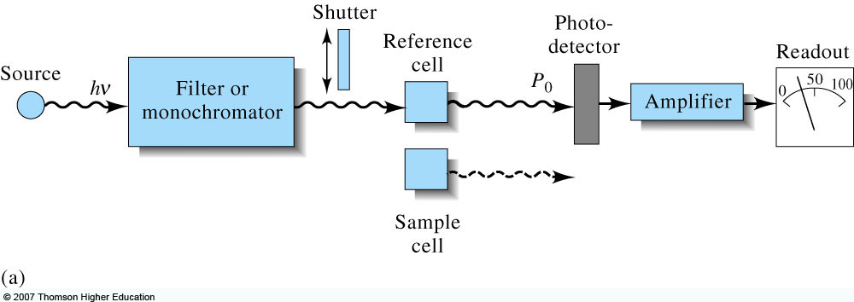
Single-beam UV-vis spectrometers
Skoog, Fig. 13-13
Good light throughput, but
what if the source
power fluctuates?

Slide 13
Double-beam in time UV vis spectrometers
Beam is split in two, but measured by same detector
“in time” because
the beam appears in 2 places over one cycle in time
- Sample
- Reference
Sample
Reference
What if the source
power fluctuates?
Skoog, Fig. 13-13

Slide 14
Double-beam in space UV-vis spectrometers
Beam is split into two paths and measured by matched detectors
  Difficult to find perfectly matched detectors
“in space” because
two beams are always
present in space
Continuous
Reference
What if the source
power fluctuates?
Continuous
Sample

Slide 15
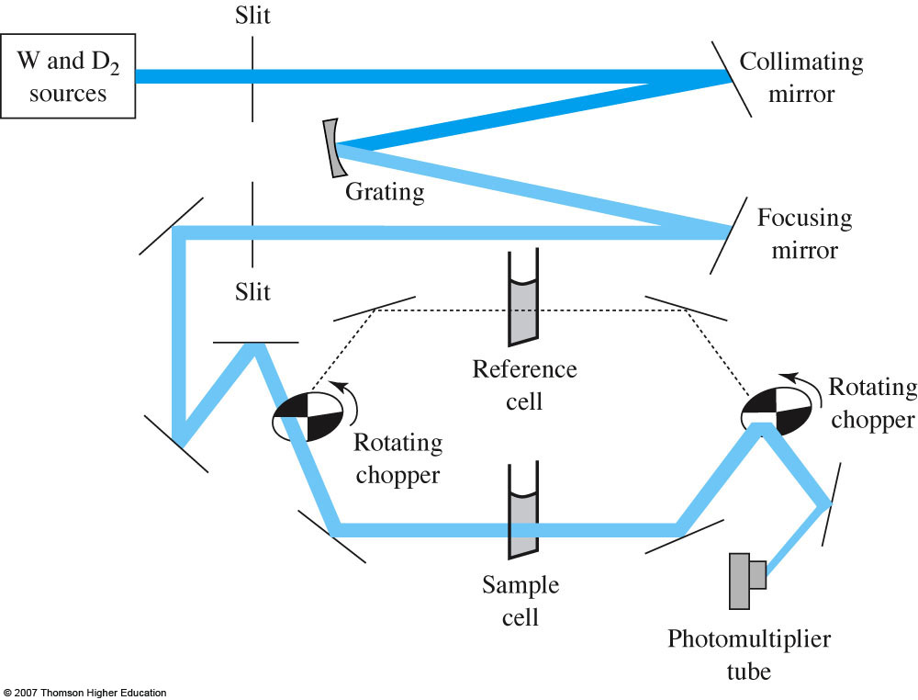
Cary 100 double beam spectrometer
- Sample
- Dark
- Reference
- Dark

Slide 16
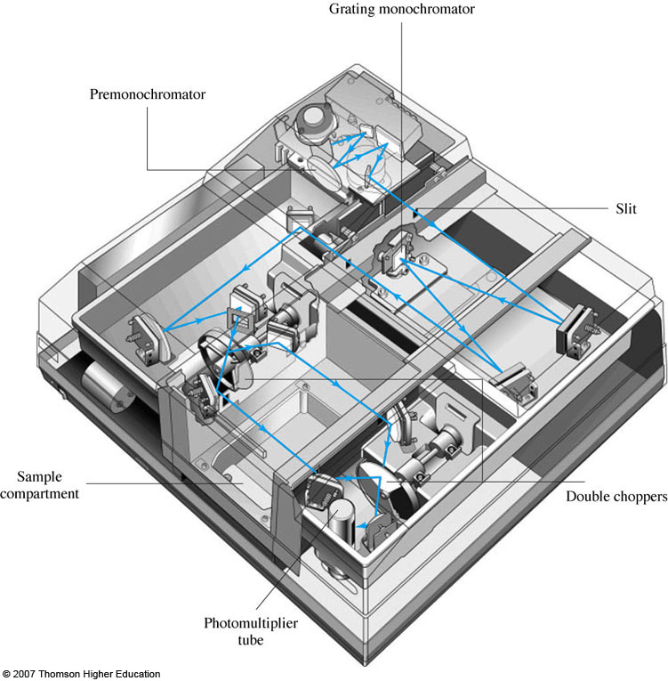
Cary 300 double-dispersing spectrophotometer
Why does double dispersion help with extending absorption to ~5.0 absorbance units?
Two gratings
Reduced stray light
  0.00008% or less
Improved spectral resolution
  Bandwidth < 4 nm
If Abs = 5.0, %T = ?

Slide 17
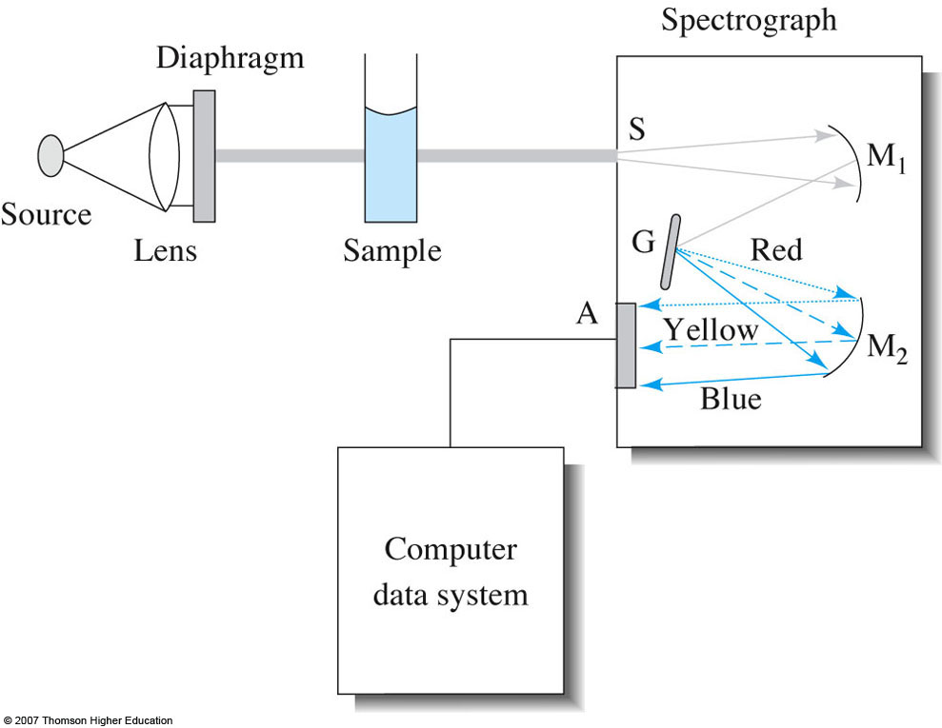
Multichannel UV-vis spectrometers
Dispersing optic (grating or prism) used to separate different wavelengths in space.
Detection with diode array or CCD
Fast acquisition of entire spectrum

Slide 18
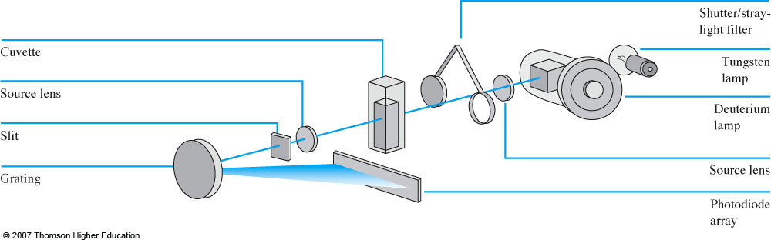
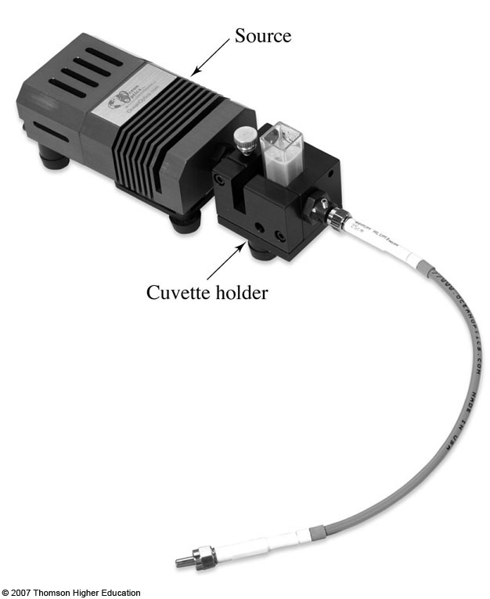
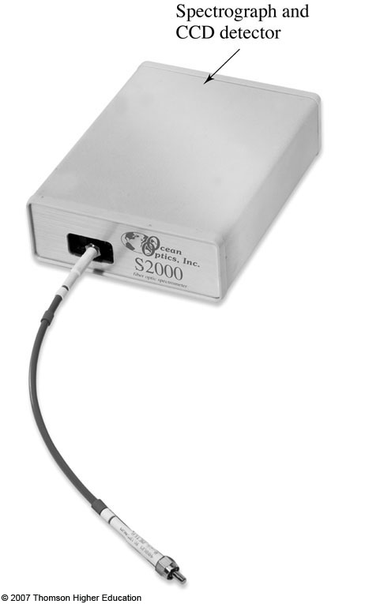
Diode array spectrophotometers
Fairly inexpensive, but good quality fiber optic models available for ~$3000.
Ocean Optics
StellarNet

Slide 19
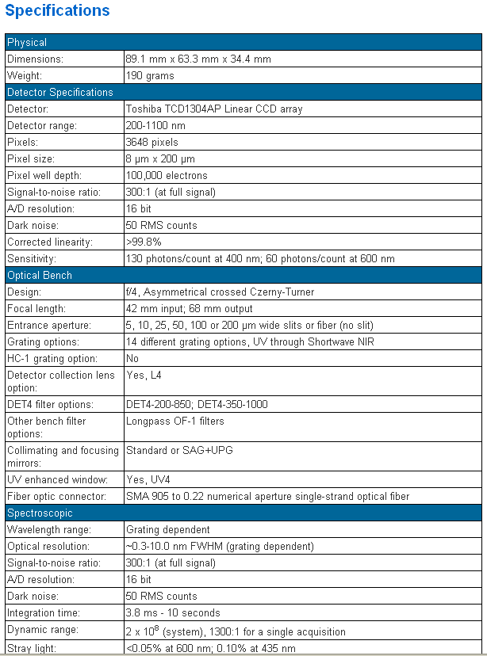
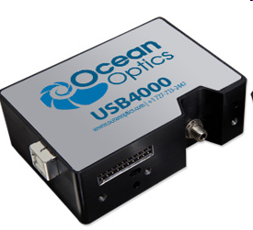
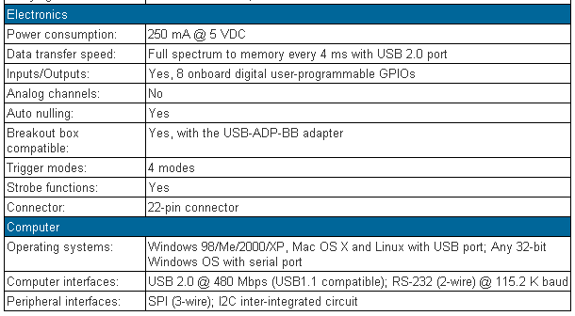
Diode array spectrophotometers
http://www.oceanoptics.com/products/usb4000.asp
89 mm
3.5 inches
250 specta per sec

Slide 20
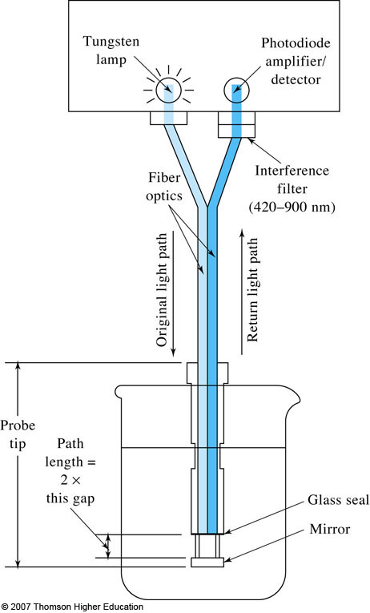
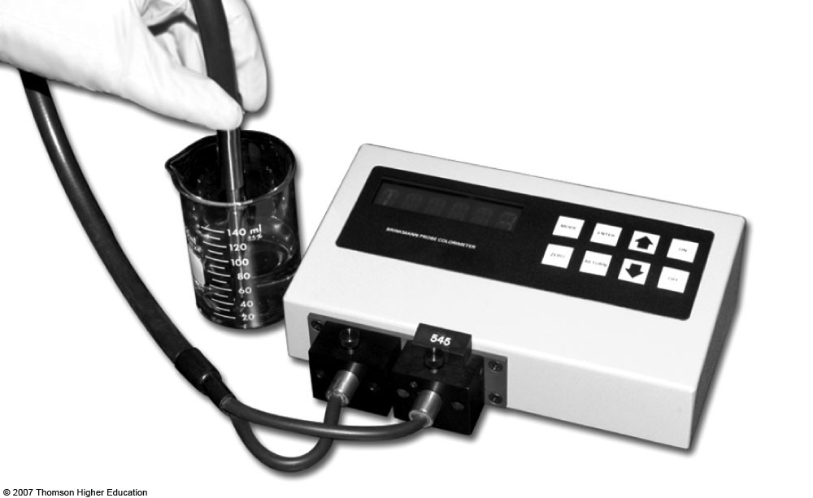
Reflective dip probes

Slide 21
What is UV-visible absorption measuring?
The absorption of a photon generates an electronic excited state
UV-vis energy often matches up with transitions of bonding electrons
  Often relatively short lifetimes (1-10 nsec)
Relaxation can occur non-radiatively
or by emission of radiation (fluorescence or phosphorescence)

Slide 22
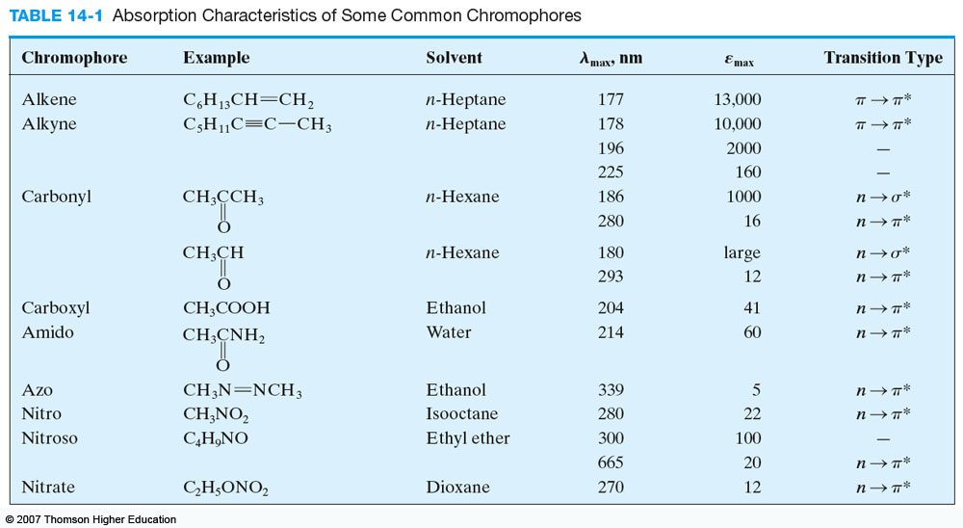
Absorption signatures of various organic functional groups
Commonly observed transitions are n→π* or π→π*
  Chromophores have unsaturated functional groups
  Rotational and vibrational transitions add detail to spectra
  Single bond excitation energies (n→σ*) are in vacuum UV (λ < 185 nm) and have very low molar absorptivities
ε normalized
with respect to
path length and
concentration

Slide 23
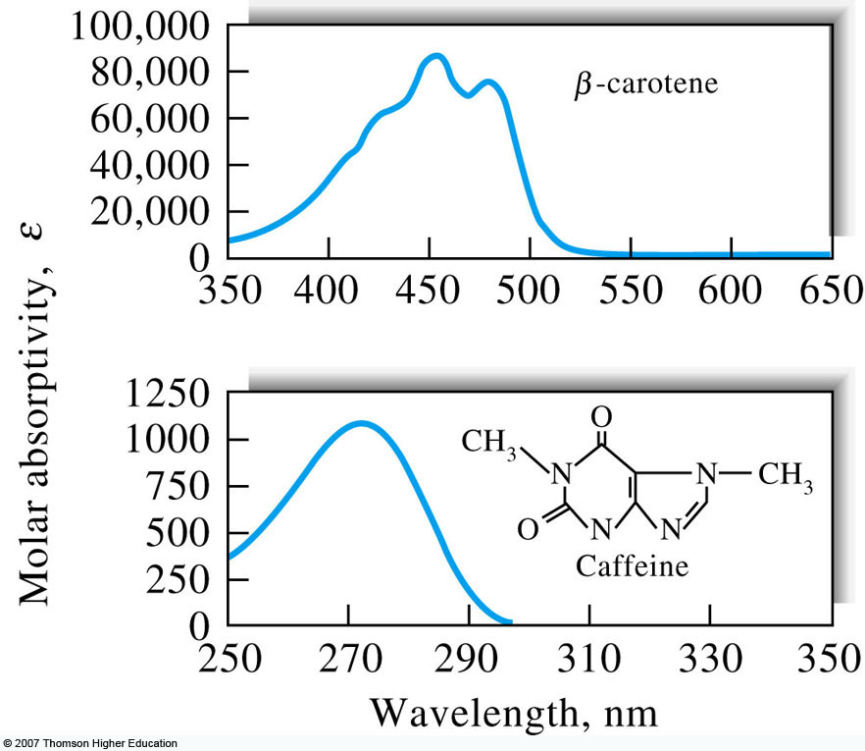
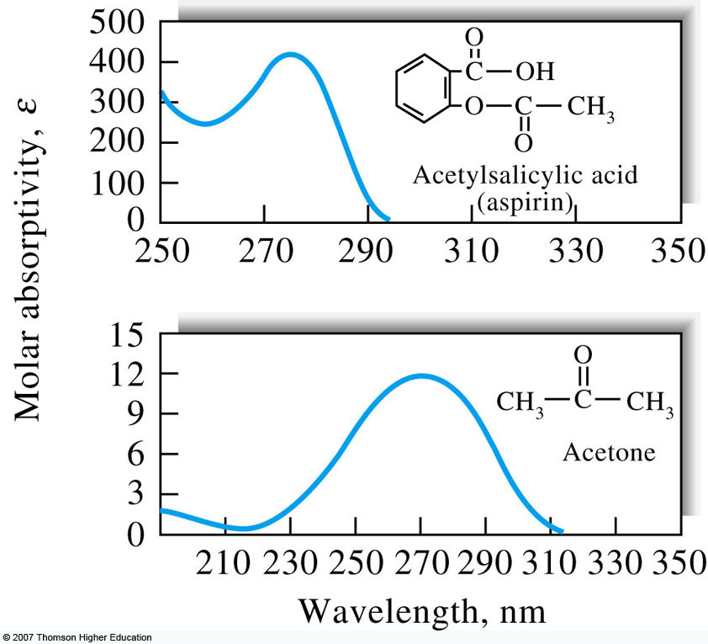
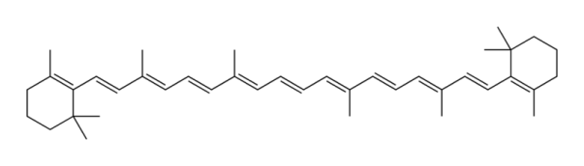
Absorption signatures of various organic functional groups, continued
Conjugation causes shift to longer wavelength
π→π* transitions more 10-100x or more intense than n→π*
Nonbonding electrons of heteroatoms in saturated compounds can give UV absorbance signature.
Note distinct λ_{max} values

Slide 24
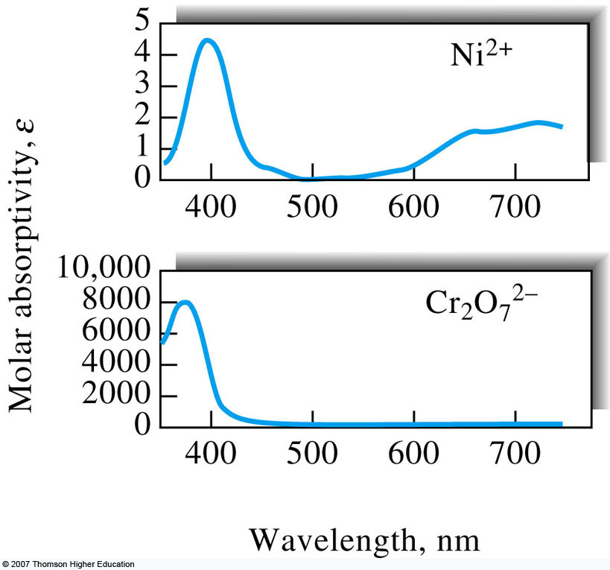
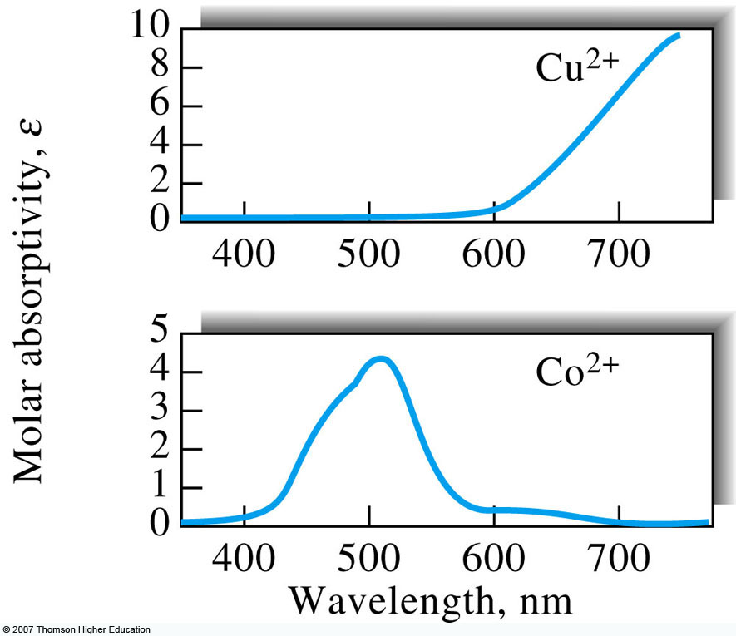
Spectra of inorganic (metal and non-metal) ions and ionic complexes
Inorganic anions have broad UV absorption bands from non-bonding electrons.
Transition metal ions and complexes absorb visible light upon excitation between filled and unfilled d-orbitals.
  Dependent upon oxidation state and coordination environment.

Slide 25
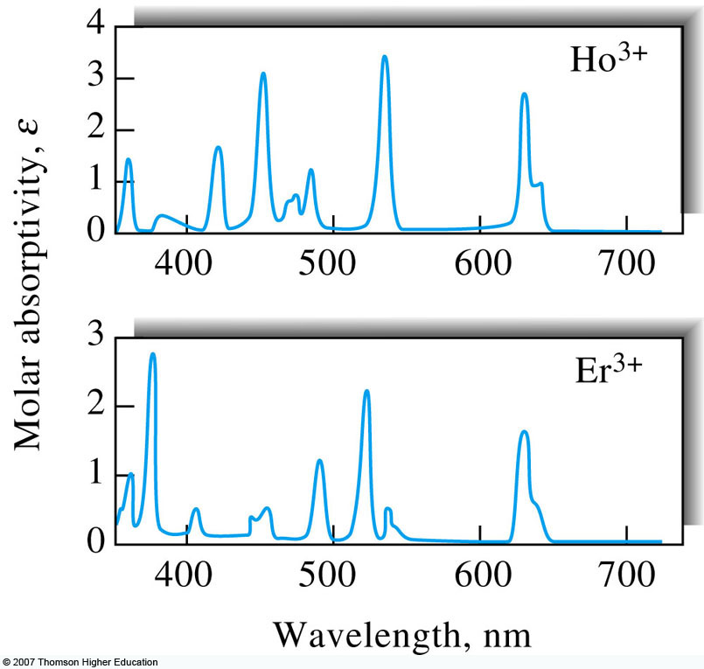
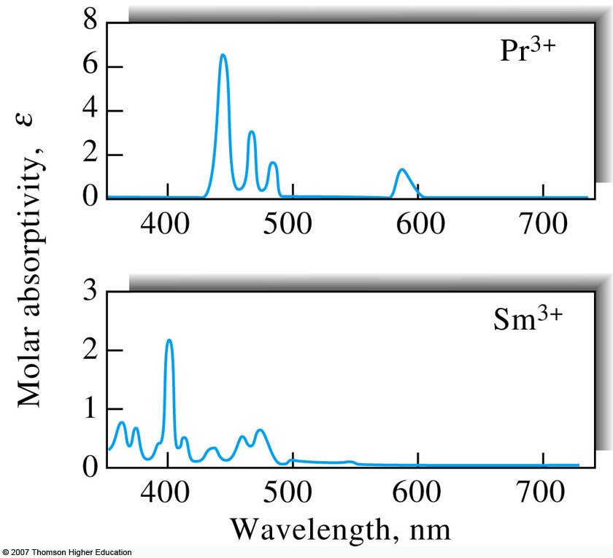
Spectra of lanthanide and actinide ions
Lanthanide and actinide ions absorptions come from excitation of 4f and 5f electrons.
  f electrons are shielded from s, p, and d orbitals and have narrow absorption bands

Slide 26
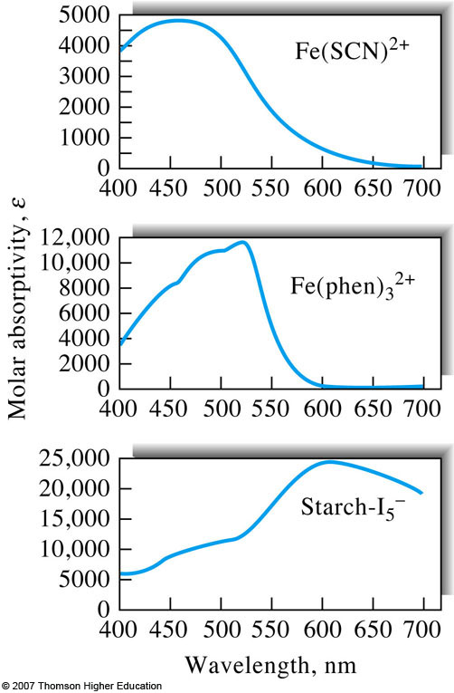
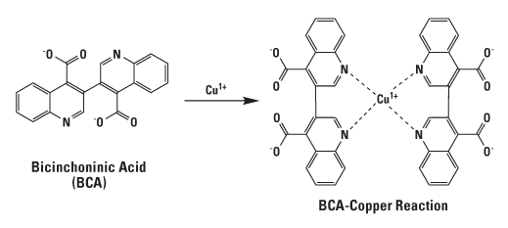
Charge-transfer complexes
Electron donor absorbs light and transfers to acceptor.
  Internal red-ox process
Typically very large molar absorptivities (ε>10,000)
  Metal-to-ligand charge transfers (MLCT)
  Ligand-to-metal charge transfer (LMCT)
http://www.piercenet.com/browse.cfm?fldID=876562B0-5056-8A76-4E0C-B764EAB3A339

Slide 27
Environmental effects
The environment that the analyte is in can have profound effect on the observed spectrum
  In the gas phase, rotational and vibrational fine structure can be observed given adequate spectral bandwidth.
  In solid form or in solution, molecules cannot rotate as freely and differences in rotational energy level are not observable.
  Solvent molecules can also lead to a loss of vibrational detail in the absorbance spectrum.
The visible absorption spectrum of sym-tetrazine: I, at room temperature in the vapour; II, at 77º K in a 5 : 1 isopentane-methylcyclohexane glass, III, in cyclohexane; and IV, in aqueous solution at room temperature.
J. Chem. Soc., 1959, 1263-1268.

Slide 28
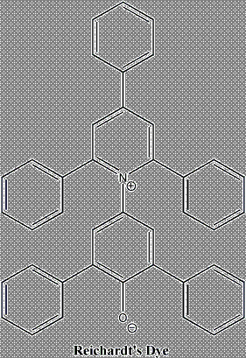
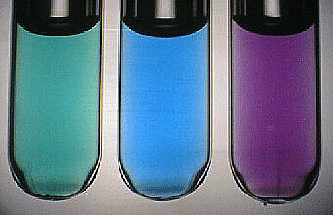
Solvatochromism
The polarity of solvents can preferentially stabilize the ground or excited state leading to different energy level gaps and thus a solvent-dependent absorption spectrum.
acetone
isopropanol
ethanol
http://scienceblogs.com/moleculeoftheday/2007/02/reichardts_dye_solvatochromic.php
http://www.uni-regensburg.de/Fakultaeten/nat_Fak_IV/Organische_Chemie/Didaktik/Keusch/p28_neg_sol-e.htm

Slide 29
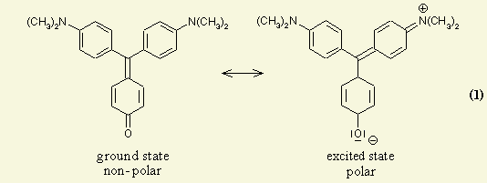
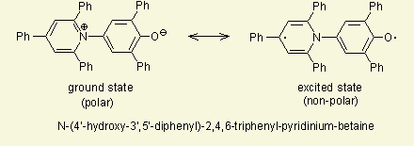
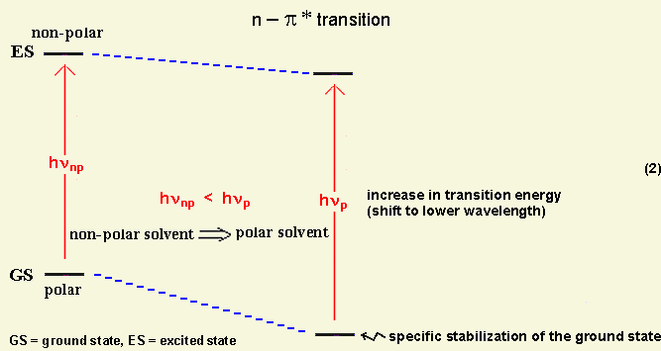
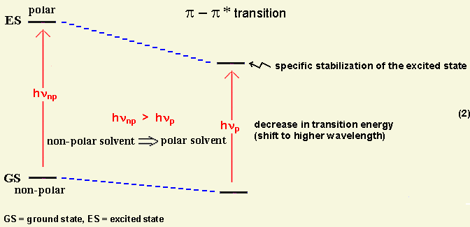
Solvatochromism, continued
Positive solvatochromism (red shift) Bathochromic
Negative solvatochromism (blue shift) Hypsochromic
Resonance structures of 4,4'-bis(dimethylamino)fuchsone
http://www.chemie.uni-regensburg.de/Organische_Chemie/Didaktik/Keusch/D-pos_sol-e.htm
http://www.uni-regensburg.de/Fakultaeten/nat_Fak_IV/Organische_Chemie/Didaktik/Keusch/p28_neg_sol-e.htm

Slide 30
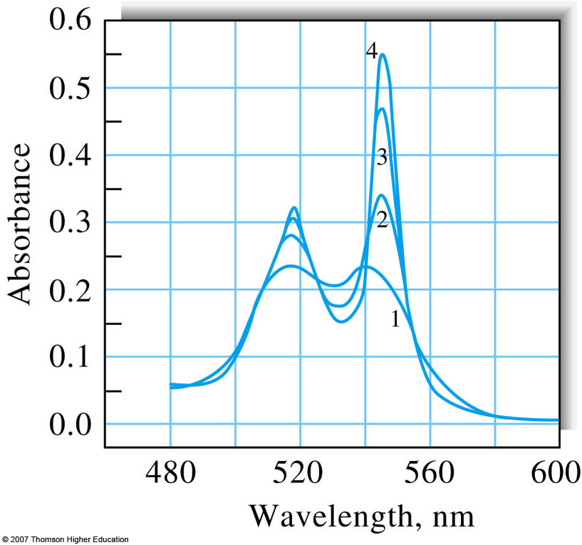
Qualitative versus quantitative analysis via UV-vis absorption
What are the objectives of qualitative versus quantitative UV-visible absorption spectroscopy?
How might the application guide slit width selection?
  Large slit width = good sensitivity but poor resolution
  Small slit width = poor sensitivity but good resolution
Qualitative work needs __??
Quantitative work needs __??
Visible region absorbance spectrum for cytochrome c with spectral bandwidths of (1) 20 nm, (2) 10 nm, (3) 5 nm, and (4) 1 nm.

Slide 31
Attributes of UV-visible absorption for quantitative analysis
Applicable to organic and inorganic species
Good detection limits: 10-100 μM or better
  Possible need for larger slit widths to achieve best sensitivities
Moderate to high selectivity
Accuracy: ±1-3% or better
Ease and convenience ($$$) of data acquisition

Slide 32
Considerations for using UV-vis for quantitative measurements
Directly monitor absorbing analytes; usually non-destructive
Can use reagents that react with colorless analyte to generate measureable species
  Greatly increase molar absorptivity
  Thiocyanate (Fe, Co, Mo), H₂O₂ (Ti, V, Cr), iodide (Bi, Pd, Te)
Monitor at wavelength of max absorption, ε_{max} at λ_{max}
  Greatest change in absorbance per unit concentration
  Absorbance least sensitive to a small change in wavelength
    Relaxes requirement on instrument to stringently achieve the exact same wavelength
UV-visible absorbance sensitive to environment, pH, temperature, high electrolyte concentration, interfering species. Be careful with standards
Use matched cells.

Slide 33
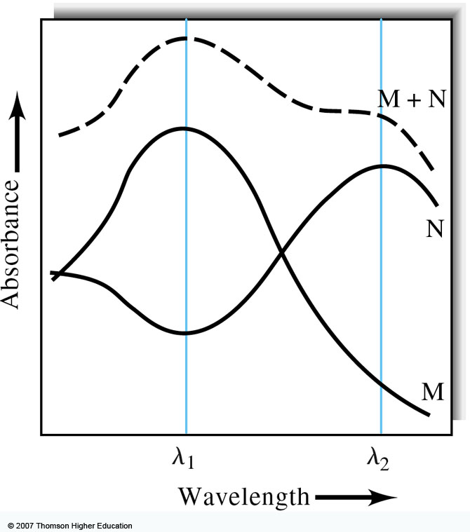
Calibration and mixture analysis
Generate calibration curve (linear) using external standards
  Must use multiple standards
Standards hopefully match sample matrix
Matrix matching is hard—consider using standard addition.
Mixtures are additive
  Need to monitor at as many wavelengths as components to be analyzed.
  Requirement of solving multiple equations with multiple unknowns.

