Slide 1
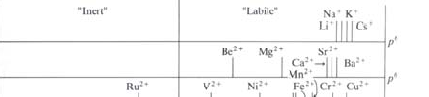




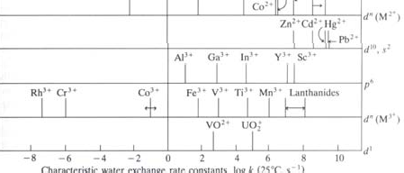


2P32 – Principles of Inorganic Chemistry
Dr. M. Pilkington
Lecture 12 –Octahedral Substitution Reactions
The most extensively studied reactions of coordination compounds
Measuring rates of water exchange in aquo metal ions
Mechanisms of substitution reactions: dissociative vs
associative activation.
Evidence for the dissociative mechanism for octahedral complexes
Factors affecting the rate of octahedral substitution.
Rate constants for water exchange for various ions
Very slow
[M(H₂O)_{n}]^{x+} + ¹⁸OH₂ [M(H₂O)_{n-1}¹⁸(OH₂)]^{x+} + H₂O
Very Fast
K > 10⁸ sec⁻¹
K > 10⁻³ to 10⁻⁶ sec⁻¹
Group 1A – as we go down the group the cations are getting larger and the charge density decreases so the M^{n+}-OH2 bond is getting weaker and more easily broken Group 2A – the charge density is larger (doubly charged) so the strength of the bond is greater so the rate of exchange is slower

Slide 2
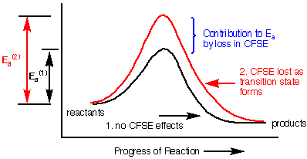
Classes 2 and 3 - Includes most of the first row TM ions and the lanthanides plus Be²⁺, Al³⁺, V²⁺. Rate constants 1 to 10⁸ sec⁻¹.
These elements who tend to undergo water exchange and ligand exchange reactions.
For T.M. metal ions the correlation of rate with size is not obeyed, e.g. Cr²⁺, Ni²⁺, and Cu²⁺ have identical radii.
Mn²⁺ > Fe²⁺ > Co²⁺ substitution rates decrease across the series. This is due to the increase in Z_{eff} across the series and increase in E(M--L).
d- electron configurations are important because the CFSE will affect the rates of exchange here.
Class 4 - Rate constants are in the range 10⁻³-10⁻⁶ sec⁻¹. This includes Cr³⁺, Co³⁺, Rh³⁺, Ir³⁺, Pt²⁺.
For these metal ions the rate of exchange is partially related to the size of the cations and partly to the CFSE.
The basic assumption is that the significant contribution to the activation energy in a substitution reaction is the change in d-orbital energy on going from the ground state of the complex to the transition state.
d³ and d⁶ ions are predicted to be inert e.g. Rh^{3+,} Cr³⁺ and Co²⁺

Slide 3

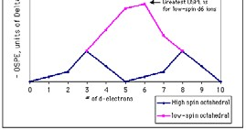

For transition metal ions the electronic configurations are important because the CFSE will affect the rates of exchange here. For these metal ions the rate of exchange is partially related to the size of the cations and partly to the CFSE. (see handout).
Remember this plot from lecture 10. This shows that the highest OSPE is for low
spin d⁶ and d³ octahedral complexes, d⁴ and d⁷ configs also have some OSPE. d⁰ and d¹⁰ have none.
It is important to be able to rationalize what effect the CSFE has on increasing the activation energy for the formation of a 5- or 7-coordinate intermediate.
You need to be able to rationalize why six coordinate hexaaquo complexes of transition metal ions with d³ or d⁶ configuration are kinetically inert with respect to substitution reactions.
2. Reaction Mechanisms for Octahedral Substitution
There are only two kinds of substitution reactions that can be studied:
Aquation – replacement of ligand X by H₂O, where X is the labile ligand.
ML₅X + H₂O ML₅H₂O + X
Anation – replacement of H₂O by ligand X⁻ (anion) ML₅H₂O + X⁻ ML₅X + H₂O
^{N.B.} The direct replacement of X by Y cannot be studied:
ML₅X + Y ML₅Y +X is not known.
It always goes via the aquo complex, i.e. in two steps, the replacement of one ligand with water, then water is replaced with another ligand.

Slide 4
Possible Mechanisms for:
ML₅X + Y ML₅Y + X (X = H₂O, Y = anion or vice versa)
1. Associative (A) – via a 7-coordinate intermediate
X
L L
slow
X _{Y}
fast
-X
Y
L
L
+ Y
L
7 co-ordinate intermediate
the first step is slow since the incomingY causes steric hinderance
X Y
L
L
or
L
L M
L
Y
L M L
L _{L}
"monocapped octahedron"
X
L
"pentagonal bipyramidal"
Rate determining step (slow step) is the collision between the original complex ML₅X and the incoming ligand Y to produce a 7 coordinate intermediate ML₅XY.
The second faster step is dissociation of the X ligand to produce the desired product. The associative mechanism predicts that the rate of reaction depends on the concentration of ML₅X and Y.
Rate = k₁[ML₅X][Y]
but note this is not strictly the case when Y is H₂O, see later!

Slide 5
2. Dissociative (D) – via a 5-coordinate intermediate (corresponds to organic SN₁)
X
-X fast
_{l w} +Y
5 co-ordinate intermediate
Y
L
L
L
L M L L
or
L M
Y
X
L
"square
pyramidal" ^{"trigonal}
bipyramidal"
X
-X
slow
step 1
fast
+Y
step 2
Y
5 co-ordinate intermediate
Rate determining step “bottleneck step” is the slowest reaction in a mechanism. This rate determines the overall rate of reaction.
The dissociative mechanism – predicts that the rate of overall substitution reaction depends on only the concentration of the original complex [ML₅X], and is independent of the concentration of the incoming ligand [Y].
Overall rate = rate of rate determining step (1)
= k₁[ML₅X]

Slide 6
So life seems simple ….
If we determine the rate law for the reaction if it depends on only [ML₅X] then it is dissociative.
If it depends on [ML₅X]and [Y] then it is associative.
BUT - coordination chemistry kinetics are not quite so simple (unfortunately ☹ ).
Additional complications
  the actual mechanisms maybe more complicated than those differentiated between A and D.
  Experimental conditions may “mask” the dependence of a rate on the concentration of the incoming ligand.
For an Associative Mechanism – we have seen that:
Rate determining step (slow step) is the collision between the original complex ML₅X and the incoming ligand Y to produce a 7 coordinate intermediate ML₅XY.
The second faster step is dissociation of the X ligand to produce the desired product. The associative mechanism predicts that the rate of reaction depends on the concentration of ML₅X and Y.
Rate = k₁[ML₅X][Y]
but note this is not strictly the case when Y is H₂O. The concentration of water is so large that it is essentially a constant, we cannot dilute water!
Hence Rate = k₁[ML₅X]
and the experimental conditions mask the dependence of a rate on the concentration of the incoming ligand.
Now we are unable to distinguish between the associative and dissociative mechanism from the reaction kinetics.
“ ”

Slide 7
3. The Interchange Mechanism (I)
As Y begins to bond X begins to leave. i.e. the bond making to Y and bond breaking to X occur simultaneously (organic SN₂)
X Y
X
Y
Y
+ X⁻
Bond Breaking
Bond Making
Although we speak generally about associative and disassociative reaction mechanisms, the terms A and D are reserved for situations where 7 and 5 coordinate intermediates have actually been isolated and positively identified. If no intermediates have been isolated or identified the designations I_{d} and I_{a} are more appropriate.
Experimental Conditions
There is masking of concentration dependence in aqueous solution.
An dissociative mechanism is first order in the concentration of the complex reactant.
An associative mechanism is first order in both complex reactant and the incoming water ligand.
A mechanism
For example ML₅X + H₂O ML₅H₂O
The concentration of H₂O (55M) in aqueous solution is so large it is very nearly constant.
So it is combined with k₁ and the resulting rate law is “pseudo’ first order.
The dependence of the associative mechanism on the concentration of the incoming ligand has been masked.

Slide 8
For this reaction we cannot determine the Y dependence because H₂O exchange is more likely to occur. We cannot do anything about this because we cannot vary the concentration of H₂O.
X Y
H₂O
+Y
+ H₂O
Water is in great excess over Y
H₂0 replacement of X proceeds more rapidly than replacement of
H₂O by Y.
Conclusions
The rate law for all of these mechanisms is identical:
Rate = k₁[ML₅X]
So we cannot use the rate law to decide between the two mechanisms.
BUT we now know that dissociative mechanisms are generally preferred! – How can we deduce this?
3. Additional Evidence for a Dissociative Pathway for Octahedral Substitution Reactions
What other data can we use? - 3 types:
Entering Group
Leaving Group
Steric Hindrance
i. Entering Group Effect
[Ni(H₂O)₆]²⁺ + L [Ni(H₂O)₅L]²⁺ + H₂O
We can vary L (refer to Table 5.1 in text)
If we compare the rate constants for the substitution reactions, look at their values then we can see that the largest difference is for anionic compared to neutral ligands:
For example: NH₃ = 3x10³, CH₃COO⁻ = 30 x 10³ so a factor of 10 difference.

Slide 9
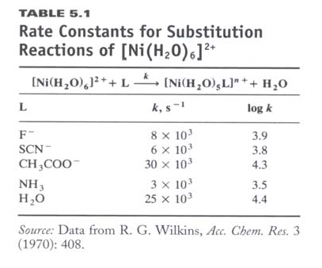
So the conclusion is that the rate doesn’t depend on the incoming ligand significantly which is consistent with the loss of water being rate determining and a dissociative rate determining step which a water molecule breaks away from the Ni(II) and in a succeeding fast step is replaced by L.
ii. Effects of Leaving Group
Table 5.2 shows how the rate of the reaction measured by (k, s⁻¹) now depends on the strength of the metal-ligand bond.
The rate constants k refer to the following reactions:
k
[Co(NH ) L]²⁺ +H O [Co(NH ) (H O)]³⁺ + L⁻
3 5 2 3 5 2
The equilibrium constants K_{a} refer to the following anation reactions:
[Co(NH ) (H O)]³⁺ + L^{- Ka} [Co(NH ) L]²⁺ + H O
3 5 2 3 3 2
The stronger the M-L bond the larger the equilibrium constant K_{a}, the slower the reaction (k, s⁻¹).

Slide 10
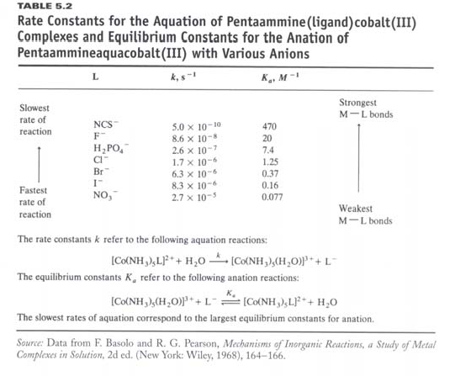
The rate constant- such variation is consistent with a rate determining step in which M-bonds of varying strength are broken.
For equilibrium constants for the reactions in which water is replaced by L⁻ the only major difference would seem to be the strength of the M-L bond.
As the M-L bond strength increases it becomes more difficult to remove the L, and the rate decreases.
For the 7 ligands NCS⁻ has the slowest rate (5.0 x 10-10 s⁻¹), NO₃ has the
-
fastest rate (2.7 x 10-5 s⁻¹). i.e. NCS⁻ forms a very strong bond and is not replaced as fast.
Comparing equilibrium constants for the complexes:
[Co(NH₃)₅(H₂O)]²⁺ + NCS⁻ K_{a} = 470 M⁻¹ [Co(NH₃)₅(H₂O)]²⁺ + NO₃
[Co(NH₃)₅NCS]³⁺ + H₂O
-
[Co(NH₃)₅ONO₂] + H₂O
3+
K_{a} = 0.08 M⁻¹
We can say that NCS is very stable and the NO₃ complex is not.
The rate determining step depends on the breaking M-L bond so the weaker bond, i.e. the nitrate is faster. This is consistent with a dissociative mechanism where the slow step is the ligand leaving to form a 5-coordinate intermediate.

Slide 11
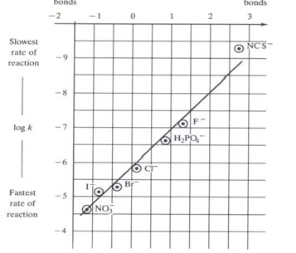
To Summarize see:
Figure 5.6 = the largest equilibrium constants (Ka = stronger bonds).
We plot logK_{a} (a measure of the M-L bond strength) versus logk (a measure of the rate of the aquation). We obtain a straight line.
The plot shows that the stronger the M-L bond the slower the rate of aquation.
For example: [(H₃N)CoNCS]² ⁺ + H₂O
[Co(NH₃)₅H₂O] ³⁺ +NCS⁻
100, 000 x slower than replacement by NO ⁻
3
[Co(NH₃)₅(ONO₂)]²⁺ + H₂O Table 5.2
Conclusion - if we cannot get water in until the bond is broken and if the bond is strong, then H₂O cannot get in, in this case it is the group that determines what is going on.
This is further evidence to support a dissociative pathway for octahedral substitution reactions.

Slide 12
iii. Steric Hindrance
Consider the following two reactions:
[CoCl₂(en)₂]⁺ + H₂O [CoCl(H₂O)(en)₂]⁺ + Cl⁻
[CoCl₂(Me₄en)₂]⁺ + H₂O [CoCl(H₂O)(Me₄en)₂]⁺ + Cl⁻
H₂N NH₂
H₂N
NH₂
Me₄en
en
We can compare the rates of reaction for:
Cl
_{N N} N N
_{N N} N N
_{Cl} Cl
Cl
reaction is 1000 times faster than reaction with
For this dissasociative reaction – steric crowding is reduced by the loss of Cl^{-,} if it was associative we would go via a 7-coordinate intermediate so we would expect the reaction to be considerably slowed by steric strain. It is not!
[CoCl₂(en)₂]⁺
Study Aid: Past Exam Question (Mid Term 2007)
(5 marks) Transition metal complexes undergo ligand substitution reactions by either associative (A) or dissociative (D) mechanisms. Show that you understand these terms by drawing diagrams or writing equations to show the reaction mechanism for each of the following reactions:
  [PtCl₄]²⁻ + NH₃ [PtCl₃(NH₃)]⁻ + Cl⁻ (A mechanism)
  [Co(NH₃)₅Cl]²⁺ + H₂0 [Co(NH₃)₅H₂O]³⁺ + Cl- (D mechanism)

Slide 13
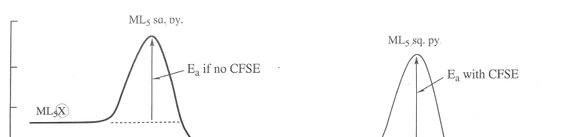
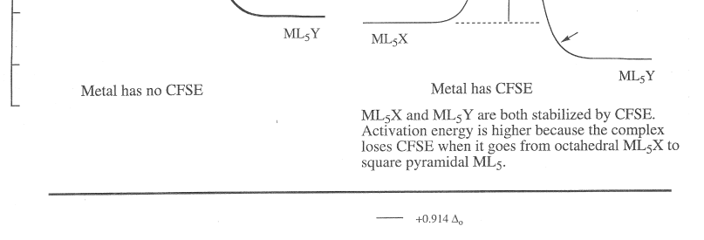
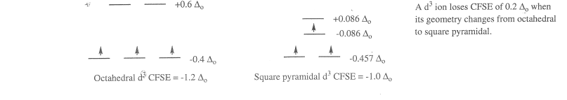
4. Factors Affecting the Rate of Octahedral Substitution.
1. Size and Charge of Metal – the strongest bonds occur for the smallest size and higher charge on the metal.
2. Change in CFSE – complexes with d³, low spin d⁶ configurations and exchange ligands slowly. This is because you loose a lot of crystal field stabilization energy when going to 5 co-ordinate. (any geometry is less than octahedral in terms of CFSE).
Look at the handout
If we compare Al³⁺ and Cr³⁺ Both metals have the same size
Cr³⁺ has 3 d electrons and Al³⁺ has none
Cr ³⁺ exhibits slow exchange whereas exchange is rapid for Al³⁺
8
CFSE = 1.0Δo
e.g. d⁰ Al³⁺
CFSE = 1.2Δo
e.g. d³ Cr³⁺

