Slide 1


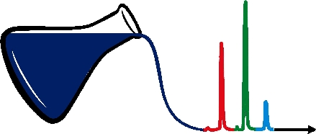
Applications of Chemometrics
Dr. Hassan Imran Afridi
National Center of Excellence in Analytical Chemistry, University of Sindh Jamshoro

Slide 2
HISTORICAL background of chemometrics
Name first proposed in early 1970s by Swedish organic chemist S.Wold.
International Chemometrics Society - 1970s.
International meeting - Cosenza 1983
Journals : 1986 (Chemometrics and Intelligent Laboratory Systems) and 1987 (J Chemometrics)
Books : mid 1980s
Courses : mainly at continuing professional development level in late 1980s.

Slide 3
What is chemometrics?
“Chemometrics is the science of extracting information from chemical systems by data-driven means” (Wikipedia)
In our world:
- Handling data and situations where there are correlation or interaction between variables
Correlation can be our enemy – but it can also be our friend!

Slide 4
Mathematics
Statistics
Organic
Chemistry
Biology
Computing
CHEMOMETRICS
Analytical
Applications
CHEMOMETRICS
Chemistry
Industrial
Applications
among others
among others
p
Theoretical
Engineering
Theoretical
Pharmaceuticals
Engineering
and Physical
and Physical
Chemistry
Chemistry

Slide 5
DIFFERENT GROUPS HAVE DIFFERENT BACKGROUNDS AND EXPECTATIONS AS TO HOW CHEMOMETRICS SHOULD BE INTRODUCED
Statisticians want to start with distributions, hypothesis tests etc. and build up from there. They are dissatisfied if the maths is not explained.
Chemical engineers like to start with linear algebra such as matrices, and expect a mathematical approach but are not always so interested in distributions etc.

Slide 6
Computer scientists are often most interested in algorithms.
Analytical chemists often know a little statistics but are not necessarily very confident in maths and algorithms so like to approach this via statistical analytical chemistry. Difficult group because the ability to run instruments is not necessarily an ability in maths and computing.
Organic chemists do not like maths and want automated packages they can use. They often require elaborate courses that avoid matrices. The course an organic chemist would regard is good is one a statistician would regard as bad.

Slide 7
APPLICATIONS
Biggest growth area in past 10 years
Classical chemometrics
A few classical applications, mainly related to the interests and funding of pioneers
  Process control and analysis
  Chromatographic optimisation
  Food analysis

Slide 8
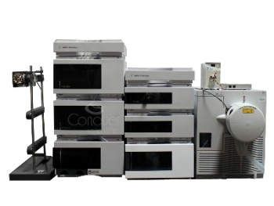


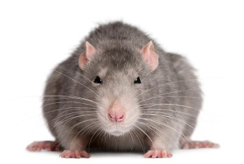
Chemometrics in analytical chemistry
Samples
Analytical method
Interpretation
Design of experiments
Sample selection
Optimization
Noise reduction
Extraction of relevant data
Pattern recognition
Classification
Regression

Slide 9
FOUR BUILDING BLOCKS
Methods.
Software.
Instrumental techniques.
Applications.

Slide 10
METHODS
Experimental design
Pattern recognition
Calibration

Slide 11
MOTIVATIONS FOR DESIGN
Screening
Saving time
Quantitative modelling
Optimisation

Slide 12
WHY DESIGN EXPERIMENTS?
Example : Optimisation of a reaction with pH and temperature.
Can we find the combination of pH and temperature that produces the best yield?

Slide 13
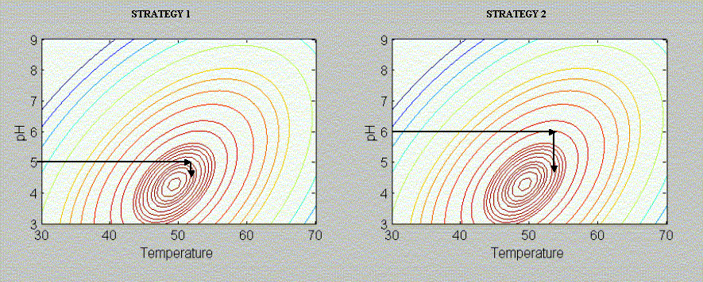
One factor at a time strategy : may miss optima

Slide 14
DIFFICULTY
Interactions – the response for each factor is not independent.
The optimum temperature at pH 5 differs from that at pH 6.

Slide 15
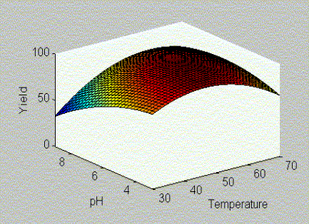

Slide 16
How to be on the safe side?
Grid search. 10 pHs, 10 temperatures, 100 experiments.
Big grid. Then smaller grid.

Slide 17
PROBLEMS
Time consuming and expensive.
Many experiments we are almost certain are not near at optimum so are obviously a waste of time
Reproducibility and experimental error

Slide 18
WHAT DO WE DO?
We need rules!
Formal experimental design

Slide 19
Screening
  Factorial designs
  Partial factorials and Plackett-Burman designs
Modelling and optimisation
  Response surface designs
  Mixture designs

Slide 20
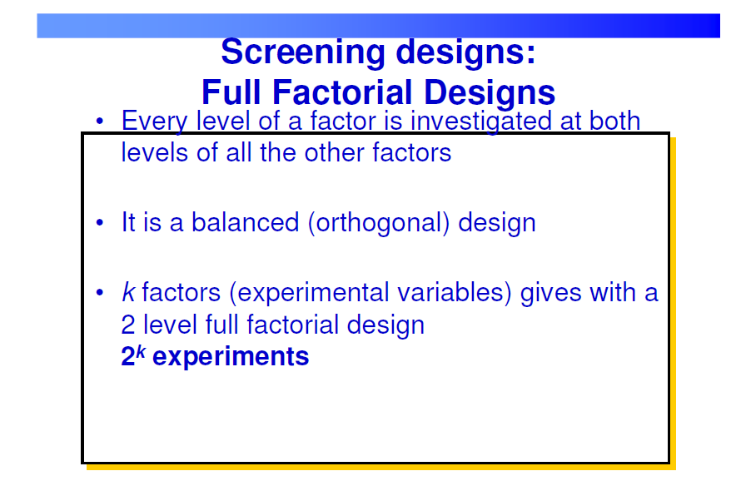

Slide 21
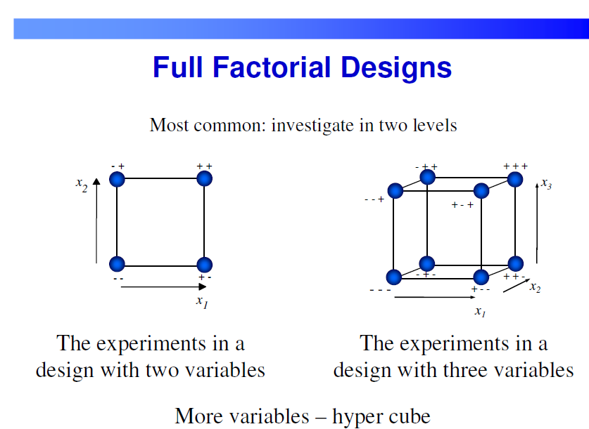

Slide 22
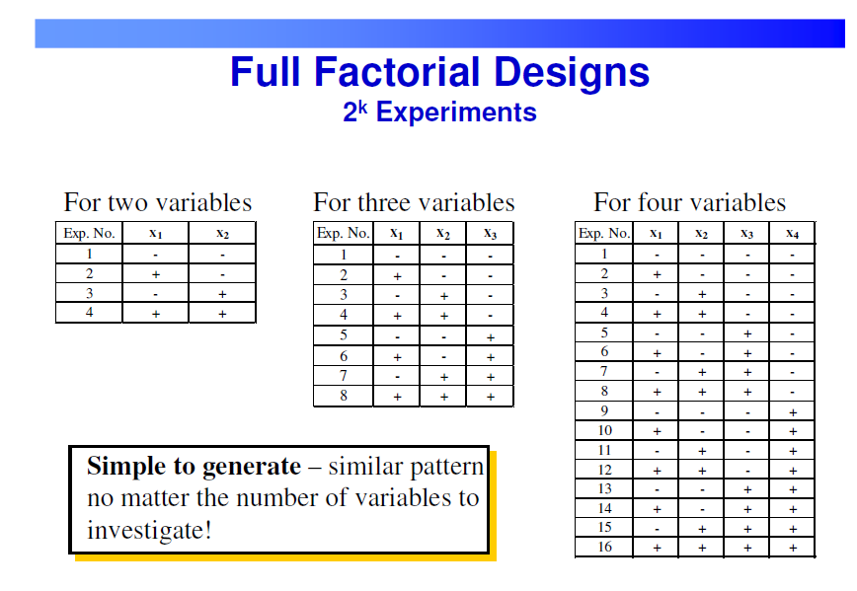

Slide 23
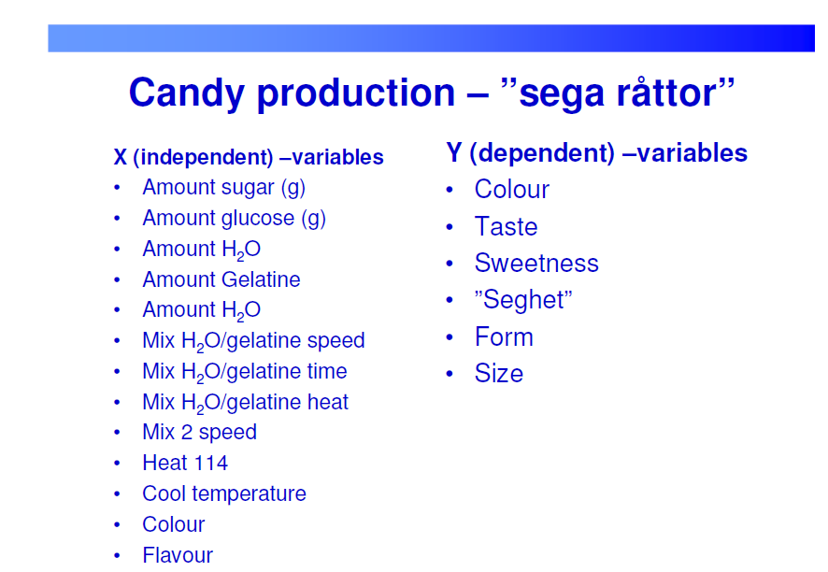

Slide 24
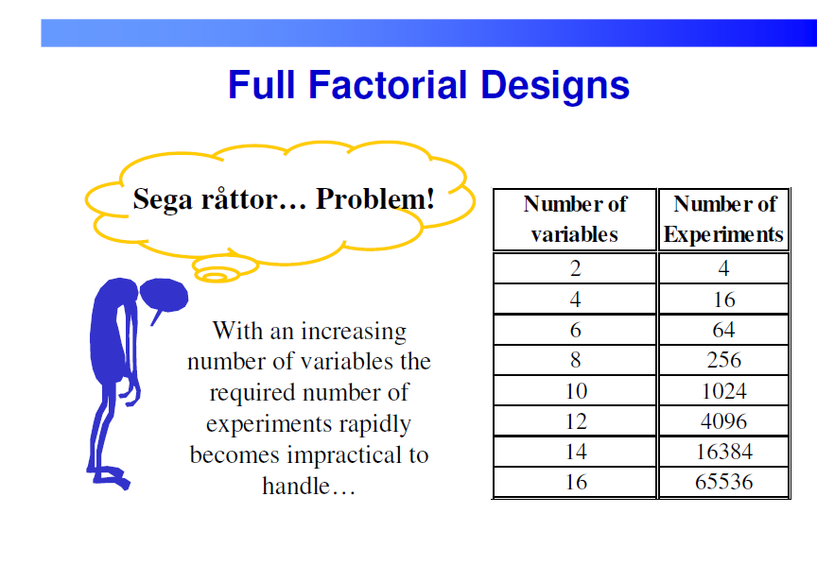

Slide 25
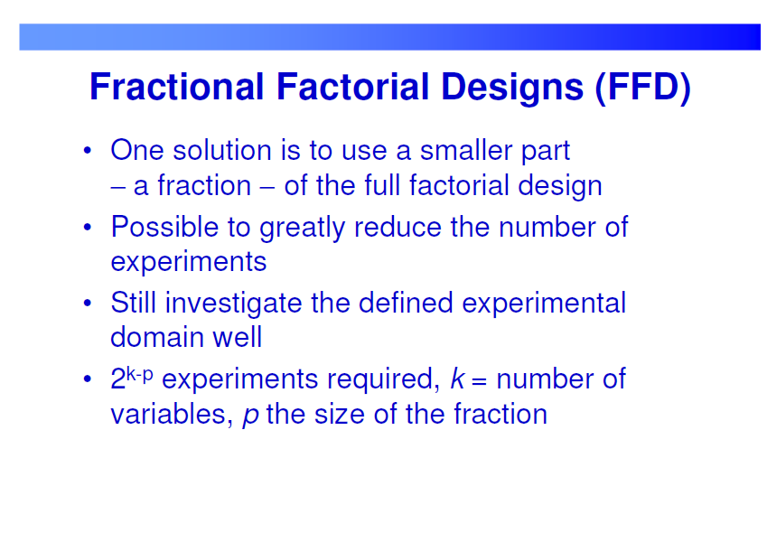

Slide 26
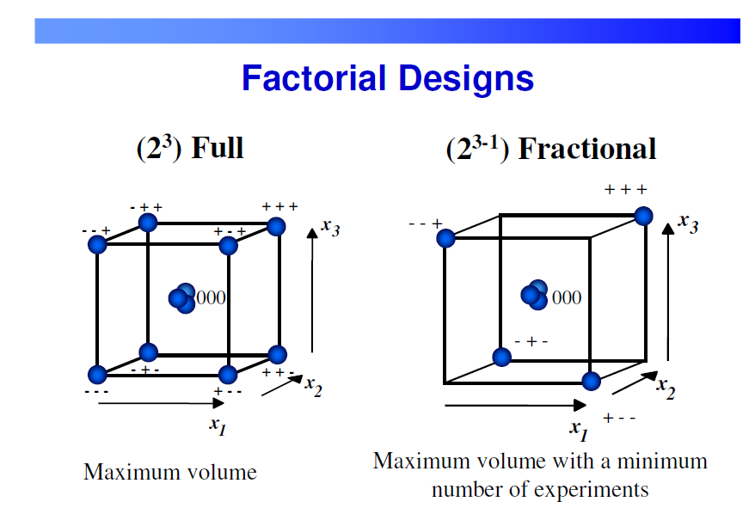

Slide 27
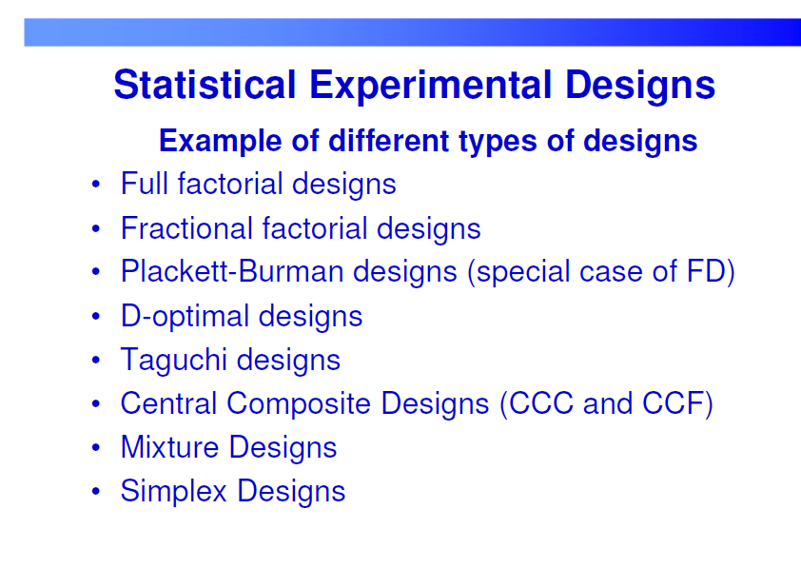

Slide 28
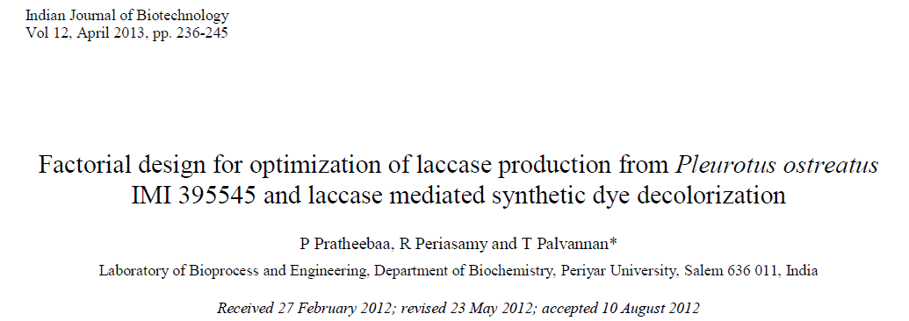

Slide 29
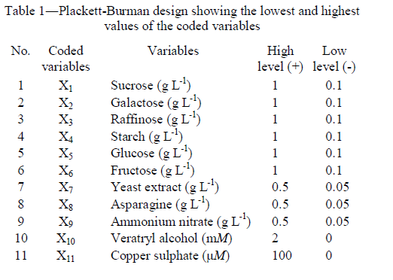
Notes:
Kn+1 = multiple of 4
Like k=3, 7, 11, 15 etc

Slide 30
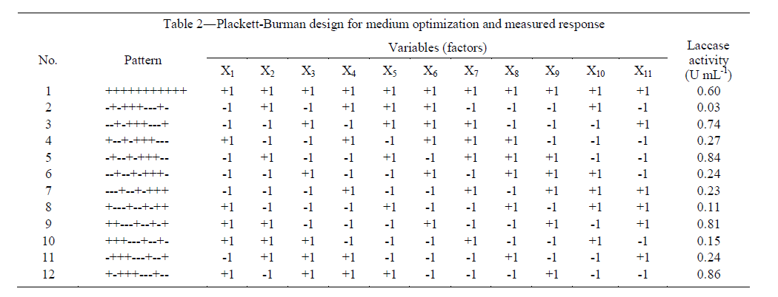

Slide 31
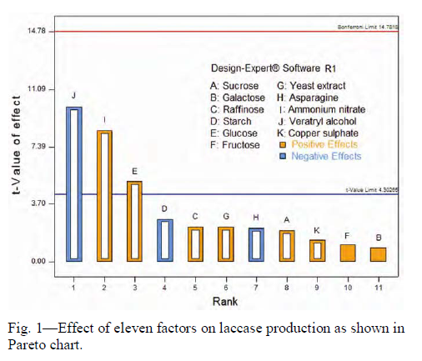

Slide 32
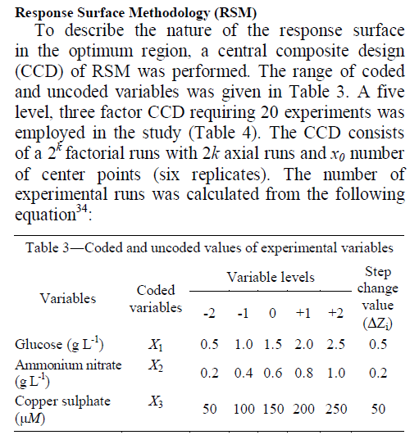

Slide 33

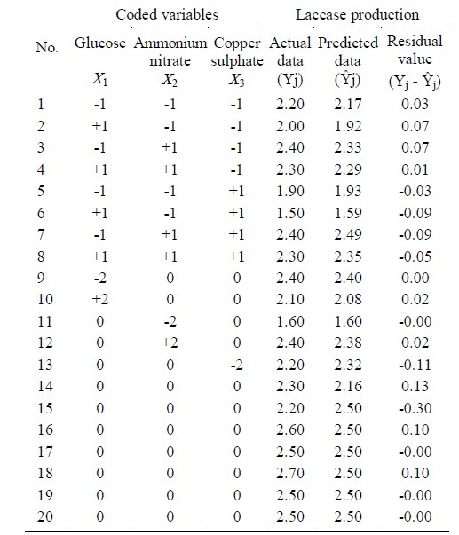

Slide 34
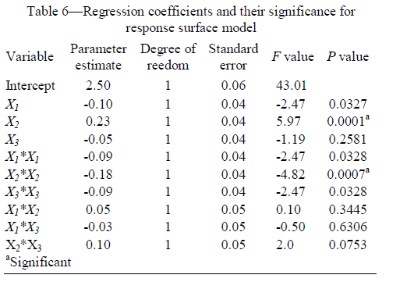

Slide 35
PATTERN RECOGNITION
Grouping of objects e.g. how similar is the behaviour of compounds, how similar are products. Also PCA used a great deal to visualise changes e.g. in a reaction or product.
“PCA”
Can we classify products into acceptable or unacceptable?
“Discriminant analysis” and “Cluster analysis”
Exploratory Data Analysis
Unsupervised Pattern Recognition
Supervised Pattern Recognition

Slide 36
Exploratory data analysis
  e.g. PCA – Principal Components and Factor Analysis
Looking at relationships
  between samples
  patients, food samples, organisms, chromatographic columns, wood, spectra, people
  between variables
  compound concentrations, spectral peaks, expenditure, chromatographic tests, elemental compositions

Slide 37
Why Use Principal Components Analysis?
The major goal of principal components analysis is to reveal hidden structure in a data set. In so doing, we may be able to:
•identify how different variables work together to create the dynamics of the system
•reduce the dimensionality of the data
• decrease redundancy in the data
•filter some of the noise in the data
•compress the data

Slide 38
Example:
Population School Employment Services House Value
5700 12.8 2500 270 25000
1000 10.9 600 10 10000
3400 8.8 1000 10 9000
3800 13.6 1700 140 25000
4000 12.8 1600 140 25000
8200 8.3 2600 60 12000
1200 11.4 400 10 16000
9100 11.5 3300 60 14000
9900 12.5 3400 180 18000
9600 13.7 3600 390 25000
9600 9.6 3300 80 12000
9400 11.4 4000 100 13000

Slide 39
Means and Standard Deviations from 12 Observations
Variable | Mean | Std Dev
Population | 6241.667 | 3439.9943
School | 11.442 | 1.7865
Employment | 2333.333 | 1241.2115
Services | 120.833 | 114.9275
HouseValue | 17000.000 | 6367.5313
The FACTOR Procedure
Correlations
 | Population | School | Employment | Services | HouseValue
Population | 1.00000 | 0.00975 | 0.97245 | 0.43887 | 0.02241
School | 0.00975 | 1.00000 | 0.15428 | 0.69141 | 0.86307
Employment | 0.97245 | 0.15428 | 1.00000 | 0.51472 | 0.12193
Services | 0.43887 | 0.69141 | 0.51472 | 1.00000 | 0.77765
HouseValue | 0.02241 | 0.86307 | 0.12193 | 0.77765 | 1.00000

Slide 40
Eigen values of the Correlation Matrix: Total = 5 Average = 1
 | Eigenvalue | Difference | Proportion | Cumulative
1 | 2.87331359 | 1.07665350 | 0.5747 | 0.5747
2 | 1.79666009 | 1.58182321 | 0.3593 | 0.9340
3 | 0.21483689 | 0.11490283 | 0.0430 | 0.9770
4 | 0.09993405 | 0.08467868 | 0.0200 | 0.9969
5 | 0.01525537 |  | 0.0031 | 1.0000
nitial Factor Method: Principal Components

Slide 41
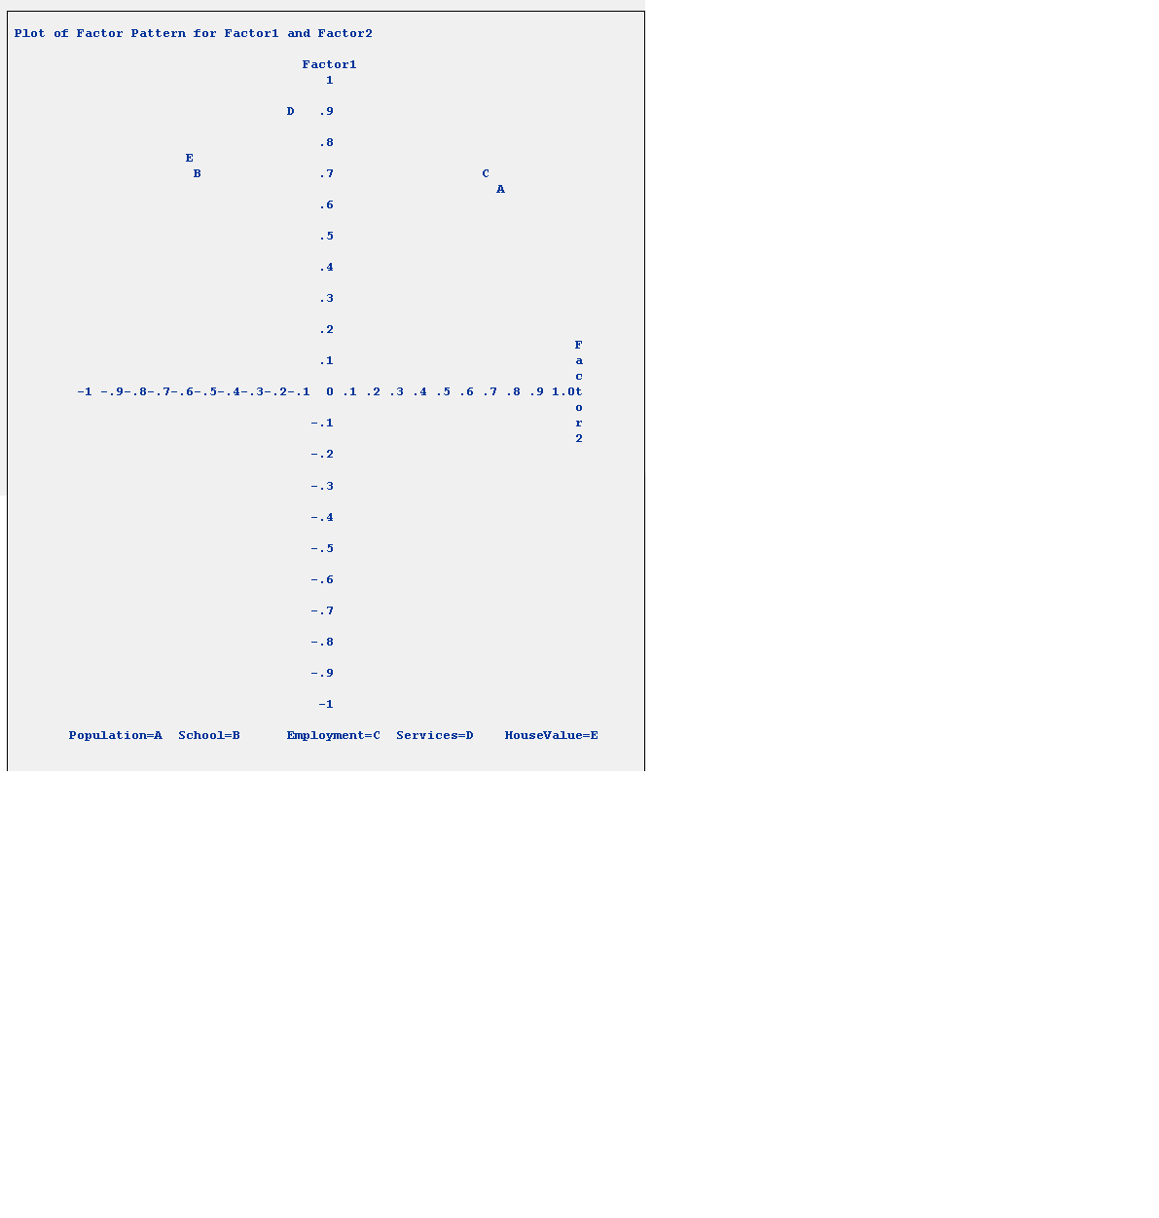

Slide 42
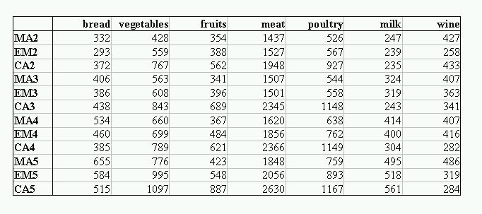
Families : MA (manual), EM (Employee), CA (Manager) together with number of children and monthly expenditure

Slide 43
PCA SCORES PLOT

Slide 44
PCA LOADINGS PLOT

Slide 45
Unsupervised pattern recognition
Dendrograms
Example : Toxicology
  Urine samples
  Discrimination between acute or chronic intoxication helps elucidating the source of contamination and may suggest the best cure for an effective remediation
  Use capillary electrophoresis and then compare chromatograms.

Slide 46
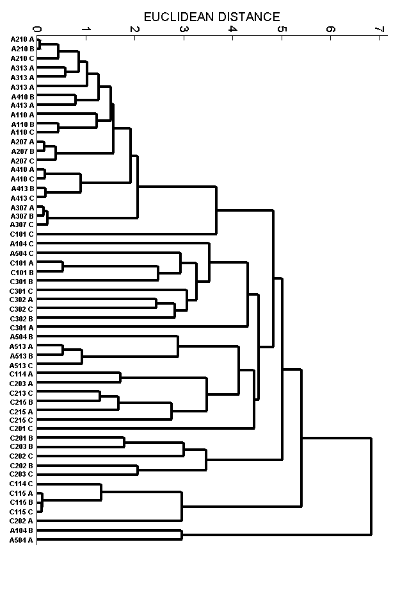
Notes:
The Correlation analysis is performed on log normalised spot expression levels. Spots can then be clustered according to how closely correlated they are. Spots with a high correlation value (i.e. close to 1) show similar expression profiles while spots which a high negative correlation value (i.e. close to -1) show opposing expression profiles.
The distance measure between two clusters is calculated as follows:
D=1-C
where D = Distance and C = correlation between spot clusters.

Slide 47
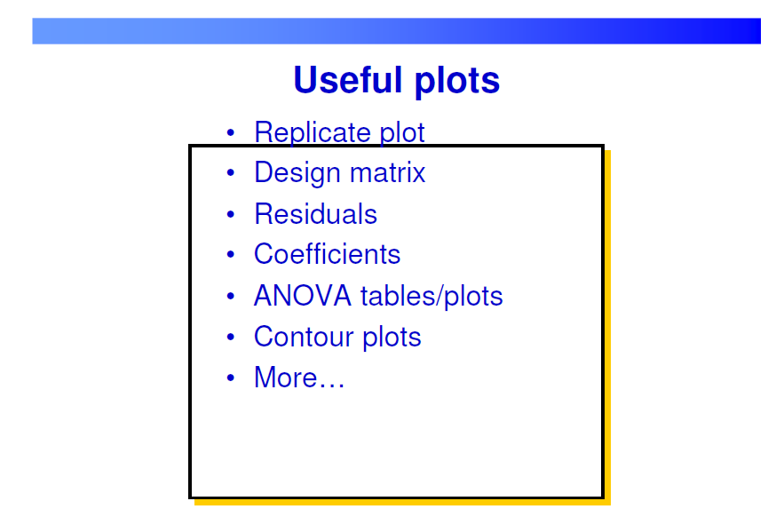

Slide 48
UNIVARIATE CALIBRATION
    One measurement e.g. a peak height
MULTIVARIATE CALIBRATION
Several measurements e.g. spectra

Slide 49
MULTIVARIATE CALIBRATION IN ANALYTICAL CHEMISTRY
Single component.
Example, concentration of pharmaceutical by uv/vis spectra.
Mixture of components, all compounds known.
Example, mixture of pharmaceuticals, all pure compounds known.

Slide 50
Mixture of components, only some compounds known.
Example, coal tar pitch volatiles in industrial waste studied by spectroscopy, only some known.
Statistical parameters.
Example, protein in wheat by NIR spectroscopy.

Slide 51
SOFTWARE
Many approaches according background of user.
Programmers, unlikely in industrial environment
C / C++
VB and VBA
Matlab
Users, specialist industrial chemometricians
Matlab [very common]
Python
Excel
VBA using Excel

Slide 52
Packages : “customised”
e.g. in Bristol often specially commissioned for contracts
Packages
Distance learning package for European teaching (R.Brereton 1994)
MIR deconvolution for HSE (S.Gurden 1996)
Madcap deconvolution for SB (C.Bessant 2000)
Excel add-in for calibration and pattern recognition relate to Wiley textbook (L.Erskine and T.Thurston 2002)
Boris software package commissioned for GSK (T.Thurston et al 2004).
Packages : “commercial”, most people in industry
Many limited to philosophy of users but quite user friendly and well supported.
SIMCA, Pirouette, Unscrambler
SAS, SPSS, Splus
Both statistical and chemometric packages.

Slide 53
INSTRUMENTAL TECHNIQUES
Classical chemometrics
1980s, early 1990s
Dominated by a few techniques e.g.
  Near Infrared Spectroscopy (NIR)
  High Performance Liquid Chromatography (HPLC)
  Atomic absorption spectrophotometry (AAS)
Much early work using these methods.

Slide 54
MODERN DAY
Sophistication
e.g. LC-MS, LC-NMR, MS/MS, inductive couple plasma-AES etc.
Rapid and convenient
e.g. Raman, uv/vis, MIR
Huge range of techniques

Slide 55
APPLICATIONS
Biggest growth area in past 10 years
Classical chemometrics
A few classical applications, mainly related to the interests and funding of pioneers
  Process control and analysis
  Chromatographic optimisation
  Food analysis

Slide 56
FINDING OUT ABOUT CHEMOMETRICS
Book and Website
R.G.Brereton, Chemometrics : Data Analysis for the Laboratory and Chemical Plant, Wiley, Chichester, 2003 and 2004
www.spectroscopynow.com Website
Chemometrics Channel

Slide 57
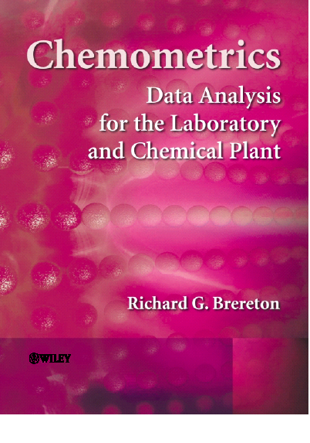

Slide 58
INTRODUCTION
EXPERIMENTAL DESIGN
SIGNAL PROCESSING
PATTERN RECOGNITION
CALIBRATION
EVOLUTIONARY SIGNALS
APPENDICES
Vectors and Matrices, Algorithms, Basic statistics, Excel, Matlab

Slide 59
54 Problems, some quite lengthy e.g. Chapter 4. Many case studies.
Problem 4.1 Grouping of elements from fundamental properties using PCA.
Problem 4.2 Introductory PCA
Problem 4.3 Introduction to Cluster Analysis
Problem 4.4 Classification using Euclidean distance and KNN
Problem 4.5 Certification of NIR filters using PC scores plots.
Problem 4.6 Simple KNN classification
Problem 4.7 Classification of swedes into fresh and stored using SIMCA.
Problem 4.8 Classification of Pottery from pre-classical sites in Italy, using Euclidean and Mahalanobis distance measures.
Problem 4.9 Effect of Centring on PCA
Problem 4.10 Linear discriminant analysis in QSAR to study the toxicity of Polyaromatic Hydrocarbons.
Problem 4.11 Class Modelling Using PCA
Problem 4.12 Effect of Preprocessing on PCA in LCMS.
Problem 4.13 Determining the number of significant components in a dataset by cross-validation.

Slide 60
Chemweb
www.chemweb.com → The Alchemist → Features → Chemometrics → Archive

Slide 61
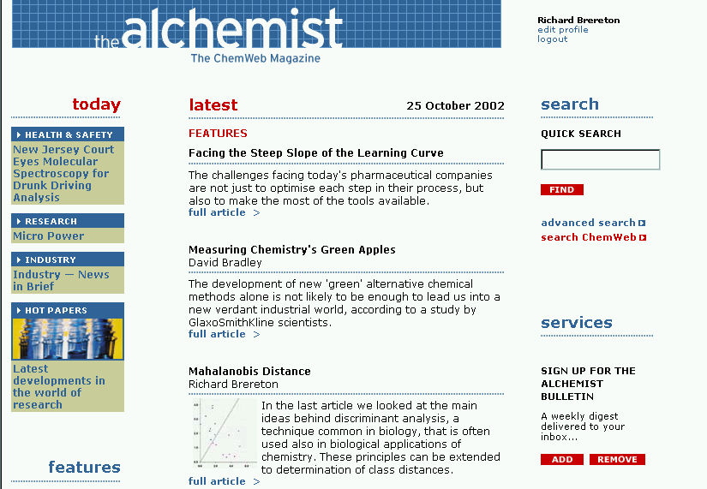

Slide 62
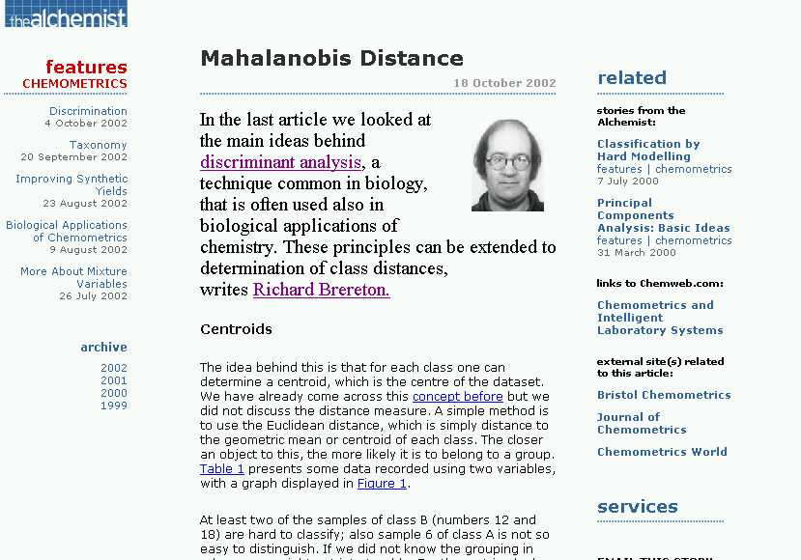

Slide 63
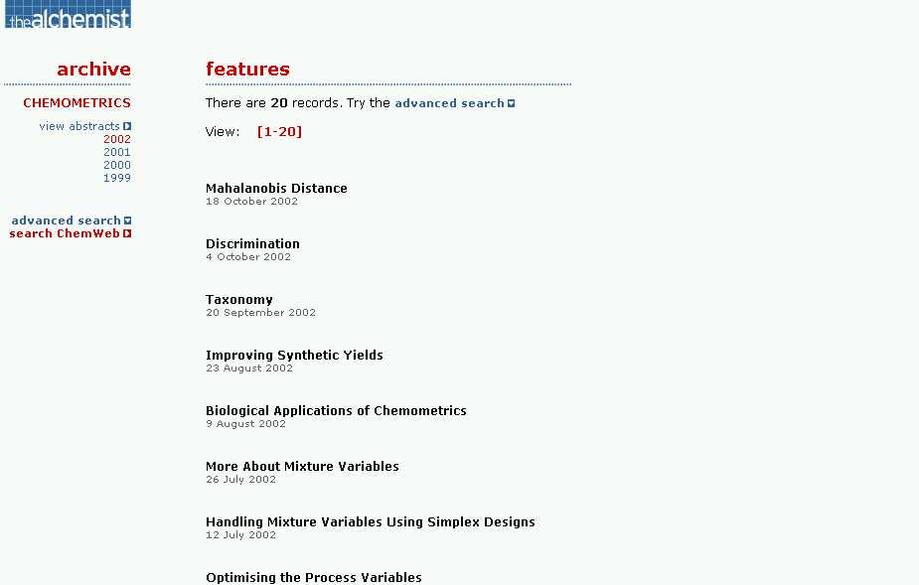

Slide 64
Other sources
www.spectroscopynow.com
Chemometrics channel
Websites run by companies e.g.
  Applied Spectroscopy
  Infometrix
  Umetrics
  Camo

Slide 65
Other selected books
D.L.Massart, B.G.M.Vandeginste, L.M.C.Buydens, S. De Jong, P.J.Lewi, J.Smeyers-Verbeke, Handbook of Chemometrics and Qualimetrics Part A, Elsevier, Amsterdam, 1997
B. M. G. Vandeginste, D. L. Massart. L. M. C. Buydens, S. de Jong, P. J. Lewi and J. Smeyers-Verbeke, Handbook of Chemometrics and Qualimetrics Part B, Elsevier, Amsterdam, 1998
M. Otto, Chemometrics : Statistics and Computer Applications in Analytical Chemistry, Wiley-VCH, Weinheim, 1998
K.R. Beebe, R.J. Pell and M.B. Seasholtz, Chemometrics : a practical guide, Wiley, New York, 1998
R.Kramer, Chemometrics Techniques for Quantitative Analysis, Marcel Dekker, New York, 1998

Slide 66
Journals
Specialist chemometrics journals – for the enthusiast and expert at the cutting edge
Applications journals – most chemometrics papers published in applied journals, very large variety of journals, probably 50 or more

Slide 67



