Slide 1
Fundamentals of UV-Visible Spectroscopy
Prof. Dr. Gul Afshan Soomro
Institute of Chemistry
Shah Abdul Latif University Khairpur, Sindh, Pakistan

Slide 2
What is Spectroscopy?
The study of molecular structure and dynamics through the absorption, emission and scattering of light.

Slide 3
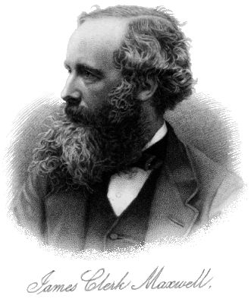
What is Light?
According to Maxwell, light is an electromagnetic field characterized by a frequency f, velocity v, and wavelength λ. Light obeys the relationship
f = v / λ.

Slide 4

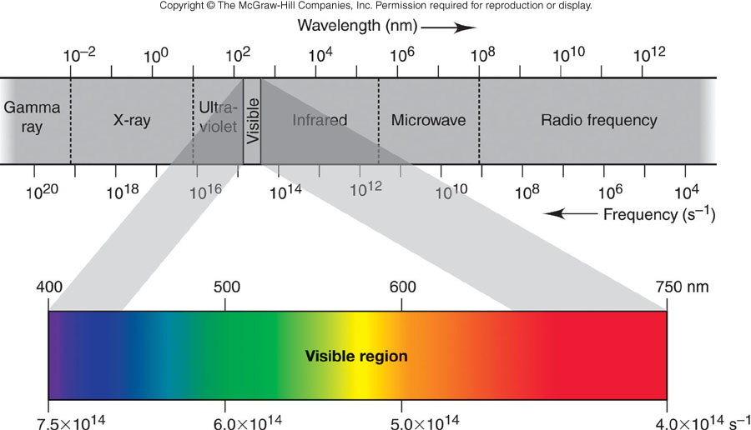
Regions of the Electromagnetic Spectrum
Light waves all travel at the same speed through a vacuum but
differ in frequency and, therefore, in wavelength.

Slide 5
Review on properties of light:photon
Light is energy in the form of electromagenetic field
Wavelength (λ): Crest-to-crest distance between waves
Frequency (ν): Number of complete oscillations that the wave makes each second
units: number of oscillations/sec or s⁻¹ or Hertz |(Hz)
Light travelling speed:
in other media: c/n (n = refractive index, generally >1)
in a vacuum: c=2.998 x 10⁸ m s⁻¹ (n=1 exactly, in air n=1.0002926)
c/n= νλ
And of course, the relationship between energy and frequency:
E = hν = hc/λ = hc ν
h = Planck’s constant (6.626 x 10⁻³⁴ J s)
ν = wavenumber (most common units = cm⁻¹)
~
~
Therefore:
Energy is inversely proportional to wavelength
but proportional to wavenumber

Slide 6
Frequency Scanning Techniques: a few definitions
Emission method: source of light is sample
Absorption method: intensities of a source with and without the sample in place are compared
Spectrum: a plot of intensity vs. frequency/wavelength
In quantitative analysis:
common to work at 1 wavelength
running a spectrum is an important initial step (to select best conditions)

Slide 7
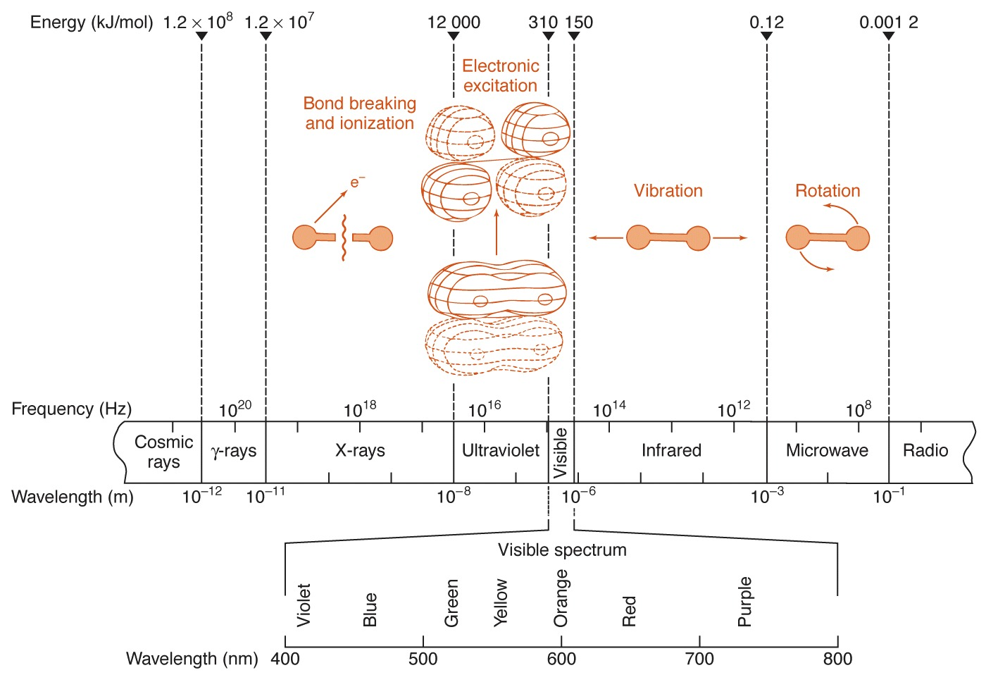
Regions of Electromagnetic Spectrum-the “colour” of light
Fig. 18-2

Slide 8
An Electronic Spectrum
Make solution of concentration low enough that A≤ 1
(Ensures Linear Beer’s law behavior)
Even though a dual beam goes through a solvent blank, choose solvents that are UV transparent.
Can extract the ε value if conc. (M) and b (cm) are known
UV bands are much broader than the photonic transition event. This is because vibration levels are superimposed on UV.
1.0
λ_{max}with certain extinction ε
UV
Visible
Absorbance
0.0
200
400
800
Wavelength, λ, generally in nanometers (nm)

Slide 9
Absorption Spectra of Hemoglobin Derivatives

Slide 10

Components of the basic UV Visible spectrophotometer

Slide 11
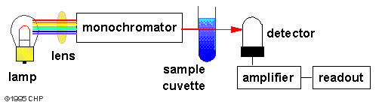
Instruments for measuring the absorption of U.V. or visible radiation are made up of the following components;
Sources (UV and visible)
Wavelength selector (monochromator)
A Sample cell
Detector
A device to read out the response of the detector
schematic diagram of a single-beam UV-Vis. spectrophotometer

Slide 12

Sources of UV radiation
Continuous sources
Tungten lamp (350-2500 nm)
Deuterium (200-400 nm)
Xenon Arc lamps (200-1000 nm)
Line sources
Hollow cathode lamp

Slide 13
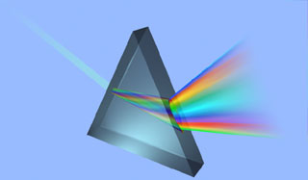
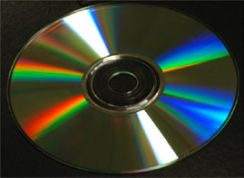
Monochromators
Early spectrophotometers used prisms
- quartz for UV
- glass for vis and IR
Why?
These are now superseded by:
Diffraction gratings:
- made by drawing lines on a glass with a diamond stylus
ca. 20 grooves mm⁻¹ for far IR
ca. 6000 mm⁻¹ for UV/vis
- can use plastic replicas in less expensive instruments
Think of diffraction on a CD
http://www.ii.com/images/prism.jpg
http://www.mrfiber.com/images/cddiffract.jpg
10μmx10μm
http://www.veeco.com/library/nanotheater_detail.php?type=application&id=331&app_id=34

Slide 14

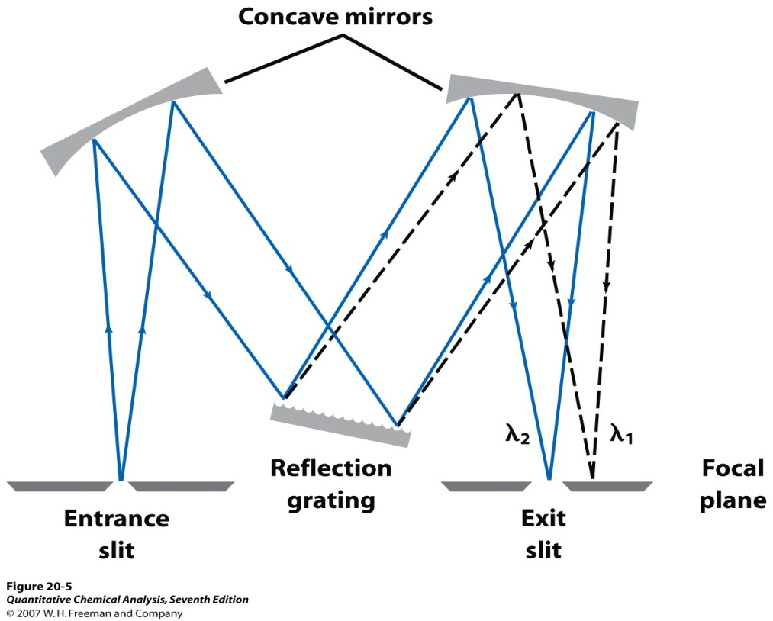
All monochromators contain:
An entrance slit
A dispersing device (usually a prism, and gratting)
An exit slit

Slide 15
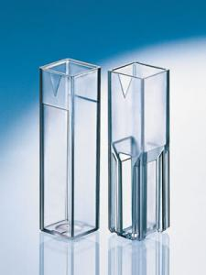
Cuvettes
Visible; can be plastic or glass
UV; you must use quartz

Slide 16
Transmission Characteristics of Cell Materials
Note that all materials exhibit at least approximately 10% loss in transmittance at all wavelengths

Slide 17
Cell Types I
Open-topped rectangular standard cell (a)
and apertured cell (b) for limited sample volume

Slide 18
Cell Types II
Micro cell (a) for very small volumes and flow-through cell (b) for automated applications

Slide 19

Detectors
Photomultipliers are very sensitive to UV and visible radiation. They have fast response times. Intense light damages photomultipliers; they are limited to measuring low power radiation.
The photomultiplier tube is a commonly used detector in UV-Vis spectroscopy. It consists of a photoemissive cathode (a cathode which emits electrons when struck by photons of radiation), several dynodes (which emit several electrons for each electron striking them) and an anode.
A photon of radiation entering the tube strikes the cathode, causing the emission of several electrons.

Slide 20
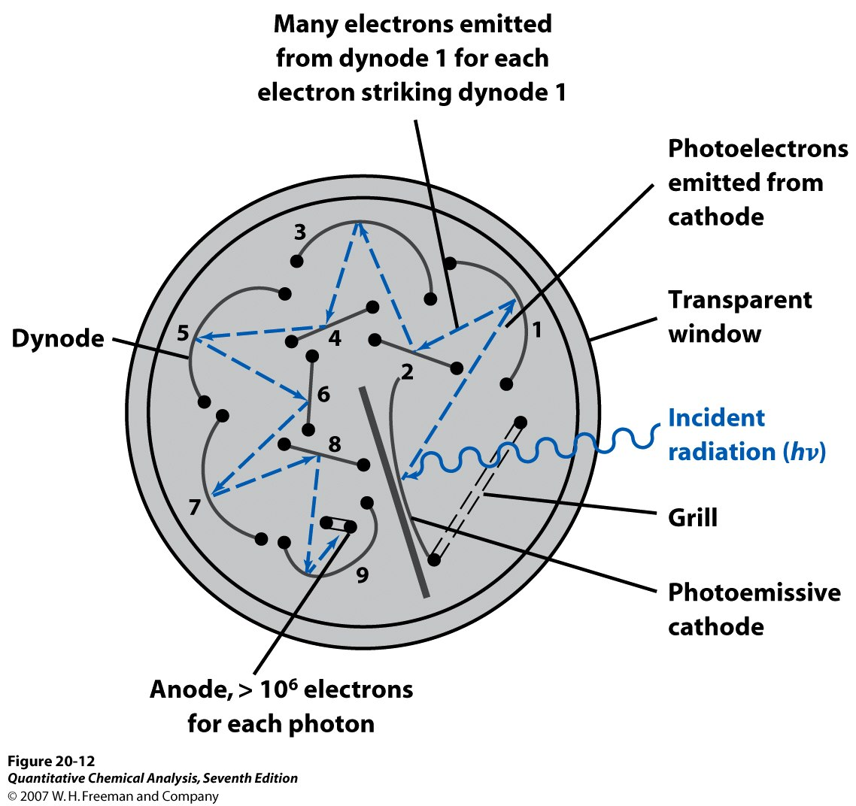
Photomultiplier-single channel, but very high sensitivity
- Light falls on a photosensitive alloy (Cs₃Sb, K₂CsSb, Na₂KSb)
- Electrons from surface are accelerated towards secondary electrodes called dynodes and gain enough energy to remove further electrons (typically 4-12, to 50 with GaP).
- For 9 stages giving 4 electrons for 1, the amplification is 4⁹ or 2.6 x 10⁵)
- The output is fed to an amplifier which generates a signal
- To minimise noise it is necessary to operate at the lowest possible voltage

Slide 21
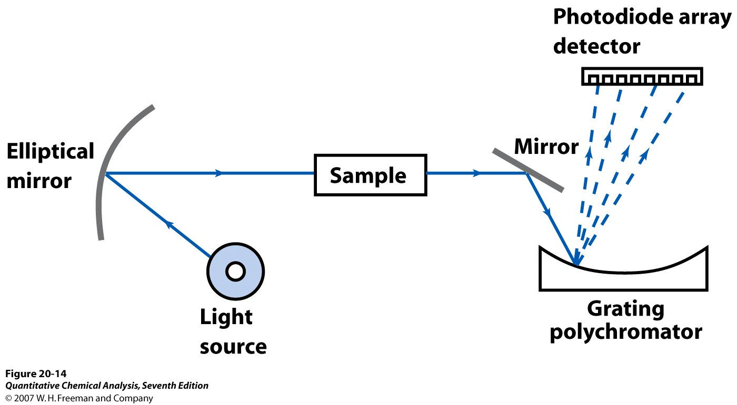
Photodiode Array Spectrophotometer
- For photodiode array spectrophotometers, a white light passes through sample
- The grating polychromator disperses the light into the component wavelengths
- All wavelengths are measured simultaneously
- Resolution depends upon the distance between the diodes and amount of dispersion
No moving parts!
Simple mechanical and optical design, very compact.

Slide 22
Conventional Spectrophotometer
Schematic of a conventional single-beam spectrophotometer

Slide 23
Conventional Spectrophotometer
Optical system of a double-beam spectrophotometer

Slide 24
Conventional Spectrophotometer
Optical system of a split-beam spectrophotometer

Slide 25
Definition of Resolution
Spectral resolution is a measure of the ability of an instrument to differentiate between two adjacent wavelengths

Slide 26
Instrumental Spectral Bandwidth
The SBW is defined as the width, at half the maximum intensity, of the band of light leaving the monochromator

Slide 27
Natural Spectral Bandwidth
The NBW is the width of the sample absorption band at half the absorption maximum

Slide 28
Characteristics of Beer’s Law Plots
One wavelength
Good plots have a range of absorbances from 0.010 to 1.000
Absorbances over 1.000 are not that valid and should be avoided
2 orders of magnitude

Slide 29
Standard Practice
Prepare standards of known concentration
Measure absorbance at λmax
Plot A vs. concentration
Obtain slope
Use slope (and intercept) to determine the concentration of the analyte in the unknown

Slide 30
Typical Beer’s Law Plot

Slide 31
Molar Absorptivity
We have seen earlier that validation of Beer’s law is dependent on the nature of the molar absorptivity. It was found that the molar absorptivity is influenced by:
The wavelength of radiation
The refractive index and is thus indirectly related to concentration
Electrostatic interactions taking place in solution; and thus electronic distribution
In rare cases, like methylene blue, the molar absorptivity is directly dependent on concentration

Slide 32
Molar absorptivities
    ε = 8.7 x 10 ¹⁹ P A
    A: cross section of molecule in cm² (~10⁻¹⁵)
    P: Probability of the electronic transition (0-1)
      P>0.1-1 → allowable transitions
      P<0.01 → forbidden transitions

Slide 33
Molar absorptivities
Therefore, the value of the molar absorptivity is crucial for the sensitivity of an analysis.
The value of the molar absorptivity can usually range from zero (for a nonabsorbing species) to 10⁵ (for highly absorbing species).
For quantitative analysis, a value of at least 10³ is necessary for a reasonable quantitative analytical determination of an analyte

Slide 34
L = Cm
C = Moles/Liter
A = KCL
A = No unit C = Gram/Liter L = Cm
Liter
K=
Cm × Gram

Slide 35
Relating Absorbance and Transmittance
Absorbance rises linearly with concentration. Absorbance is measured in units.
Transmittance decreases in a non-linear fashion.
Transmittance is measured as a %.
Absorbance = log10
  (100/% transmittance)

Slide 36
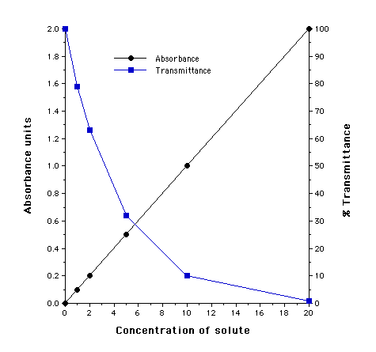

Slide 37
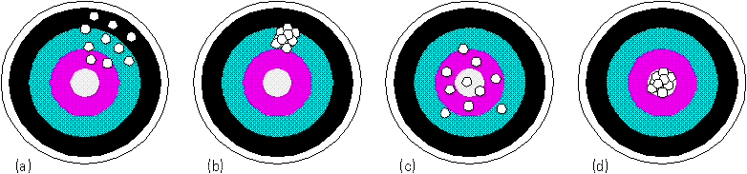
Precision and Accuracy
Precision –
Precision +
Precision –
Precision +
Accuracy –
Accuracy –
Accuracy +
Accuracy +

Slide 38
Spectral changes can be classed as follows:
1- bathochromic shift: The shift of λmax to longer wavelength; known by red shift, due to substitution and /or solvent effect.
2- Hypsochromic shift: The shift of λmax to shorterwavelength; known by blue shift, due to substitution and /or solvent effect.
3- Hyperchomic effect: An increase in absorption intensity (absorptivity).
4- Hypochomic effect: An decrease in absorption intensity (absorptivity).

Slide 39
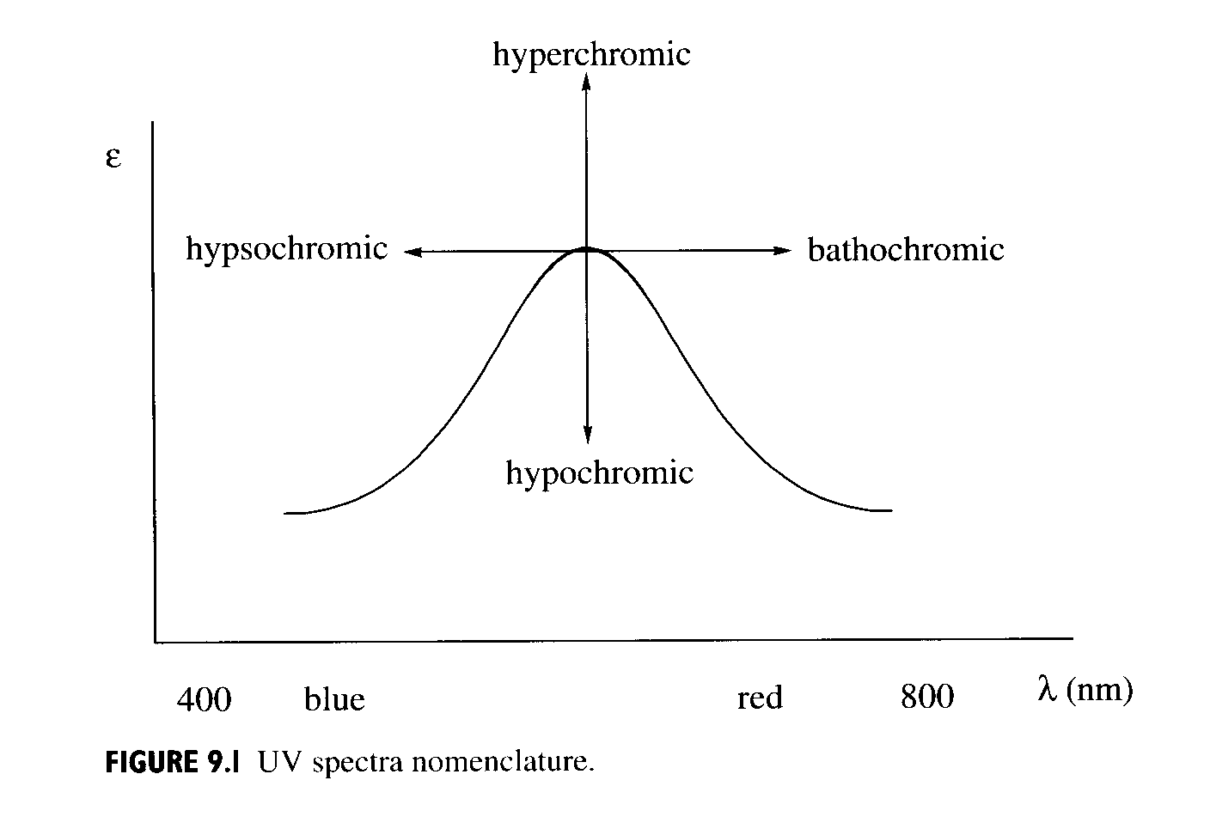
Spectral nomenclature of shifts

Slide 40
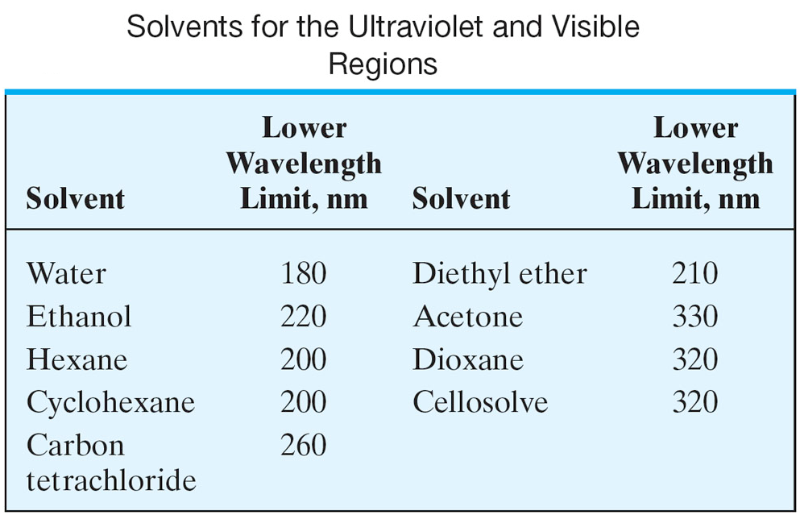
Optically clear solvent concept

Slide 41
Calibration methods
1- standard calibration curve
2- standard addition method

Slide 42
UV-Vis Spectroscopy
UV- organic molecules
  Outer electron bonding transitions
  conjugation
Visible – metal/ligands in solution
  d-orbital transitions

Slide 43
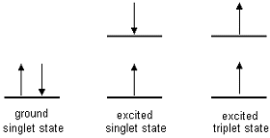
Selection Rules
In electronic spectroscopy there are three selection rules which determine whether or not transitions are formally allowed:
Spin selection rule: ΔS = 0
allowed transitions: singlet → singlet or triplet → triplet forbidden transitions: singlet → triplet or triplet → singlet
Changes in spin multiplicity are forbidden

Slide 44

Selection rules
2. Laporte selection rule: there must be a
change in the parity (symmetry) of the complex.
Laporte-allowed transitions: g → u
Laporte-forbidden transitions: u → u or g → g

Slide 45
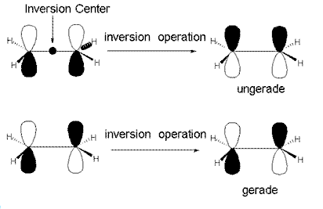
g and u form
(u; odd)
(g; even)
d orbital are (g) and (p) orbital are u

Slide 46
3. Selection rule of Dℓ = ± 1 (ℓ is the azimuthal or orbital quantum number, where ℓ = 0 (s orbital), 1 (p orbital), 2 (d orbital), etc.)
allowed transitions: s → p, p → d, d → f, etc.
forbidden transitions: s → s, d → d, p → f, etc.

Slide 47
d-d transitions
Characterized by low intensities (lower molecular absorptivities ε)
ε ∼ 10⁻² to10² (0.01-100)
Why?
d-d transition are Laporte-forbidden transitions
Involve g-g transition (d orbital are g)

Slide 48
Ligand to metal charge transfer complex (LMCT)
a. intramolecular e⁻ transfer from ligand-based orbitals to metal-based orbitals.
M^{n+___}L⁻ M ^{(n-1)+____}L
b. ε values are 5000-50,000 M⁻¹ cm⁻¹
(very intense)
Since we are “oxidizing” the ligand and “reducing” the metal, LMCT are favored with
i.Easily oxidized ligands (π-donors)
ii. Easily reduced metals (i.e. High oxidation state)

Slide 49
Ligand-to-Metal Charge Transfer (LMCT)
Occurs with metals in high oxidation states (few d electrons) complexed by ligands which are good electron-donors
Manganese(VII) has no d electrons, while the O²⁻ (oxide) ligands donate lone pairs of electrons to form double bonds
Permanganate anion

Slide 50
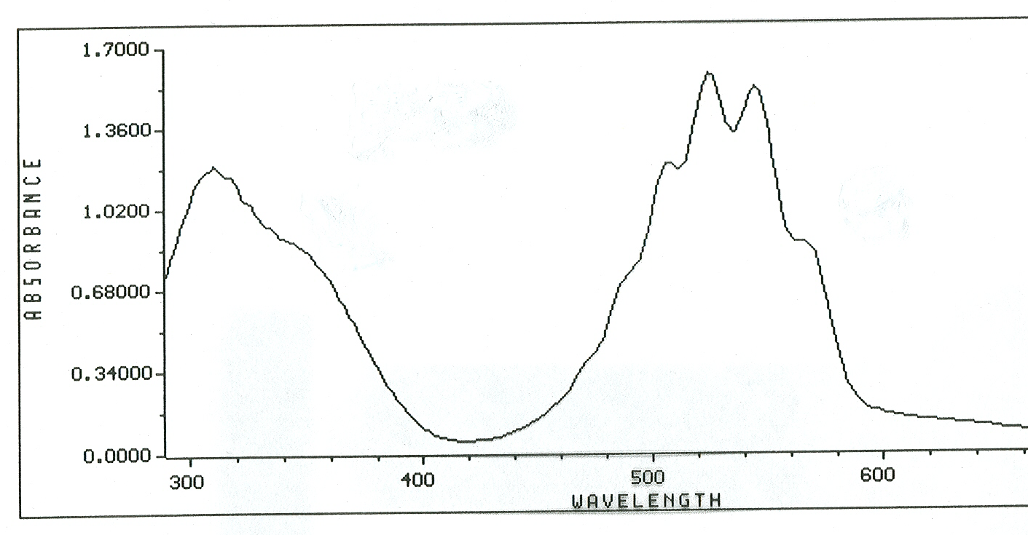
UV-Visible spectrum of MnO₄⁻
Lπ → M(t_{2g})
Lπ → M(e_{g})

Slide 51
Metal to ligand charge transfer complex (MLCT)
a. intramolecular e⁻ transfer from metal-based orbitals to ligand-based orbitals.
M___L M ^{+____}L –
b. Similar to LMCT in terms of intensities.
c. Not as common as LMCT.

Slide 52
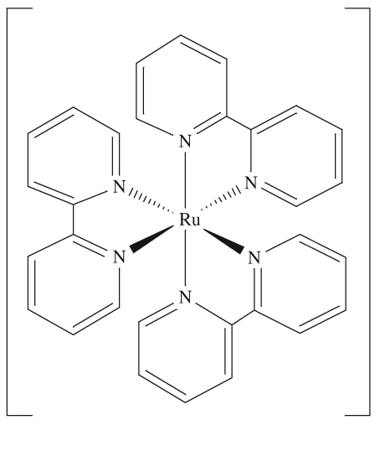
Metal-to-Ligand Charge Transfer (MLCT)
Occurs with metals in low oxidation states (lots of d electrons) complexed by ligands which are good electron-acceptors
Ruthenium(II) has 6 d e⁻
2,2’-bipyridine is a good π-acceptor ligand
Ru(2,2’-bipyridine)₃²⁺

Slide 53
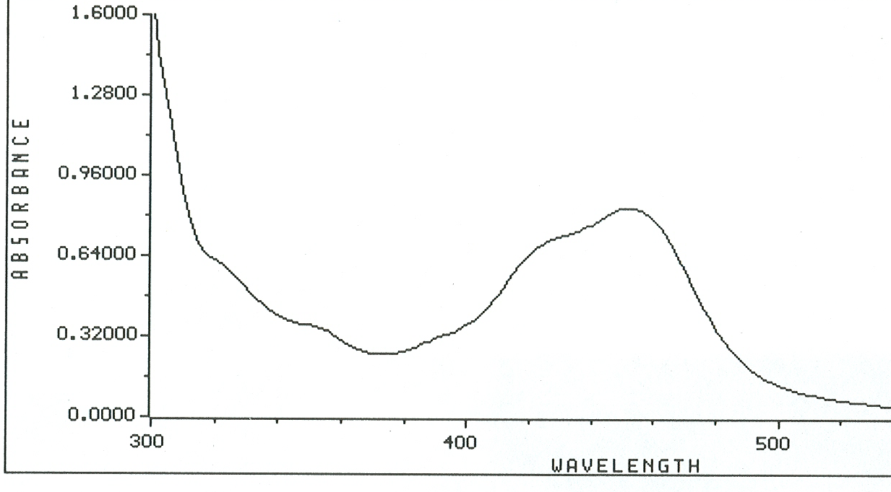
Visible spectrum of Ru(2,2’-bipyridine)₃²⁺
[Ru(bpy)₃]²⁺ MLCT
λ_{max} = 452 nm ε = 14,600 M⁻¹ cm⁻¹

Slide 54
Absorption by Inorganic Groups
Inorganic groups containing double bonds absorb in the UV-Vis region. The most transitions are a result of n-π* transitions as in nitrate (313 nm), carbonate (217 nm), nitrite (280 and 360 nm) and azide (230 nm)

Slide 55
Absorption Involving d and f Orbitals
Many transition metals have colored solutions and are also colored in the solid state.
The transition metals have some of their d orbitals empty where a d-d transition can occur.
The d-d transitions require excitation energy in the UV-Vis region. The direct interaction of the d electrons with ligands around the transition metal results in a spectrum of broad band nature.
On the other hand, inner transition elements show transitions by absorption of UV-Vis radiation (f-f transitions).

Slide 56
Since the electrons in the f orbitals are far inside the metal orbitals and are screened by electrons in orbitals of higher principal quantum numbers, f-f electronic transitions will not be affected by the nature of ligands or solvent around the inner transition metals.
Therefore, the spectra of inner transition metals have narrow bands.
Absorption Involving d and f Orbitals

Slide 57
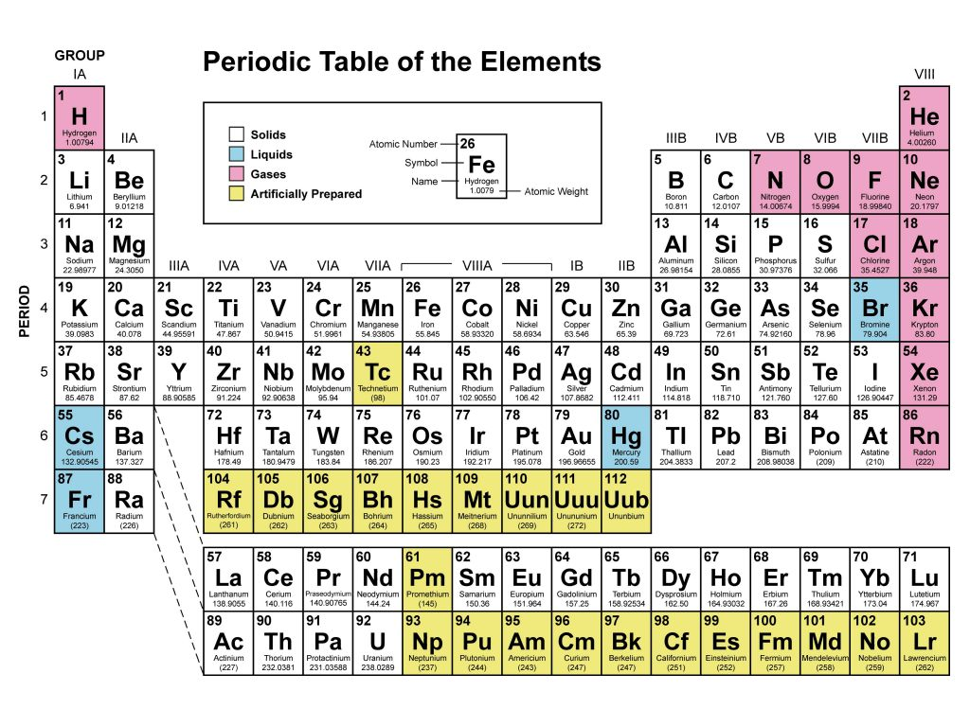

Slide 58
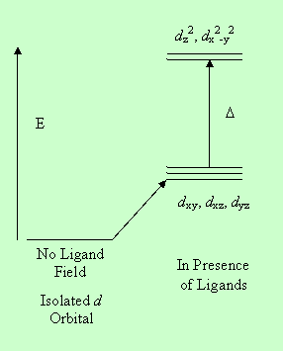
The crystal field theory is usually used to explain splitting of the d orbital energy so that a transition from a lower energy d orbital electron can be excited to a higher energy d orbital.

Slide 59
Charge Transfer Absorption
When a ligand permanently donates an electron to a metal ion, a charge transfer is said to take place.
The net outcome of the process is an oxidation reduction phenomenon occurring within the complex.
An example is the reaction of Fe³⁺ with thiocyanate where the product is an excited species with neutral thiocyanate and Fe³⁺.

Slide 60
In less common situations, the transfer of electrons can take place from the electron deficient metal ion to the ligand.
An example is the Fe²⁺ or Cu⁺ complexes with 1,10-phenanthroline where Fe²⁺ and Cu⁺ metal ions donate electrons to 1,10-phenanthroline. The complex will then have Fe³⁺ and Cu²⁺ ions.
Charge transfer complexes are of special interest their molar absorptivities are unusually high; allowing very sensitive determinations.

Slide 61
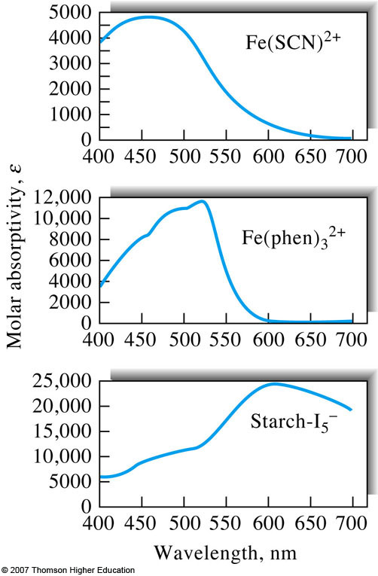

Slide 62
Absorption in the UV-VIS Region
Chemical species that can form soluble complexes with chromophoric reagents.
Examples
  → thiocyanate ion for iron, cobalt, & molybdenum;
  → diethyldithiocarbamate for copper;
  → diphenylthiocarbazone for lead;
  → 1,10-phenanthroline for iron.

Slide 63
Limitation of UV-visible spectroscopy
1. Deviation from beer´s law
Positive deviation
Negative deviation
2. Instrumental deviation
Noise originating from the light source and electronicComponents:
Baseline flatness as the intensity of the radiation coming
from the light sources is not constant over the whole UV-Visible range.
3. Chemical deviation
mixtures of molecules can be a problem due to overlap (hence, routinely requires significant sample preparation)

Slide 64

Thanks

