Slide 1
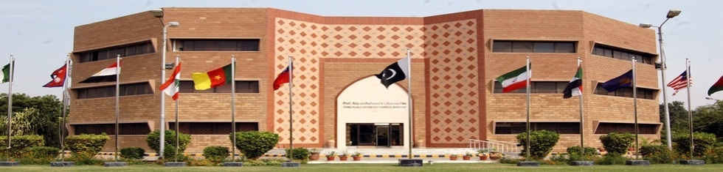
NCEAC Sept 25 2013
UV-Visible spectroscopy – an economic tool for trace metal analysis

Slide 2
Trace metal analysis
Environmental monitoring of heavy metals is of great importance for ecological assessments as well as for understanding the spread of these as pollutants
Due to their toxicity, even at low concentrations, Pb, Cd, As, Hg, Al, Cr are key elements, while Cu, Zn, Ni, Co, Se, Bi are important because they may play a vital or a toxic role, depending on their concentrations and the nature of the considered organisms.
Their biogeochemical role also strongly depends on their physico-chemical forms.

Slide 3
Physical Methods to Characterize Trace Metals
  Atomic absorption spectroscopy
  UV-visible spectroscopy
  Fluorescence spectroscopy
  CD spectroscopy
  Mossbauer spectroscopy
  Electrochemical methods
  Inductively Coupled Plasma-AES
  Medium resolution methods
  EPR spectroscopy
  EXAFS
  High resolution methods
  NMR spectroscopy
  X-ray diffraction

Slide 4
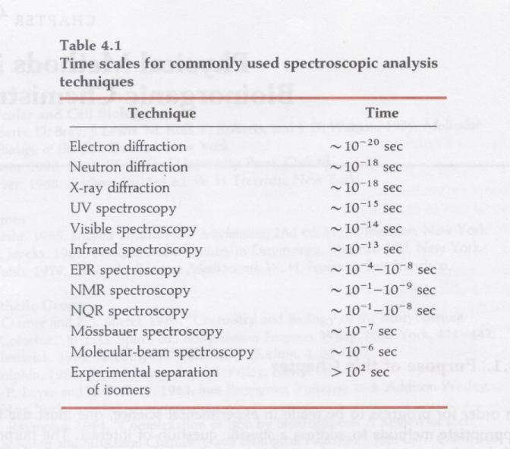
Time scale of spectroscopic techniques
very fast
fast
time scales are determined by the frequency of light
very fast reactions (e.g. electron transfer reactions) require very fast spectroscopic methods to follow the reactions

Slide 5
UV-Vis Spectroscopy
UV- organic molecules
  Outer electron bonding transitions
  Conjugation
Visible – metal / ligands in solution
  d-orbital transitions

Slide 6
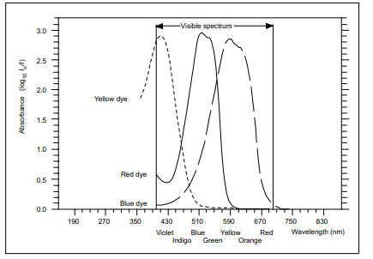
Violet Red

Slide 7
Beer-Lambert Law
The absorption at any wavelength obeys the Beer-Lambert Law:
A = log(Io/I) = εcb
where A = absorbance
Io = incident light intensity
I = transmitted light intensity
ε = molar absorptivity at a particular wavelength
c = molar concentration
b = path length through the absorbing medium

Slide 8
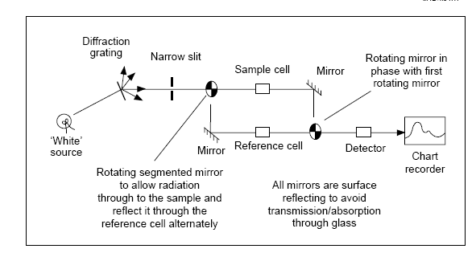
Design of UV-Visible Spectrophotometer
Notes:
A hydrogen or deuterium discharge lamp for UV range
A Tungsten / halogen lamp for visible range
Photomultiplier tube / photodiode

Slide 9
UV-Visible spectroscopy of metals
Transition metals
Can be studied either by due to their tendency to form coloured
compounds with inorganic molecules
or
from complexes usually with Organic molecules which may not be
necessarily be coloured.
Colors of transition metal complexes result from absorption
of a small portion of the visible spectrum with transmission of
the unabsorbed frequencies.
Notes:
Variable oxidation states
Unlike s-block elements, which are limited to oxidation numbers of +1 (for group 1), or +2 (for group 2), transition metals can form a huge variety of oxidation states. This is because of their successive ionisation energies.

Slide 10
Why some metal salts are white and some coloured ?

Slide 11
Absorb in UV range - colourless Absorb Visible range – coloured
Na+ ions
Colourless
3d -----
3p ---
3s -
ΔE higher
between
2p and 3s
2p
2s
Cu²⁺ ions coloured
--
3d ----- ΔE
--- small
Electronic transition happens in Visible range
Notes:
Colour of d-d transitions depends on magnitude of ΔE

Slide 12
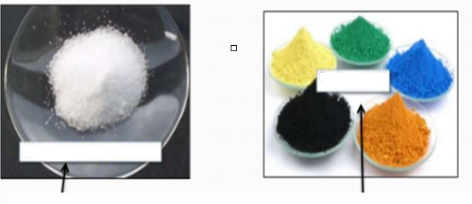
Ultraviolet and visible spectroscopy
200 UV 400 | 400 Visible 700 nm
Group 1 & 2 metal salts are colourless Absorb radiation in UV region No splitting of 3d orbital Electronic transition between filled 2p orbital with unfilled 3s 3p orbitals | Transition Metal ions are coloured (3d orbitals) Absorb radiation in Visible range Splitting of d orbitals Electronic transition between split 3d orbitals happens in visible region

Slide 13
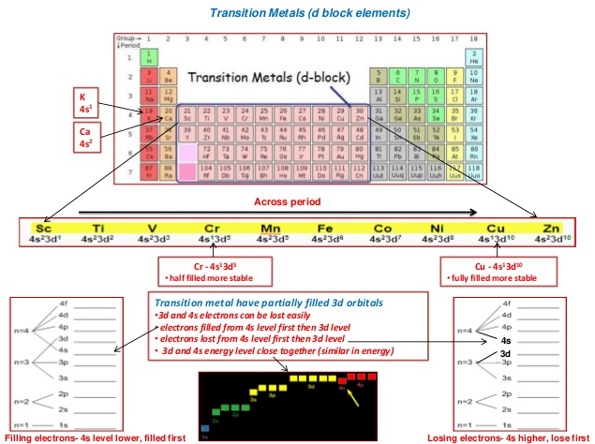

Slide 14
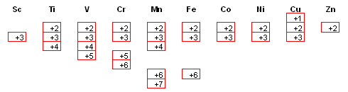
Table showing the most common oxidation states of some of the transition metals:
The shapes of the 3d orbitals
There are five 3d orbitals called
3d_{xy}
3d_{xz}
3d_{yz}
3d_{x}² _{- y}²
3d_{z}²
Notes:
Copper is the only element above in which the +1 ion is important.
Ag ox no +1 coord no 2
Co ox no +2 coord no 4
Ni ox no +2 coord no 6
Ni ox no +2 coord no 6
Pt ox no +2 coord no 4

Slide 15
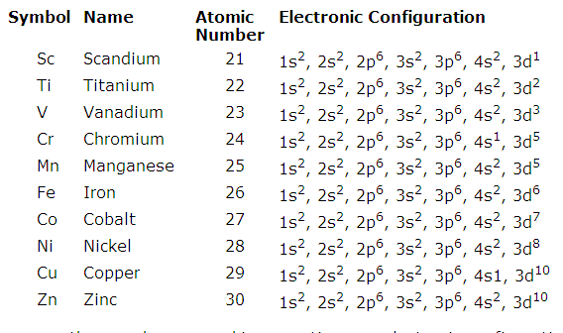
The transition metals are in the middle section of periodic Table. The most common are first row transition metals as below
4p
4p
4p
4p
4p
4p
4p
4p
4p
4p
Notes:
Also remember that when forming ions, they all start by losing the 4s electron first, then the 4d electrons. The d electrons are loosely bound, which contributes to the high electrical conductivity and malleability of the transition elements. The transition elements have low ionization energies. They exhibit a wide range of oxidation states or positively charged forms. The positive oxidation states allow transition elements to form many different ionic and partially ionic compounds. The formation of complexes causes the d orbitals to split into two energy sublevels, which enables many of the complexes to absorb specific frequencies of light. Thus, the complexes form characteristic colored solutions and compounds. Complexation reactions sometimes enhanc

Slide 16
The crystal field theory is usually used to explain splitting of the d orbital energy so that a transition from a lower energy d orbital electron can be excited to a higher energy d orbital.
The theory describes a transition metal with six ligands or molecules of water around it.
An octahedral arrangement of these ligands is most appropriate where ligands will be located at the z axis and at the x and y axis (will repel electronic cloud in the d_{z2} and d_{x2-y2} orbitals and thus will make these two orbitals to have higher energies).
The other four ligands will be arranged in between axis (d_{xy}, d_{xz}, and d_{yz}) which will increase their energies but to a lower extent.

Slide 17
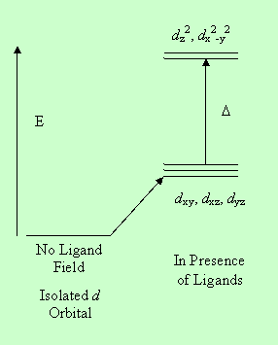

Slide 18
Colour formation of transition metals due to splitting of 3d orbitals by ligands
Metal ion without any ligand :
3d orbitals are in the same energy levels i.e.
all the five d orbitals are equal in energy
Metal ion in presence of a ligand :
Splitting of 3d orbitals i.e.
Five d orbitals are unequal in energy

Slide 19
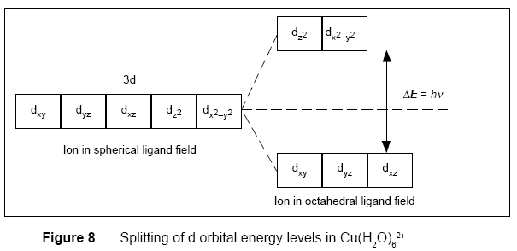

Slide 20
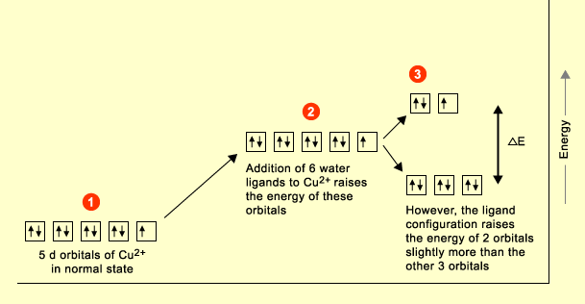
The UV-Vis spectra of transition metal complexes arise as a result of electronic transitions ,these are known as d-d transitions and relate to excitation of the metal ion itself.
Transition metals are often defined as forming one or more stable ions with incompletely filled d orbitals. It is believed that these are involved in generating colour.
When ligands bond to a transition metal ion to form a complex, electrons in the ligands and electrons in the five d orbitals of the metal ion repel each other. The net effect is that the energies of the d orbitals are raised, however they are split into two groups of differing energy.

Slide 21
Copper complexes
Uncomplexed copper(II) --- is in white color
(reason : because the transition between the highest occupied and the lowest occupied orbital is at too short a wavelength to see.
Whereas in hydrated Cu(II) for the energy level of 3d orbitals splits and when visible light absorbs a transition is possible).
For detail see below ….

Slide 22
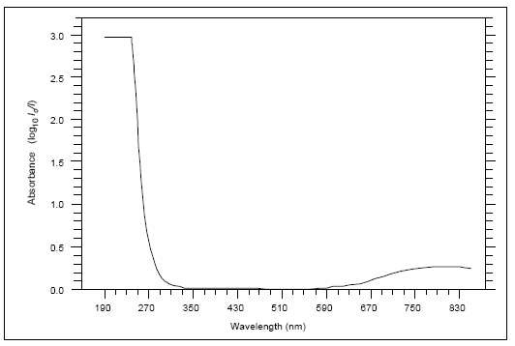
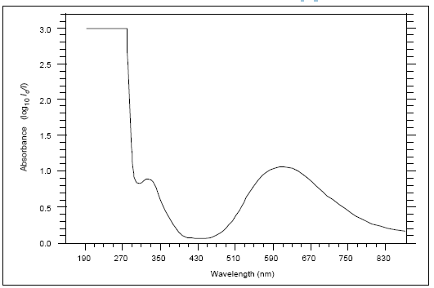
Effect of change of ligand on the UV-Vis. absorption of metal ion
Ultraviolet/visible spectrum of Cu(H₂O)₆ ²⁺
Ultraviolet/visible spectrum of
Cu(NH₃)₄(H₂O)₂ ²⁺
Same conc. But different molr absorptivity ?
Absorption in red end, so the complex appears blue
Absorption in blue (middle) region so the complex appears as violet -blue
Notes:
The amount of splitting of energy levels depend upon ligand so if ammonia replaces water the delta E increase the colour of complexes becomes blue-violet as absorption occurs in the middle of the visible spectrum. Note that the molar absorption spectrum is larger as both spectra contain same concentration of Copper (II) ions.
Factors affecting magnitude of ∆E
1. Oxidation state of metal e.g.
2. Position of metal in periodic table
3. Type of ligand in spectrochemical series

Slide 23
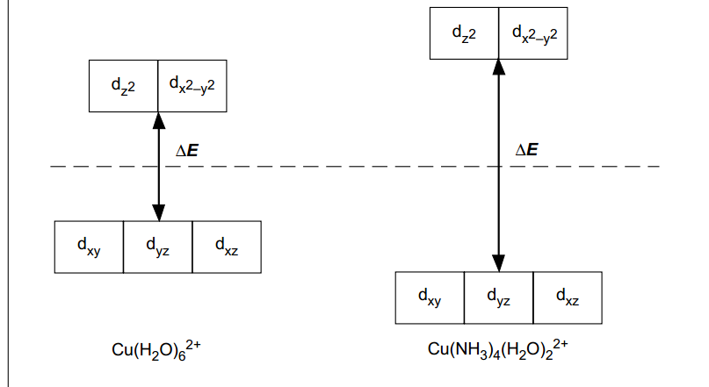
Stability of metal complex
Changing the ligand around transition metal ion can change the stability.
Reason : Because the difference between the energy levels of the d orbitals increases.
Notes:
Stability of complex means the extent to which the complex will form or dissociate into its constituents.
Colour of d-d transitions depends on magnitude of ΔE

Slide 24
Some ligands give increasingly separation energy levels and therefore increasing stability to the metal ions :
I ⁻ smallest separation of energy levels
Br ⁻
Cl ⁻
OH ⁻
F ⁻
H₂O
NH₃
NH₂CH₂CH₂NH₂
bpy
phen
CN⁻ largest separation of energy levels
Notes:
Weak field ligands ---- strong field ligands

Slide 25
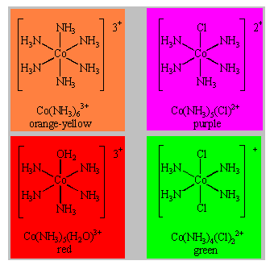

Slide 26
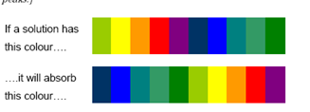

Slide 27
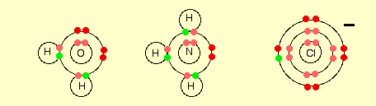
Simple ligands such as water, ammonia and chloride ion
Notes:
What all these ligands have got in common is active lone pairs of electrons in the outer energy level. These are used to form co-ordinate bonds with the metal ion. All ligands are lone pair donors. In other words, all ligands function as Lewis bases.

Slide 28
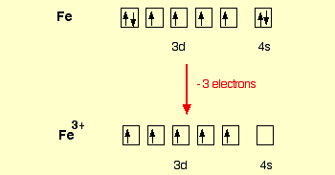
Example
Fe has the configuration ;
1s²2s²2p⁶3s²3p⁶3d⁶4s²
When it forms an Fe³⁺ ion it loses the 4s electrons and one of the 3d electrons to leave
1s²2s²2p⁶3s²3p⁶3d⁵
The single electrons in the 3d level are NOT involved in the bonding in any way. Instead, the ion uses 6 orbitals from the 4s, 4p and 4d levels to accept lone pairs from the water molecules. Before they are used, the orbitals are re-organised (hybridised) to produce 6 orbitals of equal energy.

Slide 29
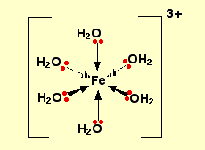
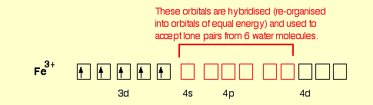
The orbitals are re-organised (hybridised) to produce 6 orbitals of equal energy.

Slide 30
Copper complexes Example
Uncomplexed copper(II) ions appear white or colourless because the transition between the highest occupied orbital and the lowest unoccupied orbital is at too short a wavelength to see.
In hydrated copper (II) ions the energy levels of the 3d orbitals are split, and when visible light is absorbed a transition is possible. For the hydrated copper (II) ion the absorption occurs at the red end of the spectrum, hence the complex appears blue.

Slide 31
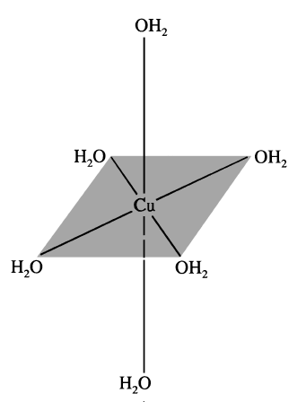
[Cu(H2O)6]⁺³ ------------> Electrons in 3d orbitals
with 6 ligands (H2O) approaching octahedrally.
Metal ion surrounded by ligands
Ligands water approaches the electrons in the 3d orbitals
and splits the 3d orbital into 2 different energy levels

Slide 33
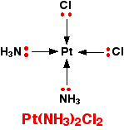
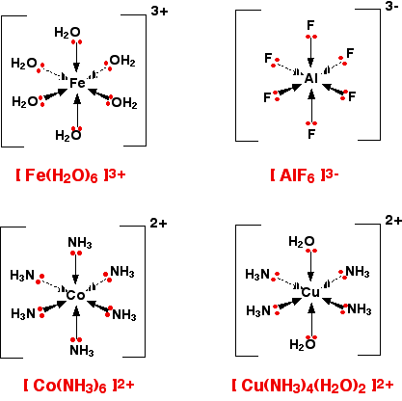
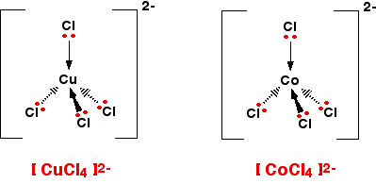
A square planar complex
Octahedral complexes Tetradehdral complexes
Notes:
6-co-ordinated complex ions : These are complex ions in which the central metal ion is forming six bonds. In the simple cases we are talking about, that means that it will be attached to six ligands. These ions have an octahedral shape. Four of the ligands are in one plane, with the fifth one above the plane, and the sixth one below the plane. These ions have an octahedral shape. Four of the ligands are in one plane, with the fifth one above the plane, and the sixth one below the plane.
Cisplatin is a neutral complex, Pt(NH₃)₂Cl₂. A square planar complex. It is neutral because the 2+ charge of the original platinum(II) ion is exactly cancelled by the two negative charges supplied by the chloride ions.

Slide 34
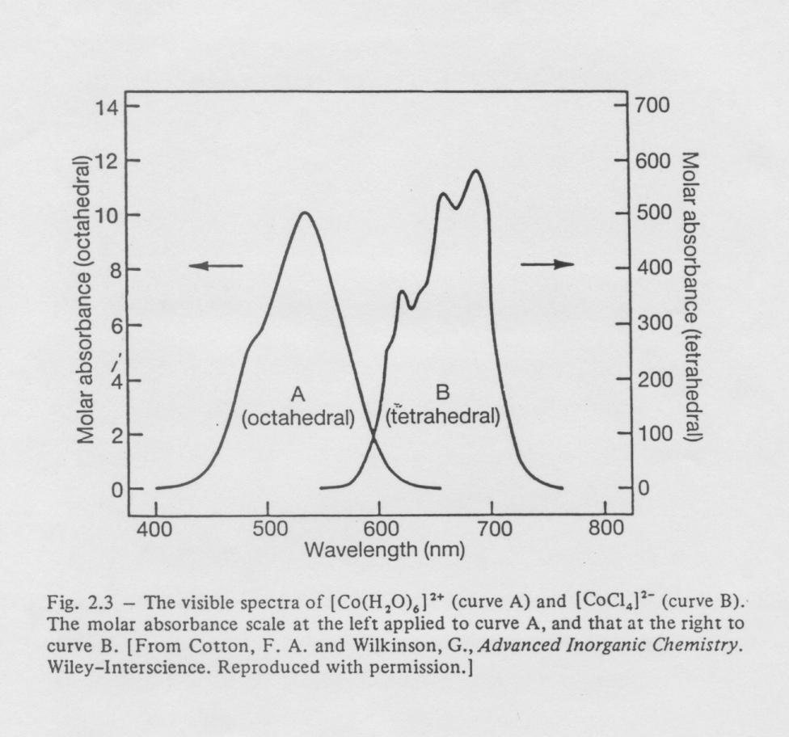
UV-visible spectroscopy
Co(II) complexes
Tetrahedral Co(II) complexes have higher transition probabilities (greater molar absorbance) with lower transition energies (higher wavelengths)
Notes:
Co (II) complexes Octahedral pale-pink, tetrahedral bright-blue,

Slide 35
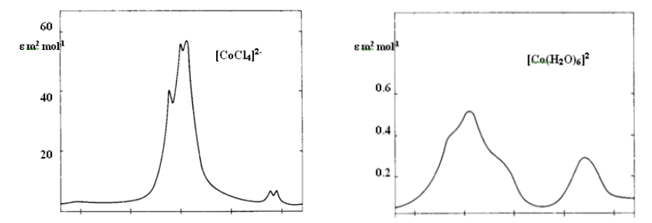
Tetrahedral complexes are usually more strongly coloured than analogous octahedral complexes
400 800
Tetrahedral complex, [CoCl₄]²⁻4-co-ordinated complex ions
400 600
Octahedral complex, [CoCl₄]²⁻
6-co-ordinated complex ions

Slide 36
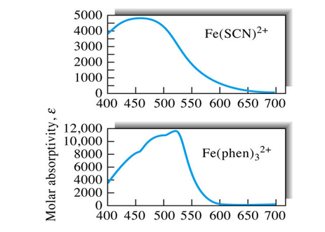

Slide 37
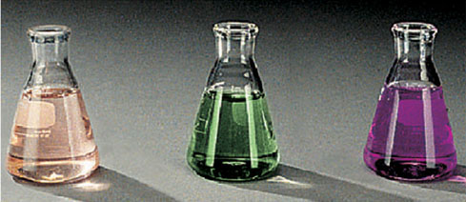
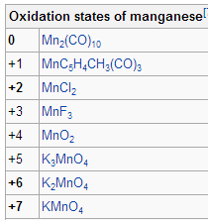
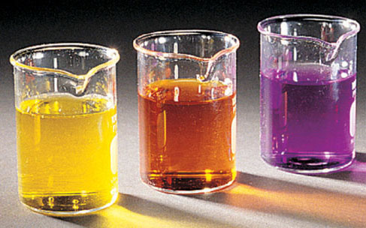
Aqueous oxoanions of transition elements
One of the most characteristic chemical properties of these elements is the occurrence of multiple oxidation states.
Mn(II)
Mn(VI)
Mn(VII)
Mn(VII)
Cr(VI)
V(V)
Notes:
The most stable oxidation state for manganese is +2, which has a pale pink color, and many manganese(II) compounds are known, such as manganese(II) sulfate (MnSO₄) and manganese(II) chloride (MnCl₂).

Slide 38
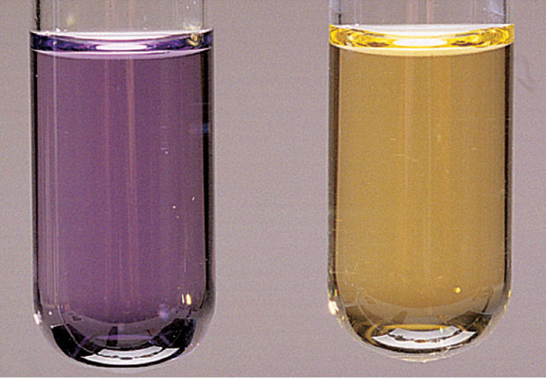
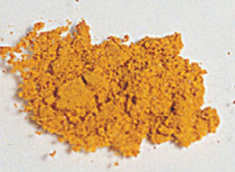
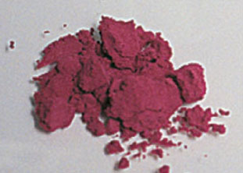
Effects of the metal oxidation state and of ligand identity on color
[V(H₂O)₆]²⁺
[V(H₂O)₆]³⁺
[Cr(NH₃)₆]³⁺
[Cr(NH₃)₅Cl ]²⁺

Slide 39

EXAMPLE :
The Intensity of the colour depends on few factor and is measured by the absorbance
Absorbance is defined by the Beer-Lambert equation: A = log Io (Io/I) = ε.c.l
where A = absorbance Io = intensity of incident light; I = intensity of light after passing through the cell; ε = molar absorption coefficient; c = concentration; l = cell pathlength.
Typical Spectrum: Octahedral Cr(III) complex [Cr] = 0.002M
Calculation of ε: At 590 nm, A = 0.138
A = εcl,
0.138 = ε x 0.002M x 1 cm
ε = 0.138/ 0.002 x 1
ε = 69 M-1 cm-1
Transitions allowed by the selection rules
0
0.05
0.1
0.15
0.2
0.25
300 350 400 450 500 550 600 650 700
Wavelength nm

Slide 40
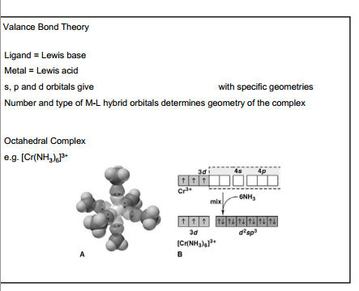

Slide 41
Metal interaction with Organic molecules

Slide 42
Schiff bases named after Hugo Schiff - a condensation between an aldehyde and an amine
Schiff base ligands are able to coordinate metals through imine nitrogen and another group usually linked to aldehyde. Schiff bases are an important class of ligands in coordination chemistry and find extensive application.
In present time active and well-designed Schiff base ligands are considered good chelating agents due to their ability to form complexes with a wide range of transition metal ions.
These complexes have played an important role in the development of coordination chemistry.

Slide 43
Synthesis of Schiff base – a typical ligand

Slide 44
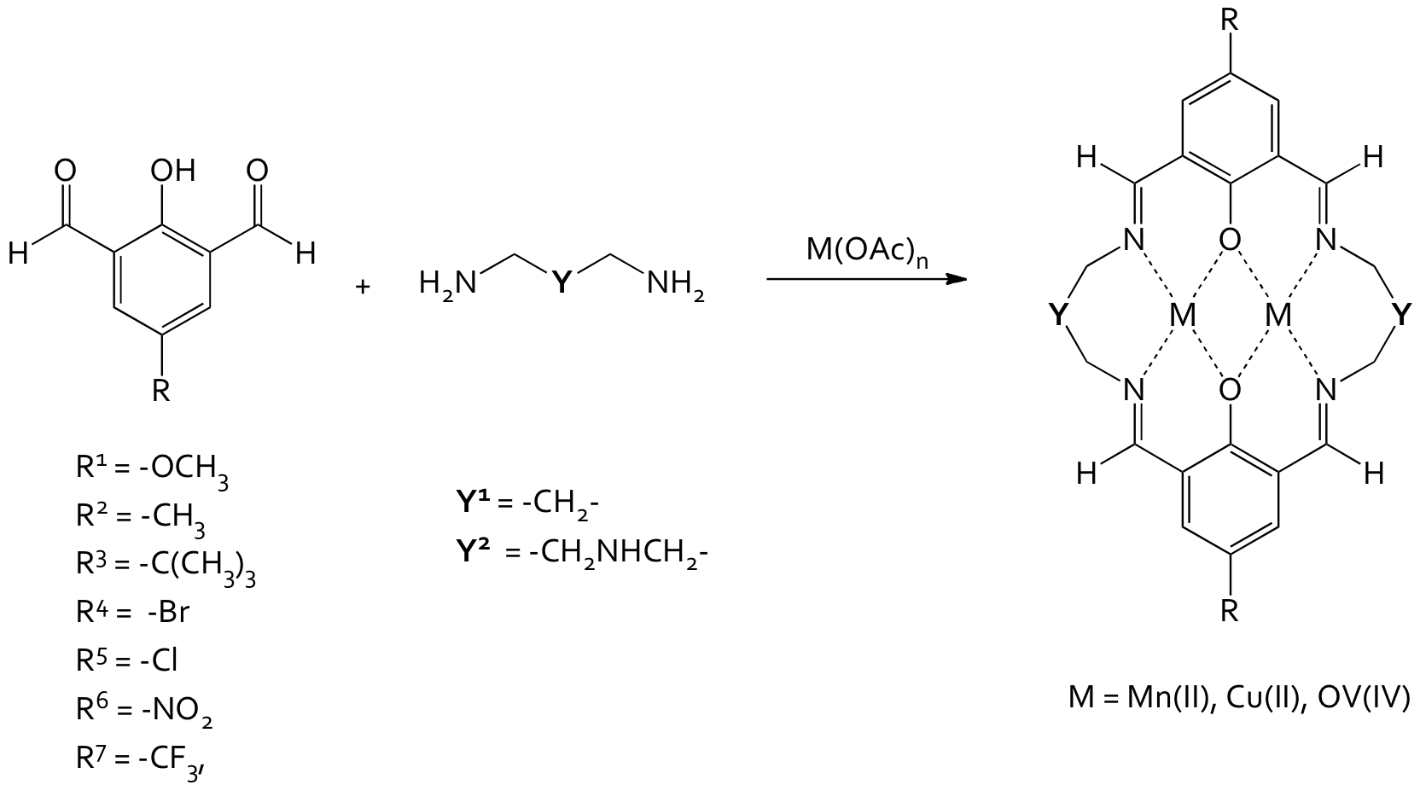
Schiff Base ;
Source : Vanessa P. McCaffrey, PhD , Albion College, Reports: UNI349494-UNI3:
Electronic Tuning of Magnetic Exchange in Phenoxy-bridged Dinuclear Transition Metal Complexes

Slide 45
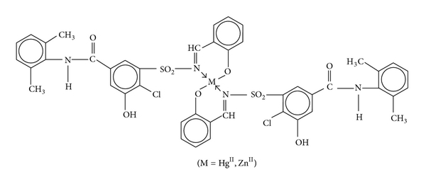
SOURCE: Synthesis, Characterization, and Biological Evaluation of Some 3d-Metal Complexes of Schiff Base Derived from Xipamide Drug, Suman Malik, Suparna Ghosh, Bharti Jain, Archana Singh and Mamta Bhattacharya, International Journal of Inorganic Chemistry, 2013

Slide 47
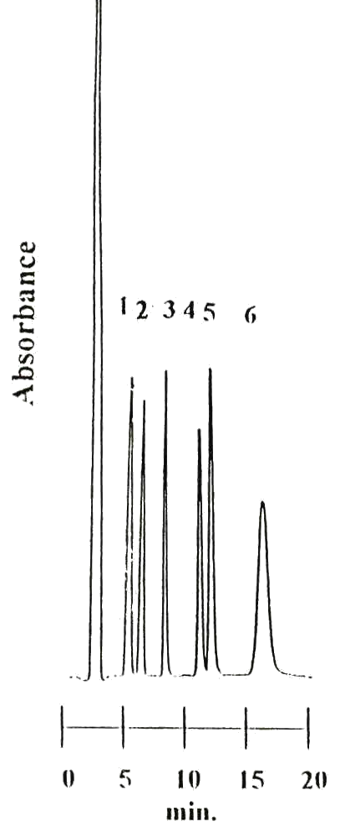
RP-HPLC separation of PMDTC complexes of Cr(III), Mn(II), Fe(III), Co(III), Ni(II) and Cu(II)
Cr(III)
Mn(II)
Fe(III)
Co(III)
Ni(II)
Cu(II)
Conditions: Column LiChrosorb ODS, 150 x 4.6 mm id, 5 µm, mobile phase methanol-water-1mM sodium acetate (70:28:02), flow-rate 1.2 ml/min, UV detection 260 nm.

Slide 48
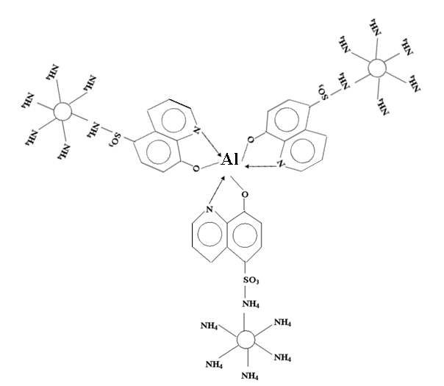
MLC of aluminum-8-hydroxyquinolate -5-sulfonic acid using CTAB as mobile phase

Slide 49
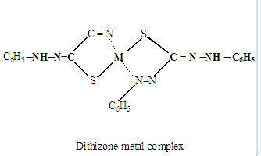
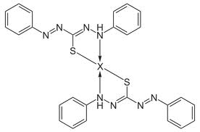

Slide 50
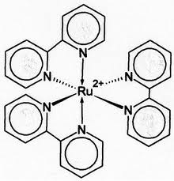
Absorption of radiation leading to electronic transitions within a molecule or complex
Tris(bipyridine)ruthenium(II)_chloride
Absorption
Absorption
[Ni(H₂O)₆]²⁺
10⁴
10
~14 000
25 000
50 000
200
400
700
UV
visible
visible
UV
λ / nm (wavelength)
−
ν / cm⁻¹ (frequency)
UV = higher energy transitions - between ligand orbitals
visible = lower energy transitions - between d-orbitals of transition metals
- between metal and ligand orbitals

Slide 51
IMPORTANCE OF METAL CHELATION
METHOD DEVELOPMENT STUDIES, (IN ENVIRONMENTAL POLLUTION)
2. THERMAL DEPOSITION OF METALS ON THE SURFACES FROM VAPOUR PHASE.
Study of protein – metal interactions or monitoring reactions with other biologically interesting molecules
3. ACTIVE AGAINST INFLUENZA, SMALLPOX, TUMOR, PESTS AND FUNGI.
4. CHELATION THERAPY
a). Thalassemia treatment
b). Decalcification

Slide 52
METHOD DEVELOPMENT STUDIES
(Few examples)

Slide 53
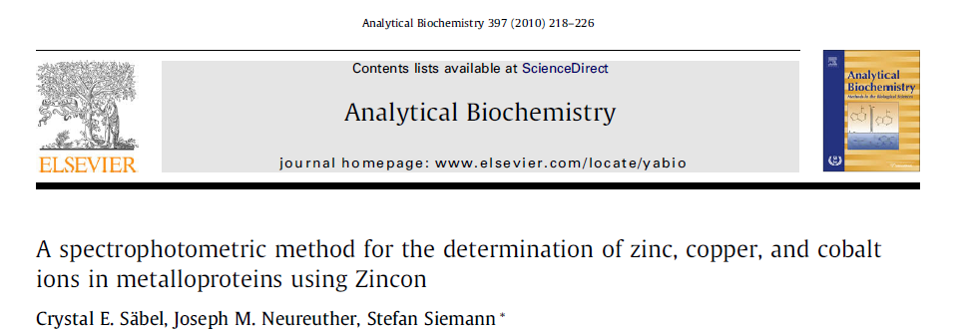

Slide 54
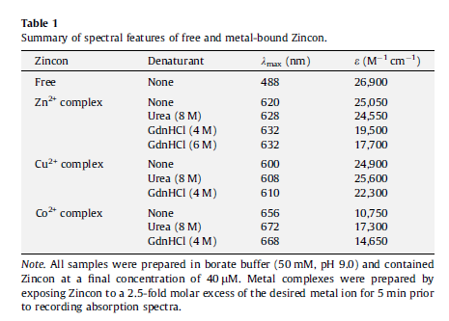
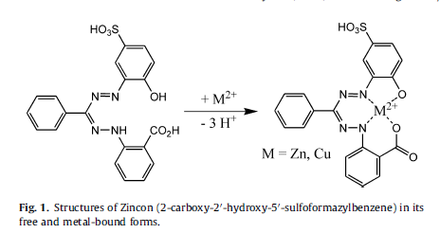

Slide 55
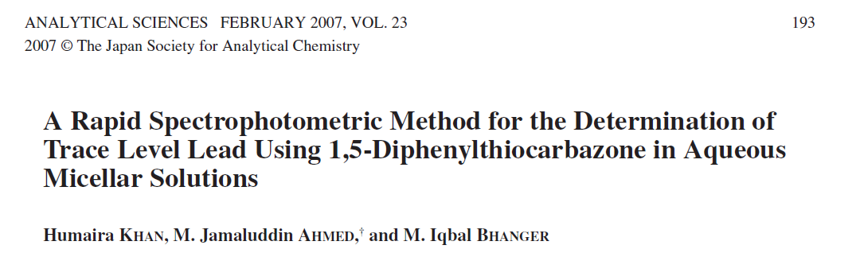

Slide 56
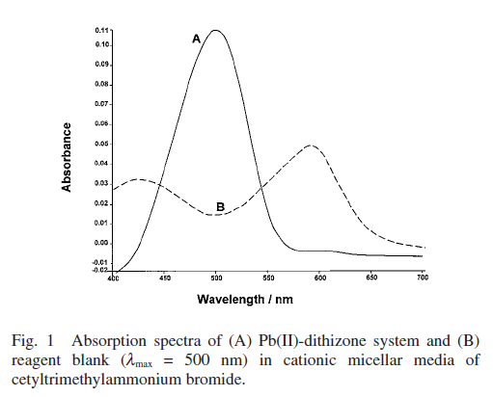
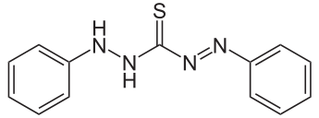

Slide 57
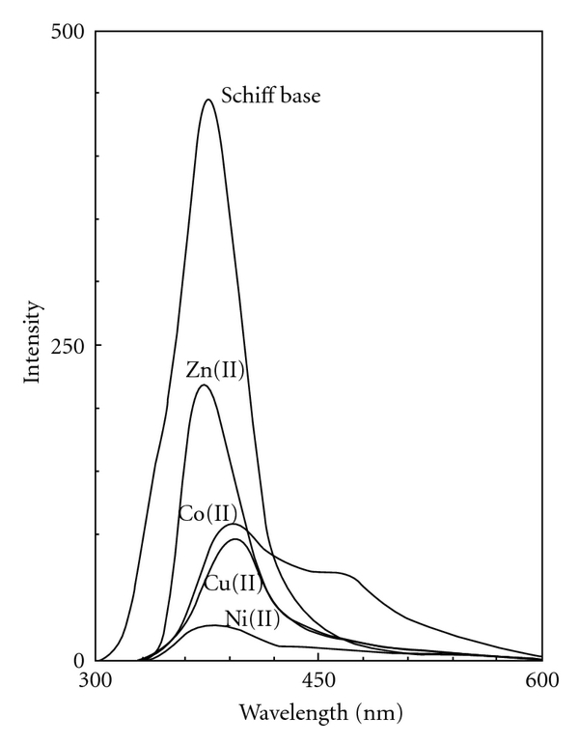
Thermal, Spectral, Fluorescence, and Antimicrobial Studies of Cobalt, Nickel, Copper, and Zinc Complexes Derived from 4-[(5-Bromo-thiophen-2-ylmethylene)-amino]-3-mercapto-6-methyl-5-oxo-[1,2,4]triazine
Kiran Singh et al. International Journal of Inorganic Chemistry Volume 2012 (2012),

Slide 58
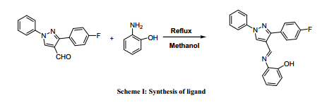
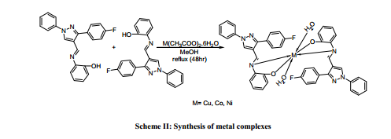
Synthesis and spectral studies of transition metal complexes supported by NO-bidentate Schiff-Base ligand
Manish K. Shah et al Der Chemica Sinica, 2013, 4(1):141-146
Notes:
The complexes were coloured and the ratio of metal to ligand are 1:2 in all complexes.
M = Cu, Co, Ni

Slide 59


A extraction-spectrophotometric method for the simultaneous determination of barium and strontium. The method is based on the formation of the ternary complexes with 18C6 and RB with barium and strontium.

Slide 60

Source : Jahanbakhsh GHASEMI, Alireza NIKRAH and Ali NIAZI
Extraction-Spectrophotometric Determination of Trace
Amounts of Barium and Strontium by 18-Crown-6 and
Rose Bengal Using Partial Least Squares, Turk J Chem 29 (2005) , 669-678.
Figure : Absorption spectra of barium and strontium ternary complexes and their mixture. (1) RB-18C6, (2) RB-Ba-18C6, Ba 5 _g mL−1, (3) RB-Sr-18C6, Sr 4.5 _g mL−1 (4) mixture of Ba 4 _g mL−1 and Sr 3 _g mL−1.

Slide 61


Applications of the reported methods
Anal. Chem. 2007

Slide 62
Study of protein – metal interactions or monitoring
Study of the interactions of metal complexes with
biological targets is of extreme interest in medicinal
Chemistry.
•It is known now that platinum complexes interact with
DNA, titanium complexes with proteins, gold(I) complexes interact with thioreductin reductase, gallium complexes with ribonucleotide reductase…
• This is due in part to the advances in some techniques
such as UV-vis, cyclovoltammetry, fluorescence, NMR, IR…

Slide 63

Removal of iron excess is the core of the treatment of iron overload caused by multiple transfusions for thalassemia syndrome.
Chronically transfused patients develop overload that leads to organ damage and ultimately to death.
Regular subcutaneous administration of deferoxamine has dramatically altered the prognosis of thalassemia major and is considered the standard iron chelation therapy at present .

Slide 64


Slide 65

Conclusion

Slide 66


