Slide 1
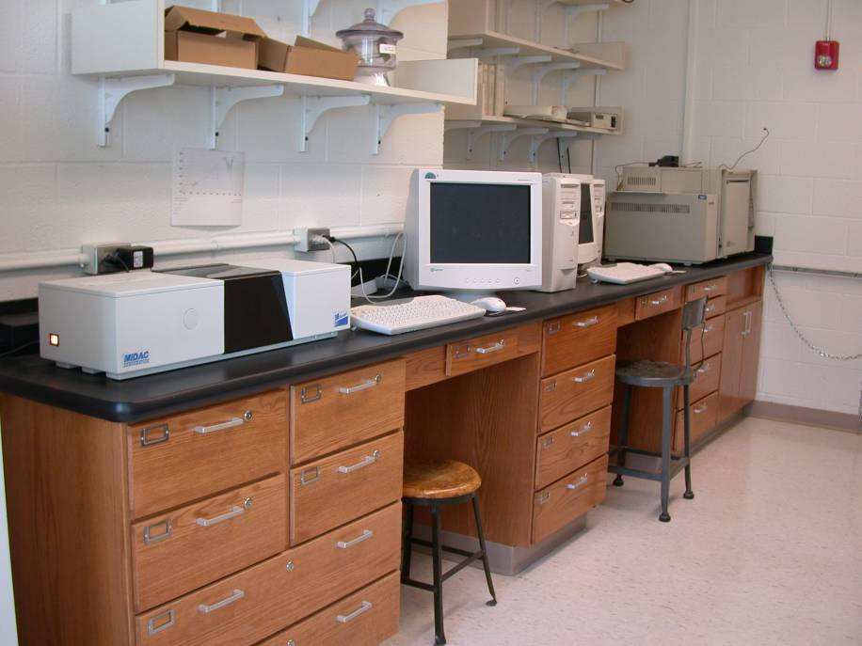
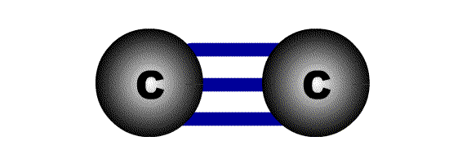
Infrared Spectroscopy
CHEM 210

Slide 2
IR Spectroscopy
Introduction
  Spectroscopy is the study of the interaction of matter with the electromagnetic spectrum
    Electromagnetic radiation displays the properties of both particles and waves
    The particle component is called a photon
    The energy (E) component of a photon is proportional to the frequency. Where h is Planck’s constant and ν is the frequency in Hertz (cycles per second)
    E = hν
    The term “photon” is implied to mean a small, massless particle that contains a small wave-packet of EM radiation/light – we will use this terminology in the course

Slide 3
IR Spectroscopy
Introduction
    Because the speed of light, c, is constant, the frequency, ν, (number of cycles of the wave per second) can complete in the same time, must be inversely proportional to how long the oscillation is, or wavelength:
    Amplitude, A, describes the wave height, or strength of the oscillation
    Because the atomic particles in matter also exhibit wave and particle properties (though opposite in how much) EM radiation can interact with matter in two ways:
      Collision – particle-to-particle – energy is lost as heat and movement
      Coupling – the wave property of the radiation matches the wave property of the particle and “couple” to the next higher quantum mechanical energy level
c
___
hc
ν =
___
 E = hν =
λ
λ
c = 3 x 10¹⁰ cm/s

Slide 4


IR Spectroscopy
Introduction
    The entire electromagnetic spectrum is used by chemists:
Frequency, ν in Hz
~10¹⁹
~10¹⁷
~10¹⁵
~10¹³
~10¹⁰
~10⁵
Wavelength, λ
~.0001 nm
~0.01 nm
10 nm
1000 nm
0.01 cm
100 m
Energy (kcal/mol)
> 300
300-30
300-30
~10⁻⁴
~10⁻⁶
γ-rays
X-rays
UV
IR
Microwave
Radio
nuclear excitation (PET) | core electron excitation (X-ray cryst.) | electronic excitation (π to π*) | molecular vibration | molecular rotation | Nuclear Magnetic Resonance NMR (MRI)
Visible

Slide 5
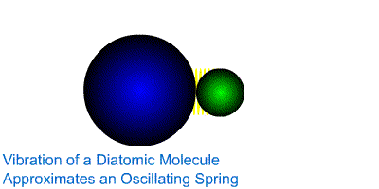
IR Spectroscopy
Introduction
  The IR Spectroscopic Process
    The quantum mechanical energy levels observed in IR spectroscopy are those of molecular vibration
    We perceive this vibration as heat
    When we say a covalent bond between two atoms is of a certain length, we are citing an average because the bond behaves as if it were a vibrating spring connecting the two atoms
    For a simple diatomic molecule, this model is easy to visualize:

Slide 6
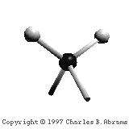
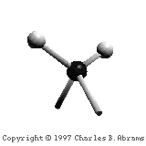
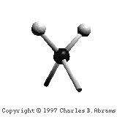
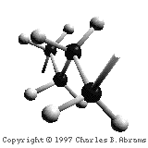
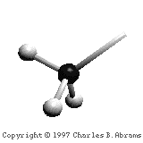
IR Spectroscopy
Introduction
  The IR Spectroscopic Process
    There are two types of bond vibration:
      Stretch – Vibration or oscillation along the line of the bond
      Bend – Vibration or oscillation not along the line of the bond
H
H
C
C
H
H
symmetric
asymmetric
H
H
H
H
C
C
C
C
C
C
C
C
H
H
H
H
scissor
rock
twist
wag
in plane
out of plane

Slide 7

Infrared Spectroscopy
The IR Spectroscopic Process
  As a covalent bond oscillates – due to the oscillation of the dipole of the molecule – a varying electromagnetic field is produced
  The greater the dipole moment change through the vibration, the more intense the EM field that is generated

Slide 8
Infrared Spectroscopy
The IR Spectroscopic Process
  When a wave of infrared light encounters this oscillating EM field generated by the oscillating dipole of the same frequency, the two waves couple, and IR light is absorbed
  The coupled wave now vibrates with twice the amplitude
IR beam from spectrometer
“coupled” wave
EM oscillating wave
from bond vibration

Slide 9
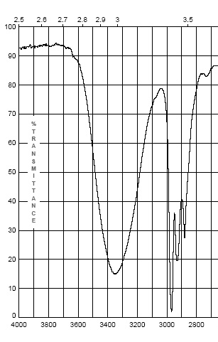
Infrared Spectroscopy
  The IR Spectrum
    Each stretching and bending vibration occurs with a characteristic frequency as the atoms and charges involved are different for different bonds
The y-axis on an IR spectrum is in units of % transmittance
In regions where the EM field of an osc. bond interacts with IR light of the same ν – transmittance is low (light is absorbed)
In regions where no osc. bond is interacting with IR light, transmittance nears 100%

Slide 10
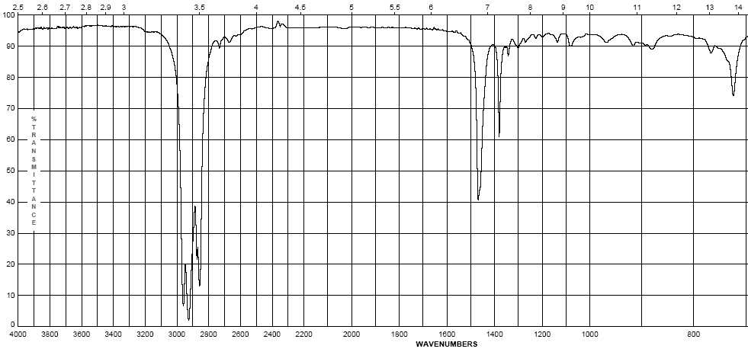
IR Spectroscopy
  The IR Spectrum
    The x-axis of the IR spectrum is in units of wavenumbers, ν, which is the number of waves per centimeter in units of cm⁻¹ (Remember E = hν or E = hc/λ)

Slide 11
IR Spectroscopy
  The IR Spectrum
    This unit is used rather than wavelength (microns) because wavenumbers are directly proportional to the energy of transition being observed – chemists like this, physicists hate it
      High frequencies and high wavenumbers equate higher energy
      is quicker to understand than
      Short wavelengths equate higher energy
    This unit is used rather than frequency as the numbers are more “real” than the exponential units of frequency
    IR spectra are observed for the mid-infrared: 600-4000 cm⁻¹
    The peaks are Gaussian distributions of the average energy of a transition

Slide 12
IR Spectroscopy
  The IR Spectrum
    In general:
    Lighter atoms will allow the oscillation to be faster – higher energy
      This is especially true of bonds to hydrogen – C-H, N-H and O-H
    Stronger bonds will have higher energy oscillations
        Triple bonds > double bonds > single bonds in energy
Energy/ν of oscillation

Slide 13
Infrared Spectroscopy
  The IR Spectrum – The detection of different bonds
    As opposed to chromatography or other spectroscopic methods, the area of a IR band (or peak) is not directly proportional to concentration of the functional group producing the peak
    The intensity of an IR band is affected by two primary factors:
      Whether the vibration is one of stretching or bending
      Electronegativity difference of the atoms involved in the bond
      For both effects, the greater the change in dipole moment in a given vibration or bend, the larger the peak.
      The greater the difference in electronegativity between the atoms involved in bonding, the larger the dipole moment
      Typically, stretching will change dipole moment more than bending

Slide 14
Infrared Spectroscopy
  The IR Spectrum – The detection of different bonds
    It is important to make note of peak intensities to show the effect of these factors:
      Strong (s) – peak is tall, transmittance is low (0-35 %)
      Medium (m) – peak is mid-height (75-35%)
      Weak (w) – peak is short, transmittance is high (90-75%)
      * Broad (br) – if the Gaussian distribution is abnormally broad
      (*this is more for describing a bond that spans many energies)
      Exact transmittance values are rarely recorded

Slide 15
Infrared Spectroscopy
II. Infrared Group Analysis
A. General
    The primary use of the IR is to detect functional groups
    Because the IR looks at the interaction of the EM spectrum with actual bonds, it provides a unique qualitative probe into the functionality of a molecule, as functional groups are merely different configurations of different types of bonds
    Since most “types” of bonds in covalent molecules have roughly the same energy, i.e., C=C and C=O bonds, C-H and N-H bonds they show up in similar regions of the IR spectrum
    Remember all organic functional groups are made of multiple bonds and therefore show up as multiple IR bands (peaks)

Slide 16
Infrared Spectroscopy
II. Infrared Group Analysis
A. General
    The four primary regions of the IR spectrum
Bonds to H
Triple bonds
Double bonds
Single Bonds
O-H N-H C-H | C≡C C≡N | C=O C=N C=C | Fingerprint Region C-C C-N C-O
4000 cm⁻¹
2700 cm⁻¹
2000 cm⁻¹
1600 cm⁻¹
600 cm⁻¹

Slide 17
Infrared Spectroscopy
Octane
  Alkanes – combination of C-C and C-H bonds
    C-C stretches and bends 1360-1470 cm⁻¹
    CH₂-CH₂ bond 1450-1470 cm⁻¹
    CH₂-CH₃ bond 1360-1390 cm⁻¹
    sp³ C-H between 2800-3000 cm⁻¹
(w – s)
(m)

Slide 18
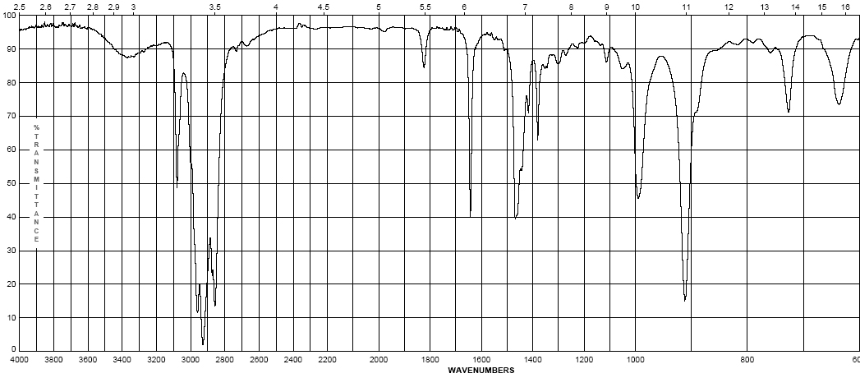
Infrared Spectroscopy
1-Octene
  Alkenes – addition of the C=C and vinyl C-H bonds
    C=C stretch at 1620-1680 cm⁻¹ weaker as substitution increases
    vinyl C-H stretch occurs at 3000-3100 cm⁻¹
    The difference between alkane, alkene or alkyne C-H is important! If the band is slightly above 3000 it is vinyl sp² C-H or alkynyl sp C-H if it is below it is alkyl sp³ C-H
(w – m)
(w – m)

Slide 19
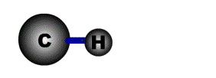
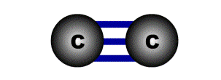
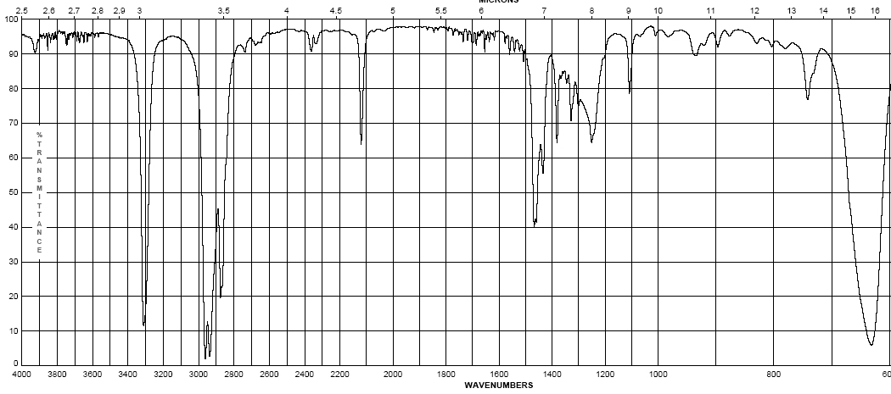
Infrared Spectroscopy
1-Octyne
  Alkynes – addition of the C=C and vinyl C-H bonds
    C≡C stretch 2100-2260 cm⁻¹; strength depends on asymmetry of bond, strongest for terminal alkynes, weakest for symmetrical internal alkynes
    C-H for terminal alkynes occurs at 3200-3300 cm⁻¹
    Internal alkynes ( R-C≡C-R ) would not have this band!
(w-m)
(m – s)

Slide 20
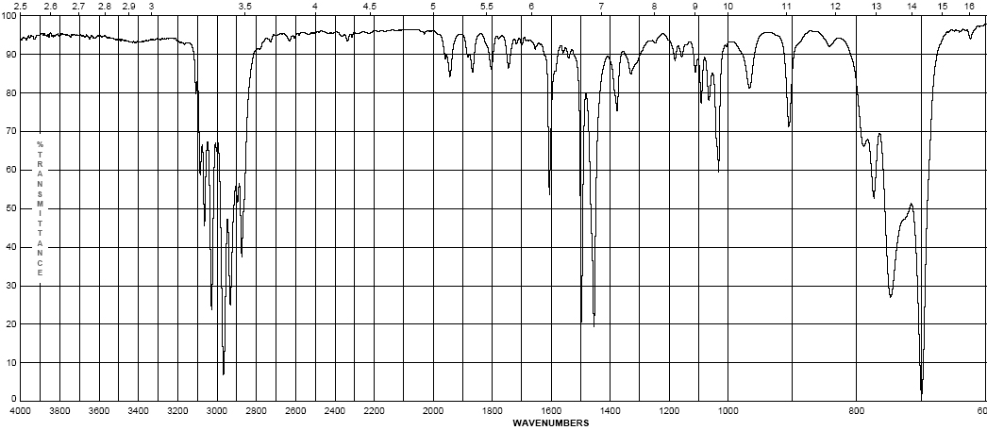
Infrared Spectroscopy
Ethyl benzene
  Aromatics
    Due to the delocalization of e⁻ in the ring, C-C bond order is 1.5, the stretching frequency for these bonds is slightly lower in energy than normal C=C
    These show up as a pair of sharp bands, 1500 & 1600 cm⁻¹, (lower frequency band is stronger)
    C-H bonds off the ring show up similar to vinyl C-H at 3000-3100 cm⁻¹
(w – m)
(w – m)

Slide 21
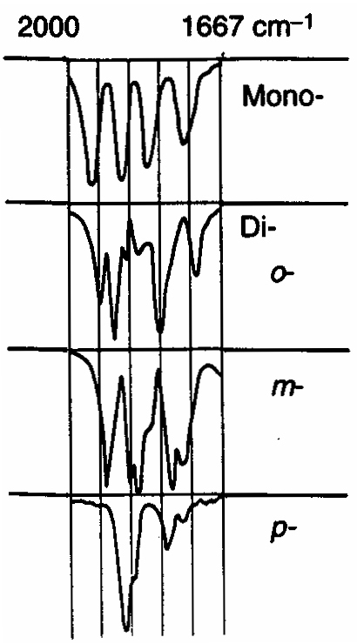
Infrared Spectroscopy
  Aromatics
    If the region between 1667-2000 cm⁻¹ (w) is free of interference (C=O stretching frequency is in this region) a weak grouping of peaks is observed for aromatic systems
    Analysis of this region, called the overtone of bending region, can lead to a determination of the substitution pattern on the aromatic ring
Monosubstituted
1,2 disubstituted (ortho or o-)
1,2 disubstituted (meta or m-)
1,4 disubstituted (para or p-)

Slide 22
Infrared Spectroscopy
  Unsaturated Systems – substitution patterns
    The substitution of aromatics and alkenes can also be discerned through the out-of-plane bending vibration region
    However, other peaks often are apparent in this region. These peaks should only be used for reinforcement of what is known or for hypothesizing as to the functional pattern.

Slide 23
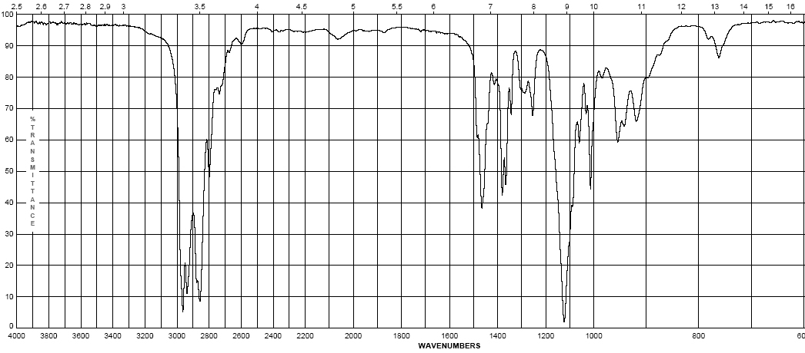
Infrared Spectroscopy
Diisopropyl ether
  Ethers – addition of the C-O-C asymmetric band and vinyl C-H bonds
    Show a strong band for the antisymmetric C-O-C stretch at 1050-1150 cm⁻¹
    Otherwise, dominated by the hydrocarbon component of the rest of the molecule
(s)

Slide 24
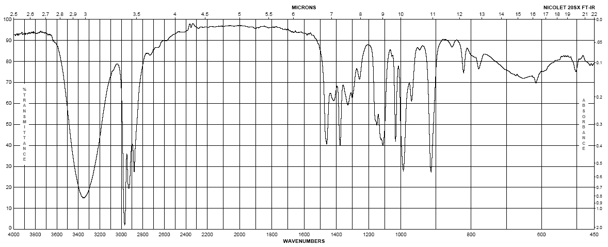
Infrared Spectroscopy
1-butanol
Alcohols
  Strong, broad O-H stretch from 3200-3400 cm⁻¹
  Like ethers, C-O stretch from 1050-1260 cm⁻¹
  Band position changes depending on the alcohols substitution: 1° 1075-1000; 2° 1075-1150; 3° 1100-1200; phenol 1180-1260
  The shape is due to the presence of hydrogen bonding
(m– s)
br
(s)

Slide 25
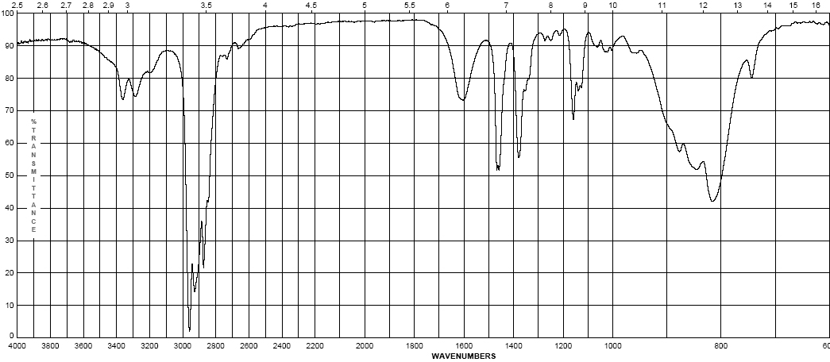
Infrared Spectroscopy
2-aminopentane
  Amines - Primary
    Shows the –N-H stretch for NH₂ as a doublet between 3200-3500 cm⁻¹ (symmetric and anti-symmetric modes)
    -NH₂ has deformation band from 1590-1650 cm⁻¹
    Additionally there is a “wag” band at 780-820 cm⁻¹ that is not diagnostic
(w)
(w)

Slide 26
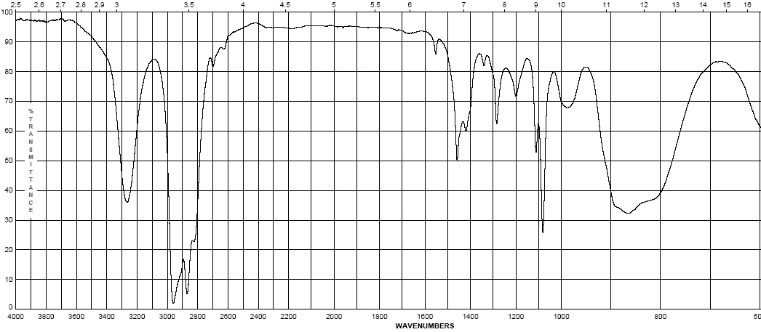
Infrared Spectroscopy
pyrrolidine
  Amines – Secondary
    N-H band for R₂N-H occurs at 3200-3500 cm⁻¹ as a single sharp peak weaker than –O-H
    Tertiary amines (R₃N) have no N-H bond and will not have a band in this region
(w – m)

Slide 27
Infrared Spectroscopy
  Pause and Review
    Inspect the bonds to H region (2700 – 4000 cm⁻¹)
    Peaks from 2850-3000 are simply sp³ C-H in most organic molecules
    Above 3000 cm⁻¹ Learn shapes, not wavenumbers!:
V-shape peak
-N—H bond for 2º amine (R₂N—H)
Broad U-shape peak
-O—H bond
W-shape peak
-N—H bond for 1º amine (RNH₂)
Sharp spike
-C≡C—H bond
3000 cm⁻¹
Small peak shouldered just above 3000 cm⁻¹ C=C—H or Ph—H

Slide 28
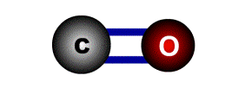
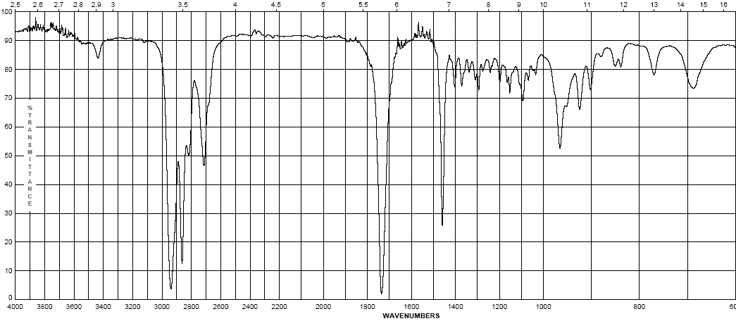
Infrared Spectroscopy
Cyclohexyl carboxaldehyde
  Aldehydes
    C=O (carbonyl) stretch from 1720-1740 cm⁻¹
    Band is sensitive to conjugation, as are all carbonyls (upcoming slide)
    A highly unique sp² C-H stretch appears as a doublet, 2720 & 2820 cm⁻¹ called a “Fermi doublet”
(w-m)
(s)

Slide 29
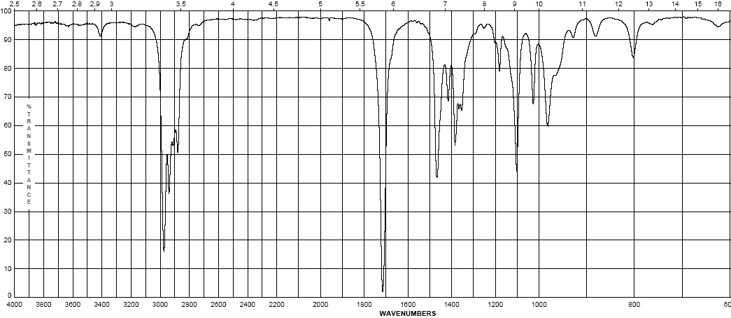
Infrared Spectroscopy
3-methyl-2-pentanone
  Ketones
    Simplest of the carbonyl compounds as far as IR spectrum – carbonyl only
    C=O stretch occurs at 1705-1725 cm⁻¹
(s)

Slide 30
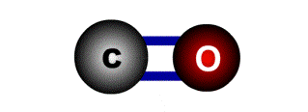
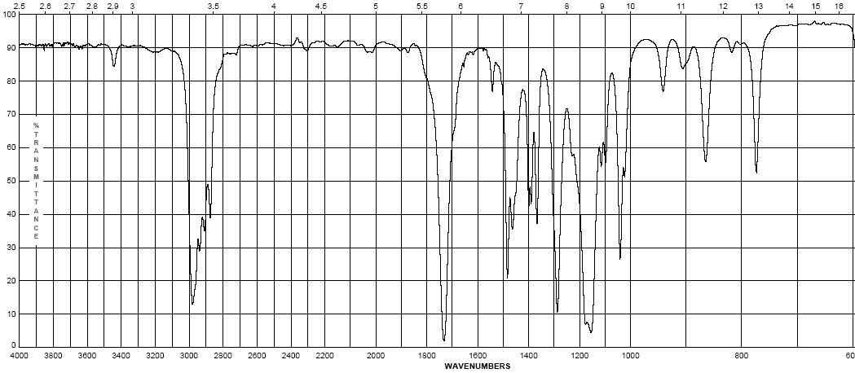
Infrared Spectroscopy
Ethyl pivalate
  Esters
    C=O stretch at 1735-1750 cm⁻¹
    Strong band for C-O at a higher frequency than ethers or alcohols at 1150-1250 cm⁻¹
(s)
(s)

Slide 31
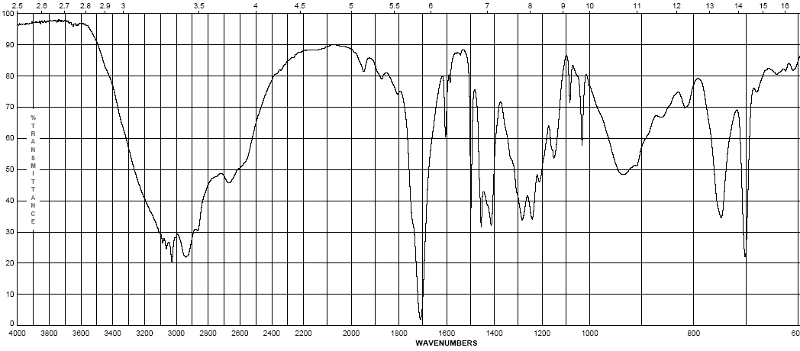
Infrared Spectroscopy
4-phenylbutyric acid
  Carboxylic Acids:
    Gives the messiest of IR spectra
    C=O band occurs between 1700-1725 cm⁻¹
    The highly dissociated O-H bond has a broad band from 2400-3500 cm⁻¹ covering up to half the IR spectrum in some cases
(w – m)
br
(s)
(s)

Slide 32
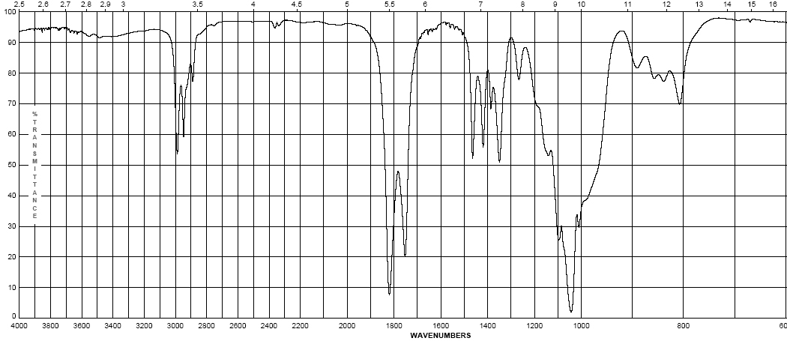
Infrared Spectroscopy
Propionic anhydride
  Acid anhydrides
    Coupling of the anhydride though the ether oxygen splits the carbonyl band into two with a separation of 70 cm⁻¹
    Bands are at 1740-1770 cm-1 and 1810-1840 cm⁻¹
    Mixed mode C-O stretch at 1000-1100 cm⁻¹
(s)
(s)

Slide 33
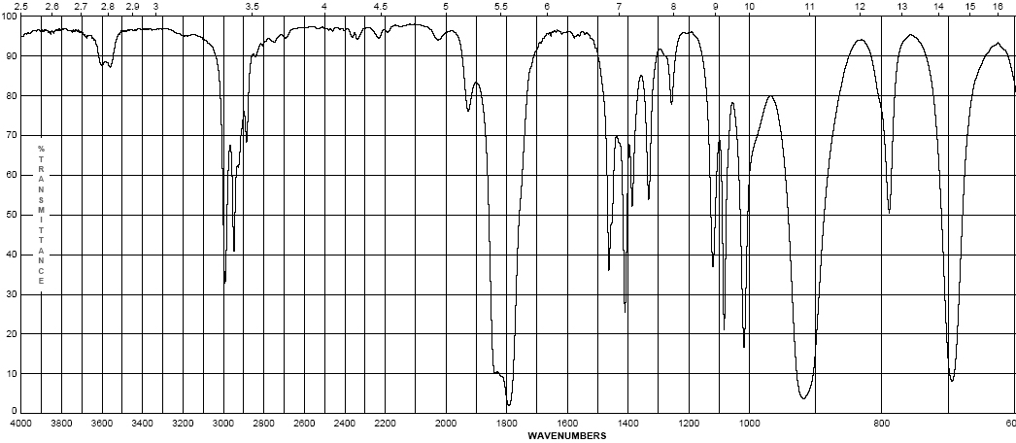
Infrared Spectroscopy
Propionyl chloride
  Acid halides
    Clefted band at 1770-1820 cm⁻¹ for C=O
    Bonds to halogens, due to their size (see Hooke’s Law derivation) occur at low frequencies, only Cl is light enough to have a band on IR, C-Cl is at 600-800 cm⁻¹
(s)
(s)

Slide 34
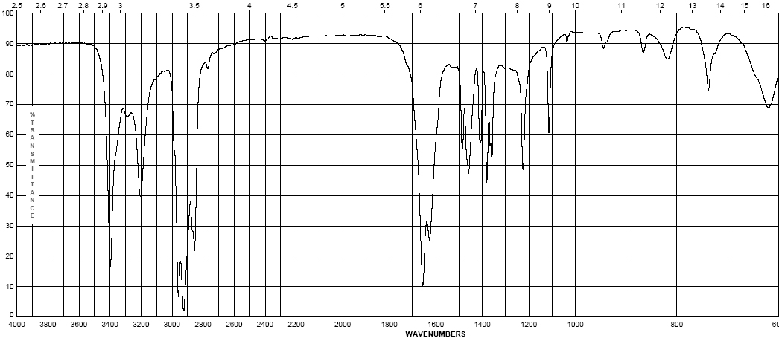
Infrared Spectroscopy
pivalamide
  Amides
    Display features of amines and carbonyl compounds
    C=O stretch at 1640-1680 cm⁻¹
    If the amide is primary (-NH₂) the N-H stretch occurs from 3200-3500 cm⁻¹ as a doublet
    If the amide is secondary (-NHR) the N-H stretch occurs at 3200-3500 cm⁻¹ as a sharp singlet
(m – s)
(s)

Slide 35
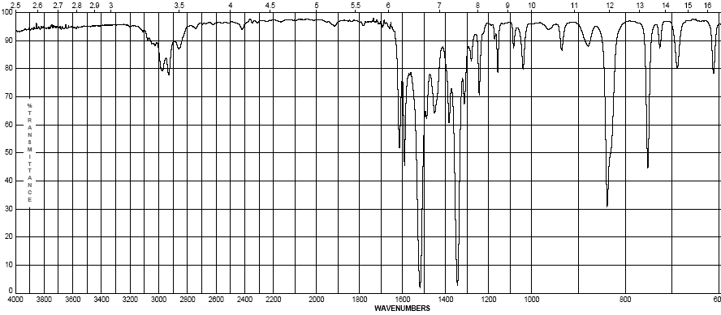
Infrared Spectroscopy
2-nitropropane
  Nitro group (-NO₂)
    Proper Lewis structure gives a bond order of 1.5 from nitrogen to each oxygen
    Two bands are seen (symmetric and asymmetric) at 1300-1380 cm⁻¹ and 1500-1570 cm⁻¹
    This group is a strong resonance withdrawing group and is itself vulnerable to resonance effects
(s)
(s)

Slide 36
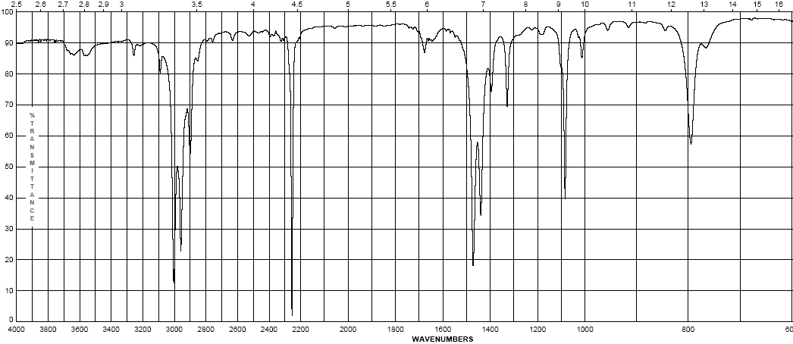
Infrared Spectroscopy
propionitrile
  Nitriles (the cyano- or –C≡N group)
    Principle group is the carbon nitrogen triple bond at 2100-2280 cm⁻¹
    This peak is usually much more intense than that of the alkyne due to the electronegativity difference between carbon and nitrogen
(s)

Slide 37
Infrared Spectroscopy
  Effects on IR bands
    Conjugation – by resonance, conjugation lowers the energy of a double or triple bond. The effect of this is readily observed in the IR spectrum:
      Conjugation will lower the observed IR band for a carbonyl from 20-40 cm⁻¹ provided conjugation gives a strong resonance contributor
      Inductive effects are usually small, unless coupled with a resonance contributor (note –CH₃ and –Cl above)

Slide 38
Infrared Spectroscopy
  Effects on IR bands
    Steric effects – usually not important in IR spectroscopy, unless they reduce the strength of a bond (usually π) by interfering with proper orbital overlap:
      Here the methyl group in the structure at the right causes the carbonyl group to be slightly out of plane, interfering with resonance
    Strain effects – changes in bond angle forced by the constraints of a ring will cause a slight change in hybridization, and therefore, bond strength
      As bond angle decreases, carbon becomes more electronegative, as well as less sp² hybridized (bond angle < 120°)

Slide 39
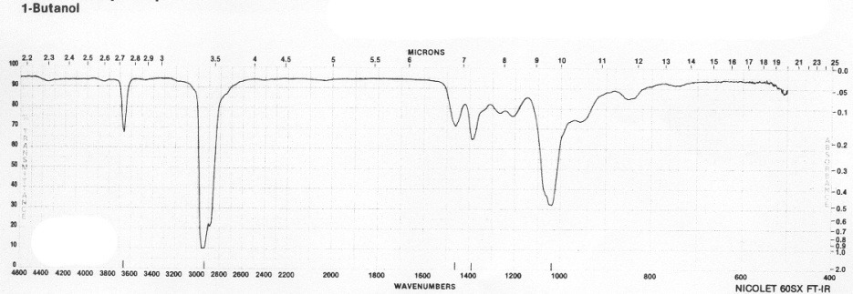
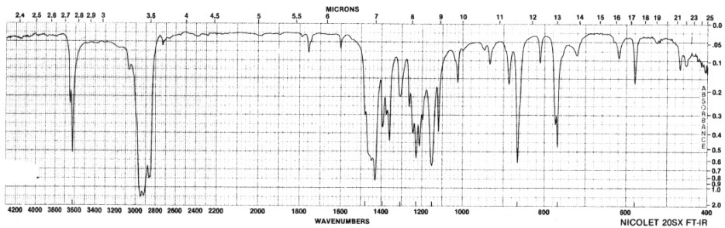
Infrared Spectroscopy
  Effects on IR bands
    Hydrogen bonding
      Hydrogen bonding causes a broadening in the band due to the creation of a continuum of bond energies associated with it
      In the solution phase these effects are readily apparent; in the gas phase where these effects disappear or in lieu of steric effects, the band appears as sharp as all other IR bands:
      Gas phase spectrum of
      1-butanol
      Steric hindrance to H-bonding
      in a di-tert-butylphenol
      H-bonding can interact with other functional groups to lower frequencies

