Slide 1
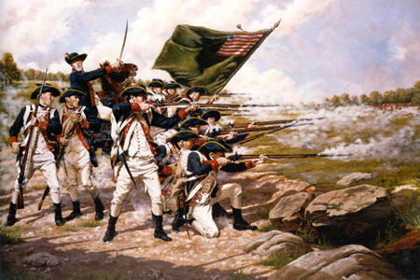
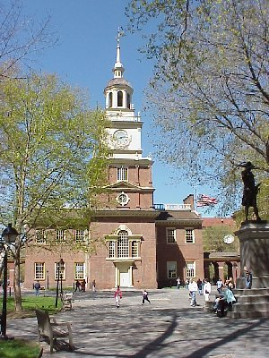
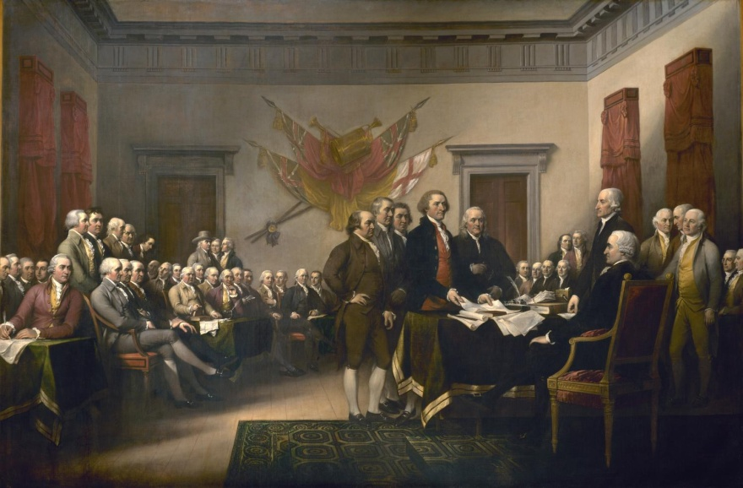
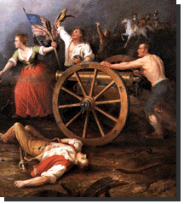
The American Revolution

Slide 2
The American Revolution
Theme One: When hostilities began in 1775, the colonists were still fighting for their rights as English citizens within the empire, but in 1776 they declared their independence, based on a proclamation of universal, “self-evident” truths.

Slide 3
Review! Long-Term Causes
French & Indian War; British replacement of Salutary Neglect with Parliamentary Sovereignty
Taxation policies (Grenville & Townshend Acts);
Conflicts (Boston Massacre & Tea Party, Intolerable Acts, Lexington & Concord)
Spark: Common Sense & Declaration of Independence

Slide 4
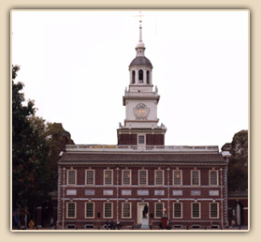
Second Continental Congress (May, 1775)
All 13 colonies were present
-- Sought the redress of their grievances, NOT independence
Philadelphia State House (Independence Hall)

Slide 5
Most significant acts:
1. Agreed to wage war against Britain
2. Appointed George Washington as leader of the Continental Army
Declaration of the Causes & Necessity of Taking up Arms, 1775
1. Drafted a 2nd set of grievances to the King & British People
2. Made measures to raise money and create an army & navy

Slide 6
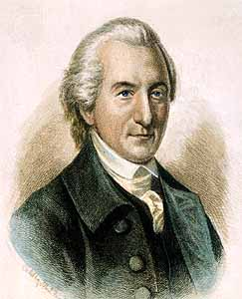
Olive Branch Petition
-- Moderates in Congress, (e.g. John Dickinson) sought to prevent a full-scale war by pledging loyalty to the King but directly appealing to him to repeal the “Intolerable Acts.”

Slide 7
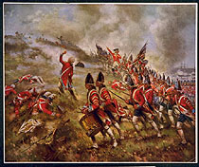
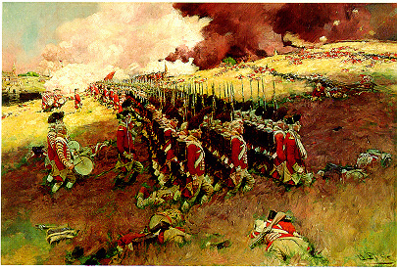
Early American Victories
A. Ticonderoga and Crown Point (May 1775) (Ethan Allen-Vt, Benedict Arnold-Ct
B. Bunker Hill (June 1775) -- Seen as American victory; bloodiest battle of the war -- Britain abandoned Boston and focused on New York
Notes:
Left: Library of Congress Artist: Percy Morgan, 1909 Right: Scribner’s Magazine, 1898

Slide 8
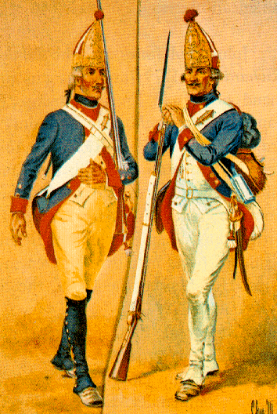
In response, King George declared the colonies in rebellion (in effect, a declaration of war)
1.18,000 Hessians were hired to support British forces in the war against the colonies.
2. Colonials were horrified
Americans failed in their invasion of Canada (a successful failure-postponed British offensive)
Notes:
Top: Charles M. Lefforts public domain

Slide 9
The Declaration of Independence
A. Most Americans still did not want independence in the spring of ‘76
B. Reasons for shift of loyalty away from Britain
1. Hiring of Hessians
2. Burning of colonial towns
3. Promising freedom to slaves who fought for the British cause

Slide 10
Thomas Paine: Common Sense, 1776
1. Main ideas
a. British colonial policy inconsistent; independence was the only choice
b. Why should tiny Britain control the huge continent of North America?
c. King was the “Royal Brute of Great Britain”
d. America had a sacred & moral mission to the world

Slide 11
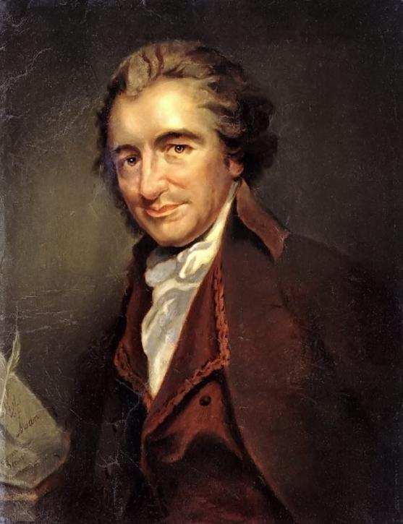
2. Significance of Common Sense:
-- Convinced Congress and many colonists to declare independence
Thomas Paine

Slide 12
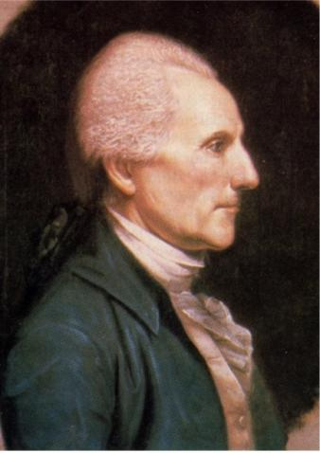
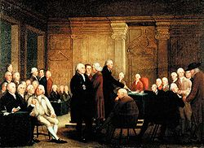
Richard Henry Lee’s motion (June 7, ‘76) -- Motion later adopted July 2, 1776
Resolved, That these United Colonies are, and of right ought to be, free and independent States, that they are absolved from all allegiance to the British Crown, and that all political connection between them and the State of Great Britain is, and ought to be, totally dissolved.
Notes:
Left: Wikipe dia Commons

Slide 13
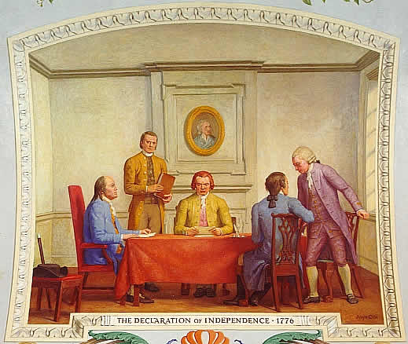
Thomas Jefferson was appointed to write the Declaration of Independence as part of a committee of five
Some debate and amendment preceded its adoption
Document was approved July 4, 1776
Notes:
U.S. Capitol Building

Slide 14
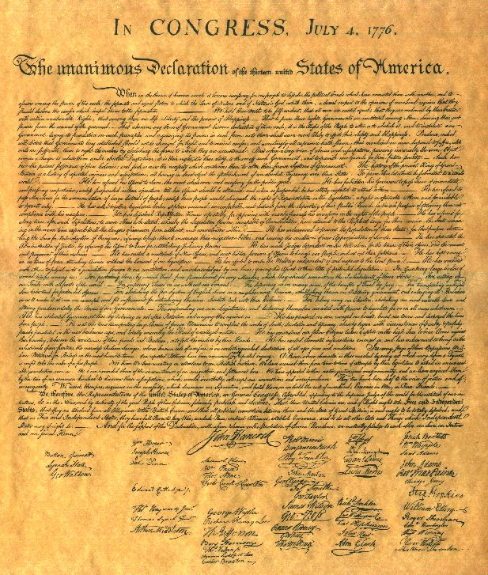

Slide 15
Declaration of Independence, John Trumbull, 1819

Slide 16
Three major parts of D of I:
1. Preamble: rights of colonists a. natural rights b. equality c. social contract
2. List of 27 grievances a. Seen by Congress as the most important part b. Most heavily modified part of Declaration c. Grievances:

Slide 17
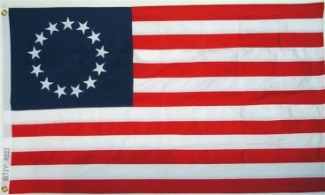
3. Formal Declaration of Independence -- Broke ties with England; U.S. was now independent
Result: foreign aid was now possible

Slide 18
Theme Two: General Washington’s skilled leadership and British military mistakes in 1776-1777 prevented a quick British victory and brought French assistance after the Battle of Saratoga (1777) which enabled the Patriots to achieve victory by 1781.

Slide 19
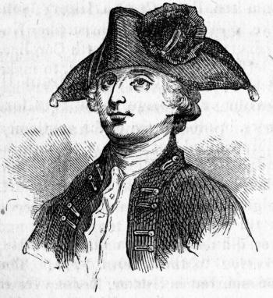
Patriots and Loyalists
A. Colonies approximately 1/3 Patriot, 1/3 Tory, and 1/3 neutral
B. “Tories”/Loyalists 1. Fought for a return to colonial rule by Britain; loyal to the king.
Notes:
http://www.northcarolinahistory.org/commentary/96/entry Edmund Fanning

Slide 20
2. Usually conservative: educated & wealthy
3. Older generation
4. King’s officers and beneficiaries
5. Anglican clergy
Notes:
http://www.northcarolinahistory.org/commentary/96/entry Edmund Fanning

Slide 21
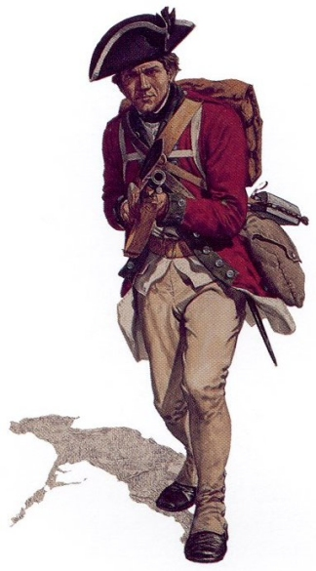
6. Influential in New York, Charleston, Pennsylvania & New Jersey
7. Least numerous in New England
8. Ineffective at gaining the allegiance of neutral colonists
Notes:
cmhg.gc.ca

Slide 22
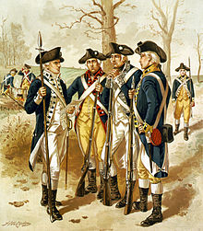
C. Patriots (sometimes called “Whigs”)
1. American rebels who fought British soldiers & rebels
2. Most numerous in New England
3. Minority movement
4. More adept at gaining support from colonials.
Notes:
Library of Congress

Slide 23
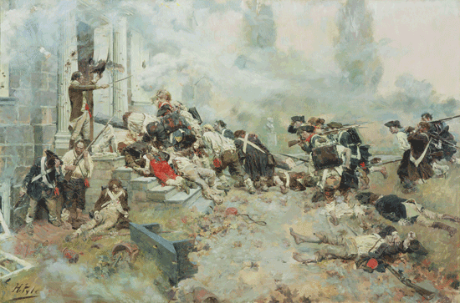
D. About 80,000 Loyalists fled the colonies as a result of the Revolution
Notes:
Painting by Howard Pyle public domain

Slide 24
VI. The War in1776-1777: Britain changed its focus from New England to the Mid-Atlantic states
A. Battle of Long Island: summer/fall, ‘76
Brooklyn, New York -- August 27, 1776

Slide 25
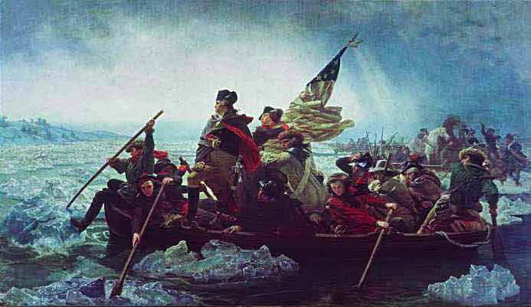
B. Battle of Trenton– Dec. 1776 1. Patriots surprised & captured 1,000 Hessians 2. Revived confidence in the colonial cause
Emmanuel Leutze, Washington Crossing the Delaware, 1851

Slide 26
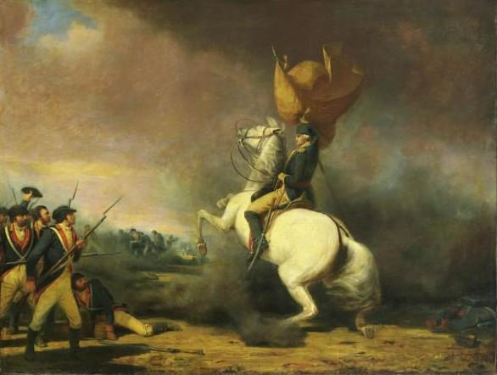
C. Battle of Princeton (January, 1777)
General Washington rallies the troops at Princeton
Notes:
General Washington rallies the troops at Princeton. Wikipedia Commons

Slide 27
Saratoga, (Oct, 1777): Most important battle of the American Revolution
1. Benedict Arnold saved New England by slowing down Burgoyne’s invasion of New York
2. Burgoyne surrendered his entire British command to General Horatio Gates on Oct 17
3. Made possible French foreign aid to the U.S.
4. Revived the faltering colonial cause

Slide 28
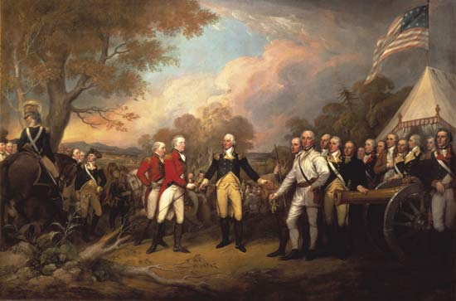
Burgoynes’ Surrender at Saratoga
Notes:
Painting by John Trumbull public domain

Slide 29
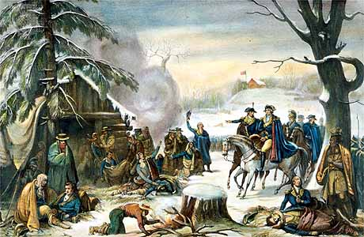
Valley Forge 1777-78 -- -- Baron Von Steuben

Slide 30
Articles of Confederation
A. Created by the Second Continental Congress to create a permanent government
B. Adopted in 1777; ratified in 1781
C. First constitution in U.S. history

Slide 31
France became a U.S. ally
A. Motive: revenge on Britain!
B. Secret supply to Americans
C. Declaration of Independence and Saratoga were turning points for French aid
D. Franco-American Alliance of 1778
1. France promised to recognize U.S. Independence
2. Gave U.S. critical financial and military support

Slide 32
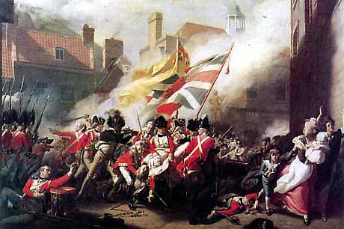
E. The Revolution became a world war
1. Spain and Netherlands entered the war against Britain in 1779
2. The American war becomes secondary for Britain
Notes:
Patriot victory at King Mountain in 1780 http://ushistory-usrevolution.com/

Slide 33
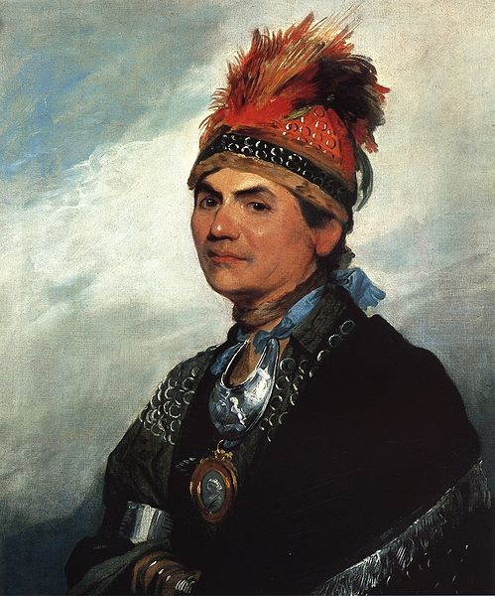
War in the West and Naval Battles
A. Clashes in the west lasted most of the war
1. Amerindian allies of the British attacked U.S. frontier positions
2. Iroquois, Joseph “Monster” Brant
B. Illinois country -- George Rogers Clark
Notes:
Wikipedia Commons Painted by Gilbert Stuart

Slide 34
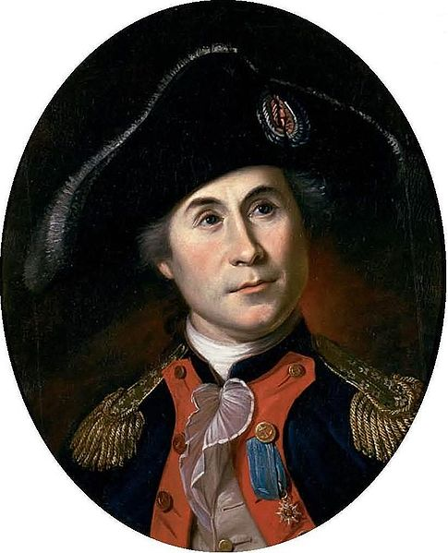
C. The American Navy
1. John Paul Jones
2. Damaged British merchant shipping
D. Privateers
E. Major naval battles between British, French, Spanish and Dutch forces -- Britain was forced to protect its empire (e.g. India)

Slide 35
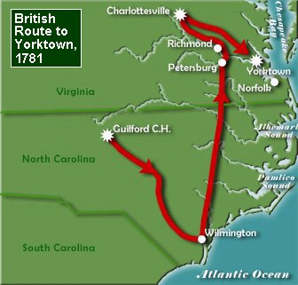
The South and the end of the war
A. After failing in the Mid-Atlantic states, Britain then focused on the South
B. Charleston, SC, fell in 1780
C. Nathaniel Greene drove British troops out of Georgia and South Carolina
-- Cornwallis abandoned southern strategy and fell back to Yorktown on the Chesapeake Bay

Slide 36
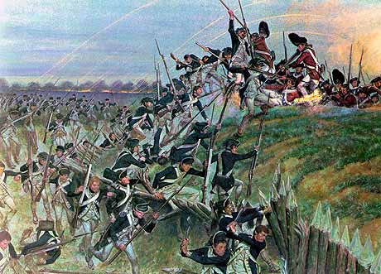
Battle of Yorktown (1781): Lord Cornwallis surrendered to Washington, Rochambeau, and de Grasse
Notes:
http://www.britishbattles.com/battle-yorktown.htm

Slide 37
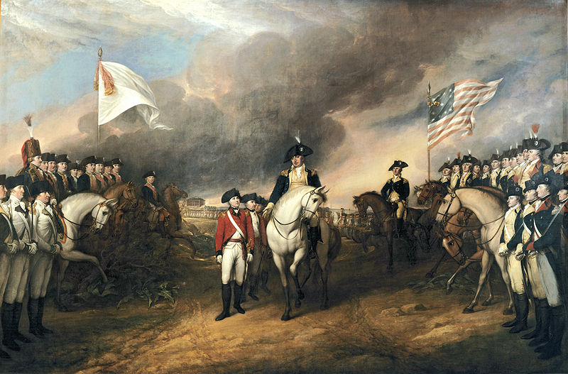
Surrender of Lord Cornwallis, John Trumbull, 1820
Notes:
Rotunda of the U.S. Capitol. Wikipedia Commons

Slide 38
Surrender at Yorktown

Slide 39
Peace at Paris (1783)
A. British ready to come to terms
1. Heavy setbacks in India, West Indies, & Mediterranean
2. Lord North’s ministry collapsed in March 1782 -- Whigs back in control
B. France attempts to weaken U.S.
1. Sought to keep U.S. borders east of the Appalachians
2. America turns to Great Britain

Slide 40
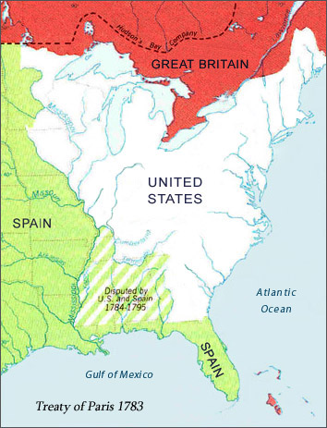
C. Treaty of Paris (1783)
1. British formally recognized U.S. independence
2. Granted generous boundaries
Notes:
Source: Library of Congress http://international.loc.gov/intldl/fiahtml/map6.html

Slide 41
3. American concessions:
a. Loyalists could not be further persecuted
b. Loyalist property was to be restored
c. U.S. states were bound to pay British creditors for past debt
d. U.S. ignored these provisions

Slide 42
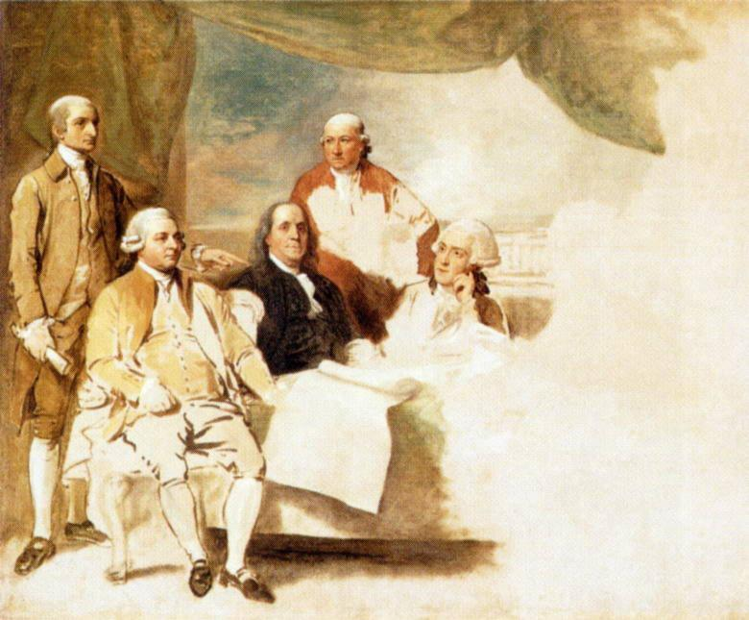
4. France formally approved British-American terms
5. America alone gained from war
Signing of the Treaty of Paris. Painting by Benjamin West. Portrays John Jay, John Adams, Benjamin Franklin, Henry Laurens, William Temple Franklin
Notes:
This painting by Benjamin West commemorates the signing of the peace treaty. It includes, from left to right, John Jay, John Adams, Benjamin Franklin, Henry Laurens, and Franklin's grandson, William Temple Franklin, secretary to the American delegation.

Slide 43
XI. American society during the war
A. Casualties

Slide 44
B. Women in the Revolution: --“Molly Pitcher”

Slide 46
Women supported the cause
Abigail Adams

Slide 47
ABIGAIL ADAMS TO JOHN ADAMS MARCH 31, 1776:
"I long to hear that you have declared an independency. And, by the way, in the new code of laws which I suppose it will be necessary for you to make, I desire you would remember the ladies and be more generous and favorable to them than your ancestors.
"Do not put such unlimited power into the hands of the husbands.
"Remember, all men would be tyrants if they could. If particular care and attention is not paid to the ladies, we are determined to foment a rebellion, and will not hold ourselves bound by any laws in which we have no voice or representation.
Notes:
http://www.thelizlibrary.org/suffrage/abigail.htm

Slide 48
JOHN ADAMS TO ABIGAIL ADAMS APRIL 14, 1776
"As to your extraordinary code of laws, I cannot but laugh.
“…you are so saucy, I won't blot it out.
"Depend upon it, we know better than to repeal our masculine systems. Although they are in full force, you know they are little more than theory. We dare not exert our power in its full latitude. We are obliged to go fair and softly, and, in practice, you know we are the subjects.
"We have only the name of masters, and rather than give up this, which would completely subject us to the despotism of the petticoat, I hope General Washington and all our brave heroes would fight."
Notes:
http://www.thelizlibrary.org/suffrage/abigail.htm

Slide 49
ABIGAIL ADAMS TO JOHN ADAMS MAY 7, 1776:
"I cannot say that I think you are very generous to the ladies; for, whilst you are proclaiming peace and good-will to men, emancipating all nations, you insist upon retaining an absolute power over wives.”
Notes:
http://www.thelizlibrary.org/suffrage/abigail.htm

Slide 50
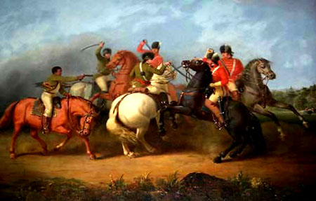
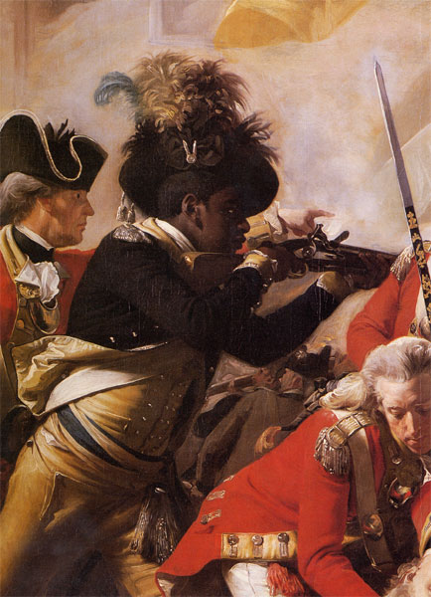
African Americans 1. 5,000 fought for the U.S. 2. Nearly 30,000 fought for Britain -- Why?
“Battle of Cowpens, William Raney, 1845. An unnamed black patriot fires his pistol at the redcoats and saves the life of Col William Washington.
"The Death of Major Pierson,” John Singleton Copley, 1782-84. An African American soldier fighting for Britain is shown in a detail from the painting
Notes:
www.johnhorse.com/images/ptour/02zz.htm Tate Gallery

Slide 51
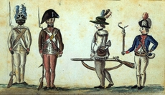
1780 drawing of American soldiers from the Yorktown campaign shows a black infantryman from the 1st Rhode Island Regiment
Notes:
American soldiers at the siege of Yorktown, by Jean-Baptiste-Antoine DeVerger, watercolor, 1781. The African American soldier is supposedly from the first Rhode Island Regiment Source: Wikipedia Commons

Slide 52
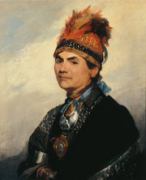
Native Americans
1. Most who fought in the war sided with Britain since the U.S. seemed a much larger threat in terms of land expansion.
2. Iroquois forced to move to Canada after the war.
Iroquois Mohawk chief, Joseph “Monster” Brant, fought led his troops on behalf of Great Britain during the Revolution. Gilbert Stuart, 1786

Slide 53
Memory Aid for Events Leading up to the Revolution:
Pretty Proclamation of 1763
Silly Stamp Act, 1765
Tammy Townshend Acts, 1767
Baked Boston Massacre, 1770
Tea Tea Act, 1773
Cookies Committees of Correspondence
Inside “Intolerable Acts,” 1774
Freshly First Continental Congress, 1774
Layered Lexington and Concord, 1775
Spicy Second Continental Congress, 1775
Dough Declaration of Independence, 1776

