Slide 1
Communication
By Becky Pugh

Slide 2
What is communication?
Communication is the process of sending and receiving messages through verbal or non verbal means
Communication can be formal or informal

Slide 3
Types of communication
Verbal – Oral (spoken), Written
Non verbal – sign, braille, body language, facial expressions, posture, images, maps, tone.

Slide 4
Styles of communication based on purpose
Formal – more of an official style – used in professional settings. No slang, should use correct pronounciation.
Informal – casual, use daily with friends and family. Often involves slang.

Slide 6
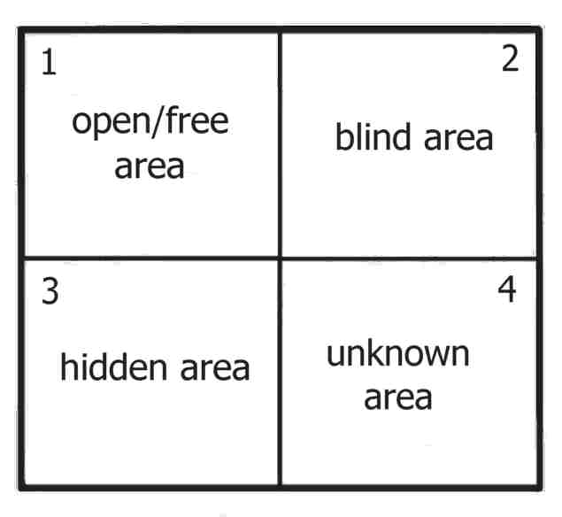
Johari window
1: Information known about the person known by themselves and others
2: information known about the person by others, but not known by the individual
3: Known to ourselves/the indivdual but hidden from others
4: information unknown to the individual and others – these may become known in the future

Slide 7
Effective communication
Effective communication is when the correct message is delivered, received and understood.
Effectively communicate a message by communicating clearly, repeating or emphasising important points, maintain eye contact, relevant body language. Be confident. Ensure the environment is quiet and suitable before starting.
Effectively receive a message by having appropriate body language, listening and being patient with the person communicating to you. Repeat key point to show you have understood.

Slide 9
7 c’s of effective communication

Slide 10
Examples of Communication Barriers
Language barriers – speak different languages or use of different terminology
Technology – technology fails, misunderstanding tone.
Attitude/emotions
Environment – too noisy, too dark.
Information overload
Time pressure
Lack of trust
Inappropriate communication method
Lack of knowledge

Slide 11
Overcoming barriers
find a form of communication that everyone involves understands
Find a suitable environment
Remain focused
Send clear messages
Listen !!!
Set aside appropriate time
Be aware of your emotions
Be polite
Get feedback

Slide 12
Examples of Communication in Practice
Handovers
Understand patients needs
Speak to patients
Paperwork eg: PRF’S
Understand incidents
Communicate with other services, such as police and fire
Contact control
Speaking to or comforting family an friends

Slide 13
Thank you for watching

