Slide 1
TRANSFORMING HEALTHCARE
By Leveraging Technology
Copyright © 2022 - Electronic Health Solutions (EHS). All rights reserved

Slide 2
Our owners
Electronic Health Solutions
Launched under the patronage of his Majesty King Abdulla II end of 2008, EHS is a private not for profit company, owned by major Jordanian healthcare and technology entities, and aims to transform and sustain a continuously improving healthcare system in Jordan by leveraging technology.

Slide 3
ehs.com.jo
Certificates and Accreditation
CERITIFICATES
ACCREDITATIONS
AWARDS
ISO 27001 certification for information security management.
ISO 22301 certificate for managing business continuity.
ISO 9001 certificate for Quality Management System.
Member in SNOMED International. Representing Jordan as its 35th Member.
The Journal of European Association of Health Information and Libraries (JEAHIL) publishes ELM feature article.
Most Innovative Medical E-Services Platform – Hakeem Electronic Services –Jordan 2020.
Most Innovative e-Learning Platform – Hakeem Academy – Jordan 2020
Most Innovative Health-Tech Company of the year 2021 – EHS.

Slide 4
ehs.com.jo
Areas Of Expertise
Hardware and Network Infrastructure and Consultancy Services
Business Continuity and Service Management
Health Data Management and Analysis
Software Development and Systems Integration
Change Management and Clinical Transformation
Project Management and Implementation of Health IT Projects
Health Data Interoperability
Health Informatics Education
Healthcare Revenue Cycle Management

Slide 5
ehs.com.jo
EHS Programs
EHS exclusively oversees four key programs that utilize technology to advance the quality of healthcare services in Jordan’s public health sector:
2009
2013
2015
2019
HAKEEM PROGRAM
ELM
HAKEEM ACADEMY
HDA
The national e-health program to automate Jordan’s healthcare sector
The central online hub for credible evidence-based health information across Jordan
The educational arm to develop human capital in health informatics
The health data analytics program that supports studies and scientific researches

Slide 6
ehs.com.jo
Hakeem Program Implementation Map
184
205
Automated Healthcare Institutions
7+ M
Electronic Health Record
19
30+ K
Trained Healthcare professionals
24/7
Technical Support
1
1
36
79%
52%
36%
75%
Hospitals
Comprehensive Clinics
Primary Clinics
Field Hospitals

Slide 7
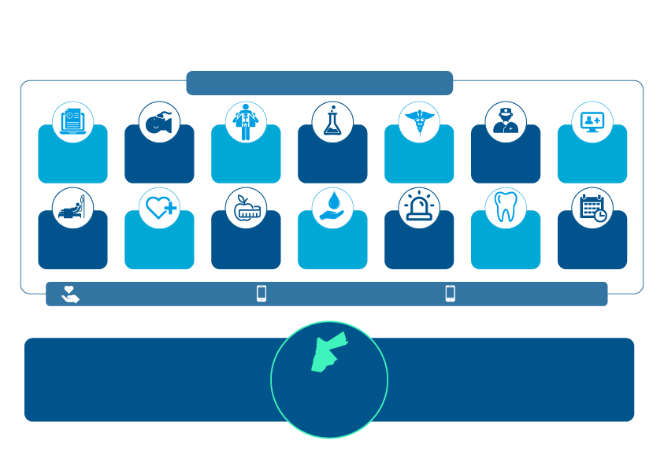
ehs.com.jo
Typical Scope of Hakeem
Computerized Patient Record System (CPRS)
Patient billing & inventory management
Anesthesia
VistA Imaging (VI)
Laboratory
Pharmacy
Surgery
Patient information management system
Admissions, Discharge & Transfer (ADT)
Care Management
Nutrition & food system (NFS)
Blood Bank (VEBCS)
Emergency
(EDIS)
Dental
Clinical scheduling system
30+ Medical & Administrative packages
Installation of hardware and network.
VistA system implementation.
Clinical Transformation activities and documentations.
Interfacing with certain medical devices.
Full training for facility staff.
Full go-live support.
Continuity and sustainability.
Hakeem Program Implementations

Slide 8
myhakeem.jo
Patient Empowerment
Medication Delivery
Allergies
“Your Gateway To Your Health Record”
Medications
History
“My Hakeem” is an electronic services platform and Mobile App that enables its users to access and view selective information that is stored on the user’s electronic health record registered within any healthcare institution that implements Hakeem program.
Appointments
Immunizations
Lab Results

Slide 9
ehs.com.jo
Healthcare Providers Empowerment
Dr@Hakeem Mobile Application
The first national mobile application that provides sufficient details for the physicians pertaining to their daily appointments and patients' medical history.
This mobile application enables physicians to track down their patients' medical appointments remotely as well as provides complete details about the patient's medical history, such as vital signs, allergies, health problems, laboratory tests, radiology reports, and medications, to improve the healthcare process.

Slide 10
3500+
7
Students trained on health informatics
MOU’s signed with Jordanian universities
148
18
Innovate Idea through Hakeem Academy Annual Competition
HAAC Winner
25K+ Active Users on ELM.jo
4
Clinical decision support tools
1.5M+
18K+
3.5K+
5K+
3
Learning tools
Yearly Hits
(search engines)
Full text articles download yearly
E-Books
Medical Journals
6
Searching engines

Slide 11
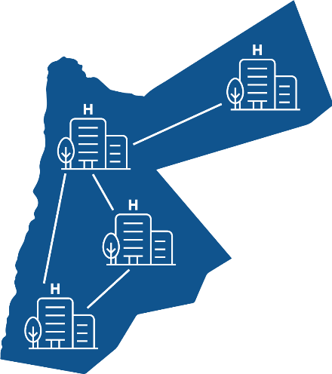
ehs.com.jo
Interoperability Solutions – Hakeem Exchange
Future
EHS has developed a data exchange tool to be used between automated healthcare facilities under the Jordanian Royal Medical Services and the Ministry of Health. This tool will allow physicians from different governmental bodies to view specific health information from patients’ files to improve healthcare.
EHS is currently waiting for approvals from related parties to implement this tool.

Slide 12
Health Data Analytics program - HDA
Lunched in 2019 under the patronage of his Majesty King Abdullah II, “HDA” program was developed and established by EHS professionals to support and empower both researchers and decision makers in the health sector in Jordan.
“HDA” program aims to institutionalize a body responsible for identifying, developing, and harnessing the necessary processes, knowledge, infrastructure and expertise that will help turn “health data” into “actionable insight” through the following:
Leveraging big data, AI, and BI technologies.
Supporting health research and studies to promote data driven decision making.
Providing just-in-time Metrics to Continuously Monitor and Control Quality.
hda.jo

Slide 13
hda.jo
Health Sector Challenges
Resolved through EHR “Hakeem Program”
Resolved through HIS “HDA Program”
Paper Work
Patient Safety
Lack of evidence-based medicine (EBM)
Bureaucracy
Process Efficiency

Slide 14
hda.jo
Health Information Systems
A Health Information System (HIS) refers to a system designed to manage healthcare data. This includes systems that collect, store, manage, summarize and transmit healthcare data
(Stores information – Actionable FACTS)
EHR vs. HIS
An Electronic Health Records (EHRs) are digital versions of the paper charts in the healthcare provider’s offices. An EHR contains the medical and treatment history of the patients in one practice. Providers will create a new digital record that they update with each new patient encounter
(Stores transactions of interactive encounters – Digital Medical/Health/Personal Records)

Slide 15
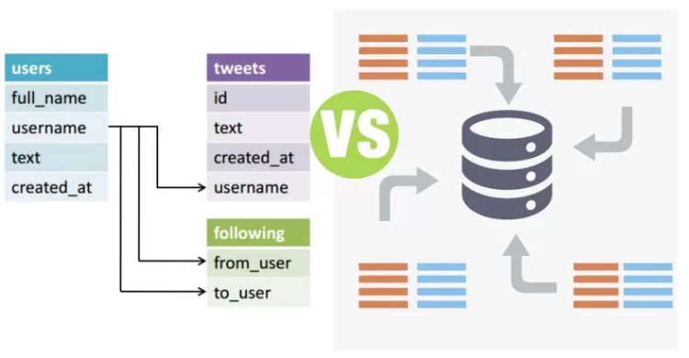
hda.jo
OLTP vs. OLAP
A transactional database is a database that stores data in tables/files that consist of transactional records
(Stores transactions - Data)
EHR
HAKEEM - OLTP
HIS
HDA - OLAP
Ahmad is admitted to Amman Field Hospital
Lama was given Insulin Shots
Zaid was transferred to ICU in Isolation wards
Ahmad is registered into the COVID 19 e-Registry
Lama is registered into the DM e-Registry
Zaid is registered into the COVID 19 e-Registry and flagged as an ICU patient within this registry
Zaid occupied (Locked) an ICU bed in the transfer recommender engine
A data analytics warehouse is a huge information repository that stores and manages the data required to analyze historical and current summary of transactions from multiple databases and sources
(Stores summaries - Meaningful FACTS)

Slide 16
hda.jo
HDA Platform
Extract from Multiple Big Data Sources
Transform and Summarize into HDA Data Warehouse
Apply Big Data, BI, and AI Analytics
Visualize and Present the Outcomes
1
2
3
4
Maintain Infrastructure and Governance
5
5

Slide 17
hda.jo
Data Governance Questions!
Process
People, Entities R&R
Technology
Ownership
Security
Quality
Knowledge
Accessibility
How is the data created? Where does it come from?
Who is responsible for the data?
How is the data processed? What business processes?
How is the data used? What business processes?
How is the data stored and destroyed?
Who uses the data? How its shared for these users?

Slide 18
hda.jo
Principles, Mindsets and Ethics
PRINCIPLES
Fundamental Assumptions: Have a strategy, make it practical (agile), define ownership, use metadata and ensure quality
MINDSETS
Way of thinking, attitude, opinion (Habitual): Timely, secured, reuse, eliminate redundancy, auditable and valued
ETHICS
Moral principles that governs our acts: Trust, fair practice, maximize on existing benefits, and respect privacy

Slide 19
hda.jo
Data Ownership Dilemma!
Joint ownership between patient and provider:
1- Has the right to access medical reports and summaries
2- Grants or denies being accessed by providers or other EHR users
3- Does not have the right to destroy it
4- Does not have the right to edit it
5- Provider can only access the EHR through a legitimate electronic visit number
Through the HIPAA Privacy Rule, patients can “inspect, review and receive a copy of his or her own medical records and billing records.”² So, even though patients do not own the actual medical records created for them by the provider office or hospital, they are still required by law to have access to their data
EHR Ownership
Data Creation (Healthcare Providers, Patients)
1- Edit Access through limited privileges depending on the responsibilities
2- Edit access to be verified with at least 1 encrypted codes and for treatment plans 2 encrypted codes
3- Cannot be edited through public internet access, only through the NBN, SGNs
4- Cannot delete or remove historical entries that has been signed or verified, only amendments
Quality Assurance
1- Edit Access through limited privileges depending on the responsibilities
2- Edit access to be verified with at least 1 encrypted codes and for treatment plans 2 encrypted codes
3- Cannot be edited through public internet access, only through the NBN, SGNs
4- Cannot delete or remove historical entries that has been signed or verified, only amendments
EHR Management
Data Analytics and Use
1- Read processed data
2- IRB for publications, Provider Approval for Institutional Data Use
3- Access through HTTPS, at least 1 encrypted code for each privileged user
4- No personal data exposed
5- Limited access per use case
HIS
Management

Slide 20
hda.jo
Assets Based Framework for Governance
Asset Creation
حق الحصول على المعلومة، حق حماية البيانات الشخصية
قانون المسائلة الطبية، الدستور الطبي
Asset Control
التعليمات المؤسسية
أخلاقيات ادارة البيانات والذكاء الاصطناعي
A patient must be present!
When to destroy the records?
Personal Record
Provider & QM, limited Use
Applications
Patient, owns PHR
Provider, owns EMR
QM, contributes EHR
Medical Record
IT, Controls DB & IS
Clients / Entities
Any Encounter between the Patient and Provider will impact the EHR
Databases, Applications, Infrastructure, Services, Security
AI Tools, contributes EHR???
Management, Regulates Data Lifecycle
NBN, SGN, Private LANs
NBN, SGN, Private LANs
ETLs
Asset Valuation
تعليمات البيانات المفتوحة
أخلاقيات البحث العلمي
Governance should be extended into all aspects of our Assets (Data) Management:
Creation, Control, and Valuation
Monetize data loss!
Provider, QM & Management, limited Use
IT, Controls DB & IS
Many entities, Unified Dimensions HDD
IRB, Regulates Data Use
Researcher, Owns Publications
Databases, Applications, Infrastructure, Services, Security
SSL, HTTPs, Public WANs
Notes:
Can AI change your appointments without your approval
Can AI add to amend your treatment plan without the provider's approval?
AI will be under the QM umbrella, and they will be able to contribute, however the approval of owners on their parts will be essential
Should the patient be present for the AI to contribute?
Pre-requisite to AI is a patient portal and doctor or provider portal?

Slide 21
hda.jo
Agility and Governance
Gate Keepers at the Creation Level?
Heavy (High Maintenance, High Cost)
Conflict of Interest
Preventive
Notes:
Can AI change your appointments without your approval
Can AI add to amend your treatment plan without the provider's approval?
AI will be under the QM umbrella, and they will be able to contribute, however the approval of owners on their parts will be essential
Should the patient be present for the AI to contribute?
Pre-requisite to AI is a patient portal and doctor or provider portal?

Slide 22
hda.jo
Agility and Governance
Gate Keepers at the Creation Level?
Heavy (High Maintenance, High Cost)
Conflict of Interest
Preventive
Notes:
Can AI change your appointments without your approval
Can AI add to amend your treatment plan without the provider's approval?
AI will be under the QM umbrella, and they will be able to contribute, however the approval of owners on their parts will be essential
Should the patient be present for the AI to contribute?
Pre-requisite to AI is a patient portal and doctor or provider portal?

Slide 23
hda.jo
Agility and Governance
Gate Keepers at the Control and Valuation Levels?
Less Maintenance, Less Cost
Unbiased Judgments
Corrective
Notes:
Can AI change your appointments without your approval
Can AI add to amend your treatment plan without the provider's approval?
AI will be under the QM umbrella, and they will be able to contribute, however the approval of owners on their parts will be essential
Should the patient be present for the AI to contribute?
Pre-requisite to AI is a patient portal and doctor or provider portal?

Slide 24
hda.jo
Agility and Governance
Question?
Should we worry about training all doctors on ICD 10 just because we use it for reporting?
What if the new generation of medicine students are using new terminologies?
Mappers for this use case are easier to maintain than limiting the doctors’ terminology … the focus would be on assuring the availability of the diagnose regardless the terminology is a more feasible / realistic objective!
Balanced Gate Keepers at all Levels?
Risk based quality driven
Agile
Preventive Strategy
(Assurance)
Corrective Strategy
(Control)
Notes:
Can AI change your appointments without your approval
Can AI add to amend your treatment plan without the provider's approval?
AI will be under the QM umbrella, and they will be able to contribute, however the approval of owners on their parts will be essential
Should the patient be present for the AI to contribute?
Pre-requisite to AI is a patient portal and doctor or provider portal?

Slide 25
hda.jo
Data Lineage to Analytics Services
Stewardships for Data Availability and Completeness
Stewardships for
Data Mapping
(Metadata + HDD)
Data Transformation
Each AI/BI service will only be able to access its designated summarized and anonymized data cube through secured connections only
Data Source
HDA Core
Data Summarization
Data Mart 1
SSL 1
AI/BI Service 1
Data Mart 2
SSL 2
AI/BI Service 2
Stewardship for Data Summarization at an Integrated Level
Split to Cubes
Data Mart 3
SSL 3
AI/BI Service 3
HDA Reports
HDA Open
HDA Sensitive

Slide 26
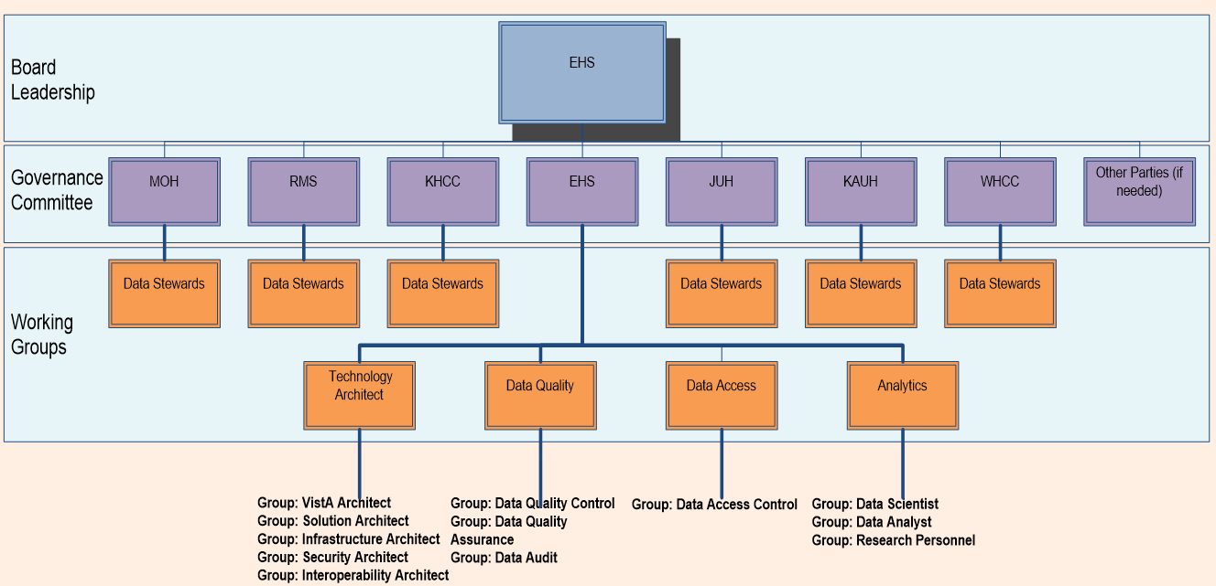
hda.jo
Roles and Responsibilities
Architect and Interoperability → EHS
Data Access → EHS
Data Quality and Governance → Steering Committee
Data Valuation → EHS
Operational Data Stewardships → Beneficiaries
Case definitions (HDD)
Meaningful use
Meaningful Use
Availability
Quality
Data Maturity
Asset Valuation
Example 1:
Say you have lost 3 admission records out of 100K admissions that you have, your loss is not randomly 3/100K, instead:
Each admission creates an average of 3 bed days with an average cost of 1000 JODs per bed day so the total loss is 3000 JODs
Example 2:
Say you have lost 3 DM patient diagnoses entries out of 250K DM patients, your loss is not 3/250K, instead:
Each DM costs 1000 JODs annually on average, then you have a recurrent loss of 3000 JODs each year, with an average of onset years of 20 (diagnosed at 50, dies at 70) makes your loss 60,000 JODs

Slide 27
hda.jo
Example: AMR, Drug Effectiveness Analysis
S% (2/10)
=20%
R
R
R
S
S
R
R
R
R
Distinct Patient
S% (2/7)
=28.5%
R
R
R
S
S
R
R
R
R
S% (1/4)
=25%
First Profile
R
R
R
S
S
R
R
R
R
365 Interval
8 Infections

Slide 28
hda.jo
Example: AMR, Drug Effectiveness Analysis
First Profile
S% (1/4)
=25%
R
R
R
S
S
R
R
R
R
365 Interval
Does Prevalence Matter?
Overall Sensitivity 78% is Biased by the Most Common Pathogens! The odds are better
Pathogen | Total | Sensitive | % (S/Tot) | Effectiveness >70%
1 | 500 | 485
2 | 30 | 5
3 | 90 | 50
4 | 44 | 32
5 | 200 | 150
6 | 31 | 10
7 | 87 | 64
8 | 82 | 37
Grand | 1064 | 833
97% Effective
17% Ineffective
However ………….
If you need a safe decision when you don’t know the pathogen its
4 effective / 8 possible pathogens = 50%
Don’t Use
Why? 22% chances it’s a pathogen other than the most common ones!
56% Ineffective
73% Effective
75% Effective
32% Ineffective
74% Effective
45% Ineffective
78% Effective

Slide 29
hda.jo
Data Use Lifecycle (4S™)
(START) Goals Setting
Grain Source
Dimensions
Facts
ETL & Refresh Plans
Metadata
Concentric
Optimizing and Flattening
Aggregation Schema
Snowflake or Star
Data Pools (Registries / Totals)
KPIs
BI / AI Technology
Data Quality
Analysis & Visualization
(END) with Operations Continuity
Business Manager (SME)
Seeing Through
Scoping
Data Analyst
Developer
Data Quality
Summarizing
Structuring and Sending
Data Engineer
Data Use Lifecycle at EHS (4S™)

Slide 30
hda.jo
Data Management (Design Fundamentals)
By 2021
Patient; Demographics
Provider; Classifications
Patient Admissions
Patient Discharges
Patient Specialty Transfers
What
Who
Patient Appointments
A Fact About the Patient (Central Process)
Admissions Problems
Prescriptions Emergencies
Surgeries Allergies Vitals
Patient Encounters
Patient Emergencies
Patient Surgeries
Patient Problems
Patient Vitals
Patient Allergies
Patient Microbiology
Patient Prescriptions
Patient Visits Exams
When
Where
Patient Visits Educations
Patient Visits Health Factors
Time; Dimensions
Patient Visits Immunizations
Location; Demographics
Patient Visits Procedures
Patient Purpose of Visit
Patient Chemistries
Aggregating (bottom->up) is easy, Disaggregating (up->bottom) is impossible

Slide 31
hda.jo
Health Data Analytics –HDA Services
Periodic Reporting
Interactive Dashboards
Publications
Interfacing between Applications (APIs)
HDA OUTCOMES & HOW IT IS PRESENTED
Exportable Datasets
Analytical Scripts

Slide 32
hda.jo
Health Data Analytics –HDA Services
HDA provides its services as per the following categories:
e-Registries
Research and Studies
Health outcomes control
Budgeting
Quality and regulatory audits
Guiding clinical protocols
Preventive medicine
Examples of e-Registries:
NCDs, Deaths, COVID 19
Cardiac surgeries, Bacteriology
Contributing to evidence based medicine (EBM) driven by local facts
Enriching the scientific content that shows how Jordanians as individuals are qualified in contributing to the international and global community
Examples:
National level: AMR and GLASS framework integration, COVID-19 planning
Individual level: Supporting Individual studies (provided IRB approval)
Workload Analysis
BI/AI Solutions
Resource allocation
Future planning and projections
Performance benchmarking
Examples of workload analysis:
Out/In/ER/OR workload analysis
Providers achievements
Prescriptions Anomalies
Business intelligence solutions and reporting tools:
Beds Management System
Prescriptions Anomalies

Slide 33
hda.jo
Individual Research Request Process
EHS
Once the IRB is ready and issued, submit it to EHS through
The website
Or hda.ehs@ehs.com.jo
Discuss the data elements needed with the assigned data engineer from EHS
EHS engineers will conform to the data elements in the abstract approved by the IRB only, any change will require an amendment to the IRB letter
If the data requires IDENTIFIED patient details you need this to be explicitly written in the IRB approval
If the data are within the available off the shelf pool of data that hda has then no additional fees are required
If the job from EHS requires support in managing or analyzing the data then additional fees will be required from the researcher
You need to sign an NDA stating that EHS is clear from any accountability on any misuse of data once delivered to the requester
MOH
Initiate the process at MOH: 1st Floor, Training and Development Department by following the central IRB application process
The IRB committee meets every 2 weeks to discuss the applications in hand
The IRB committee is based in Al-Basheer hospital and they head this committee
Make sure the final IRB letter is directed from the committee to EHS or at least EHS/Hakeem is part of the distribution list
RMS
Initiate the process at the head of the related specialty: you need to reach to each of them, mainly they are in the KHMC
The related IRB committee meets to discuss the applications in hand
The related IRB committee will give the recommendation to RMS management and they will issue the final IRB letter to EHS

Slide 34
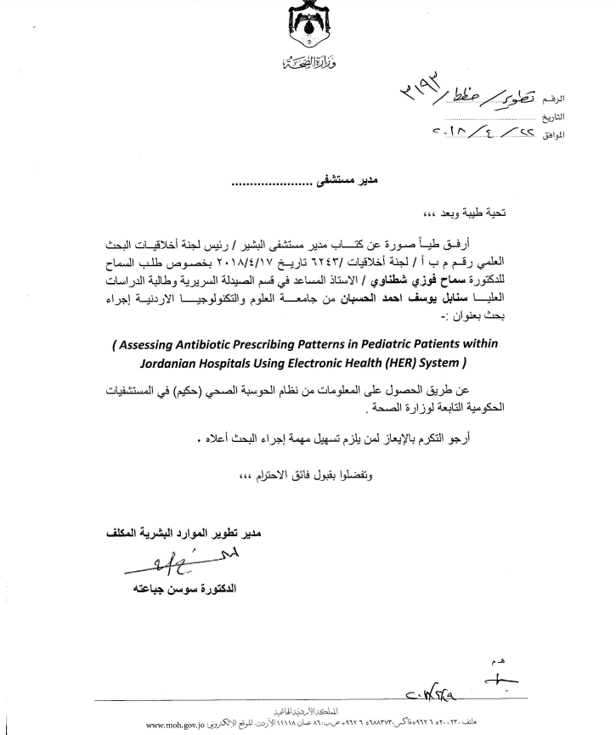
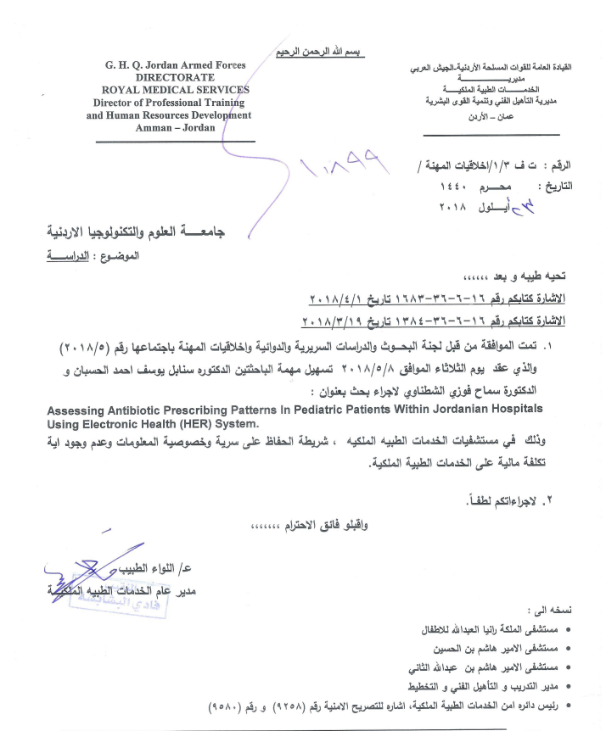
hda.jo
Individual Research Requests - Examples

Slide 35
العناصر الأساسية وأهداف للخطة الاستراتيجية للصحة الإلكترونية (eHealth) وعلاقتها باستراتيجية ادارة البيانات والذكاء الاصطناعي
الرقمنة
رفع جودة وفاعلية وكفاءة الخدمات
تمكين الوصول للخدمات
الضبط والاستمرارية
التميز
الاتصال ونشر المعرفة
وزارة الصحة
تحسين جودة وسلامة خدمات الرعاية الصحية وضمان استمراريتها
الخدمات الطبية الملكية
تقديم خدمة طبية متميزة وآمنة ذات جودة عالية وبكلفة معقولة
شركة الحوسبة الصحية
المساهمة في الحد من انتشار الأمراض غير السارية
تعزيز خدمات الصحة الإنجابية وتنظيم الأسرة وصحة الطفل
تطوير البنية التحتية لمؤسسات الرعاية الصحية الأولية والثانوية
إدارة كفؤة وفاعلة للموارد البشرية
المساهمة في تحقيق تأمين صحي شامل لكافة المواطنين الأردنيين
إدارة كفؤة وفاعلة للموارد المالية وضبط وتوجيه الإنفاق
تعزيز الدور التنظيمي والرقابي للوزارة
إدارة معرفية كفؤة وفاعلة
إدارة كفؤة للأزمات والكوارث والمخاطر
توظيف تكنولوجيا المعلومات والاتصال لضمان رعاية صحية متميزة للمواطن الأردني

Slide 36
وزارة الصحة - الأنشطة والمشاريع المتعلقة بالذكاء الاصطناعي والبيانات الضخمة
نص الهدف |  |  |  |  |  |  | الهدف
ادارة معرفية كفؤة وفاعلة إدارة كفؤة وفاعلة للموارد البشرية تعزيز الدور التنظيمي والرقابي للوزارة |  |  |  |  |  |  | الهدف المؤسسي
تمكين الوصول للخدمات |  |  |  |  |  |  | الهدف المحوري (محور الصحة الإلكترونية)
برنامج هدى |  |  |  |  |  |  | المبادرة أو البرنامج
القيمة المستهدفة للمؤشر مع نهاية الخطة | مؤشر القياس | جهة التمويل | التكلفة المتوقعة | الجهة المسؤولة | الانتهاء | البدء | الأنشطة | الرقم
85% | حساسية النموذج | غير محدد |  | EHS | 2024 | 2023 | استخدام خوارزميات الذكاء الاصطناعي في ايجاد المكان البديل الأقرب على المريض لعمل خدمة التصوير الطبقي او الرنين المغناطيسي، وذلك اعتمادا على حالة المريض من حيث الخطورة والفترة الزمنية الآمنه لوضعه الصحي للانتظار، بحيث يتوزع حجم العمل بعدالة على أجهزة الأشعة وبنفس الوقت يتم اتاحة الأولوية للحالات الحرجة التي من المتوقع أنها ستحتاج تدخل علاجي سريع لأنقاذ الحياة، ستقتصر مراحل هذه المشروع على دراسة النماذج ومدى دقتها وحساسيتها في التنبؤات لاثبات فاعليتها بطريقة علمية قبل تنفيذها | 1

Slide 37
وزارة الصحة - الأنشطة والمشاريع المتعلقة بالذكاء الاصطناعي والبيانات الضخمة
نص الهدف |  |  |  |  |  |  | الهدف
ادارة معرفية كفؤة وفاعلة إدارة كفؤة وفاعلة للموارد البشرية إدارة كفؤة لللأزمات والكوارث والمخاطر |  |  |  |  |  |  | الهدف المؤسسي
الضبط والاستمرارية |  |  |  |  |  |  | الهدف المحوري (محور الصحة الإلكترونية)
برنامج هدى |  |  |  |  |  |  | المبادرة أو البرنامج
القيمة المستهدفة للمؤشر مع نهاية الخطة | مؤشر القياس | جهة التمويل | التكلفة المتوقعة | الجهة المسؤولة | الانتهاء | البدء | الأنشطة | الرقم
85% 95% | دقة النموذج حساسية النموذج | غير محدد |  | EHS | 2025 | 2024 | استخدام خوارزميات الذكاء الاصطناعي في تطوير نماذج لتصنيف حالات مرضية محددة من خلال صور الأشعة السينية تحديدا، بهدف التقليل من حالات التحويل لخدمات التصوير الطبقي او الرنين المغناطيسي بهدف ضبط آلية تحويل المرضى لهذه الخدمات وضمان توفرها لمستحقيها في الوقت المناسب، ستقتصر مراحل هذه المشروع على دراسة النماذج ومدى دقتها وحساسيتها في التشخيص لاثبات فاعليتها بطريقة علمية قبل تنفيذها | 2
85% 95% | دقة النموذج حساسية النموذج | غير محدد |  | EHS | 2025 | 2024 | استخدام خوارزميات الذكاء الاصطناعي لجدولة مرضى الطوارى في قائمة الانتظار، بحيث يتم توقع الفترة الزمنية التي سيتم فيها تقديم خدمة الرعاية الصحية للمرضى في ظل الازدحام والحالات المرضية المتواجدة واعداد مزودي الخدمة المناوبين في الموقع، يمكن تقسيم هذا المشروع على مراحل بحيث يتم دراسة النماذج ومدى دقتها في المرحلة الأولى ثم اختيار مواقع محددة للتجربة كون نجاح هذا النموذج بحاجة الى تغيير في آلية تصنيف المرضى وتشخيصهم قبل دخولهم على خدمة المعالجة حتى تتوفر المعلومات الأولية عن الحالة اللازمة للنماذج الذكية من اجل تقديم توصيات الجدولة، وأخيرا الاطلاق والتطبيق في جميع المواقع في حال أثبتت فعاليتها وامكانية تطبيقها | 3

Slide 38
الخدمات الطبية الملكية - الأنشطة والمشاريع المتعلقة بالذكاء الاصطناعي والبيانات الضخمة
نص الهدف |  |  |  |  |  |  | الهدف
تقديم خدمة طبية متميزة وآمنة ذات جودة عالية وبكلفة معقولة |  |  |  |  |  |  | الهدف المؤسسي
 |  |  |  |  |  |  | الهدف المحوري (محور الصحة الإلكترونية)
برنامج هدى |  |  |  |  |  |  | المبادرة أو البرنامج
القيمة المستهدفة للمؤشر مع نهاية الخطة | مؤشر القياس | جهة التمويل | التكلفة المتوقعة | الجهة المسؤولة | الانتهاء | البدء | الأنشطة | الرقم

Slide 39
شركة الحوسبة الصحية - الأنشطة والمشاريع المتعلقة بالذكاء الاصطناعي والبيانات الضخمة
نص الهدف |  |  |  |  |  |  | الهدف
توظيف تكنولوجيا المعلومات والاتصال لضمان رعاية صحية متميزة للمواطن الأردني |  |  |  |  |  |  | الهدف المؤسسي
رفع جودة وفاعلية وكفاءة الخدمات التميز |  |  |  |  |  |  | الهدف المحوري (محور الصحة الإلكترونية)
برنامج هدى |  |  |  |  |  |  | المبادرة أو البرنامج
القيمة المستهدفة للمؤشر مع نهاية الخطة | مؤشر القياس | جهة التمويل | التكلفة المتوقعة | الجهة المسؤولة | الانتهاء | البدء | الأنشطة | الرقم
85% 95% | دقة النموذج حساسية النموذج | غير محدد |  | EHS | 2025 | 2023 | التنبؤ بالاصابات واوقات حدوثها من خلال استعمال عدد كبير من البيانات للمرضى بهدف التدخل المبكر للسيطرة على مضاعفاتها او تقليل الكلف العلاجية
85% 95% | دقة النموذج حساسية النموذج | غير محدد |  | EHS | 2025 | 2023 | التنبؤ بمراحل الأمراض من حيث الخطورة او تقدم المرض مقابل المرحلة الفعلية المقدرة للمرضى من قبل الطبيب المعالج (لنفس المرضى المشخصين) من خلال explainable AI، وذلك من أجل إعادة نظر وتقييم البروتوكولات العلاجية لهم
85% 95% | دقة النموذج حساسية النموذج | غير محدد |  | EHS | 2026 | 2024 | العلاج البديل، وضع حسنات وسيئات (خصائص) حالتين بنفس الاصابة ولكن تم استخدام بروتوكولات علاجية مختلفة لهم، أيضا من خلال explainable AI

Slide 40
Copyright © 2022 - Electronic Health Solutions (EHS). All rights reserved
Thank You

