Slide 1
INTRODUCTION TO SYSTEMATIC REVIEWS
DR. Reema Karasneh
Med 410

Slide 2
PRIMARY AND SECONDARY RESEARCH
Medicine and health sciences
  Primary sources: are clinical trials, research notes, original research papers, case reports…
  Secondary sources: are works that interpret or analyze the content of the primary sources.
    Literature reviews,
    Systematic reviews,
    Meta-analyses,
    Textbooks,
    Newspapers

Slide 3
SYSTEMATIC REVIEWS
Systematic review: A systematic review attempts to collate all empirical evidence that fits pre-specified eligibility criteria to answer a specific research question.
  It uses explicit, systematic methods
  Minimizes bias
  Providing reliable findings from which conclusions can be drawn and decisions made.
Systematic reviews provide the best available evidence to support evidence-based medicine

Slide 4
LEVELS OF EVIDENCE PYRAMID
Highest
Lowest

Slide 5
SYSTEMATIC REVIEWS DEFINITION
The key characteristics of a systematic review are:
  a clearly stated set of objectives with an explicit, reproducible methodology;
  a systematic search that attempts to identify all studies that would meet the eligibility criteria;
  an assessment of the validity of the findings of the included studies, for example through the assessment of risk of bias; and
  systematic presentation, and synthesis, of the characteristics and findings of the included studies.

Slide 6
META-ANALYSIS
Meta-analysis: Meta-analysis is the use of statistical techniques to integrate and summarize the results of included studies.
RELATIONSHIP WITH SYSTEMATIC REVIEWS: Many systematic reviews contain meta-analyses, but not all.
By combining information from all relevant studies, meta-analyses can provide more precise estimates of the effects of health care than those derived from the individual studies included within a systematic review.
To obtain more reliable results, a meta-analysis is mainly conducted on randomized controlled trials (RCTs), which have a high level of evidence

Slide 7
PRISMA Guidelines
Since 1999, various papers have presented guidelines for reporting meta-analyses of RCTs.
Following the Quality of Reporting of Meta-analyses (QUORUM) statement, and the appearance of registers such as Cochrane Library’s Methodology Register, a large number of systematic literature reviews have been registered.
In 2009, the Preferred Reporting Items for Systematic Reviews and Meta-Analyses (PRISMA) statement was published, and it greatly helped standardize and improve the quality of systematic reviews and meta-analyses

Slide 8
The PRISMA 2020 statement: an updated guideline for reporting systematic reviews
Many innovations in the conduct of systematic reviews have occurred since publication of the PRISMA 2009 statement.
  Technological advances have enabled the use of natural language processing and machine learning to identify relevant evidence
  Methods have been proposed to synthesize and present findings when meta-analysis is not possible or appropriate
  New methods have been developed to assess the risk of bias in results of included studies
  Evidence on sources of bias in systematic reviews has accrued, culminating in the development of new tools to appraise the conduct of systematic reviews.
  Terminology used to describe particular review processes has also evolved, as in the shift from assessing “quality” to assessing “certainty” in the body of evidence
  The publishing landscape has transformed, with multiple avenues now available for registering and disseminating systematic review protocols disseminating reports of systematic reviews, and sharing data and materials, such as preprint servers and publicly accessible repositories

Slide 9
PRISMA 2020 checklist
includes seven sections with 27 items, some of which include sub-items (table 1).

Slide 10
Glossary of terms
Outcome—An event or measurement collected for participants in a study (such as quality of life, mortality)
Result—The combination of a point estimate (such as a mean difference, risk ratio, or proportion) and a measure of its precision (such as a confidence/credible interval) for a particular outcome
Report—A document (paper or electronic) supplying information about a particular study. It could be a journal article, preprint, conference abstract, study register entry, clinical study report, dissertation, unpublished manuscript, government report, or any other document providing relevant information

Slide 11
Glossary of terms-cont.
Record—The title or abstract (or both) of a report indexed in a database or website (such as a title or abstract for an article indexed in Medline). Records that refer to the same report (such as the same journal article) are “duplicates”;
Study—An investigation, such as a clinical trial, that includes a defined group of participants and one or more interventions and outcomes. A “study” might have multiple reports. For example, reports could include the protocol, statistical analysis plan, baseline characteristics, results for the primary outcome, results for harms, results for secondary outcomes, and results for additional mediator and moderator analyses

Slide 12

The PRISMA 2020 statement: an updated guideline for reporting systematic reviews
BMJ 2021;372:n71 http://dx.doi.org/10.1136/bmj.n71
Table 1 | PRISMA 2020 item checklist
Table 2 | PRISMA 2020 for Abstracts checklist*

Slide 13
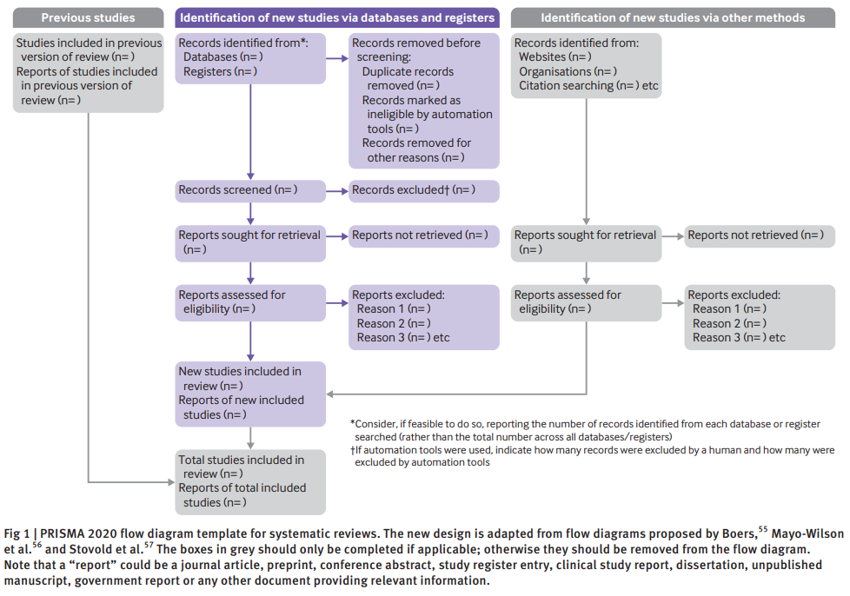

Slide 14
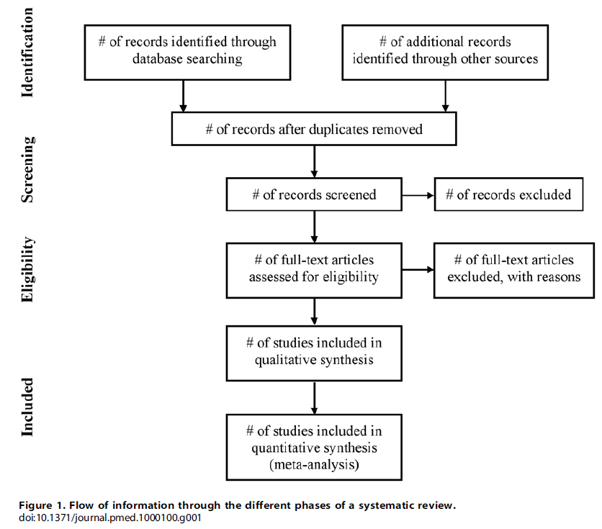

Slide 15
literature reviews and meta-analyses are being conducted in diverse medical fields
Systematic reviews and meta-analyses include various topics
For example:
  comparing various treatments of postoperative nausea and vomiting
  comparing general anesthesia and regional anesthesia
  comparing airway maintenance devices
  comparing various methods of postoperative pain control (e.g., patient-controlled analgesia pumps, nerve block, or analgesics),
  comparing the precision of various monitoring instruments,
  meta-analysis of dose-response in various drugs

Slide 16
Study Planning
It is easy to confuse systematic reviews and meta-analyses.
A systematic review is an objective, reproducible method to find answers to a certain research question, by collecting all available studies related to that question and reviewing and analyzing their results.
A meta-analysis differs from a systematic review in that it uses statistical methods on estimates from two or more different studies to form a pooled estimate.
Following a systematic review, if it is not possible to form a pooled estimate, it can be published as is without progressing to a meta-analysis; however, if it is possible to form a pooled estimate from the extracted data, a meta-analysis can be attempted.

Slide 17
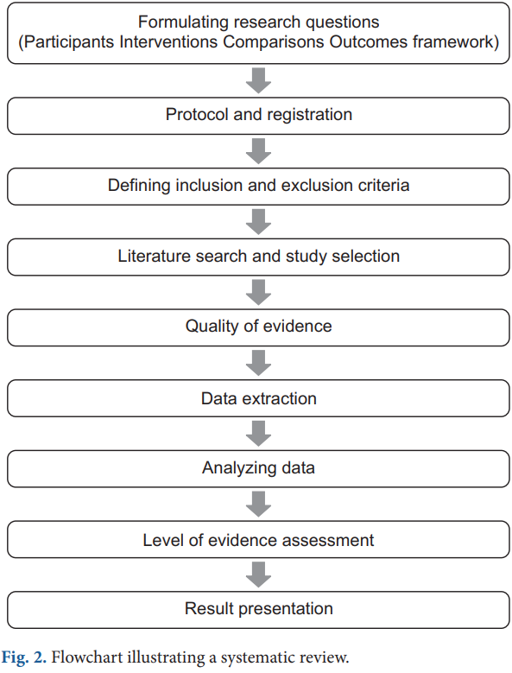

Slide 18
Formulating research questions
A systematic review attempts to gather all available empirical research by using clearly defined, systematic methods to obtain answers to a specific question.
A meta-analysis is the statistical process of analyzing and combining results from several similar studies.
Here, the definition of the word “similar” is not made clear, but when selecting a topic for the meta-analysis, it is essential to ensure that the different studies present data that can be combined.
If the studies contain data on the same topic that can be combined, a meta-analysis can even be performed using data from only two studies

Slide 19
Study selection via a systematic review is a precondition for performing a meta-analysis, and it is important to clearly define the Population, Intervention, Comparison, Outcomes (PICO) parameters that are central to evidence-based research.
Selection of the research topic is based on logical evidence, and it is important to select a topic that is familiar to readers without clearly confirmed the evidence

Slide 20
Protocols and registration
In systematic reviews, prior registration of a detailed research plan is very important.
In order to make the research process transparent, primary/secondary outcomes and methods are set in advance, and in the event of changes to the method, other researchers and readers are informed when, how, and why.
Many studies are registered with an organization like PROSPERO (http://www.crd.york.ac.uk/PROSPERO/), and the registration number is recorded when reporting the study, in order to share the protocol at the time of planning.

Slide 21
Defining inclusion and exclusion criteria
Information is included on
  The study design
  Patient characteristics
  Publication status (published or unpublished)
  Language used
  And research period.

Slide 22
Literature search and study selection
In order to secure proper basis for evidence-based research, it is essential to perform a broad search that includes as many studies as possible that meet the inclusion and exclusion criteria.
Typically, the three bibliographic databases Medline, Embase, and Cochrane Central Register of Controlled Trials (CENTRAL) are used.
Effort is required to identify not only published studies but also abstracts, ongoing studies, and studies awaiting publication.

Slide 23
Among the studies retrieved in the search, the researchers remove duplicate studies, select studies that meet the inclusion/exclusion criteria based on the abstracts, and then make the final selection of studies based on their full text.
In order to maintain transparency and objectivity throughout this process, study selection is conducted independently by at least two investigators.
When there is an inconsistency in opinions, intervention is required via debate or by a third reviewer.
The methods for this process also need to be planned in advance. It is essential to ensure the reproducibility of the literature selection process

Slide 24
Quality of evidence
Well planned the systematic review or meta-analysis is, if the quality of evidence in the studies is low, the quality of the meta-analysis decreases, and incorrect results can be obtained
Even when using randomized studies with a high quality of evidence, evaluating the quality of evidence precisely helps determine the strength of recommendations in the meta-analysis.
One method of evaluating the quality of evidence in non-randomized studies is the Newcastle-Ottawa Scale, provided by the Ottawa Hospital Research Institute.

Slide 25
The quality of evidence is evaluated on the basis of:
  The study limitations
  Inaccuracies
  Incompleteness of outcome data
  Indirectness of evidence
  Risk of publication bias
This is used to determine the strength of recommendations

Slide 26
The study limitations are evaluated using the “risk of bias” method proposed by Cochrane.
This method classifies bias in randomized studies as “low,” “high,” or “unclear” on the basis of the presence or absence of six processes:
  Random sequence generation
  Allocation concealment
  Blinding participants or investigators
  Incomplete outcome data
  Selective reporting and other biases

Slide 27
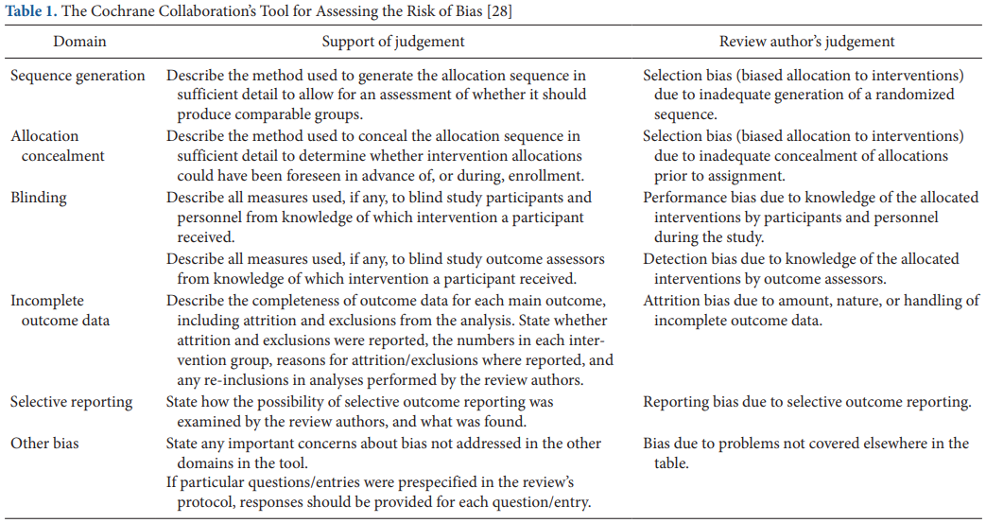

Slide 28
Data extraction
Two different investigators extract data based on the objectives and form of the study; thereafter, the extracted data are reviewed.
Since the size and format of each variable are different, the size and format of the outcomes are also different, and slight changes may be required when combining the data.
If there are differences in the size and format of the outcome variables that cause difficulties combining the data, such as the use of different evaluation instruments or different evaluation timepoints, the analysis may be limited to a systematic review.
The investigators resolve differences of opinion by debate, and if they fail to reach a consensus, a third-reviewer is consulted

Slide 29
Data Analysis
The aim of a meta-analysis is to derive a conclusion with increased power and accuracy than what could not be able to achieve in individual studies.
Therefore, before analysis, it is crucial to evaluate the direction of effect, size of effect, homogeneity of effects among studies, and strength of evidence.
Thereafter, the data are reviewed qualitatively and quantitatively.

Slide 30
If it is determined that the different research outcomes cannot be combined, all the results and characteristics of the individual studies are displayed in a table or in a descriptive form; this is referred to as a qualitative review.
A meta-analysis is a quantitative review, in which the clinical effectiveness is evaluated by calculating the weighted pooled estimate for the interventions in at least two separate studies.

Slide 31
The pooled estimate is the outcome of the meta-analysis and is typically explained using a forest plot (Figs. 3 and 4).
The black squares in the forest plot are the odds ratios (ORs) and 95% confidence intervals in each study.
The area of the squares represents the weight reflected in the meta-analysis.
The black diamond represents the OR and 95% confidence interval calculated across all the included studies.
The bold vertical line represents a lack of therapeutic effect (OR = 1); if the confidence interval includes OR = 1, it means no significant difference was found between the treatment and control groups.

Slide 32
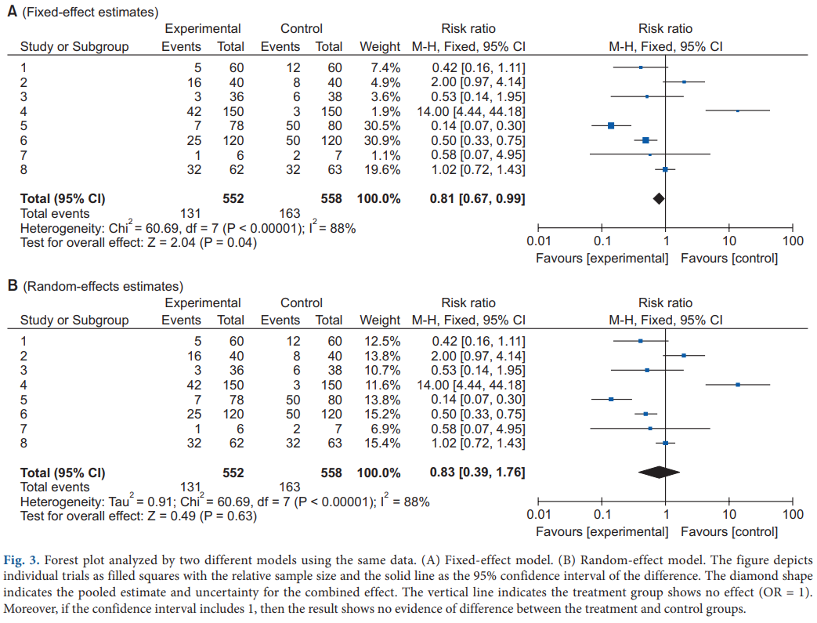

Slide 33
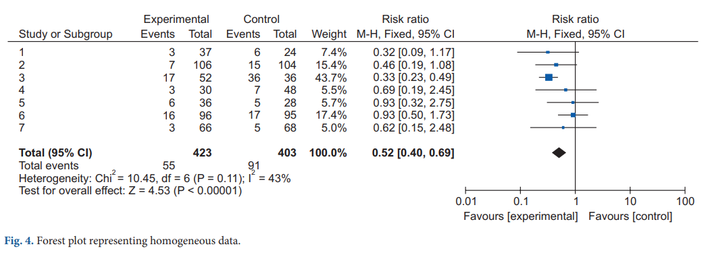

Slide 34
Dichotomous variables and continuous variables
In data analysis, outcome variables can be considered broadly in terms of dichotomous variables and continuous variables.
When combining data from continuous variables
  the mean difference (MD) and standardized mean difference (SMD) are used
  When results are presented in the same units, the MD can be used, but when results are presented in different units, the SMD should be used

Slide 35
When combining data for dichotomous variables
  the OR, risk ratio (RR), or risk difference (RD) can be used.
  The RR and RD can be used for RCTs, quasi-experimental studies, or cohort studies
  the OR can be used for other case-control studies or cross-sectional studies.
    However, because the OR is difficult to interpret, using the RR and RD, if possible, is recommended

Slide 36
Fixed-effect models and random-effect models
In order to analyze effect size, two types of models can be used:
  a fixed-effect model
    Assumes that the effect of treatment is the same, and that variation between results in different studies is due to random error.
    Can be used when the studies are considered to have the same design and methodology, or when the variability in results within a study is small, and the variance is thought to be due to random error.
  a random-effect model.
    Assumes heterogeneity between the studies being combined
    Can be used when the studies are assumed different
    Differences in variation among studies are thought to be due to not only random error but alsobetween-study variability in results

Slide 37
Heterogeneity
Homogeneity test is a method whether the degree of heterogeneity is greater than would be expected to occur naturally
Three types of homogeneity tests can be used:
  1) forest plot,
  2) Cochrane’s Q test (chi-squared)
  3) Higgins I² statistics.

Slide 38
Publication bias
Publication bias is the most common type of reporting bias in meta-analyses.
This refers to the distortion of meta-analysis outcomes due to the higher likelihood of publication of statistically significant studies rather than non-significant studies.
In order to test the presence or absence of publication bias, first, a funnel plot can be used (Fig. 5).

Slide 39
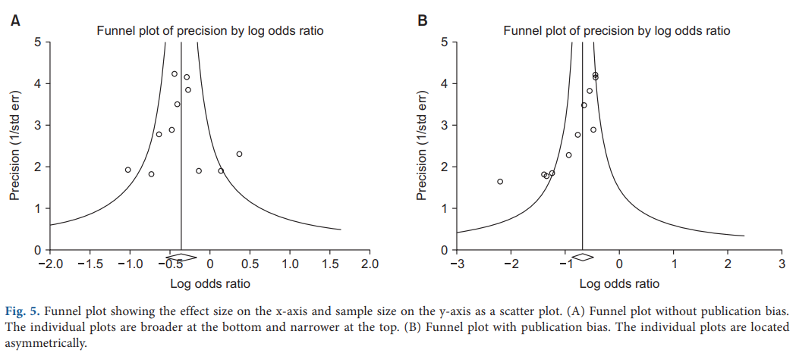

Slide 40
Funnel plot
Studies are plotted on a scatter plot with effect size on the x-axis and precision or total sample size on the y-axis.
If the points form an upside-down funnel shape, with a broad base that narrows towards the top of the plot, this indicates the absence of a publication bias (Fig. 5A).
if the plot shows an asymmetric shape, with no points on one side of the graph, then publication bias can be suspected (Fig. 5B)

Slide 41
Result Presentation
When reporting the results of a systematic review or meta-analysis, the analytical content and methods should be described in detail.
  A flowchart is displayed with the literature search and selection process according to the inclusion/exclusion criteria.
  A table is shown with the characteristics of the included studies.
  A table should also be included with information related to the quality of evidence
  The results of data analysis are shown in a forest plot and funnel plot.

Slide 42
Conclusion
When performing a systematic literature review or meta-analysis, if the quality of studies is not properly evaluated or if proper methodology is not strictly applied, the results can be biased and the outcomes can be incorrect.
However, when systematic reviews and meta-analyses are properly implemented, they can yield powerful results that could usually only be achieved using large-scale RCTs, which are difficult to perform in individual studies.
As our understanding of evidence-based medicine increases and its importance is better appreciated, the number of systematic reviews and meta-analyses will keep increasing.
However, indiscriminate acceptance of the results of all these meta-analyses can be dangerous, and hence, we recommend that their results be received critically on the basis of a more accurate understanding

