Slide 1
Qualitative Study Design
MED 410
Dr. Ola Soudah

Slide 2
When numbers can’t help
Quantitative research uses structured, hypothesis driven approaches to gather data that can be statistically analyzed.
Qualitative research uses in-depth interviews, focus group discussions, participant observation, and other unstructured or semi structured methods to explore attitudes and perceptions, identify themes and patterns, and formulate new theories.
Theory Generating

Slide 3
Data Type: text
Data Type: Numbers
Subjective
Objective

Slide 5
Data Types and collection
Qualitative researchers collect data from a variety of sources using different methods such as:
Interviewing using open ended questions ; either unstructured or semi-structured interviews.
Observation.
Documents including texts, images, or videos.
Data type can be: Words, images, non-verbal communication, documents, and artifacts (آثار).

Slide 6
Qualitative research Approaches
Case Study.
Grounded Theory.
Ethnography.
Phenomenology.

Slide 7
Case Study
"In-depth study undertaken of one particular 'case', which could be a site, individual or policy“
- Green and Thorogood
Case study refers to the collection and presentation of detailed information about a particular participant or small group, frequently including the accounts of subjects themselves and to draw conclusions only about that participant or group and only in that specific context
Researchers do not focus on the discovery of a universal, generalizable truth, nor do they typically look for cause-effect relationships; instead, emphasis is placed on exploration and description.

Slide 8
Phenomenology
Phenomenological study describes the meaning for several individuals of their lived experiences of a concept or a phenomenon.
Phenomenologists focus describing what all participants have in common as they experience a phenomenon (e.g., emotions, perceptions, social trauma …).
Phenomenology answers the question “What is like to have a certain experience?”. This description consists of “what” they experienced and “how” they experienced it.

Slide 9
Example:
A phenomenological approach was chosen to explore the lived experience of COVID-19 pandemic at the peak in Jordan.
The focus of the study will be people perceptions, emotions toward COVID-19 and COVID-19 associated forced preventive measures like curfew, & lockdown.
Data were collected through interviews, & social media posts.

Slide 10
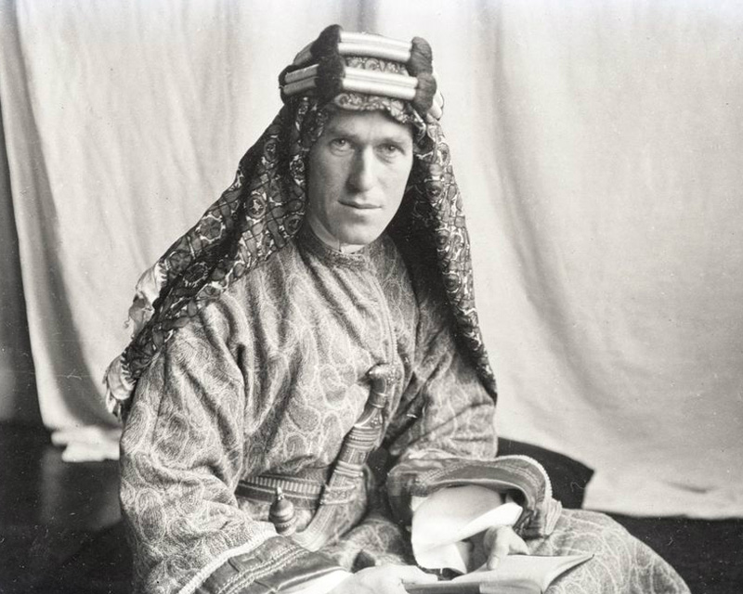
Ethnography
"The study of the culture and social organization of a particular group or community... Ethnography refers to both the data gathering of anthropology and the development of analysis of specific peoples, settings, or ways of life.“
Calhoun, C. J.
Ethnography answers the question
“What is the culture of a group of people?”.
Ethnographers often use participant observation
methods to understand a group’s collective experiences, values, beliefs, and behaviors.

Slide 11
Ethnography is the systematic study of people and cultures in their natural environments.
Ethnography is an anthropological approach in which researchers aim to develop an insider’s view (an emic perspective), rather than an outsider’s view (an etic perspective), of how members of a particular sociocultural group understand their world.
Putting yourself in their shoes
It is typical for ethnographers to immerse themselves in the study community and to intentionally interact with the group for many months or years.

Slide 12
In healthcare someone may choose ethnography when cultural parameter is suspected to play a role.
For example:
Cultural role in obesity pandemic in certain countries ; ex. Some African countries definition of beauty still value overweight girls.
Ethnography will help healthcare professional become cultural sensitive and make them understand peoples behaviors, believes, and feelings.

Slide 13
Grounded Theory
The intent of a grounded theory study is to move beyond description and to generate or discover a theory, an abstract analytical schema of a process.
A key idea is that this theory-development does not come “off the shelf,” but rather is generated or “grounded” in data from participants who have experienced the process.
Data collection and data analysis occur simultaneously, so that theories can be developed and refined (back and forth between data and theory concept).

Slide 14
Grounded theory researchers write down ideas while collecting or analyzing data … Called Memoing which help in sketching the process.
Example:
Understand how do people influence other people’s behaviors. By observing the behavior of people and their surrounding social web … researcher concluded that behavior is contagious (social contagion theory emerged).

Slide 16
Sampling
The aim of qualitative to collect rich information … thus
Purposive sampling
Types of purposive sampling:
Convenient sample
Heterogeneous sample : aim for diversity.
Homogenous sample.
Snowballing to reach hidden population.
Typical case sampling.
Extreme case sampling.

Slide 17
Data analysis

Slide 18
Approach | When to use | Example
Content analysis | To describe and categorize common words, phrases, and ideas in qualitative data. | A market researcher could perform content analysis to find out what kind of language is used in descriptions of therapeutic apps.
Thematic analysis | To identify and interpret patterns and themes in qualitative data. | A psychologist could apply thematic analysis to diabetic patients to explore how patients shapes self-care.
Textual analysis | To examine the content, structure, and design of texts. | A media researcher could use textual analysis to understand how news coverage of COVID-19 has changed people responses.

Slide 19
Word cloud for content and text analysis
The analyst begins by systematically coding the text using labels and categories derived from the text or from existing theories or previous research findings.
The analyst determines which codes occur most often and then uses that information to identify the most prominent patterns and themes in the text.

Slide 20
Codes, Categories, and Themes
The first level of coding is often called open coding or initial coding.
In qualitative analysis, coding (or indexing) is the use of words or short phrases to briefly summarize the contents.
A code is a label attached to a word or phrase.

Slide 21
The second level of coding sorts the codes and then groups the codes into categories.
A category is a group of related codes.
The goal is to identify trends and patterns, look for relationships between codes, and begin to understand multiple layers of meaning.
The analyst seeks to identify similarities and differences among codes, observe which codes occur frequently or infrequently, note the sequence of codes, and recognize other types of patterns and relationships.

Slide 22
A third level of coding, typically called thematic coding, synthesizes the categories in order to identify the concepts, meanings, and themes that answer the study question.
A theme is a concept that encompasses one or several
categories.
The core and related categories are then used to craft a narrative that explains the phenomenon.

Slide 23
Thematic analysis

Slide 25
A fourth level of coding generates a new theory about the phenomenon.
A theory is a construct or framework that provides a systematic explanation about a phenomenon.
The analyst may also engage in memoing, documenting personal reflections and impressions about observations, participants, experiences, codes, categories, and themes.
Electronic Coding: using software like NVIVO, ATLAS …

Slide 26
Quality Assurance
Credibility is present when the interpretation of the data accurately reflects the studied groups or texts.
Credibility in qualitative research is an indicator of trustworthiness that is similar to internal validity in quantitative research.
Transferability is present when the interpretation of qualitative data is likely to be applicable in other circumstances.
Transferability is an indicator of applicability that is similar to external validity or generalizability in quantitative research.

Slide 27
Dependability is an indicator of consistency that is demonstrated through transparency about data collection, analysis, and interpretation methods.
A dependable study is one that could be replicated.
Confirmability is an indicator of neutrality that is present when the results of a study are shown not to be due to researcher bias.
Confirmability may be enhanced through triangulation in which multiple data sources, methods, and theories are used to study a phenomenon from different perspectives.

Slide 28
Triangulation

Slide 30
Advantages of qualitative research
Flexibility
Natural setting
Meaningful insights
Generation of new ideas
In-depth insight

Slide 31
Disadvantages of qualitative research
Unreliability due to uncontrolled setting.
Subjectivity
Limited generalizability
Labor-intensive

Slide 32
Rigor reporting in qualitative research methods

