Slide 1
Prevention and Screening
Dr.Ghalia Abu Mohsen

Slide 4
LEVELS OF PREVENTION
Primary prevention: keeps disease from occurring at all by removing its causes.
Examples:
The most common is immunizations to prevent communicable diseases.
Folic acid supplements prenatally to decrease the risk of spina bifida.
- Smoking cessation decreases lung cancer and other pulmonary diseases and cardiovascular diseases.
- Behavioral counseling.
Prophylactic surgery: bariatric surgery to prevent complications of obesity, Ovariectomy and mastectomy to prevent ovarian and breast cancer in women with certain genetic mutations.
Drugs.

Slide 5
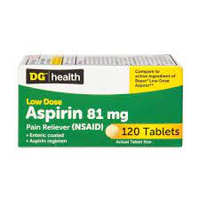
Aspirin for primary prevention
The decision regarding aspirin for primary prevention among healthy individuals should be individualized based on patient preference after discussion of the potential benefits and risks.
The balance between benefits and harms may weigh more heavily for harms over benefits in those over 70 years of age.
Possible benefits: decreases the risk of nonfatal myocardial infarction (MI), possibly reduces the risk of colorectal cancer over long-term follow-up (with >10 years of treatment).
Potential Risks: Bleeding, Aspirin sensitivity
Notes:
The 2022 US Preventive Services Task Force (USPSTF) statement on the use of aspirin for the primary prevention of CVD and colorectal cancer makes recommendations for adults aged 40 years or older without known heart disease and without increased bleeding risk.
•The decision to initiate low-dose aspirin (75-100mg) for individuals aged 40 to 59 years of age without known heart disease who have a 10 percent or greater 10-year risk of CVD risk should be individualized and the potential benefit is small. Risk was calculated using the ACC/AHA cardiovascular risk calculator.
•Among adults 60 years or older without known heart disease, initiating low-dose aspirin for the primary prevention of CVD is not recommended.

Slide 6
2) Secondary prevention
Detects early disease when it is asymptomatic and when treatment can stop it from progressing.
Example: Screening
Screening is the identification of an asymptomatic disease, unhealthy condition, or risk factor.

Slide 7
3) Tertiary prevention
Describes clinical activities that prevent deterioration or reduce complications after a disease has declared itself.
An example is the use of beta-blocking drugs to decrease the risk of death in patients who have recovered from myocardial infarction.
Diabetic patients need regular ophthalmologic examinations for detecting early diabetic retinopathy, routine foot care, and monitoring for urinary protein to guide use of angiotensin-converting enzyme inhibitors to prevent renal failure.
Tertiary prevention is really just another term for treatment

Slide 8
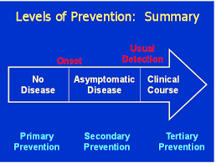

Slide 9
Periodic preventive health visits (periodic health examination PHE)
Definition: Evaluation of apparently healthy individuals in certain time periods, using a number of standard procedures such as counseling, physical examination, immunization, and laboratory investigations.
How often should PHE be done? every three years for adult patients ≤49 years without chronic conditions, and annually for adults ≥50 years.

Slide 10
Periodic Health Examination-Components
Risk identification
Screening
Immunization
Education ( counseling )

Slide 12
Risk identification
History and Physical examination

Slide 13
Screening
Definition: According to WHO:
Screening is defined as the presumptive identification of unrecognized disease in an apparently healthy, asymptomatic population by means of tests, examinations or other procedures that can be applied rapidly and easily to the target population.

Slide 14
Types of screening
1. MASS (population –based) SCREENING : large-scale screening of whole population groups. No selection of population groups is made. E.g.: cervical cancer screening.
2. SELECTIVE SCREENING : screening of selected high-risk groups in the population. It may still be large-scale, and can be considered as one form of population screening. E.g.: genetic screening of people with strong family history of breast CA.
3. MULTIPLE (OR MULTIPHASIC) SCREENING : the application of two or more screening tests in combination to large groups of people. E.g. Screening for Down syndrome by nuchal translucency in 1st trimester and AFP level in 2nd trimester.
4. SURVEILLANCE :ongoing systematic collection, analysis, and interpretation of health data that are essential to the planning, implementation, and evaluation of public health practice. e.g.: surveillance to identify active TB to ensure adequate treatment.
5. CASE-FINDING: a strategy for targeting resources at individuals or groups who are suspected to be at risk for a particular disease. It involves actively searching systematically for at risk people, rather than waiting for them to present with symptoms or signs of active disease. e.g. Identify people with COPD to administer Flu vaccine.
6. POPULATION OR EPIDEMIOLOGICAL SURVEYS: simultaneous assessment of the health outcome and exposures as well as potential confounders and effect modifiers. A survey is considered a cross-sectional study
Notes:
AFP measured in maternal serum is reduced in the majority of pregnancies involving a DS fetus.

Slide 15
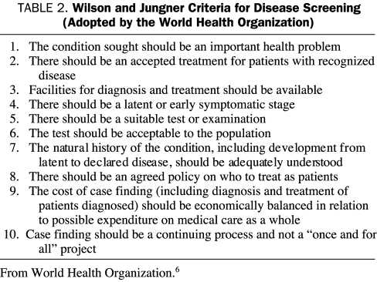

Slide 16
Wilson and Jungner criteria
Disease:
1. The condition should be an important health problem.
7. The natural history of the disease should be adequately understood.
4. There should be a latent stage of the disease.
Screening Test:
5. There should be a test or examination for the condition.( safe, valid, simple, cheap and reliable)
6. The test should be acceptable to the population.
Diagnostic Test and treatment
8. There should be an agreed policy on whom to treat.
2. There should be a treatment for the condition.
3. Facilities for diagnosis and treatment should be available.

Slide 17
Wilson and Jungner criteria
Overall Screening Program
9. The total cost of finding a case should be economically balanced in relation to medical expenditure as a whole.
10. Case-finding should be a continuous process, not just a "once and for all" project.

Slide 18
Screening tests
The following criteria for a good screening test apply to all types of screening tests:
High sensitivity and specificity
High positive predictive value (PPV is the probability of patients who have a positive test result to actually have the disease)
Simplicity and low cost
Safety
Acceptable to patients and clinicians

Slide 19
Commonly Screened Disorders in adults (cardiovascular disease prevention)
Hypertension:
Screen at every encounter starting at age of 18, every year for adults > 40 years and for those at high risk for HTN, and every 3-5 years for adults aged 18-39.
Diabetes Mellitus (Type 2)
Every 3 years beginning at age 45. Screen More Often and beginning at a younger age (35 years) for those who are overweight & if risk factors are present.
Hypercholesterolemia (USPSTF):
Screen at age 17 to 21 years with a non-fasting non-high-density lipoprotein (non-HDL) cholesterol; if the screen was normal before age 21 but patient is at high risk (e.g. smoker or hypertensive), screen for lipid abnormalities at age 25 for men and 35 for women.
If screen was normal before age 21 and patient is not at high risk, screen for lipid abnormalities at age 35 for men and 45 for women.
Repeat measurements every five years, if lipid measurements are below the threshold for Rx.
Stop screening at age 65 in patients who have had multiple lipid acceptable measurements.

Slide 20
Cont
Other cardiovascular risk assessment — Patients aged ≥20 years should undergo cardiovascular risk assessment every three to five years for the other modifiable risk factors: Diet, smoking, obesity and inadequate physical activity.
Obesity — Screen all patients for obesity with a body mass index (BMI) and counsel all patients to maintain a healthy body weight .
Smoking: Smoking status should be documented and for all patients who use tobacco, clinicians should offer the advice to quit, assess the patient’s interest in quitting, and, for those interested in quitting, offer the necessary tools and follow-up.
Vascular diseases; Abdominal aortic aneurysm : one-time ultrasound screening for AAA in men aged 65 to 75 years who are current or former smokers.
SEXUALLY TRANSMITTED AND BLOODBORNE INFECTIONS e.g. Gonorrhea and Chlamydia

Slide 21
PSYCHOSOCIAL HEALTH CONCERNS: Depression, Anxiety, Substance-related problems, etc.
Depression:
General population screening for depression, when the practice setting has adequate systems to ensure accurate diagnosis, effective treatment, and appropriate follow-up.
Screen all adults for depression at the time of a routine visit.
Method of screening: The Patient Health Questionnaire-2 (PHQ-2), also called the “Two-Question Screen:
- During the last month, have you often been bothered by feeling down, depressed, or hopeless?
- During the last month, have you often been bothered by having little interest or pleasure in doing things?

Slide 22
Osteoporosis
National Osteoporosis Foundation (NOF) recommends bone mineral density (BMD) testing for:
all women ≥ 65 years old
all men ≥ 70 years old
Perimenopausal women, postmenopausal women < 65 years old, and men aged 50-69 years with high risk for fracture
any adult with low trauma fracture after age 50 years
any adult with condition (such as rheumatoid arthritis) or use of medication (such as glucocorticoids for ≥ 3 months) associated with bone loss or low bone mass.

Slide 23
Osteoporosis
Method of screening: Dual-energy x-ray absorptiometry (DXA)
Frequency of screening: a follow-up DXA in 10 to 15 years if DXA showed normal or slightly low bone mass (T-score -1.01 to -1.49), with no risk factors for accelerated bone loss and with low absolute fracture risk.
The National osteoporosis foundation (NOF) recommends at least 1200mg calcium and 800 IU/day of vit D for all adults above 50 years of age.
Recommends also participation in weight bearing and muscle-building exercise, lifestyle modification and fall prevention.

Slide 24
Cancer screening
Global cancer incidence: both sexes
Breast and lung cancers were the most common cancers worldwide, contributing 12.5% and 12.2% of the total number of new cases diagnosed in 2020.
Colorectal cancer was the third most common cancer, contributing to 10.7% of new cases in 2020.
Rank | Cancer | New cases in 2020 | % of all cancers
 | All cancers* | 18,094,716
1 | Breast | 2,261,419 | 12.5
2 | Lung | 2,206,771 | 12.2
3 | Colorectal** | 1,931,590 | 10.7
4 | Prostate | 1,414,259 | 7.8
5 | Stomach | 1,089,103 | 6.0
6 | Liver | 905,677 | 5.0
7 | Cervix uteri | 604,127 | 3.3

Slide 25
Breast Cancer
Breast cancer has now overtaken lung cancer as the world’s most commonly-diagnosed cancer, according to statistics released by the International Agency for Research on Cancer (IARC) in December 2020.
Breast cancer is the most commonly diagnosed cancer and also the leading cause of cancer death in women worldwide.

Slide 26
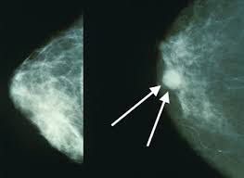
Breast Cancer Screening According to USPSTF
Average-risk women:
Average-risk women : have less than a 15 % lifetime risk of developing breast cancer, the majority of women are at average risk.
Method of screening : Mammography
When to start screening?
Age under 40 — Screening not recommended.
Age 40 to 49: The decision to perform mammography should be determined by individual patient risk and values through shared decision-making. Screening interval: every two years.
Age 50 to 74 — breast cancer screening with mammography is recommended. Screening interval: Every two years, unless the prior screening identified a finding for which more frequent breast imaging was advised.
Age 75 and older — women over the age of 74 offered screening only if their life expectancy is at least 10 years

Slide 27
Breast Cancer Screening According to USPSTF
For women with an estimated lifetime breast cancer risk of more than 20% or who have a BRCA mutation, screening should begin at 25 years of age or at the age that is five to 10 years younger than the earliest age that breast cancer was diagnosed in the family
Magnetic resonance imaging (MRI) is recommended annually for breast cancer surveillance strategy in high-risk women
Clinical breast examination plus mammography seems to be no more effective than mammography alone at reducing breast cancer mortality.
Teaching breast self-examination does not improve mortality and is not recommended; however, women should be aware of any changes in their breasts and report them promptly

Slide 28
Cervical cancer According to USPSTF
Cervical cancer is the fourth most common cancer in women worldwide.
Screening method: pap smear.
When to start: At age 21
For average-risk women (without HIV or immunocompromise) 21-29 years:
Pap smear alone every 3 years.
For average-risk women (without HIV or immunocompromise) 30-65 years,
Co-testing (Pap smear and human papillomavirus [HPV] testing) every five years OR
Pap smear screening every three years.
If both initial tests are negative.
Women ≥65 years who have had adequate negative prior screening and are not at increased risk do not need to be screened.
Older women who have not been adequately screened should be screened until age 70 to 75 years.
Individuals who have had a total hysterectomy (hysterectomy with removal of the cervix) for reasons other than cervical cancer do not need to be screened

Slide 29
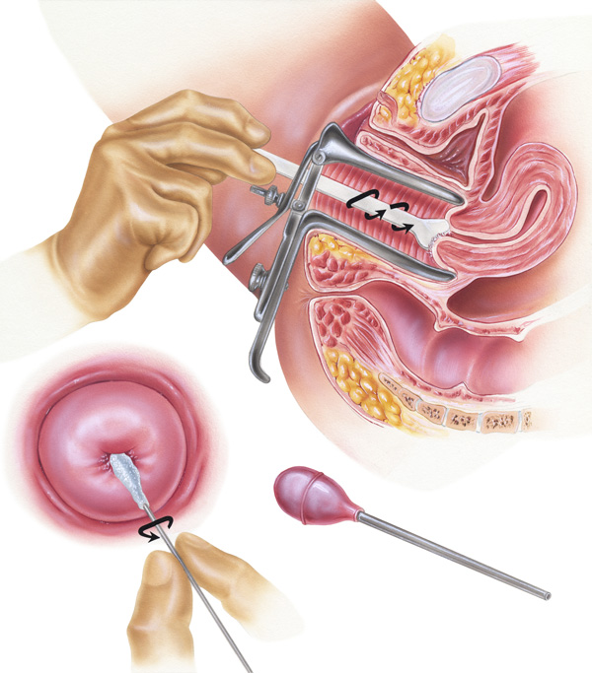

Slide 30
Colorectal cancer
The third most common cancer for both sexes worldwide.
When to start? do an initial risk assessment to determine if a patient is at increased risk for CRC at a first office visit and update the information at a minimum of every five years.
Average risk:
Start at age ≥45 years. (according to USPSTF)
Continue to screen until 75 years .
Screening decisions should be individualized for those aged 76 to 85 years.
Method of screening: use a shared decision-making process to discuss specific CRC screening test protocols. Options are:
Colonoscopy every 10 years
Fecal immunochemical testing (FIT ) for occult blood annually on a single sample.
Multitarget stool DNA (MT-sDNA) every three years.
Computed tomography colonography (CTC) every five years.
Other tests available include sigmoidoscopy with FIT or with guaiac-based FOBT(gFOBT), sigmoidoscopy alone,or gFOBT alone.
Every positive CRC screening test other than colonoscopy should be followed by a colonoscopy to visualize the entire colon, evaluate lesions, and remove polyps.
Notes:
Guaiac FOBT: The sample of stool on the special card is tested with a chemical. If there is blood in the stool, the special card changes color.
Immunochemical FOBT: A liquid is added to the stool sample. This mixture is injected into a machine that contains antibodies that can detect blood in the stool. If there is blood in the stool, a line appears in a window in the machine. This test is also called fecal immunochemical test or FIT.

Slide 31
Colorectal cancer
High risk adults: (individuals with family history of CRC, familial adenomatous polyposis, inflammatory bowel disease, etc)
Start at age 40 years (or 10 years younger than age at which youngest affected relative was diagnosed with colorectal cancer) .

Slide 32
Prostate Cancer Screening
Worldwide, prostate cancer is the second most commonly diagnosed cancer in men.
Clinicians do not specifically advise in favor of or against screening. Men who are candidates for screening should be engaged in shared decision-making about whether they choose to be screened.
Method of screening: prostate-specific antigen (PSA) testing
When to start:
In average-risk men, initiate discussion of screening at age 50 years.
For other men at higher risk for prostate cancer, including black men and men with a family history of prostate cancer, initiate discussion of screening at age 40 to 45 years.

Slide 33
Prostate Cancer Screening
Screening interval : one to two years.
When to stop: For most patients, offer screening up to age 70 years, stopping earlier if comorbidities limit life expectancy to less than 10 years.
Men with a PSA level above 7 ng/mL should be referred, without further testing, to a urologist for evaluation.
For men with a PSA level between 4 and 7 ng/mL, repeat the PSA testing several weeks later. Men with a repeat PSA level >4 ng/mL should be referred to a urologist for evaluation.
If a DRE is performed, men with a nodule, induration, or asymmetry on prostate examination should be referred to a urologist, regardless of the PSA result.

Slide 34
Lung Cancer
Lung cancer is the second most common cancer worldwide and is the leading cause of cancer-related death.
Prevention (promoting smoking cessation) is likely to have far greater impact on lung cancer mortality than is screening.
Screening lung cancer with annual low-dose computed tomography (LDCT) has the potential to significantly reduce the burden of lung cancer.
Screen adults aged 55 to 80 years who have at least 30 pack-year smoking history and currently smoke or have quit within the past 15 years.

Slide 35
Jordanian National Program
Breast Cancer:
Women between 25 and 39 years old at normal risk:
Monthly breast self-examination.
Annual clinical breast exam.
Women 40 years and older:
Monthly breast self-examination.
Annual clinical breast exam.
Mammogram annually.

Slide 36
Jordanian National Program
Cervical Cancer:
PAP smear starting three years after becoming sexually active, and annually thereafter.
Colon Cancer:
Colonoscopy every ten years, fecal occult blood testing (FOBT) annually, or flexible sigmoidoscopy every five years starting at the age of 50.

Slide 37
IMMUNIZATION

Slide 38
Notes:
The AAP recommends routine immunization of infants with either RV1 or RV5. If RV5 is used, it should be administered orally in a three-dose series at two, four, and six months of age. The minimum interval between doses is four weeks. All doses should be given by eight months of age

Slide 39
ADULT IMMUNIZATION
According to The Centers for Disease Control and Prevention (CDC) :
Influenza vaccine – Annual influenza vaccination for all adults.
Tetanus, diphtheria, and acellular pertussis vaccination (Td/Tdap) : a single dose of Tdap for all adults aged 19 years and older who have not received Tdap previously. Thereafter, all adults should receive a booster every 10 years with either TdaP or Td and should receive a TdaP with each pregnancy.
Varicella vaccine : recommended for healthy persons >13 years of age without evidence of immunity. should receive two doses, separated by four to eight weeks
Zoster vaccine – All individuals 50 years of age or older, RZV recombinant zoster vaccine (2 doses separated by 2 months)

Slide 40
ADULT IMMUNIZATION..cont
Human papillomavirus vaccines : For all individuals between ages 11 and 26 years.
Pneumococcal vaccines – all adults 19 to 64 years who have a condition that increases the risk of pneumococcal disease (e.g. Chronic lung disease, Chronic liver disease, etc). It is also recommended for all adults ≥65 years.
Hepatitis B vaccination: HBV vaccination is recommended for all adults <60 years of age, and for those ≥60 who are at increased risk for acquiring HBV infection

Slide 41
Counselling
Education

Slide 42
Counseling
Newborns - Counseling to prevent sudden infant death syndrome (avoid prone sleeping position) - Counseling to promote a healthy diet and breast-feeding
Children -Counseling to prevent household injuries : *Smoke detectors *Hot water heaters set, 49-55 °C *Childproof containers for medication *Approved bicycle helmets - Counseling to prevent dental disease : *Fluoride supplementation if inadequate in water * Regular visits to dentist *Regular brushing and flossing

Slide 43
Counseling
III. Adolescents
- Counseling to prevent motor vehicle injuries - Counseling to promote a healthy diet and physical activity - Counseling to prevent drugs, tobacco use & alcohol use - Counseling to prevent sexually transmitted diseases
IV. Adults
Smoking cessation, nicotine replacement therapy
Dental hygiene
Seat belt use
Injury prevention
Moderate physical activity
Problem drinking screening/counseling
STD counseling
Nutritional counseling
Osteoporosis and HRT ( In Perimenopausal Women)

Slide 44
Case Study No.1
A 47-year-old patient presents for a routine physical examination. The patient does not have a history of colorectal cancer, inflammatory bowel disease, or adenomatous polyps or a family history of colorectal cancer. The patient's body mass index is 27 kg per m², and the HA1C level at their last visit was 5.9%. The patient has not been screened for colorectal cancer in prior visits.

Slide 45
1. According to the USPSTF recommendation statement, how should this patient be counseled regarding the need for colorectal screening?
A. Only adults at increased risk of colorectal cancer should begin screening at 45 years of age.
B. Regardless of risk factors, all patients should be screened for colorectal cancer starting at 45 years of age.
C. The patient is at increased risk of colorectal cancer because of an abnormal body mass index and A1C level and should be offered screening at today's visit.
D. The patient has no personal or family history of colorectal cancer, so routine screening should begin at 50 years of age.
E. The net benefit of screening for colorectal cancer is small, so the patient should be referred to screening only if a strong preference is expressed.

Slide 46
The correct answer is B.
The USPSTF recommends screening for colorectal cancer beginning at 45 years of age in adults at average risk

Slide 47
2. According to the USPSTF recommendation statement, which one of the following is an appropriate test and interval for colorectal cancer screening?
A. Stool DNA test with fecal immunochemical testing (sDNA-FIT) every five years.
B. High-sensitivity guaiac fecal occult blood test (gFOBT) or FIT every five years.
C. Flexible sigmoidoscopy every seven years.
D. Colonoscopy every 10 years.
E. Computed tomography colonography every 10 years.
The correct answer is D.

Slide 48
Case study No.2
DB is 72 years old and recently moved into a nursing home. She has not received her yearly influenza shot. DB has numerous health problems, including diabetes mellitus, arthritis (for which she receives prednisone) and emphysema. She has a history of having influenza almost every year for the past 15 years.
1. Which of the following factors contribute to placing this patient at high risk for serious complications of influenza?
A. More than 65 years of age.
B. Living in an institution.
C. Having pulmonary lung disease.
D. Having a history of influenza viruses
The answers are A, B and C

Slide 49
2. During which one of the following times would it have been optimal for DB to have received the influenza vaccine?
A. Once influenza virus activity has been documented in the community.
B. During the month of September.
C. Between October and mid-November.
D. Between December and mid-January.
E. Between September and January.
The answer is C: between October and mid-November. Because the influenza season usually begins in December, the period between October and mid-November is the optimal time for immunization campaigns.

Slide 50
Thank You

