Slide 1
Case-Control Studies

Slide 2
Case-Control Studies
To determine the significance of clinical observations in a group of cases reported by physicians, a comparison (sometimes called a control or reference) group is needed.
Observations based on case series would have been intriguing, but no firm conclusion would be possible without comparing these observations in cases to those from a series of controls who are similar in most respects to the cases but are free of the disease under study.
Comparison is an essential component of epidemiologic investigation and is well exemplified by the case-control study design.

Slide 3
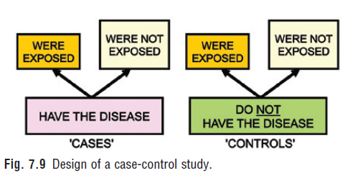
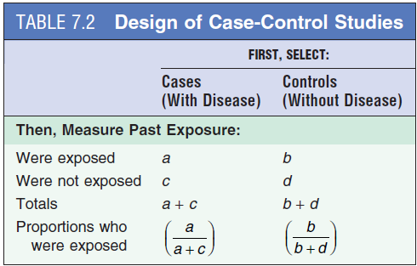
Case-Control Studies – DESIGN OF A CASE-CONTROL STUDY
Fig. 7.9 shows the design of a case-control study.
To examine the possible relation of an exposure to a certain disease, we identify a group of individuals
with that disease (called cases) and, for purposes of comparison,
a group of people without that disease (called controls).
We then determine what proportion of the cases was exposed and what proportion was not.
We also determine what proportion of the controls was exposed and what proportion was not.

Slide 4
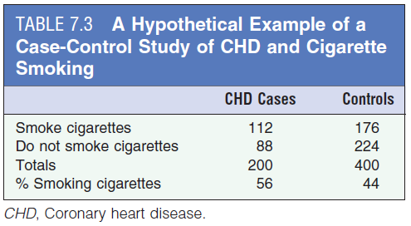
Case-Control Studies – DESIGN OF A CASE-CONTROL STUDY
A hypothetical example of a case-control study is seen in Table 7.3.
We are conducting a case-control study of whether smoking is related to CHD.
We start with 200 people with CHD (cases) and compare them to 400 people without CHD (controls).
If there is a relationship between a lifetime history of smoking and CHD, we would anticipate that a greater proportion of the CHD cases than of the controls would have been smokers (exposed).
Let’s say we find that of the 200 CHD cases, 112 were smokers and 88 were nonsmokers.
Of the 400 controls, 176 were smokers and 224 were nonsmokers.
Thus 56% of CHD cases were smokers compared to 44% of the controls.

Slide 5
POTENTIAL BIASES IN CASE-CONTROL STUDIES - Selection Bias
1. Sources of Cases.
If cases are selected from a single hospital, any risk factors that are identified may be unique to that hospital as a result of referral patterns or other factors, and the results may not be generalizable to all patients with the disease.
Consequently, if hospitalized cases are to be used, it is desirable to select the cases from several hospitals in the community.
Furthermore, if the hospital from which the cases are drawn is a tertiary care facility, which selectively admits a large number of severely ill patients, any risk factors identified in the study may be risk factors only in persons with severe forms of the disease.
In any event, it is essential that in case-control studies, the criteria for eligibility be carefully specified in writing before the study is begun.

Slide 6
POTENTIAL BIASES IN CASE-CONTROL STUDIES - Selection Bias
2. Using Incident or Prevalent Cases.
An important consideration in case-control studies is whether to include incident cases of a disease (newly diagnosed cases) or prevalent cases of the disease (people who may have had the disease for some time).
The problem with use of incident cases is that we must often wait for new cases to be diagnosed; whereas if we use prevalent cases, which have already been diagnosed, a larger number of cases is often available for study.
However, despite this practical advantage of using prevalent cases, it is generally preferable to use incident cases of the disease in case-control studies of disease etiology.
The reason is that any risk factors we may identify in a study using prevalent cases may be related more to survival with the disease than to the development of the disease (incidence).
If, for example, most people who develop the disease die soon after diagnosis, they will be underrepresented in a study that uses prevalent cases, and such a study is more likely to include longer-term survivors.
This would constitute a highly nonrepresentative group of cases, and any risk factors identified with this nonrepresentative group may not be a general characteristic of all patients with the disease, but only of survivors.

Slide 7
POTENTIAL BIASES IN CASE-CONTROL STUDIES - Selection Bias
Selection of Controls
A fundamental conceptual issue relating to selection of controls is whether the controls should be similar to the cases in all respects other than having the disease in question, or whether they should be representative of all persons without the disease in the population from which the cases are selected.
This question has stimulated considerable discussion, but in actuality, the characteristics of the nondiseased people in the population from which the cases are selected are often not known, because the reference population may not be well defined.

Slide 8
POTENTIAL BIASES IN CASE-CONTROL STUDIES - Selection Bias
3. Sources of Controls :
Controls may be selected from nonhospitalized persons living in the community, from outpatient clinics, or from hospitalized patients admitted for diseases other than that for which the cases were admitted.
Use of Nonhospitalized People as Controls. Nonhospitalized controls may be selected from several sources in the community. Ideally, a probability sample of the total population might be selected, but as a practical matter, this is rarely possible.
However, they represent a sample of an ill-defined reference population that usually cannot be characterized and thus to which results cannot be generalized. Moreover, hospital patients differ from people in the community.

Slide 9
POTENTIAL BIASES IN CASE-CONTROL STUDIES - Information Bias
1. Problems of Recall.
A major problem in case-control studies is that of recall of a history of past exposure.
Recall problems are of two types: limitations in recall and recall bias.
Recall bias is the main form of information bias in case-control studies.
The problem of recall is not limited to the case-control study design.
Most epidemiologic studies inquire about life histories and are thus subject to recall biases.

Slide 10
POTENTIAL BIASES IN CASE-CONTROL STUDIES - Information Bias
A. Limitations in Recall (rumination bias)
Much of the information relating to exposure in case-control studies often involves collecting data from subjects by interviews.
Because virtually all human beings are limited to varying degrees in their ability to recall information, limitations in recall is an important issue in such studies.
A related issue that is somewhat different from limitations in recall is that persons being interviewed may simply not have the information being requested.

Slide 11
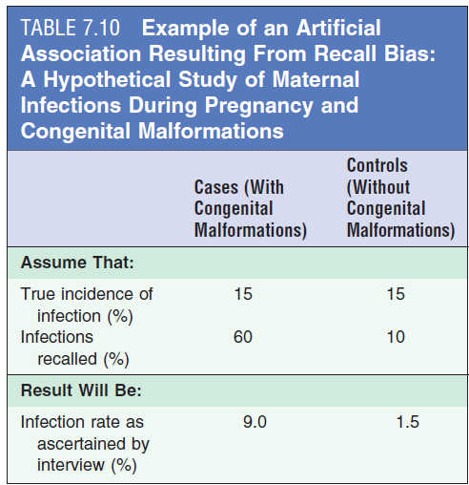
POTENTIAL BIASES IN CASE-CONTROL STUDIES - Information Bias
B. Recall Bias.
A more serious potential problem in case-control studies is that of recall bias.
Ex. As seen in Table 7.10, the apparent infection rate estimated from this case-control study using interviews would be 9% for mothers of malformed infants and 1.5% for mothers of control infants.
Thus the differential recall between cases and controls introduces a recall bias into the study that could artifactually suggest a relation of congenital malformations and prenatal infections.
Although a potential for recall bias is self-evident in case-control studies, in point of fact, few actual examples demonstrate that recall bias has been a major problem in case-control studies and has led to erroneous conclusions regarding associations.
The potential problem cannot be disregarded, and the possibility for such bias must always be kept in mind.

Slide 12
POTENTIAL BIASES IN CASE-CONTROL STUDIES - OTHER ISSUES IN CASE-CONTROL STUDIES
Matching
A major concern in conducting a case-control study is that cases and controls may differ in characteristics or exposures other than the one that has been targeted for study.
If more cases than controls are found to have been exposed, we may be left with the question of whether the observed association could be due to differences between the cases and controls in factors other than the exposure being studied.
One approach to dealing with this problem in the design and conduct of the study is to match the cases and controls for factors about which we may be concerned, such as income, as in the preceding example.
Matching is defined as the process of selecting the controls so that they are similar to the cases in certain characteristics, such as age, race, sex, socioeconomic status, and occupation.
Matching may be of two types:
(1) group matching and
(2) individual matching.
It is very important to distinguish between the two types, since each has its own implications for the statistical analysis of the case-control study.

Slide 13
POTENTIAL BIASES IN CASE-CONTROL STUDIES - Matching
A. Group Matching.
Group matching (or frequency matching) consists of selecting the controls in such a manner that the proportion of controls with a certain characteristic is identical to the proportion of cases with the same characteristic.
Thus if 25% of the cases are married, the controls will be selected so that 25% of that group is also married.
This type of selection generally requires that all of the cases be selected first. After calculations are made of the proportions of certain characteristics in the group of cases, then a control group, in which the same characteristics occur in the same proportions, is selected.
In general, when group matching, we never achieve exactly the same proportions of the key characteristic in cases and controls.
When group matching is done for age, for example, the distribution that is the same in cases and controls is of the age groups (e.g., 45 to 49, 50 to 54); within each group, however, there may still be differences between cases and controls that must be considered: for example, although 10% of cases and controls are 50 to 54 years old, there may be a higher proportion of cases closer to age 54 than that of controls.

Slide 14
POTENTIAL BIASES IN CASE-CONTROL STUDIES - Matching
B- Individual Matching.
In this approach, for each case selected for the study, a control is selected who is similar to the case in terms of the specific variable or variables of concern.
For example, if the first case enrolled in our study is a 45-year-old white woman, we will seek a 45-year-old white female control. If the second case is a 24-year-old black man, we will select a control who is also a 24-year-old black man.
This type of control selection yields matched case-control pairs—that is, each case is individually matched to a control.
In our hypothetical case, we would absolutely match the cases by gender and race/ethnicity, but we might use a 3- or 5-year bound for age. Thus we might match a 45-year-old white woman with a 42- to 48-year-old white woman control.

Slide 15
The problems with matching are of two types:
Practical Problems With Matching.
Conceptual Problems With Matching.

Slide 16
POTENTIAL BIASES IN CASE-CONTROL STUDIES - Matching
1. Practical Problems With Matching.
If an attempt is made to match according to too many characteristics, it may prove difficult or impossible to identify an appropriate control.
For example, suppose that it is decided to match each case for race, sex, age, marital status, number of children, ZIP code of residence, and occupation.
If the case is a 48-year-old black woman who is married, has four children, lives in ZIP code 21209, and works in a photo-processing plant, it may prove difficult or impossible to find a control who is similar to the case in all of these characteristics.
Therefore the more variables on which we choose to match, the more difficult it will be to find a suitable control.
Overmatching also leads to an inability to statistically analyze variables used in matching

Slide 17
POTENTIAL BIASES IN CASE-CONTROL STUDIES - Matching
2. Conceptual Problems With Matching:
Perhaps a more important problem is the conceptual one: Once we have matched controls to cases according to a given characteristic, we cannot study that characteristic.
For example, suppose we are interested in studying marital status as a risk factor for breast cancer. If we match the cases (breast cancer) and the controls (no breast cancer) for marital status, we can no longer study whether or not marital status is a risk factor for breast cancer. Why not? Because in matching according to marital status, we have artificially established an identical proportion in cases and controls: if 35% of the cases are married, and through matching we create a control group in which 35% are also married, we have artificially ensured that the proportion of married subjects will be identical in both groups.
By using matching to impose comparability for a certain factor, we ensure the same prevalence of that factor in the cases and the controls.
Clearly we will not be able to ask whether cases differ from controls in the prevalence of that factor. We would therefore not want to match on the variable of marital status in this study.
Indeed, we do not want to match on any variable that we may wish to explore in our study.

Slide 18
POTENTIAL BIASES IN CASE-CONTROL STUDIES - Matching
Unplanned matching on a variable that is strongly related to the exposure being investigated in the study is called overmatching.
In carrying out a case-control study, therefore, we match only on variables that we are convinced are risk factors for the disease, which we are therefore not interested in investigating in this study

Slide 19
POTENTIAL BIASES IN CASE-CONTROL STUDIES - Use of Multiple Controls
The investigator can determine how many controls will be used per case in a case-control study and that multiple controls for each case are frequently used.
Matching 2 : 1, 3 : 1 or 4 : 1 will increase the statistical power of our study.
Therefore, many case-control studies will have more controls than cases.
These controls may be either:
(1) controls of the same type, or
(2) controls of different types, such as hospital and neighborhood controls or controls with different diseases.

Slide 20
POTENTIAL BIASES IN CASE-CONTROL STUDIES - Use of Multiple Controls
1. Controls of the Same Type.
Multiple controls of the same type, such as two controls or three controls for each case, are used to increase the power of the study.

Slide 21
POTENTIAL BIASES IN CASE-CONTROL STUDIES - Use of Multiple Controls
One might ask,
“Why use multiple controls for each case? Why not keep the ratio of controls to cases at 1 : 1 and just increase the number of cases?”
The answer is that for many of the relatively infrequent diseases we study (which are best studied using case-control designs), there may be a limit to the number of potential cases available for study.
A clinic may see only a certain number of patients with a given cancer or with a certain connective tissue disorder each year.
Because the number of cases cannot be increased without either extending the study in time to enroll more cases or developing a collaborative multicenter study, the option of increasing the number of controls per case is often chosen.
These controls are of the same type (e.g., neighborhood controls); only the ratio of controls to cases has changed.

Slide 22
POTENTIAL BIASES IN CASE-CONTROL STUDIES - Use of Multiple Controls
2. Multiple Controls of Different Types.
In contrast, we may choose to use multiple controls of different types.
For example, we may be concerned that the exposure of the hospital controls used in our study may not represent the rate of exposure that is “expected” in a population of nondiseased persons—that is, the controls may be a highly selected subset of nondiseased individuals and may have a different exposure experience.
We mentioned earlier that hospitalized patients smoke more than people living in the community, and we are concerned because we do not know what the prevalence level of smoking in hospitalized controls represents or how to interpret a comparison of these rates with those of the cases. To address this problem, we may choose to use an additional control group, such as neighborhood controls.
The hope is that the results obtained when cases are compared with hospital controls will be similar to the results obtained when cases are compared with neighborhood controls.
If the findings differ, the reason for the discrepancy should be sought.
In using multiple controls of different types, the investigator should ideally decide which comparison will be considered the “gold standard of truth” before embarking on the actual study.

Slide 23
WHEN IS A CASE-CONTROL STUDY WARRANTED?
A case-control study is useful as a first step when searching for a cause of an adverse health outcome.
At an early stage in our search for an etiology, we may suspect any one of several exposures, but we may not have evidence, and certainly no strong evidence, to suggest an association of any one of the suspect exposures with the disease in question.

Slide 24
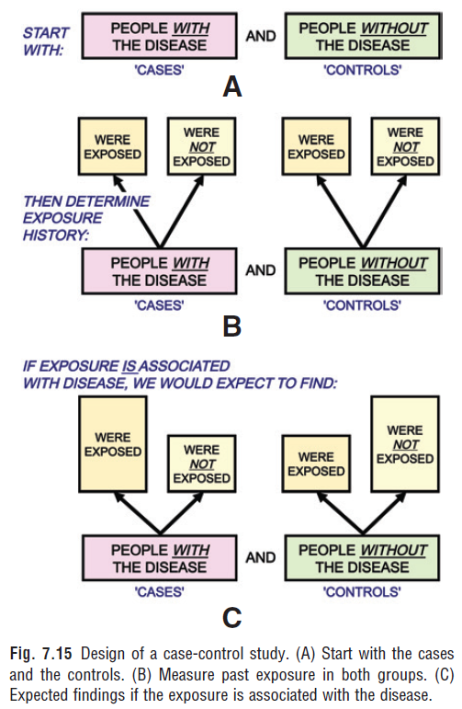
WHEN IS A CASE-CONTROL STUDY WARRANTED?
Using the case-control design, we compare people with the disease (cases) and people without the disease (controls; Fig. 7.15A).
We can then explore the possible roles of a variety of exposures or characteristics in causing the disease (see Fig. 7.15B).
If the exposure is associated with the disease, we would expect the proportion of cases who have been exposed to be greater than the proportion of controls who have been exposed (see Fig. 7.15C).

Slide 25
WHEN IS A CASE-CONTROL STUDY WARRANTED?
When such an association is documented in a case-control study, the next step is often to carry out a cohort study to further elucidate the relationship.
Because case-control studies are generally less expensive than cohort studies and can be carried out more quickly, they are often the first step in determining whether an exposure is linked to an increased risk of disease.
Case-control studies are also valuable when the disease being investigated is rare.
It is often possible to identify cases for study from disease registries, hospital records, or other sources.
In contrast, if we conduct a cohort study for a rare disease, an extremely large study population may be needed in order to observe a sufficient number of individuals in the cohort develop the disease in question.
In addition, depending on the length of the interval between exposure and development of disease, a cohort design may involve many years of follow-up of the cohort and considerable logistical difficulty and expense in maintaining and following the cohort over the study period.

Slide 26
Cohort Studies

Slide 27
Cohort Studies- Lecture objectives
• To describe the designs of cohort studies and options for the conduct of longitudinal studies.
• To illustrate the cohort study design with two important historical examples.
• To discuss some potential biases in cohort studies

Slide 28
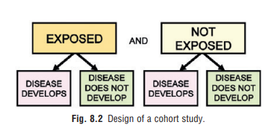
Cohort Study
Cohort study is defined the investigator selects a group of exposed individuals and a group of unexposed individuals and follows both groups over time to compare the incidence of disease (or rate of death from disease) in the two groups.

Slide 29
If a positive association exists between the exposure and the disease,
we would expect that the proportion of the exposed group in whom the disease develops (incidence in the exposed group) would be greater than the proportion of the unexposed group in whom the disease develops (incidence in the unexposed group).

Slide 30
Selection of Study Populations
The essential characteristic in the design of cohort studies is the comparison of outcomes in an exposed group and in an unexposed group (or a group with a certain characteristic and a group without that characteristic, There are two basic ways to generate such groups:

Slide 31
We can create a study population by selecting groups for inclusion in the study on the basis of whether or not they were exposed
(e.g., occupationally exposed cohorts compared with similarly aged community residents who do not work in those occupations)

Slide 32
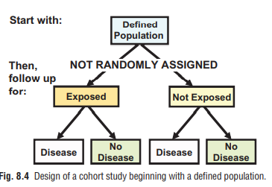
2. We can select a defined population before any of its members become exposed or before their exposures are identified. We could select a population on the basis of some factor not related to exposure (such as community of residence)

Slide 33
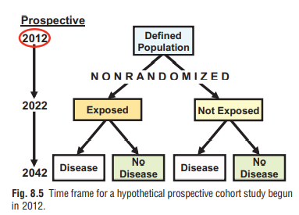
Types of Cohort Studies
Prospective Cohort Study (also called a concurrent cohort or longitudinal study):
the investigator identifies the original
population at the beginning of the study
and, in effect, follows the subjects
concurrently through calendar time
until the point at which the disease develops or does not develop.

Slide 34
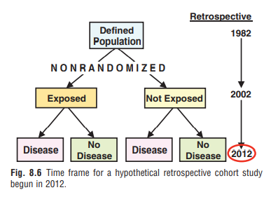
Retrospective Cohort or historical cohort study (also called a nonconcurrent prospective study),
it is initiated after the outcomes have occurred.
Nevertheless, defining exposure status is the first step.

Slide 35
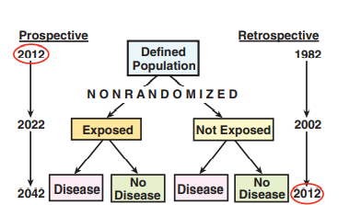
The designs for both the prospective cohort study and the retrospective or historical cohort study are identical: we are comparing exposed and unexposed populations. The only difference between them is calendar time.

Slide 36
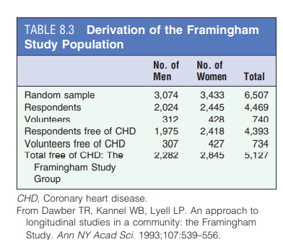
Example of Cohort Studies
EXAMPLE 1: THE FRAMINGHAM STUDY One of the first, most important, and best-known cohort studies is the Framingham Study of cardiovascular disease, which was begun in 1948.

Slide 37
Potential Biases in Cohort Studies - SELECTION BIASES
Nonparticipation and nonresponse can introduce major biases that can complicate the interpretation of the study findings.
If participants refuse to join a cohort, might their characteristics differ sufficiently from those who consent to enroll, and might these differences lead to misguided inferences regarding exposures to outcomes
For example, if those who refuse to join a study are more likely to smoke than those who consent to participate, would our estimate of the effect of smoking on the disease outcome be biased? If smokers who refuse participation are more likely to develop the disease than those who participate, the impact would be to diminish the association toward the null.
Similarly, loss to follow-up can be a serious problem: If people with the disease are selectively lost to follow-up, and those lost to follow-up differ from those not lost to followup, the incidence rates calculated in the exposed and unexposed groups will clearly be difficult to interpret.

Slide 38
Potential Biases in Cohort Studies - INFORMATION BIASES
If the quality and extent of information obtained is different for exposed persons than for the unexposed persons, a significant bias can be introduced.
This is particularly likely to occur in historical cohort studies, in which information is obtained from past records.
In any cohort study, it is essential that the quality of the information obtained be comparable in both exposed and unexposed individuals.

Slide 39
Potential Biases in Cohort Studies - INFORMATION BIASES
If the person who decides whether the disease has developed in each subject also knows whether that subject was exposed, and if that person is aware of the hypothesis being tested, that person’s judgment as to whether the disease developed may be biased by that knowledge. This problem can be addressed by “masking” the person who is making the disease assessment and also by determining whether this person was, in fact, aware of each subject’s exposure status.

Slide 40
Potential Biases in Cohort Studies - INFORMATION BIASES
As in any study, if the epidemiologists and statisticians who are analyzing the data have strong preconceptions, they may unintentionally introduce their biases into their data analyses and into their interpretation of the study findings.

Slide 41
When Is a Cohort Study Warranted?
Fig. 8.11A to C reviews the basic steps in a cohort study, beginning with identifying an exposed group and an unexposed group (see Fig. 8.11A).
We then ascertain the rate of development of disease (incidence) in both the exposed and the unexposed groups (see Fig. 8.11B). If the exposure is associated with disease, we would expect to find a greater incidence rate of disease in the exposed group than in the unexposed group, as shown schematically in Fig. 8.11C.

Slide 42
When Is a Cohort Study Warranted?
Clearly, to carry out a cohort study, we must have some idea of which exposures are suspected a priori as possible causes of a disease and are therefore worth investigating.
Consequently, a cohort study is indicated when good evidence suggests an association of a disease with a certain exposure or exposures (evidence obtained from either clinical observations or case-control or other types of studies).
Because cohort studies often involve follow-up of populations over a long period, the cohort approach is particularly attractive when we can minimize attrition (losses to follow-up) of the study population.
Consequently, such studies are generally easier to conduct when the interval between the exposure and the development of disease is short.

