Slide 1

Outbreak investigation
MED 410
Lec. 14
Dr. Ola Soudah

Slide 2
So how are outbreaks uncovered?
Outbreaks may come to the attention of health professionals through a report from :
  Routinely collected public health surveillance reports.
  Clinicians, infection control practitioners, or laboratories about one or cluster of cases.
  Patients or community public health partners.

Slide 3
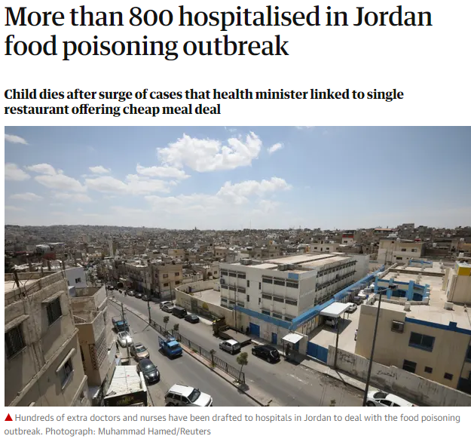

When do outbreaks are investigated?
The decisions regarding whether and how extensively to investigate a potential outbreak depend on a variety of factors.
Factors include:
  The severity of the illness,
  The number of cases,
  The source,
  Mode or ease of transmission,
  The availability of prevention and control measures.

Slide 4
The epidemiologic iceberg

Slide 5
Why outbreak investigation is important?
To control the outbreak.
To prevent future outbreaks
To prepare by providing training opportunities
To provide mandated services, policies and laws
To strengthen surveillance at local level
To advance knowledge about a disease

Slide 6
Components of Effective Outbreak Management
Anticipation/Prediction
Preparedness
Early warning/Surveillance
Effective and co-ordinated response
A good field investigator must be a good manager and collaborator as well as a good epidemiologist, because most investigations are conducted by a team rather than just one individual.

Slide 7

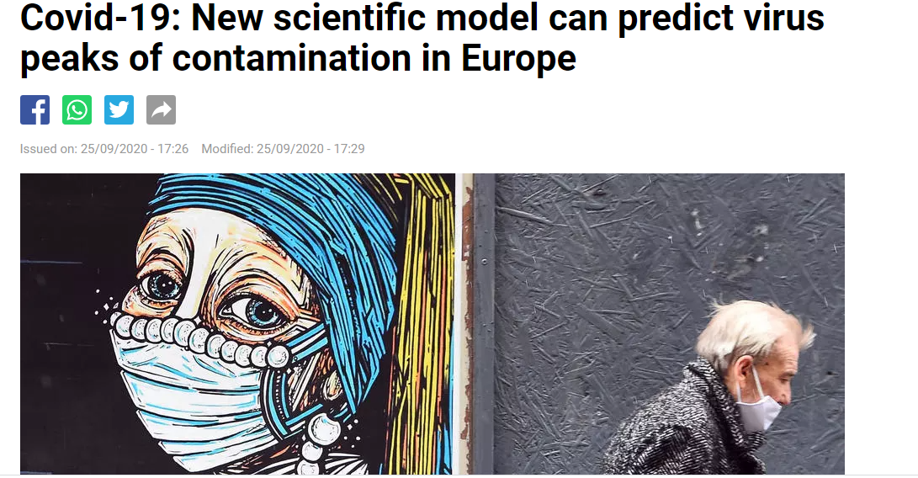
Anticipation/Prediction

Slide 8
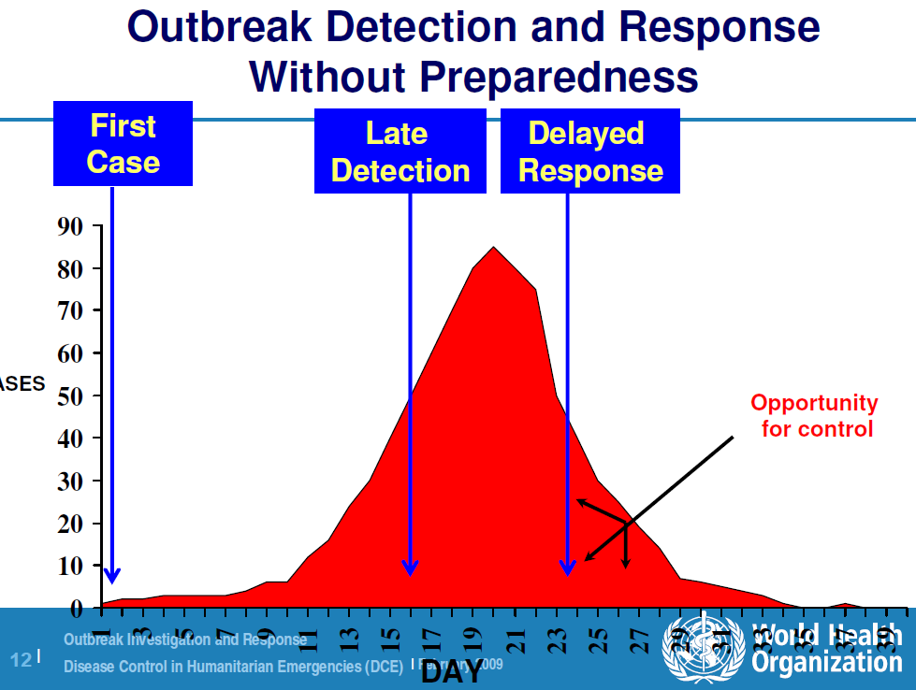
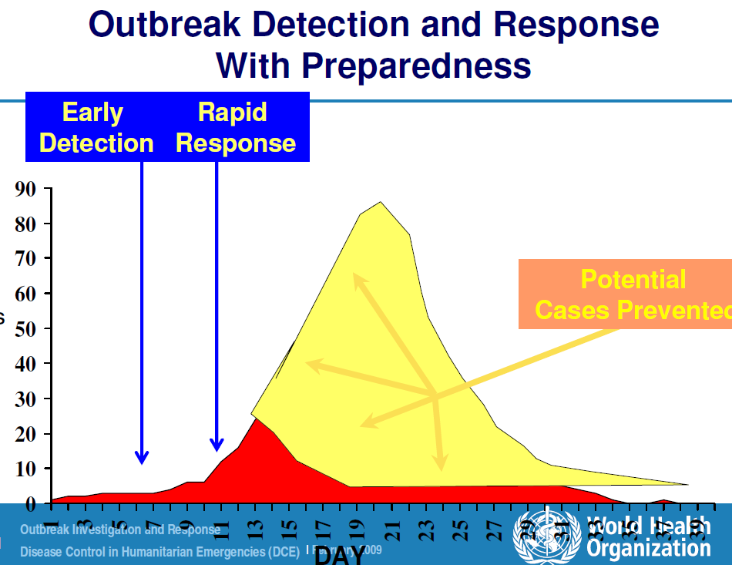
Preparedness

Slide 9
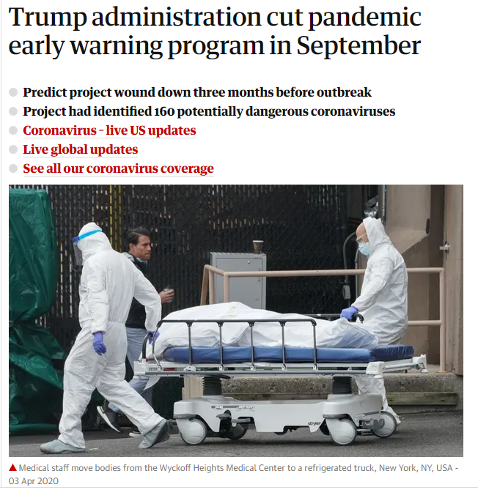
Early warning/ Surveillance
“Too often infectious outbreaks spread undetected due to gaps in surveillance at the community level. These gaps have contributed to tragic and unnecessary illness and loss of life, as we have seen over the past year,” says senior author Jeffrey Shaman, PhD, a professor in the Department of Environmental Health Sciences at the Columbia Mailman School.

Slide 10
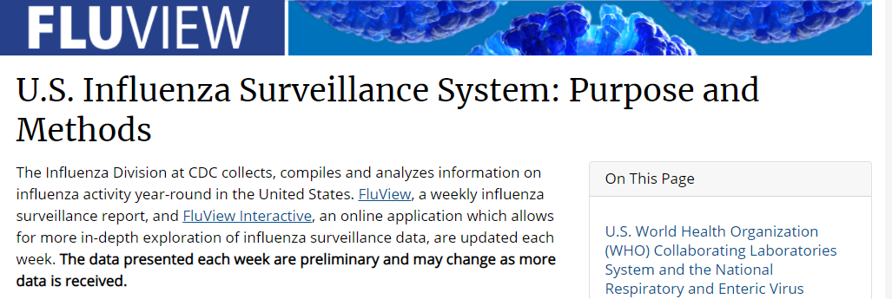
https://www.cdc.gov/flu/weekly/overview.htm

Slide 11

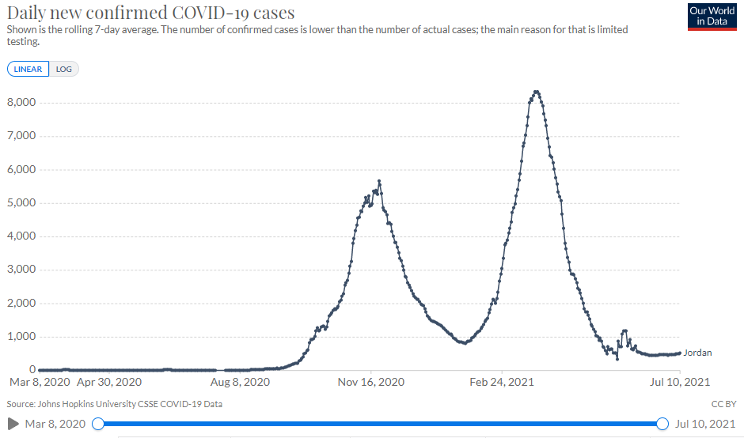
Effective and co-ordinated response
https://ourworldindata.org/coronavirus/country/jordan

Slide 12
STEPS IN AN OUTBREAK INVESTIGATION
Prepare and plan for the investigation
Confirm the existence of an outbreak—verify the diagnosis
Identify and count cases and exposed persons
  Select a case definition
  Identify cases, population at risk, and controls
Choose a study design
Find cases systematically and record information (Tracing)
Tabulate the data in terms of time, place, and person
Collect specimens for laboratory analysis
Conduct an environmental investigation
Institute control measures
Formulate and test hypotheses
Conduct additional systematic studies
Communicate the findings

Slide 13
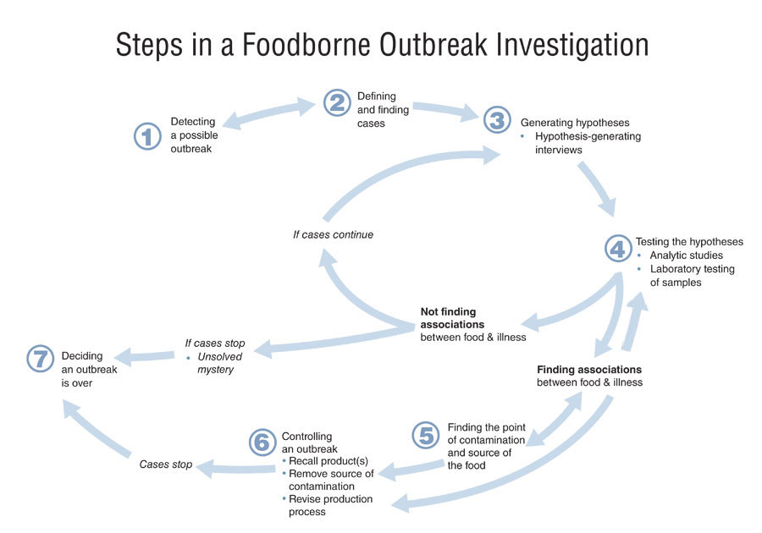
Outbreak investigation is a systematic process of evaluating data to form hypotheses, and then collecting additional data to test the hypotheses.

Slide 14
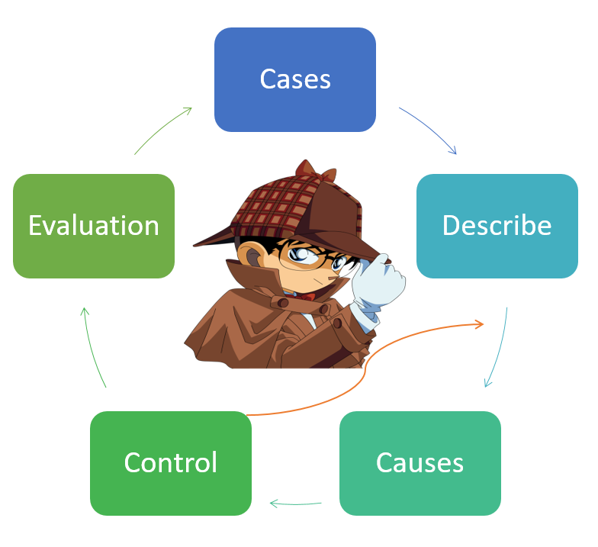

Simply
Cases
Describe
Causes
Control
Evaluation

Slide 15
Defining a case
A case definition is a set of standard criteria for classifying whether a person has a particular disease, syndrome, or other health condition.
  A Case definition: is the standard set of criteria by which we decide if a person has the disease or not (classify sick population from normal ones’).
Use of an agreed-upon standard case definition ensures that every case is equivalent.
Furthermore, the number of cases or rate of disease identified in one time or place can be compared with the number or rate from another time or place.

Slide 16
Components of a case definition for outbreak investigations
A case definition consists of clinical criteria and, sometimes, epidemiologic criteria.
  The clinical criteria usually include confirmatory laboratory tests, if available, or combinations of symptoms (subjective complaints), signs (objective physical findings), and other findings.
  Epidemiologic criteria usually to specify limits on time, place, and/or person than those used for surveillance.

Slide 17
Criteria of good case definition
Must be easily applied by health workers
  Preferably does not require laboratory results (if possible)
Must be standardized (agreed on and used by all authorities)
Should be relatively sensitive
  Detect most cases

Slide 18
Sometimes define levels of certainty regarding diagnosis;
Suspect case (maybe a case/doubted about): suggestive clinical signs but does not fit case definition
Probable case (likely a case): fits all components of clinical case definition
Confirmed case (a case): laboratory confirmed
No one case definition is the absolutely correct case definition.
  One investigator could decide to include those with symptoms but without testing as suspect or probable cases, while another investigator could exclude them.
Level of certainty

Slide 19
WHO COVID-19: Case Definitions
Clinical Criteria:
  • Acute onset of fever AND cough;
  OR
  • Acute onset of ANY THREE OR MORE of the following signs or symptoms: Fever, cough, general weakness/fatigue, headache, myalgia, sore throat, coryza, dyspnoea, anorexia/nausea/vomiting, diarrhea, altered mental status.
Epidemiological Criteria (contact):
  • Residing or working in an area with high risk of transmission of virus (such as camp and camp-like settings ) anytime within the 14 days prior to symptom onset;
  OR
  • Residing or travel to an area with community transmission anytime within the 14 days prior to symptom onset;
  OR
  • Working in any health care setting, including within health facilities or within the community; any time within the 14 days prior of symptom onset.

Slide 20
Case classification:
Suspected cases (May has the disease may not)
  A person who meets the clinical AND epidemiological criteria.
  A patient with severe acute respiratory illness.
  Asymptomatic person not meeting epidemiologic criteria with a positive SARS-CoV-2 Antigen-RDT2.
Probable cases (most likely has the disease)
  A patient who meets clinical criteria above AND is a contact of a probable or confirmed case, or linked to a COVID-19 cluster.
  A suspect case with chest imaging showing findings suggestive of COVID-19 disease.
  A person with recent onset of anosmia (loss of smell) or ageusia (loss of taste) in the absence of any other identified cause.
  Death, not otherwise explained, in an adult with respiratory distress preceding death AND was a contact of a probable or confirmed case or linked to a COVID-19 cluster.

Slide 21
Confirmed cases (has the disease)
  A person with a positive Nucleic Acid Amplification Test (NAAT).
  A person with a positive SARS-CoV-2 Antigen-RDT AND meeting either the probable case definition or suspect criteria.
  An asymptomatic person with a positive SARS-CoV-2 Antigen-RDT who is a contact of a probable or confirmed case.

Slide 22
Find cases systematically and record information
Investigators may conduct what is sometimes called stimulated or enhanced passive surveillance by sending a letter describing the situation and asking for reports of similar cases.
Alternatively, they may conduct active surveillance by telephoning or visiting the facilities to collect information on any additional cases.
In some outbreaks, public health officials may decide to alert the public directly, usually through the local media.

Slide 23
Collect Risk Information (Data)
Type of data should be collected:
Identifying information. A name, address, and telephone
Demographic information. Age, sex, race, occupation
Clinical information. Signs and symptoms
Risk factor information. This information must be tailored to the specific disease in question.

Slide 24
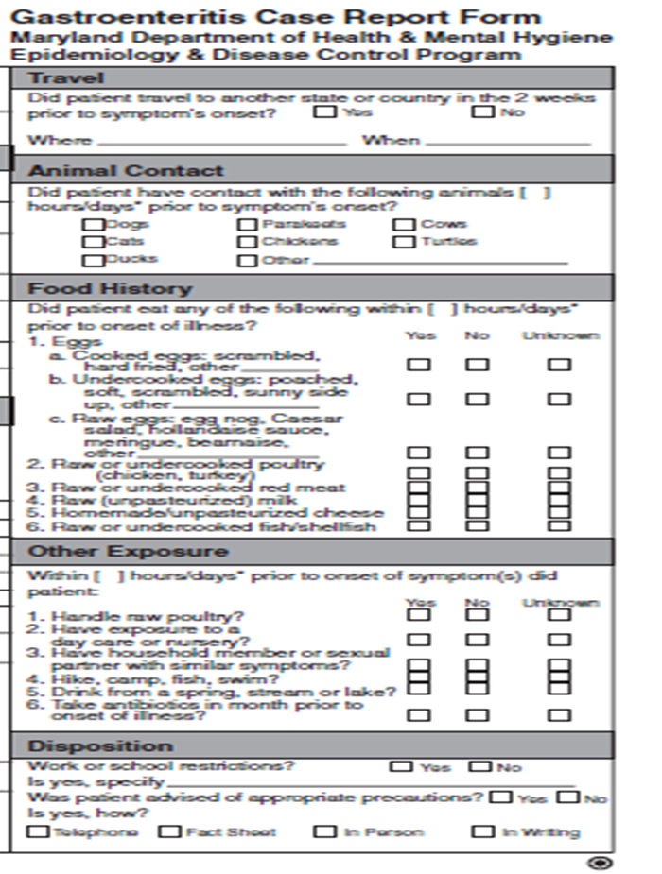
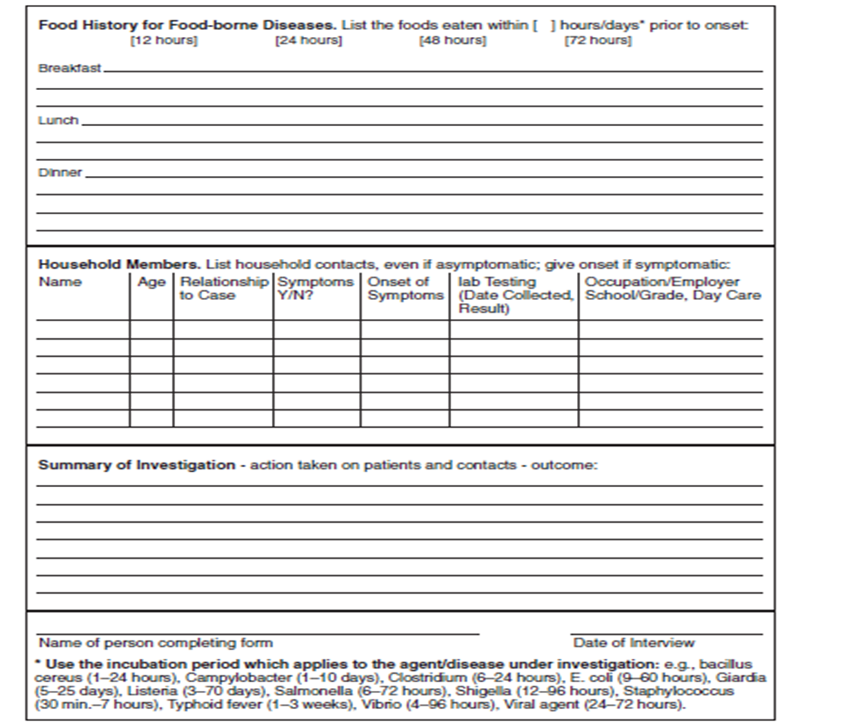
Ex. Active surveillance
Some times it becomes a routine when cases are widely spread

Slide 25
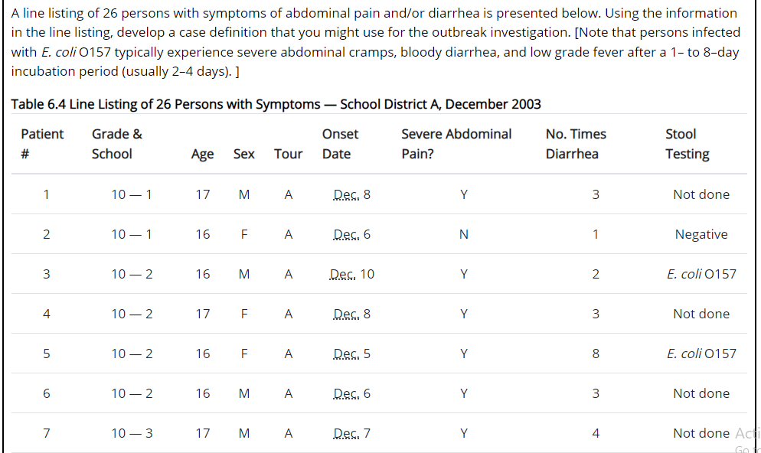
Data Collection for each case …. Line-Listing

Slide 26
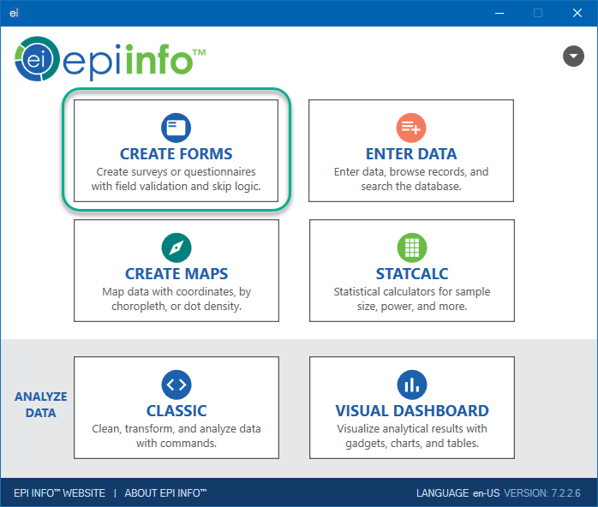
The CDC has developed the EpiInfo computer software program, in which questionnaires can be created, data entered and analyzed, and line listings produced.
This program is currently in worldwide use because it is free, is easy to use, and is designed specifically for surveillance systems and outbreak epidemiology.
https://www.cdc.gov/epiinfo/index.html

Slide 27
Epidemic curve, or epi-curve
Spot maps of cases by residence, site of care, or location in a facility can help explain the occurrence of cases.
Epidemic curve: depicts the frequency of cases over time by plotting the number of cases by date or time of onset.
  This provides information regarding the nature and time course of the outbreak.
  The epi-curve can allow an estimate of the incubation time of the infection, which may help in the identification of the organism.

Slide 28
How to draw an epi-curve?
Simply, it is a histogram that consists of number of cases over time period (hours , days, months).
Drawing an epidemic curve. To draw an epidemic curve, you first must know the time of onset of illness for each case.
  For some diseases, date of onset is sufficient. For other diseases, particularly those with a relatively short incubation period, hour of onset may be more suitable.
Using EXCEL: https://outbreaktools.ca/tools/documents/epidemic-curve-exercise/

Slide 29
SO we have a table of cases for each time point.

Slide 30
Stratification – separating cases into categories such as:
  Exposures (e.g., those who attended an event versus those that did not)
  Geography (e.g., place of residence, patient location on hospital ward)
  Personal characteristics (e.g., occupation – health care staff versus non-health care staff)
Key events that occur during an outbreak can be added to the epi curve Some examples include:
  Exposures (e.g., mass gathering event, implicated dinner)
  Public health measures (e.g., restaurant closure, product recall)
  Communications (e.g., media release warning public not to consume implicated food)

Slide 31
What do Epi-Curve tell us?
Size
  Whether it is increasing over time, stabilizing, or decreasing.
Time component
  Start day.
  End day.
  Disease duration.
  Outbreak peak.
  Probable exposure period (not precise method). https://www.cdc.gov/training/quicklearns/exposure/

Slide 32
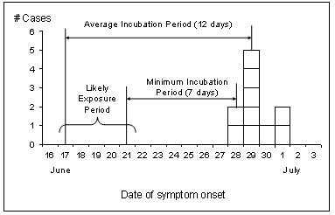
Probable exposure period

Slide 33

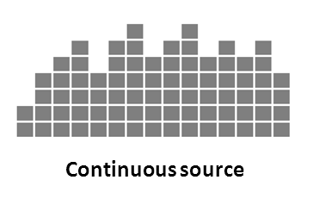
Pattern of spread
Point source – Persons are exposed to the same common source over a brief period of time, such as through a single meal or event attended by all cases; number of cases rise rapidly to a peak and falls off gradually; majority of cases occur within one incubation period.
Continuous common source – Exposure is not confined to one point in time (prolonged over a period of days, weeks or longer); as such, cases are spread over a greater period of time depending on how long the exposure persists; lasts more than one incubation period.

Slide 34
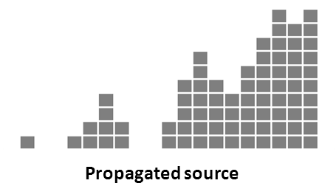
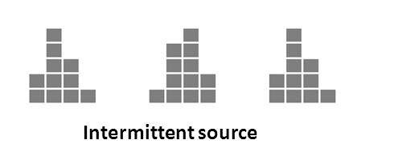
Propagated source – does not have a common source but instead caused by spread of pathogen from one susceptible person to another; transmission may occur directly (person-to-person) or via an intermediate host; tends to have a series of irregular peaks reflecting the number of generations of infection; multiple peaks separated by approx. one incubation period; e.g., person-to-person spread of shigellosis.
Intermittent – similar to continuous but exposure is intermittent; multiple peaks – length: no relation to the incubation period (reflects intermittent times of exposure) e.g., contaminated food product sold over period of time

Slide 35
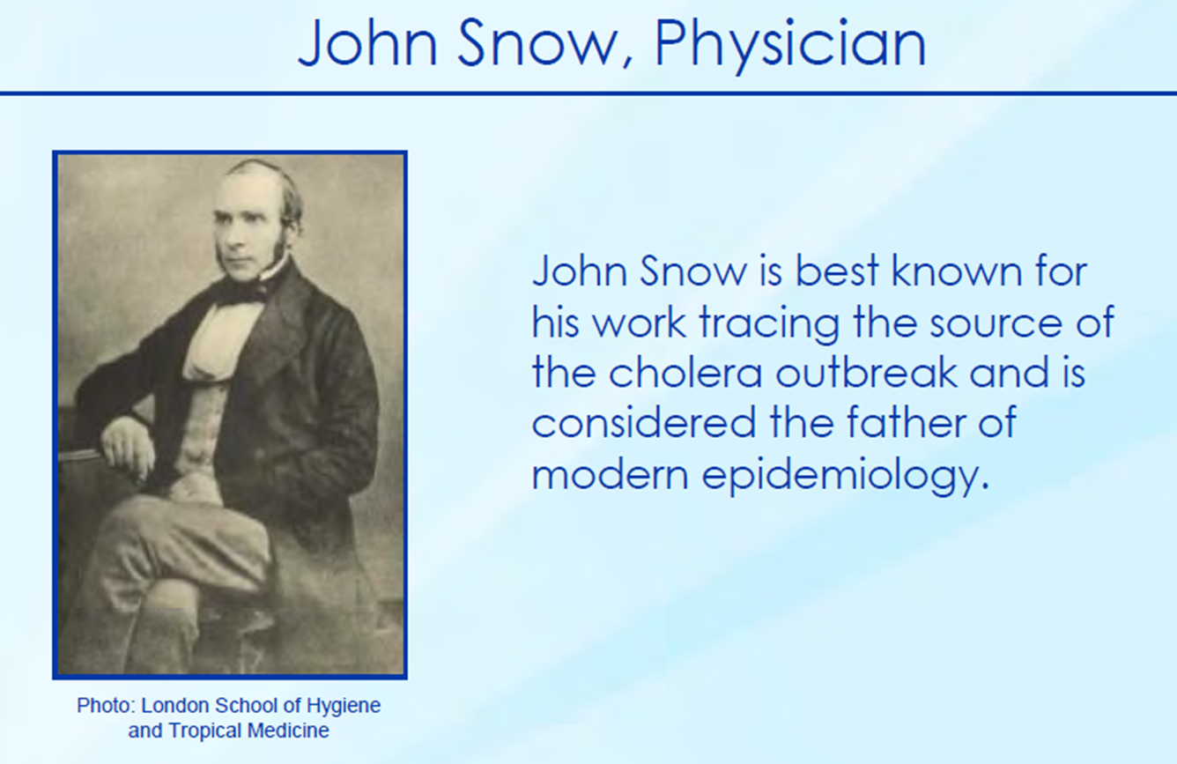
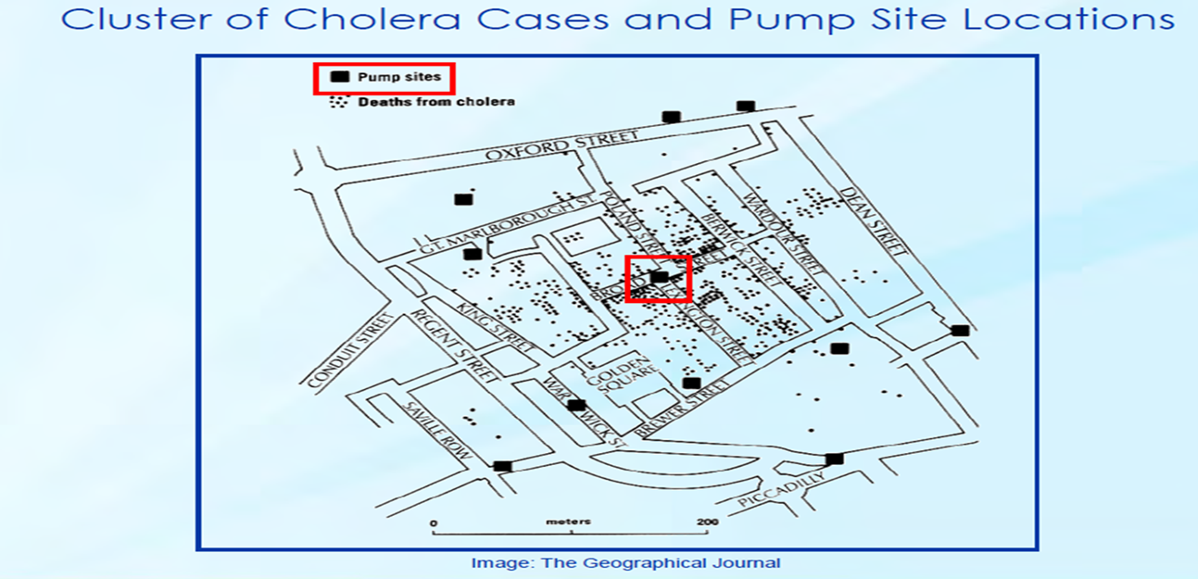
Epidemiologic Map (Spot map)
A spot map is a simple and useful technique for illustrating where cases live, work, or may have been exposed.

Slide 36
Perform Laboratory Analysis
To identify the etiologic agent, the collection of laboratory specimens needs to be appropriately timed. Examples of specimens include food and water samples, other environmental samples (e.g., air settling plates), and clinical specimens (e.g., stool, blood, sputum, or wound specimens) from cases and controls.
Conduct an Environmental Investigation
The environmental investigation assists in answering the how and why questions. This includes an inspection of the facility, a review of practices and procedures for the operation, and an assessment of employee illness.

Slide 37
Develop hypotheses
Depending on the outbreak, the hypotheses may address:
  The source of the agent,
  The mode (and vehicle or vector) of transmission, and
  The exposures that caused the disease.
Given recent concerns about bioterrorism, investigators should consider intentional dissemination of an infectious or chemical agent when trying to determine the cause of an outbreak.

Slide 38
Example, Investigators of an outbreak of salmonellosis in Oregon, were stumped when they were able to implicate salad bars in several local restaurants, but could not identify any common ingredients or distribution system. A year later, a member of a local cult admitted that the cult had intentionally contaminated the salads bars with Salmonella organisms.
“When the epidemiology does not fit the natural pattern, think unnatural, i.e., intentional. “

Slide 39
Measure of Risk – ATTACK RATE
The measure of risk used in outbreaks investigated using cohort design is the Risk-specific attack rate (e.g., the food-specific attack rate for foodborne outbreaks), which is the number of persons who became ill who reported the risk behavior divided by the total number of people who reported that risk behavior.
Method for calculating risk ratio:
Attack rate (risk) in exposed group / Attack rate (risk) in unexposed group

Slide 40
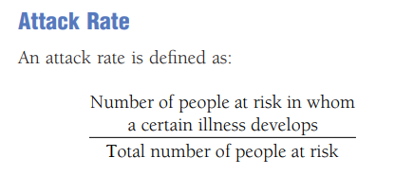
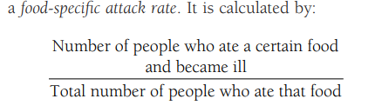

Slide 41
Attack rate= number of cases / total number of specific exposure or risk factor.

Slide 42
The relative risk (RR) is the attack rate among those exposed to the risk factor / the attack rate in those who were not exposed.

Slide 43
Implement Control Measures
As soon as preliminary data indicate the magnitude and severity of the outbreak, a hypothesis should be developed regarding the time, place, and person; the suspected etiologic agent(s); and the mode of transmission.
Remove source of contamination
Remove persons from exposure
Inactivate / neutralize the pathogen
Isolate and/or treat infected persons
Interrupt transmission
Modify host response

Slide 44
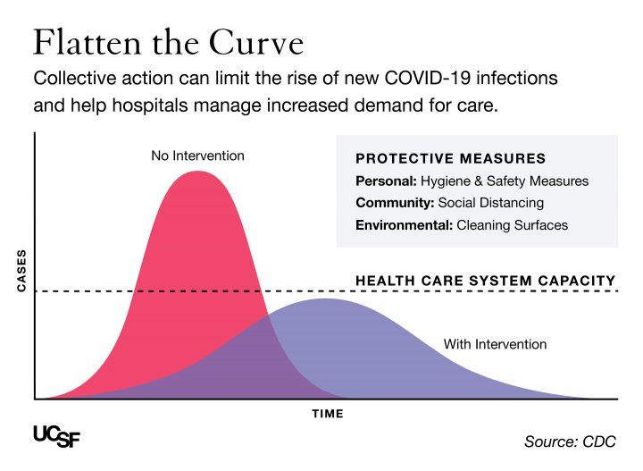
“If we can’t stop it, we can slow it”
Mitigation is to slow the disease spread to give time for vaccine or treatment development.

Slide 45
Communicate findings
The final task is to summarize the investigation, its findings, and its outcome in a report, and to communicate this report in an effective manner.
Methods to communicate findings:
An oral briefing for local authorities.
A written report

Slide 46
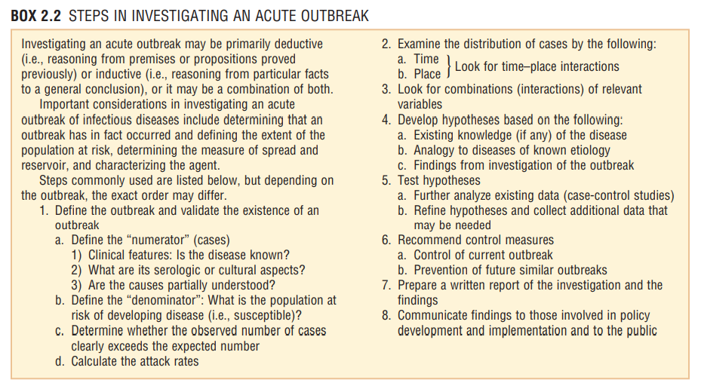

Slide 47
Questions

