Slide 1
The Dynamics of disease Transmission
MED 410
Lec. 11
Dr. Ola Soudah

Slide 2
What is epidemiology?
“I keep six honest serving-men (They taught me all I knew); Their names are What and Why and When And How and Where and Who”. —Rudyard Kipling1 (1865–1936)
Epidemiologists are the scientists that collect, analyze, and interpret data to inform interventions to halt further spread.

Slide 3
Studies of the epidemiology of infectious diseases include evaluation of the:
    Disease determinants: Factors leading to the disease,
    Transmission: factors affecting the transmission of the disease from one person to another, and
    Symptoms: factors associated with clinically recognizable disease among those who has the disease.

Slide 4
In public health, it is the epidemiologic features—for instance, the prevalence, incidence, transmission route, and susceptible populations—that are of paramount importance in developing a control program.
Clinicians role is to treat a disease may be more concerned with the clinical symptoms or pathophysiology.

Slide 5
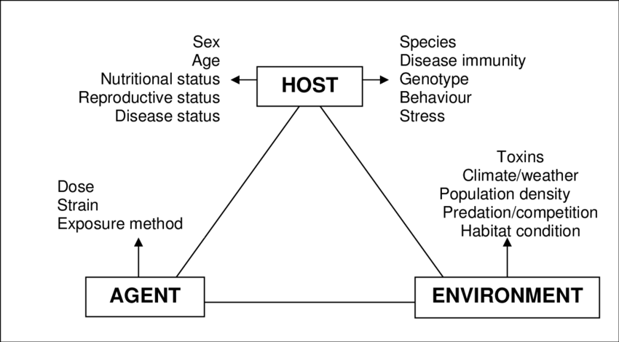
Epidemiologic Triad
Agent, host, and the environment

Slide 6
Agents are biological, physical, and chemical factors whose presence, absence, or relative amount (too much or too little) are necessary for disease to occur.
Host factors include personal characteristics and behaviors, genetic predispositions, and immunologic and other susceptibility-related factors that influence the likelihood or severity of disease. Host factors can be physiological, anatomical, genetic, behavioral, occupational, or constitutional.
Environmental factors are external conditions other than the agent that contribute to the disease process. Environmental factors can be physical, biological, social, economic, or political in nature.

Slide 7
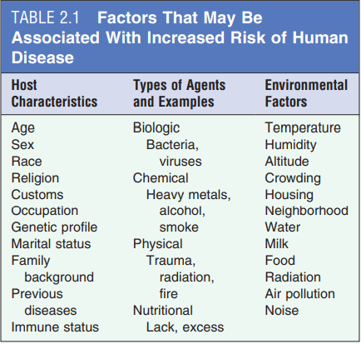

Slide 8
Epidemiologic homeostasis
Over time, an epidemiologic homeostasis may form as agent, host, and environmental factors reach equilibrium (balance).
When an element contributing to the epidemiologic equilibrium is disturbed, the population may experience an increase or decrease in disease occurrence.

Slide 9
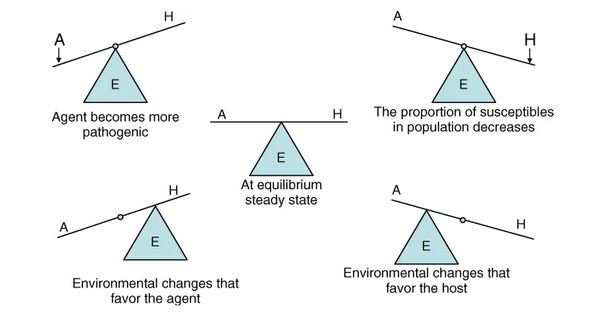
Agent, host, and environmental homeostasis and imbalance.
Causal forces can strengthen, weaken, or cancel-out each other, tipping the epidemiologic balance in favor of the host or in favor of the disease causing agent.

Slide 10
For example, an epidemic may arise from any of the following:
  introduction of a new agent into the population
  increases in the ability of an agent to survive in the environment
  increases in an agent’s ability to infect the host (infectivity)
  increases in the ability of the agent to cause disease once inside the host (pathogenicity)
  increases in the severity of the disease caused by the agent once it has established itself in the host (virulence)
  increases in the proportion of susceptible in the population
  environmental changes that favor growth
  environmental changes that favor transmission of the agent
  environmental changes that compromise host resistance.

Slide 11
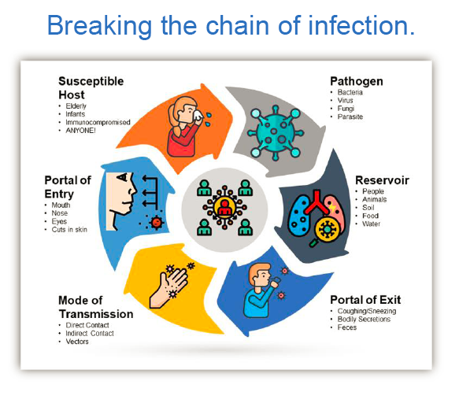
The chain of infection

Slide 12
The diagram above is a model used to understand the infection process. Each link in the chain must be present and in the correct sequential order for an infection to occur.
Agent - a microbial organism with the ability to cause disease
Reservoir - a place where agents can thrive and reproduce
Portal of exit - a place of exit providing a way for an agent to leave the reservoir
Mode of transmission - method of transfer by which the organism moves or is carried from one place to another
Portal of Entry - an opening allowing the microorganism to enter the host
Susceptible host – a person who cannot resist an microorganism invading the body, multiplying and resulting in infection.

Slide 13
Period of communicability - the period when you are infectious and can spread your germs (whether bacteria, viruses, or parasites) to an uninfected person.
Disease susceptibility or vulnerability: Persons more vulnerable to becoming susceptible hosts include the young, the elderly, and people with weakened immune systems.

Slide 14
Mode of transmission
Direct transmission: a disease can be transmitted from person to person (direct transmission) by means of direct contact (as in the case of sexually transmitted infections).
Indirect transmission can occur through a common vehicle such as a contaminated air or water supply or by a vector such as the mosquito.

Slide 15
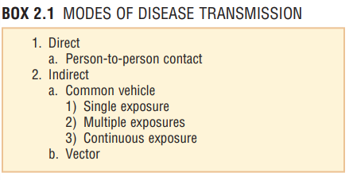
Directly,
Sexually (HIV),
Touching (scabies), by biting (rabies),
Vertically from mother to child (rubella and cytomegalovirus (CMV)).
Indirectly:
A vector or vehicle (food- and water-borne pathogens, healthcare-associated infections (HAIs), e.g. an infected catheter).
Droplets over very short distances (Ebola) and by droplet nuclei, which are smaller and can travel longer distances (airborne transmission, e.g. influenza and tuberculosis (TB)).

Slide 16
Vector – an animate intermediary in the indirect transmission of an agent that carries the agent from a reservoir to a susceptible host.
  Sometimes there are organisms as insects, arthropods, or even mammals as dogs or bats who can act as vectors; as a mosquito transmits the malaria protozoans.
Fomite - a physical object that serves to transmit an infectious agent from person to person.
  A comb infested with one or more head lice would be a fomite or the dust particles containing infectious cold virus that remain after droplets of infected saliva are coughed into the air.
Zoonosis - An infectious disease that is transmissible from animals to humans.

Slide 17
Infectious Diseases Transmitted by More Than One Means
Anthrax is an infection with Bacillus anthracis, the resulting disease has three clinical forms in humans: cutaneous, gastrointestinal and inhalation anthrax.
Different disease manifestation based on route of transmission:
    Contact with infected animal cause woolsorter’s disease.
    Inoculation of organisms into the skin during butchering of an infected animal; this type of exposure usually leads to cutaneous anthrax.
    Consumption of meat from an infected animal leads to gastrointestinal anthrax.
    Inhalation anthrax occurs when an infectious aerosol of B. anthracis spores is inhaled and germinates in the pulmonary lymphatic tissues.

Slide 18
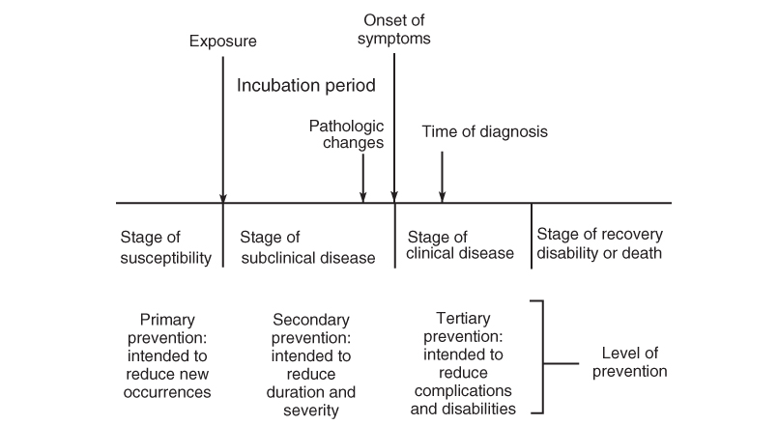
Natural History and Spectrum of Disease
Natural history of disease refers to the progression of a disease process in an individual over time, in the absence of treatment.

Slide 19
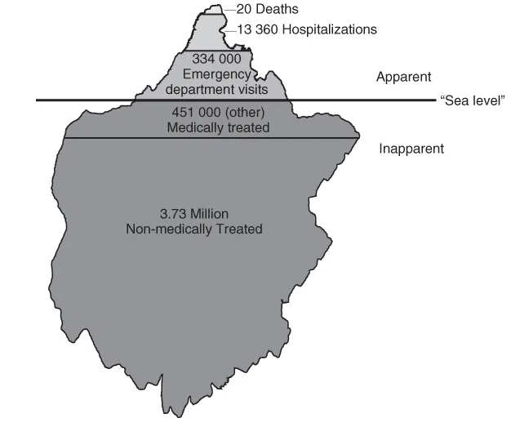
The epidemiologic iceberg
The bulk of a health problem in a population may be hidden from view. This phenomenon, referred to as the epidemiologic iceberg.
Uncovering disease that might otherwise be “below sea level” by screening and better detection often allows for better control of health problems.

Slide 20
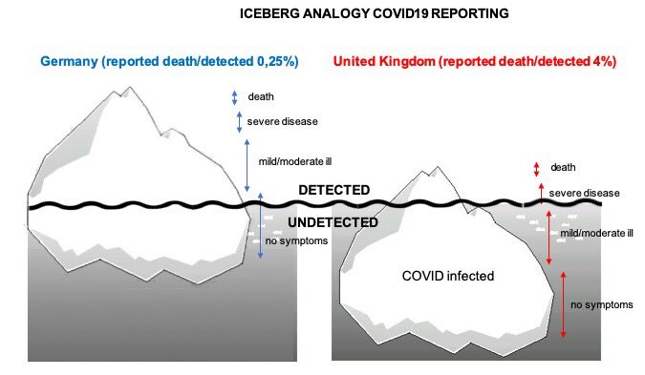
The case of COVID-19,why testing is important?

Slide 21
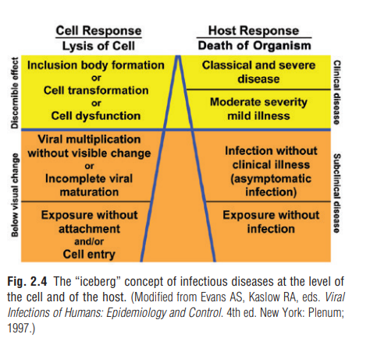
The Ice-berg at Individual level ….

Slide 22
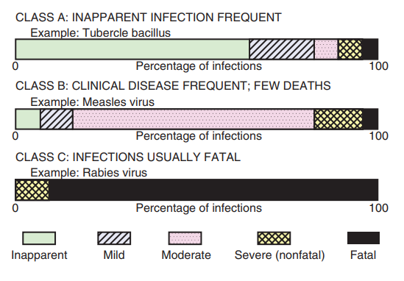
Clinical and Subclinical Disease
We should not only look at the iceberg, we need to understand the spectrum of severity …
Which disease we should screen for??

Slide 23
CLINICAL DISEASE Clinical disease is characterized by signs and symptoms.
NONCLINICAL (INAPPARENT) DISEASE may include the following:
  Preclinical disease: Disease that is not yet clinically apparent but is destined to progress to clinical disease.
  Subclinical disease: Disease that is not clinically apparent and is not destined to become clinically apparent. This type of disease is often diagnosed by serologic (antibody) response or culture of the organism.

Slide 24
C. Persistent (chronic) disease: A person fails to “shake off” the infection, and it persists for years, at times for life.
“In recent years, an interesting phenomenon has been the manifestation of symptoms many years after an infection was thought to have been resolved. Ex. Long COVID-19syndrome”.
D. Latent disease: An infection with no active multiplication of the agent, as when viral nucleic acid is incorporated into the nucleus of a cell as a provirus.
  In contrast to persistent infection, only the genetic message is present in the host, not the viable organism. EX. COVID -19 keep testing positive by PCR for 3 months in some individuals.

Slide 25
Carrier Status
A carrier is an individual who harbors the organism but is not infected as measured by serologic studies (no evidence of an antibody response) or shows no evidence of clinical illness.
This person can still infect others, although the infectivity is generally lower than with other infections. Carrier status may be of limited duration or may be chronic, lasting for months or years.

Slide 26
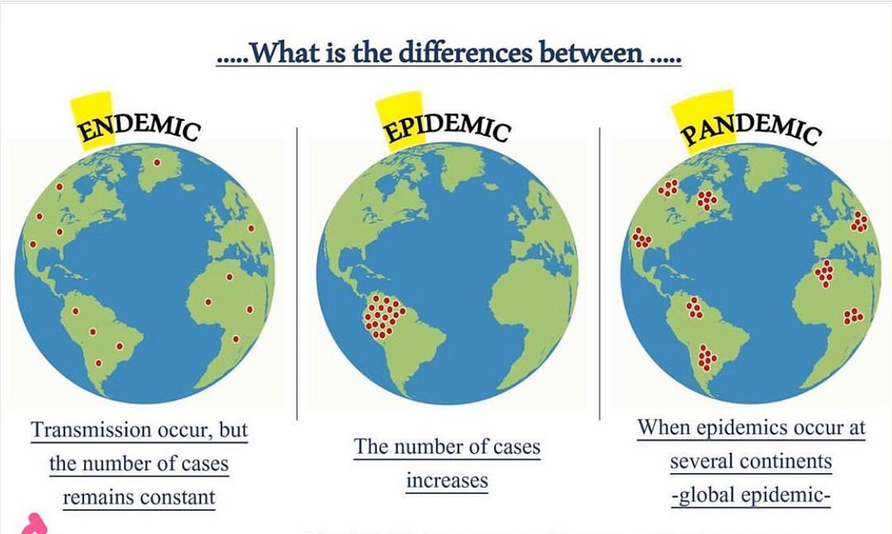
Endemic, Epidemic, and Pandemic

Slide 27
Basic Epidemiology Terms – Levels of Disease Frequency
Endemic – disease or condition present among a population at low level in all times.
Hyper-endemic-- refers to persistent, high levels of disease occurrence.
Outbreak – (localized epidemic) – more cases of a particular disease than expected in a given area or among a specialized group of people over a particular period of time.
Epidemic – large numbers of people over a wide geographic area affected.
Pandemic -An epidemic occurring over a very wide area (several countries or continents) and usually affecting a large proportion of the population.
Cluster –refers to an aggregation of cases grouped in place and time that are suspected to be greater than the number expected, even though the expected number may not be known.
Sporadic – a disease that occurs infrequently and irregularly.

Slide 28
Epidemiologic Characteristics of Infectious Diseases
Incubation Period:
The incubation period of an infectious disease is the time between exposure to an infectious agent and the onset of symptoms or signs of infection.
Infectious agent during incubation period do multiply until it cross a threshold necessary to produce symptoms or laboratory evidence of infection.
During this stage, disease is said to be asymptomatic (no symptoms) or inapparent.

Slide 29
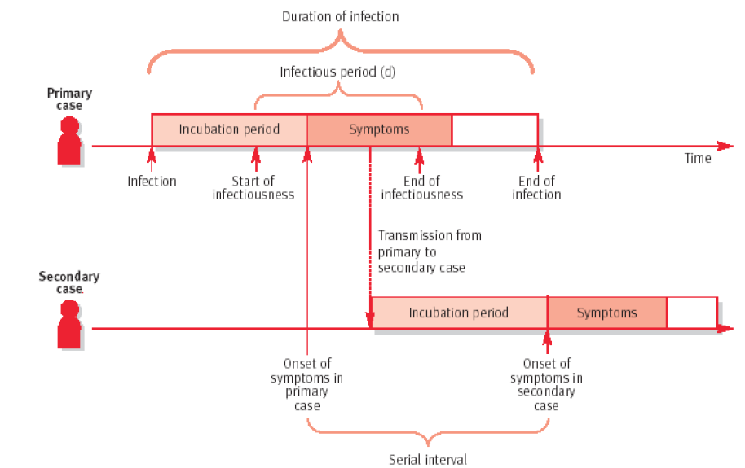

Slide 30
The incubation period from person to another may vary, Why?
  The dose or inoculum of the infectious agent,
  The route of inoculation, and
  The rate of replication of the organism.
  Infectious dose or inoculation size - the amount of pathogen (measured in number of microorganisms) required to cause an infection in the host. Usually it varies according to the pathogenic agent and the consumer's age and overall health.

Slide 31
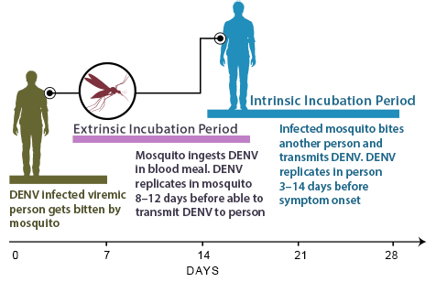
Incubation period applies to vector-borne infections; it is the time that a vector-borne agent requires for maturation to infectivity in the vector before the organism becomes infectious to humans, we call it The extrinsic incubation period.
The extrinsic incubation period can be affected by environmental conditions as well.

Slide 32
Biologic Characteristics of the Organism
Infectivity refers to the proportion of exposed persons who become infected.
Pathogenicity refers to the proportion of infected persons who develop clinical disease.
Virulence refers to the proportion of persons with clinical disease who become severely ill or die.
  Virulence can best be measured by the case fatality rate or as the proportion of clinical cases that develop severe disease.
Immunogenicity is the ability of an organism to produce an immune response after an infection that is capable of providing protection against reinfection with the same or a similar organism.

Slide 33
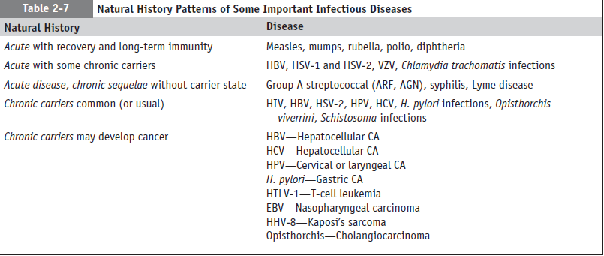

Slide 34
Herd Immunity
The level of immunity of the population may be critical in determining whether an epidemic will occur and, therefore, the risk of infection for a susceptible individual in the population.
If the number of immune persons is large enough that it is unlikely that a susceptible individual will have contact with an infected person, the population is said to have herd immunity.
What percentage of a population must be immune for herd immunity to operate? The level of immunity required (immune individual percentages) to attain herd immunity depends on the characteristics of the infectious disease.

Slide 35
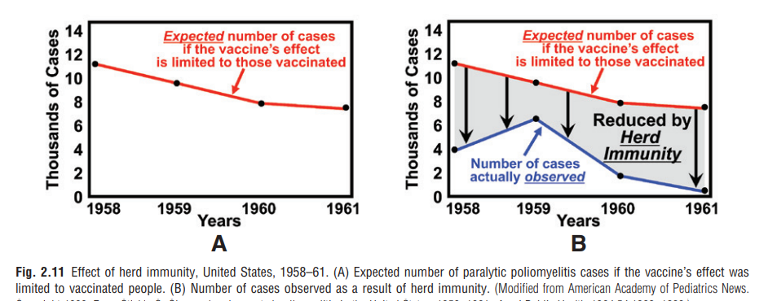
Herd immunity is defined as the resistance of a group of people to an attack by a disease to which a large proportion of the members of the group are immune.

Slide 36
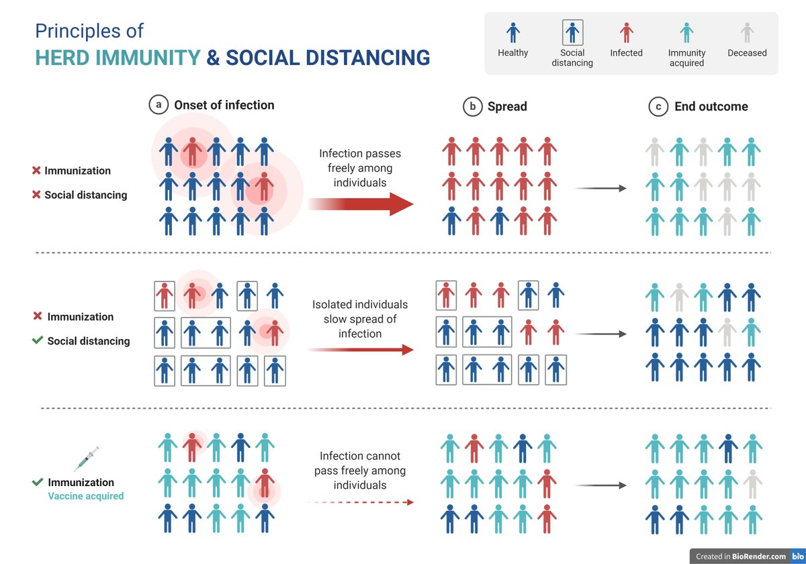
If a large percentage of the population is immune, the entire population is likely to be protected, not just those who are immune.

Slide 37
The levels of herd immunity and individual susceptibility to infections are major epidemiologic factors that have influenced the periodicity and secular trends observed in many diseases, such as measles, rubella, varicella, and polio.

Slide 38
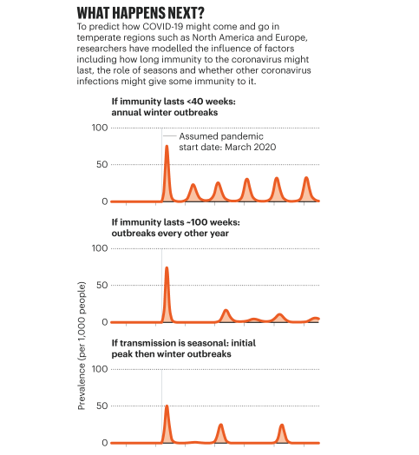
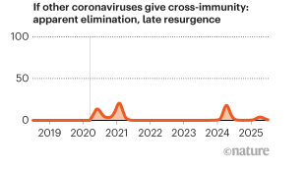
Based on Simulation study.
https://www.nature.com/articles/d41586-020-02278-5

Slide 39
Quantification of Diseases
Epidemiologists use a variety of measurements to quantify the occurrence of disease:
  The prevalence of disease in a population is the number of people who are infected divided by the number of people in the population.
  The incidence is either the rate at which persons acquire the disease or the rate at which the infectious agent is being transmitted throughout the population.
Both measures always include a unit of time—the number of cases of influenza in a given year, month, or week.

Slide 40
Surveillance of Communicable Diseases
Surveillance can be defined as the ongoing and systematic collection, collation, and analysis of data, and the dissemination of the results to those who need to know to avoid or prevent infections or epidemics.
A disease surveillance system serves two key functions;
    The early warning functions of surveillance are fundamental for national, regional and global health security.
    The programme monitoring function of surveillance of communicable diseases encompasses a variety of goals such as eradication or elimination and surveillance to monitor trends of endemic diseases.

Slide 41
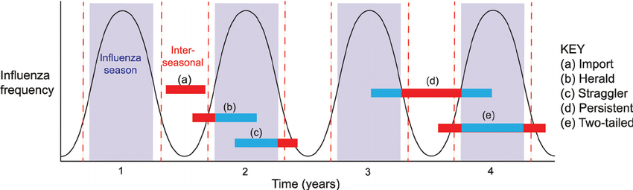
Trends of Infectious Diseases overtime
Seasonal Variation

Slide 42
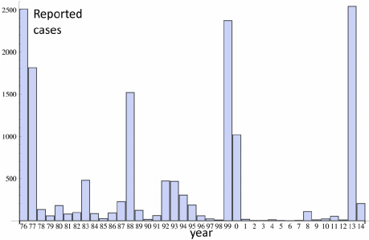
Annual Variation
Infections exhibited marked and repetitive cyclical trends, which depended largely on an epidemic exhausting the susceptible population and another birth cohort replenishing it.
This cyclical pattern indicates persistent transmission.
The annual number of reported cases of the measles in the Netherlands in the period 1976–2014.

Slide 43
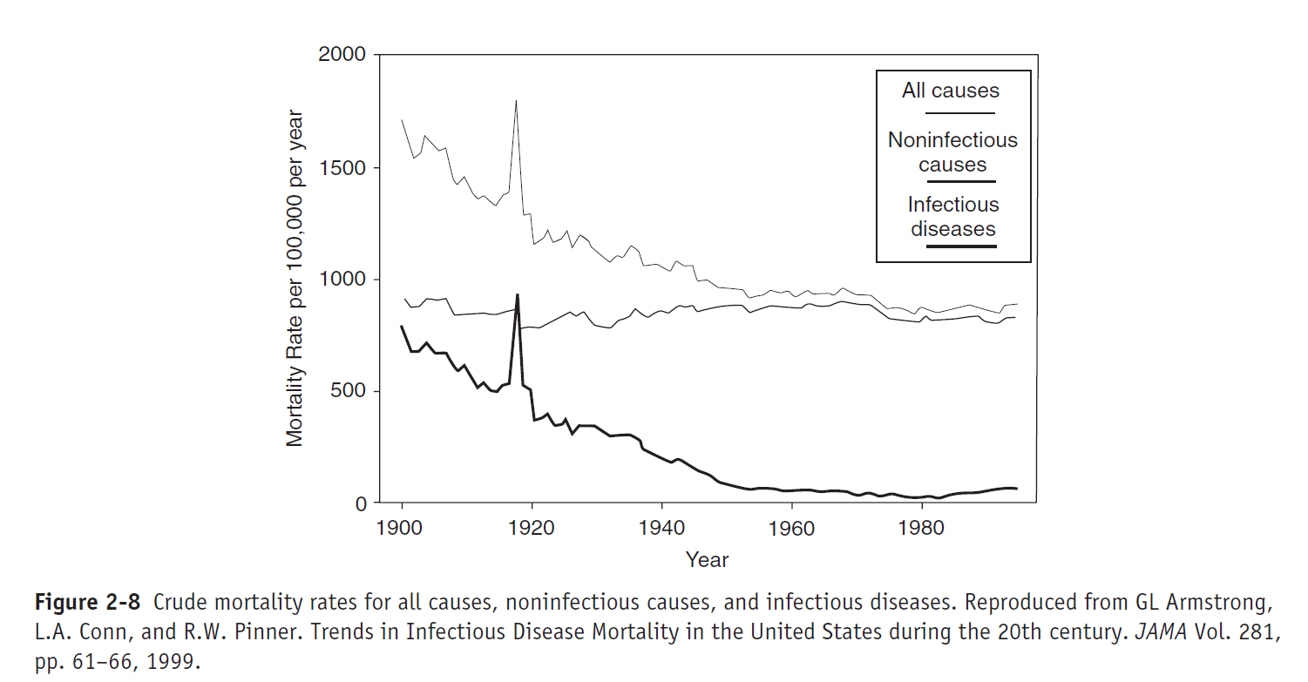
Variations of Infectious Diseases Over Decades
After 1800s, there is at dramatic reduction in mortality rate that attributed to reduction in infectious diseases mortality.

Slide 44
What caused these remarkable reductions in the mortality from common infectious diseases?
One might surmise that the development of modern microbiology with the understanding the discipline provided about the pathogenesis of specific infections led to the creation of vaccines and effective antibiotics to prevent or treat infections.

Slide 45
In reality, for most of these infections, the evidence suggests a more complex scenario.

Slide 46
What might account for these declines in mortality?
In Africa, some of these diseases still have high mortality in certain populations.
For example, measles, which is rarely fatal when it occurs in children in the United States, is still associated with a 15–20% mortality rate in infants and children in sub-Saharan Africa.
Hypotheses to explain this difference have included poorer nutritional status, earlier ages at exposure, other concomitant infections, higher infectious dose, and greater crowding during epidemic spread among infants in Africa.
Clearly, the complex changes that have occurred in society, hygiene, and lifestyle in the United States and in Europe during the late 1800s and early 1900s have had a profound effect on these diseases.

Slide 47
Questions

