Slide 1
Measures of disease occurrence
Lec. 9
MED 410
Dr. Ola Soudah

Slide 2
Overview
Proportions
It is the number of (a) observation with specific characteristics divided by total number of the observations in a given group.
Example: (a) represent the number of diabetic patients in Jordan , (b) represent the non-diabetics patients in Jordan.
Proportion = a / (a+b)
Note that:
a= diabetics number
b= non-diabetics number
a+b = n (total population)

Slide 3
Percentage = Proportion x 100

Slide 4
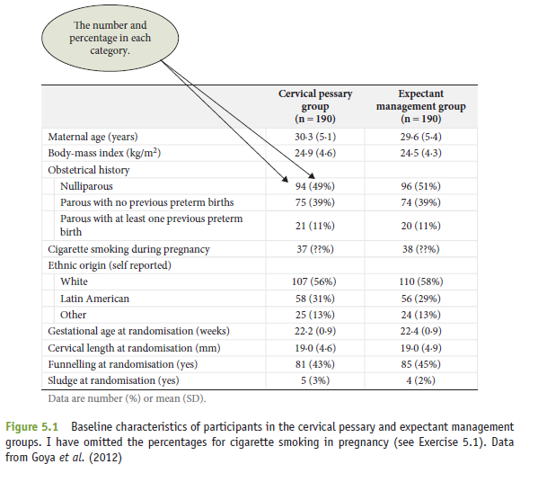

Slide 5
Rates
The most commonly used measures in descriptive epidemiology to calculate health burden due to certain disease or health outcome.
Rates are similar to proportions except that the multiplier (eg. 1,000 , 10,000 , 100,000) is used, and they are computed over a specific period of time.
The multiplier is called the base .
Rates = Proportion x base or ( a / (a + b) ) x base
Note that:
a= diabetics number
b= non-diabetics number
a+b = n (total population)

Slide 6
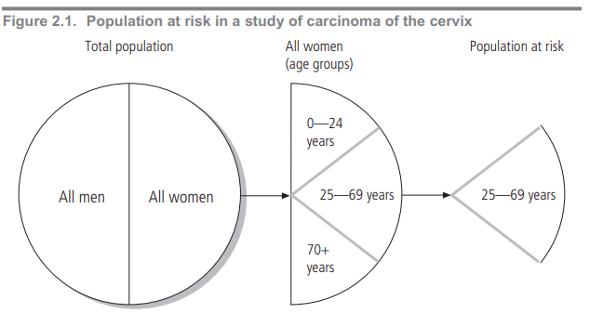
Population at risk
An important factor in calculating measures of disease frequency is the correct estimate of the numbers of people under study (Denominator).
Ideally these numbers should only include people who are potentially susceptible to the diseases being studied. For instance, men should not be included when calculating the frequency of cervical cancer.

Slide 7
Measures of disease Morbidity

Slide 8
Prevalence
Prevalence is defined as the number of affected persons present in the population at a specific time divided by the number of persons in the population at that time.

Slide 9
Types of Prevalence
Point prevalence: number of people with the disease at point of time.
Period prevalence: Number of people with a disease over period of time, the denominator is the average of the population size during that period of time (accounting for dynamic population).

Slide 11
How can prevalence be affected by disease duration?

Slide 12
Factors determine prevalence
The severity of illness (if many people who develop a disease die within a short time, its prevalence is decreased);
The duration of illness (if a disease lasts a short time its prevalence is lower than if it lasts a long time);
The number of new cases (if many people develop a disease, its prevalence is higher than if few people do so).

Slide 14
Incidence
Incidence refers to the rate at which new events occur in a population.

Slide 15
Cumulative incidence is a simpler measure of the occurrence of a disease or health status. Unlike incidence, it measures the denominator only at the beginning of a study.

Slide 16
Cross-Sectional survey

Slide 17
Relationship between incidence and prevalence
Prevalence = incidence x duration

Slide 20
Measures of mortality
The death rate (or crude mortality rate) for all deaths or a specific cause of death.

Slide 21
Age-specific death rates
Infant mortality

Slide 22
Maternal mortality rate The maternal mortality rate refers to the risk of mothers dying from causes associated with delivering babies, complications of pregnancy or childbirth.

Slide 23
Case fatality (CFR)
Case fatality is a measure of disease severity and is defined as the proportion of cases with a specified disease or condition who die within a specified time.

Slide 24
Check the denominator ….

Slide 26
Other population health measures:
Years of potential life lost (PLL) based on the years of life lost through premature death (before an arbitrarily determined age);
Healthy life expectancy (HALE);
Disability-free life expectancy (DFLE);
Quality-adjusted life years (QALYS);
Disability-adjusted life years (DALYS).
It combine duration of life with its quality.

Slide 27
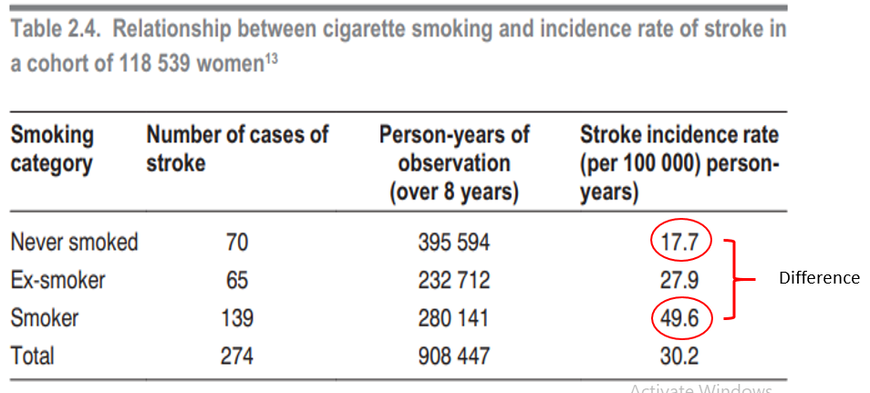
Comparing disease occurrence
The risk difference is the difference in rates of occurrence between exposed and unexposed groups in the population.
The risk difference between the incidence rate of stroke in women, who smoke, and the rate of stroke in women who have never smoked, is 31.9 per 100 000 person-years.
Difference

Slide 28
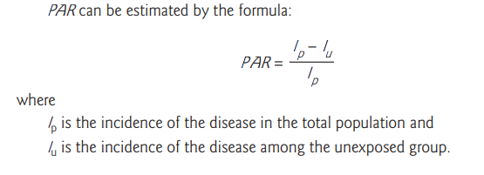
The population attributable risk (PAR) is the incidence of a disease in a population that is associated with (or attributed to) an exposure to a risk factor.
This measure is useful for determining the relative importance of exposures for the entire population.
It is the proportion by which the incidence rate of the outcome in the entire population would be reduced if exposure were eliminated.

Slide 29
the attributable risk of smoking for stroke in the smokers is: ((49.6 – 17.7)/49.6) ×100 = 64%.

Slide 30
Measures of associations
Ratio
It is the number of (a) observation with specific characteristics divided by the number (b) of the observations without the given characteristics.
Ratio = a / b or a / ( n – a )
Note that:
The numerator is not part of the denominator.
Usually used to calculate risk ratios like Odds ratio (OR) & relative risk ratio (RR).

Slide 31
Relative Risk (RR)
The relative risk (also called the risk ratio) is the ratio of the risk of occurrence of a disease among exposed people to that among the unexposed.
An RR = 1.00 means that the risk of the event is identical in the exposed and control samples.
An RR < 1.00 means that the risk is lower in the exposed sample.
An RR > 1.00 means that the risk is increased in the exposed sample.

Slide 32
How many times more likely are exposed persons to become disease, relative to non-exposed persons?
Example an RR = 1.9 means, people whom got exposed are 1.9 likely to develop the disease compared to those didn’t exposed.

Slide 33
Odds Ratio (OR)
The odds ratio is a measure of association used when we can calculate incidence rate.
Odds ratio refer to the odds of people with the disease (cases) may got exposed.
Similar to RR:
OR = 1 , no association or relationship.
An OR < 1.00 means that the risk is lower in the exposed sample.
An OR > 1.00 means that the risk is increased in the exposed sample.

Slide 34
How many times more likely are persons with the disease being exposed compared to persons don’t have the disease?
Example an OR = 0.5 means, the odds of people with the disease got exposed are 0.5 less likely compared to those don’t have the disease.

Slide 37
Questions

