Slide 1
Data collection tool development, Sampling methods, & Quality Assurance
MED 410
Lec. 4
Dr. Ola Soudah

Slide 2
Data collection tool
Data: means information collected as an image, text, vitals, numbers, or figures.
Data sources are classified into two types:
Primary data: first-hand information collected by an investigator, It is collected for the first time. Pros: more reliable, original, and directly related to your research.
Secondary data: refers to second-hand information; It is not originally collected and rather obtained from already published or unpublished sources.

Slide 3
The main sources of health data are:
Surveys.
Electronic Medical records (EMR) .
Claims data or administrative data.
Vital records.
Surveillance.
Disease registries.
Peer-reviewed literature.

Slide 4
Surveys
Surveys are an important means of collecting health and social science information from a sample of people in a standardized way to better understand a larger population.
Pros:
Collect empirical data in a relatively short period of time.
Surveys can collect data on a representative sample of people, particularly when samples are randomized or purposive nonprobability sampling is used.
There are many methods used to conduct surveys, including questionnaires and in-depth interviews via phone, mail, email, and in-person.

Slide 5
Electronic Medical records
Electronic Medical records (EMR) or electron health records (EHR) track events and transactions between patients and health care providers, real-time data.
EMR Contain a patient’s medical history, diagnoses, medications, treatment plans, immunization dates, allergies, radiology images, and laboratory and test results.
Medical records help us measure and analyze trends in health care use, patient characteristics, and quality of care.
Pros: The data are automatically collected and usually accurate and detailed because they come from health care providers.

Slide 6
Claims data or administrative data
Claims databases collect information on millions of doctors’ appointments, bills, insurance information, and other patient-provider communications.
Pros:
Like other medical records, they come directly from notes made by the health care provider, real-time data.
The large sample size of claims data, researchers can analyze groups of patients with rare illnesses and medical conditions.
Cons: there may be low validity due to certain illegal billing practices, like ordering unnecessary tests or billing for services that were not provided.

Slide 7
Vital Records
Vital records are collected by the National Vital Statistics System, and are maintained by state and local governments.
Vital records include births, deaths, marriages, divorces, and fetal deaths. They also record information about the cause of death, or details of the birth.
Pros: Vital records are useful because they offer very detailed information and include information about rare disorders that end in death.
Cons: Vital records only provide information on diseases and illnesses that end in death.

Slide 8
Surveillance
Public health surveillance is the ongoing systematic collection, analysis, and interpretation of data, closely integrated with the timely dissemination of these data to those responsible for preventing and controlling disease and injury.”
These systems function through the efforts of local and state health departments, working in tandem with a variety of health care providers (laboratories, hospitals, private providers), who are mandated by law to report cases of certain diseases.

Slide 9
Disease registries
Disease registries are another type of public health surveillance.
Registries are systems that allow people to collect, store, retrieve, analyze, and disseminate information about people with a specific disease or condition.
Pros:
Disease registries let researchers estimate how large a health problem is, determine the incidence of the disease, study trends over time, and evaluate the effects of certain environmental exposures.
Surveillance data has a higher validity than surveys, because the data comes from lab tests, diagnoses, and other patient records.

Slide 10
Peer-reviewed literature
Peer-reviewed journals may include their articles data uploaded on some data repository, like Harvard COVID-19 dataverse.
The research of scholars who have collected their own data using an experimental study design, survey, or various other study methodologies.
They also present the work of researchers who have performed novel analyses of existing data sources.

Slide 11
Selecting, designing, and developing your questionnaire
Questionnaires offer an objective means of collecting information about people’s knowledge, beliefs, attitudes, and behavior.

Slide 12
Steps in questionnaire development
Ask your self the following questions:
What information are you trying to collect? Require a deep knowledge of the research topic.
Is a questionnaire appropriate? Sometimes questionnaires were used inappropriately.

Slide 13
Rule of thumb: don’t use a questionnaire to assess sensitive topics (associated with stigma), can be mixed with people perceptions, a broad issue that can be assessed by a question,

Slide 14
Could you use an existing instrument? Using a previously validated and published questionnaire will save you time and resources; you will be able to compare your own findings with those from other studies, you need only give outline details of the instrument when you write up your work, and you may find it easier to get published.
Is the questionnaire valid and reliable?
A valid questionnaire measures what it claims to measure.
Repliable questionnaires yield consistent results from repeated samples and different researchers over time.

Slide 15
Questions
Types of questions:
Open ended
Close ended

Slide 16
Open ended VS Close ended questions
 | Pros | Cons
Open ended | Allow free expression Capture new response options, emotions, & thoughts | Take longer time Take more effort to finish (exhaustive) Need coding and analysis Rely on hand writing skills & clarity
Closed question | Easy and quick Clear and complete Suitable for self completion Easy to standardize | Guessed answers Ceiling – Floor effect Errors in filling it can’t capture wider options

Slide 17
How should you present your questions? (Question formatting and response options)

Slide 18
Wording
Clarity. Make questions as clear and specific as possible.
For example, asking, “How much exercise do you usually get?” is less clear than asking, “During a typical week, how many hours do you spend in vigorous walking?”
Simplicity. Use simple, common words and grammar that convey the idea, and avoid technical terms and jargon.
For example, it is clearer to ask about “drugs you can buy without a prescription from a doctor” than to ask about “over-the-counter medications.”
Neutrality. Avoid “loaded” words and stereotypes that suggest a desirable answer.
Asking “During the last month, how often did you drink too much alcohol?” may discourage respondents from admitting that they drink a lot of alcohol.

Slide 19
Setting the Time Frame
To measure the frequency of the behavior it is essential to have the respondent describe it in terms of some unit of time.
During the last 7 days, how many cigarettes did you smoke (one pack is equal to 20 cigarettes)?
[ ] cigarettes in the last 7 days
The investigator must first decide what aspect of the behavior is most important to the study: the average or the extremes.

Slide 20
Avoid Pitfalls
Double-barreled questions. Each question should contain only one concept.
“How many cups of coffee or tea do you drink during a day?”
Hidden assumptions. Sometimes questions make assumptions that may not apply to all people who participate in the study.
For example, a standard depression item asks how often, in the past week: “I felt that I could not shake off the blues even with help from my family.”

Slide 21
What should the questionnaire look like?
In general, questions should be short
and to the point (around 12 words or less).
Physical layout of their questionnaire
as the font size, color, or question order.

Slide 23
For new questions and scales
Pretest
Pretest the instrument clarity and timing.
Validate
Questionnaires and interviews can be assessed for validity (an aspect of accuracy) and for reproducibility (precision)

Slide 24
Questionnaire administration methods
Self reported by mail or online.
Interview by face to face, telephone based , or virtual.
Group or focus group interview.

Slide 25
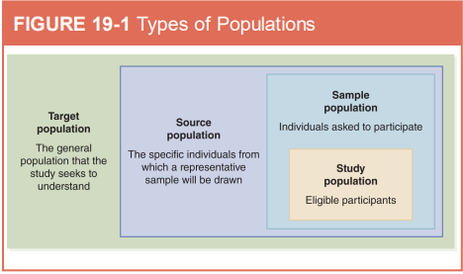
Population Sampling
We cant sample the entire population …. For a study.
The source population,
sometimes called a sampling frame, is a well-defined subset of individuals from the target population from which potential study participants will be sampled.

Slide 26
Sampling methods classification:
Non-Probability Sampling Methods
Probability Sampling Methods

Slide 27
Non-Probability Sampling Methods
Convenience sampling
Quota sampling
Purposive Sampling
Snowball sampling

Slide 28
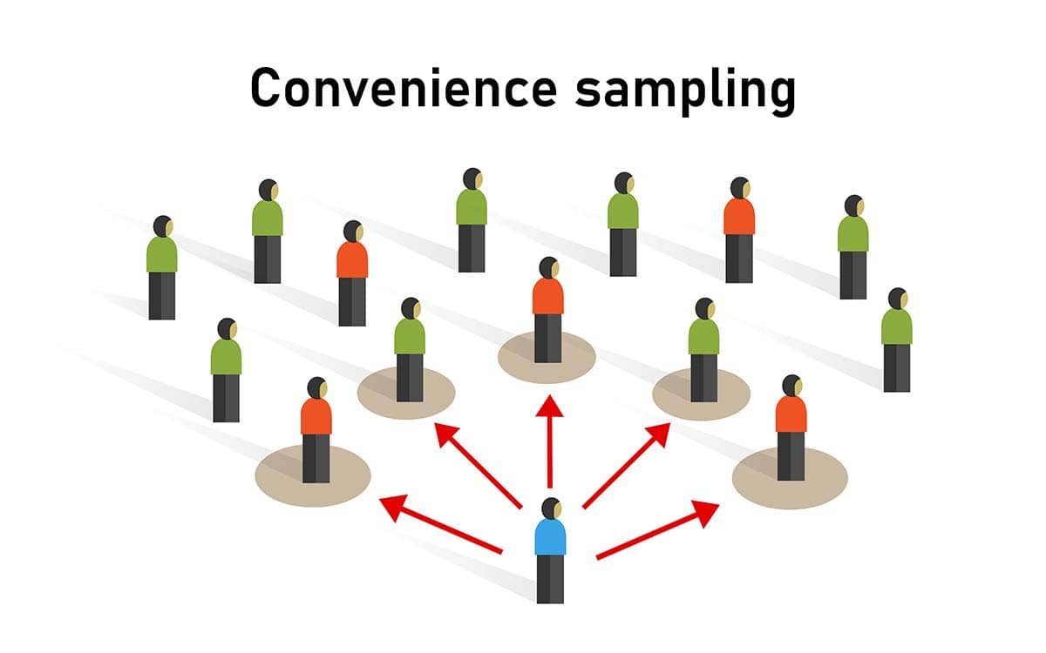
Convenience sampling
Select any one available.

Slide 29
Quota sampling

Slide 30
Purposive Sampling

Slide 31
Snowball sampling
Existing subjects are asked to nominate further subjects known to them, so the sample increases in size like a rolling snowball.

Slide 32
Probability Sampling Methods
Simple random sampling
Systematic sampling
Stratified sampling
Clustered sampling
Multi-stage sampling

Slide 33
Simple random sampling
In this case each individual is chosen entirely by chance and each member of the population has an equal chance, or probability, of being selected.
Method to choose by chance:
Toss a coin.
Random Number generator software.

Slide 34
Random number generator Have a list of individuals name (total ). Determine your sample size (n). Press generate, pick the person with the number shown.

Slide 35
Systematic sampling

Slide 36
Stratified sampling

Slide 37
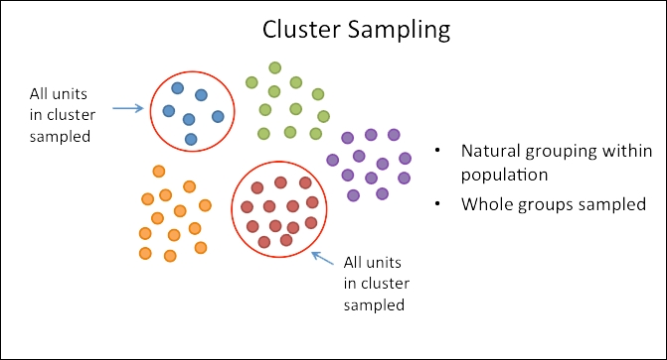
Clustered sampling
In a clustered sample, subgroups of the population are used as the sampling unit, rather than individuals.

Slide 38
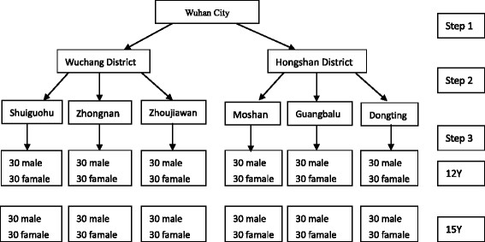
Multi-stage sampling

Slide 39
Sample Quality
Sample bias: the sample is not representative for the population. Sample is different in its’ characteristics compared to the population.
Sampling bias may be introduced when:
Poor recruitment methodology
Poor sampling methodology
How to avoid: is to stick to probability-based sampling methods.

Slide 42
Questions

