Slide 1
Association Vs Causation
Lec. 7
MED 410
Dr. Ola Soudah

Slide 2
Cause and Effect

Slide 3
Approaches to etiology in human populations
Story
Tobacco was introduced to Europe as a new world crop in the early 1600s.
The mass production and consumption of tobacco through cigarette smoking did not begin until the development of the cigarette rolling machine by James Duke in the 1880s.
Men were the first mass consumers of cigarettes.
During World War I, cigarettes were widely distributed free of charge to U.S. soldiers.

Slide 4
Cigarette smoking first became popular among women in the 1920s.
By the 1950s, over 50% of adult males and approximately 25% of adult females were regular cigarette smokers.
Epidemiologists observed that lung cancer deaths were increasing in frequency in the 1930s and 1940s.
In the 1950s, the number of lung cancer deaths in females also began to increase, and by the 1960s, the disease had become the most common cause of cancer-related deaths in males and was still rising among women

Slide 5
Directed a cyclic graph (DAG)
Smoking
Lung Cancer
Directed acyclic graphs (DAGs) are visual representations of causal assumptions that are increasingly used in modern epidemiology.
A graph is called directed if all variables in the graph are connected by arrows.
A cause is a factor that produces an effect on another factor.
An arrow reflects a causal pathway: one factor causes the other and not the other way around.

Slide 6
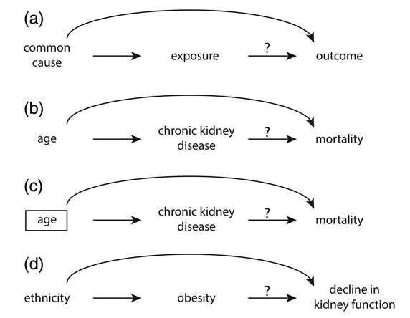
DAG. Continue …
A path in a DAG is a sequence of arrows connecting the exposure and outcome studied, irrespective of the direction of the arrows.
A directed path is a sequence of arrows in which every arrow points in the same direction.

Slide 7
Conceptually, a two-step process is followed in carrying out studies and evaluating evidence:
We determine whether there is an association or correlation between an exposure or characteristic and the risk of a disease. To do so, we use:
Studies of group characteristics: ecologic studies
Studies of individual characteristics: cohort, case-control, and other types of studies
If an association is demonstrated, we determine whether the observed association is likely to be a causal one.

Slide 8
Types of Associations
Is it a true (real) association or a false (spurious/artifactual) one?

Slide 10
Coffee consumption and pancreatic cancer

Slide 12
When to suspect a spurious relationship?
Differences or changes in the interest in identifying the disease.
Differences or changes in the ability to identify the disease.
Differences or changes in the definition of the disease.
Poor study design : Bias
Unmeasured confounding factor.

Slide 13
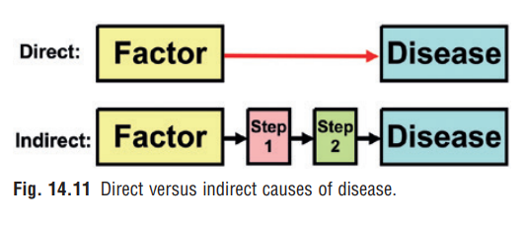
Types of Causal Relationships
A causal pathway can be either direct or indirect.
In direct causation a factor directly causes a disease without any intermediate step.
In indirect causation a factor causes a disease but only through an intermediate step or steps.

Slide 14
If a relationship is causal, four types of causal relationships are possible:
Necessary and sufficient
Necessary but not sufficient
Sufficient but not necessary
Neither sufficient nor necessary

Slide 15
NECESSARY AND SUFFICIENT
Without that factor, the disease never develops (the factor is necessary), and in the presence of that factor, the disease always develops (the factor is sufficient).
Most infectious diseases follow this model.

Slide 16
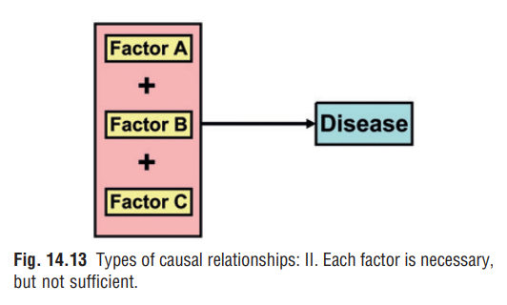
NECESSARY BUT NOT SUFFICIENT
Each factor is necessary but not in itself sufficient to cause the disease. Thus multiple factors are required, often in a specific temporal sequence.
H. Pylori is a necessary cause for gastric adenocarcinoma, not every individual with H.pylori develop Gastric cancer. Thus, in addition to H. pylori, individuals have to be exposed to other risk factors (e.g., smoking and intake of foods containing nitrates) to develop gastric cancer.

Slide 17
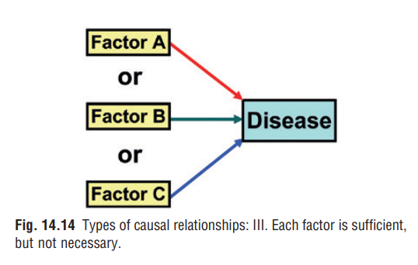
SUFFICIENT BUT NOT NECESSARY
In this model the factor alone can produce the disease but so can other factors that are acting alone.
Mostly in environmental exposure. Ex. radiation exposure or benzene exposure can each produce leukemia without the presence of the other. Although both factors are not needed, other cofactors probably are. The criterion of sufficient is rarely met by a single factor.

Slide 18
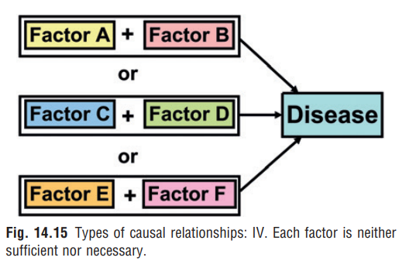
NEITHER SUFFICIENT NOR NECESSARY
In the fourth model a factor by itself is neither sufficient nor necessary to produce disease.
Mostly represent Chronic diseases, more complex model. Ex. risk factor clusters for the development of CHD; for instance, individuals may develop CHD if they are exposed to smoking, diabetes, and low high-density lipoprotein (HDL) or to a combination of hypercholesterolemia, hypertension, and physical inactivity.

Slide 19
Rothman’s Pie Chart
A “sufficient cause” is formed by a constellation of risk factors, termed by him “component causes.”
Thus Rothman’s “sufficient cause” is actually a cluster of “component causes.”

Slide 20
Evidence for a Causal Relationship
Hill’s criteria for causality

Slide 21
Back to our smoking story …
The observed increase of lung cancer associated with smoking cigarettes make scientist think that smoking is the cause?
Whether it is real or not further investigation using scientific methods were used to know long delay and/or a need for long-term exposure to cigarettes before lung cancer developed.

Slide 22
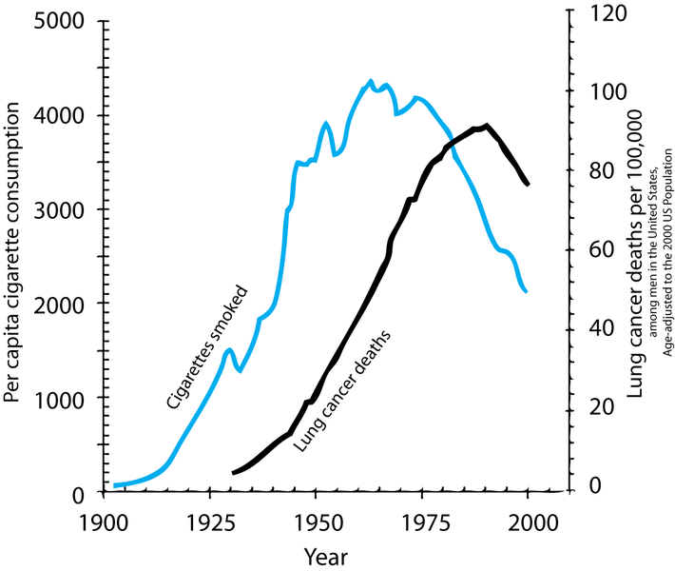
Temporal Relationship. The “cause” precedes the “effect” in time. That is, the potential “cause” is present at an earlier time than the potential “effect.”
Therefore, we need to
establish that cigarette smoking
comes before the development
of lung cancer.

Slide 23
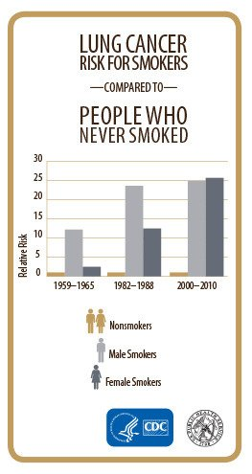
2. Strength of the Association. The strength of the association is measured by the relative risk (or odds ratio).
The stronger the association, the more likely it is that the relation is causal.

Slide 25
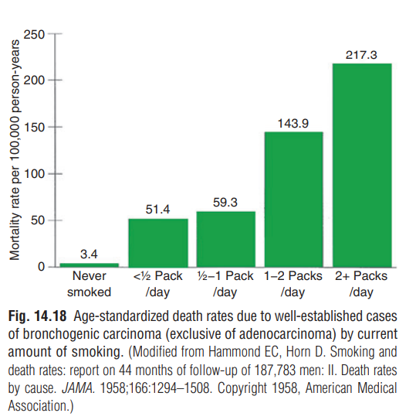
3. Dose-Response Relationship. As the dose of exposure increases, the risk of disease also increases.

Slide 26
4. Replication of the Findings. If the relationship is causal, we would expect to find it consistently in different studies and in different populations.
5. Biologic Plausibility. Biologic plausibility refers to coherence with the current body of biologic knowledge.
6. Consideration of Alternate Explanations. Taking other possible explanations into account and the extent to which they have ruled out. Especially the effect of confounding.

Slide 27
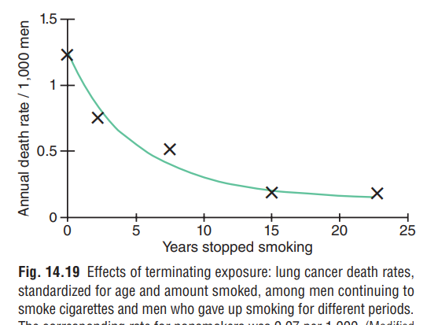
7. Cessation of Exposure. If a factor is a cause of a disease, we would expect the risk of the disease to decline when exposure to the factor is reduced or eliminated.

Slide 28
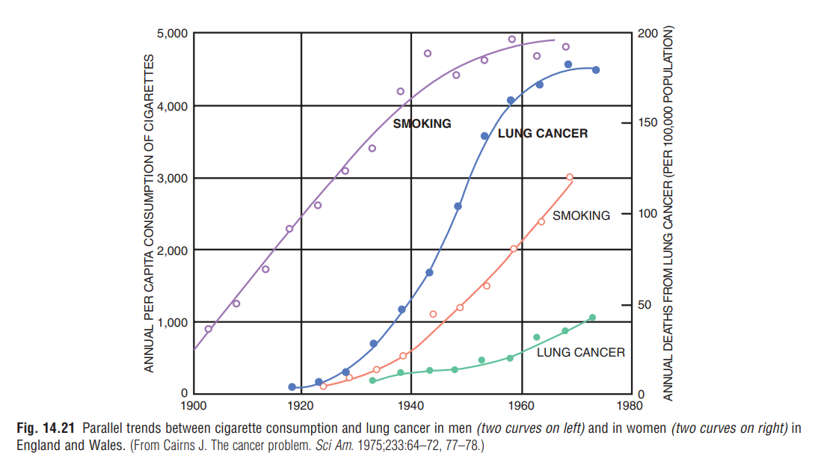
8. Consistency With Other Knowledge. If a relationship is causal, we would expect the findings to be consistent with other data.
We see a consistent direction in the curves, with
the increase in lung cancer rates following the increase
in cigarette sales for both men and women.

Slide 29
9. Specificity of the Association. An association is specific when a certain exposure is associated with only one disease.
This is the weakest of all the guidelines and should probably be deleted from the list.

Slide 30
Threats: Bias, Confounding, and Interaction

Slide 31
Bias
Bias has been defined as “any systematic error in the design, conduct or analysis of a study that results in a mistaken estimate of an exposure’s effect on the risk of disease”.
Types of Bias Common in Epidemiologic Studies:
Selection Bias.
Informational Bias.

Slide 32
SELECTION BIAS
Selection bias. Stem from the way in which individuals, were selected is such that an apparent association is observed—even if, in reality, exposure and disease are not associated.
It occurs when there is a systematic difference between the characteristics of the people
Who participate in the study and those who do not (affecting generalizability) .. External validity.
Who receiving treatment and those in the control group (affecting comparability between groups)… Internal validity.

Slide 33
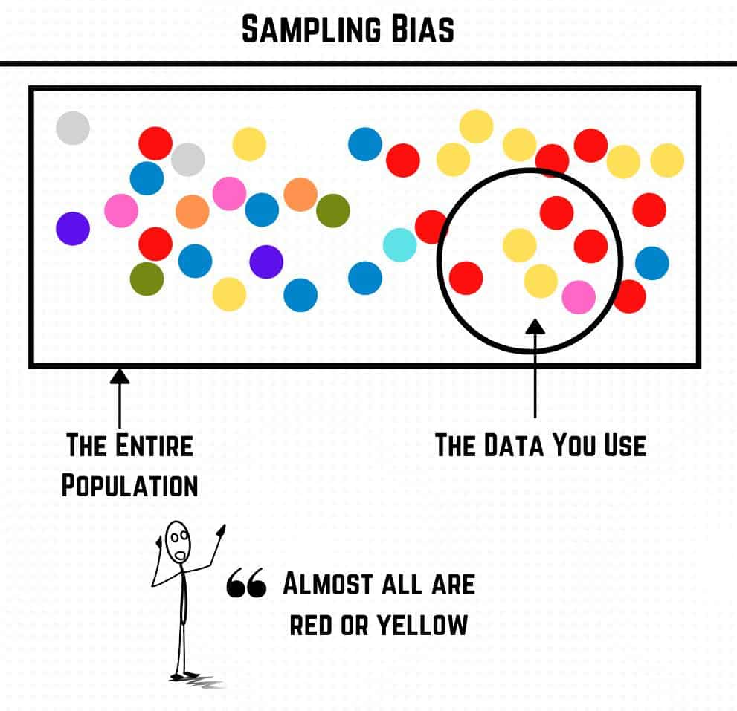
Types of selection bias

Slide 34
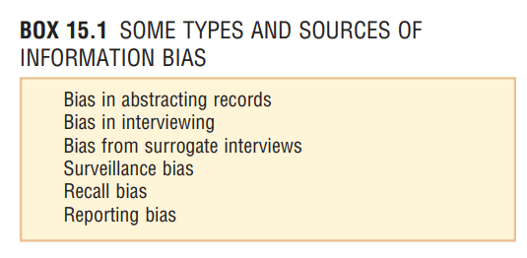
INFORMATION BIAS
Information bias can occur when the means for obtaining information (data collection) about the subjects in the study are flawed so that some of the information gathered regarding exposures and/or disease outcomes is incorrect.

Slide 35
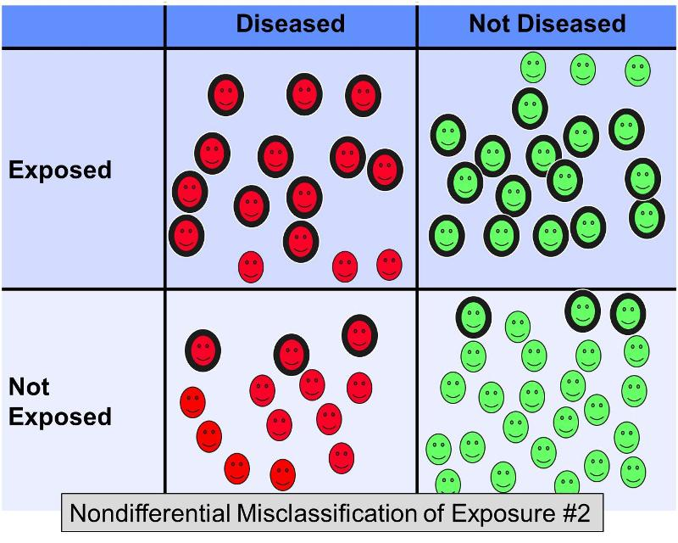
Given inaccuracies in methods of data acquisition, we may at times misclassify subjects and thereby introduce a misclassification bias.

Slide 36
Approaches to handle Bias
Strong study design
Strong , validated data collection tool.
Sensitivity analysis.
Blinding.
Data monitoring Unit.

Slide 37
Confounding
What do we mean by confounding?
In a study of whether exposure A is a cause of disease B, we say that a third factor, factor X, is a confounder if the following are true:
Factor X is a known risk factor for disease B.
Factor X is associated with exposure A, but is not a result of exposure A.

Slide 39
Coffee consumption and pancreatic cancer

Slide 40
Is there an association between exposure and the disease? RR= 1.95 > 1 ???

Slide 41
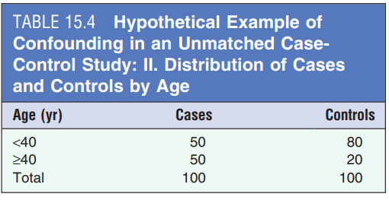
Wait …..
Is this association of the exposure with the disease a causal one, or could it have resulted from differences in the age distributions of the cases and controls (outcome)?

Slide 42
Is this association of the exposure with the disease a causal one, or could it have resulted from differences in the age distributions of the exposed and unexposed group (Independent Variable)?

Slide 43
We did stratify the analysis by age group (we did two separate analysis for each age group). What Happen to the RR ?? RR= 1 is there an association?

Slide 45
INTERACTION
In this section, we ask the question: How do multiple factors interact in causing a disease?
What do we mean by interaction? MacMahon defined interaction as follows: “When the incidence rate of disease in the presence of two or more risk factors differs from the incidence rate expected to result from their individual effects.”

Slide 46
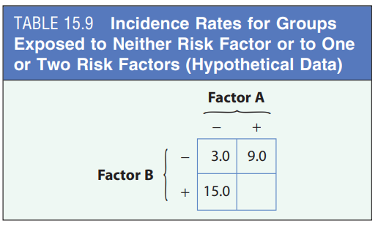
Positive interaction (synergism): The effect can be greater than what we would expect.
Negative interaction, (antagonism): Less than what we would expect (antagonism).

Slide 48
In A-Bomb Workers: we can see the incidence rate of lung cancer for smoking exposure only = 9.7 , & from radiation only =6.2.
From both exposure = 14.2 $\sim$(9.7 + 6.2 = 15.1)
Additive model of interaction

Slide 49
In Uranium Workers: we can see the incidence rate of lung cancer for smoking exposure only = 7.7 , & from radiation only =8.7.
From both exposure = 146.8 $\sim$(7.7 * 18.2 = 140.14)
Multiplicative model of interaction

Slide 50
Question

