Slide 1
Observational Studies

Slide 2
Learning Objectives
To describe the motivations for and the design of observational studies.
To discuss early origins of the research question including case reports, case series, and ecologic studies.
To describe the cross-sectional study design and its importance.

Slide 3
Case Reports and Case Series

Slide 4
Case Reports and Case Series
Perhaps one of the most common and early origins of medical research questions is through careful observations by physicians and other health care providers of what they see during their clinical practice.
Such individual-level observations can be documented in a case report, describing a particular clinical phenomenon in a single patient, or in a case series that describes more than one patient with similar problems.
Both case reports and case series are considered the simplest of study designs (although some assert that they are merely “prestudy designs”).

Slide 5
Case Reports and Case Series
The main objective of case reports and case series is to provide a comprehensive and detailed description of the case(s) under observation.
This allows other physicians to identify and potentially report similar cases from their practice, especially when they share geographic or specific clinical characteristics.

Slide 6
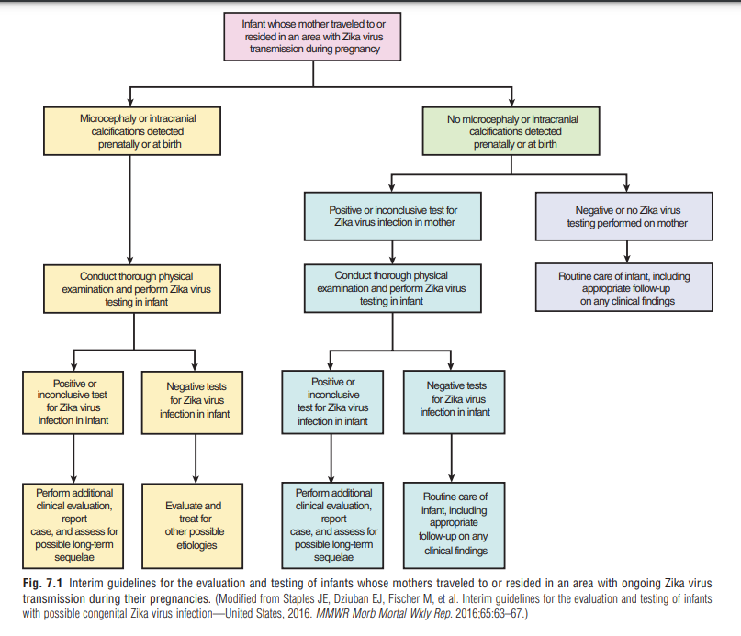
For example: 2015 witnessed an outbreak of the Zika virus in Latin America. Despite the fact that case reports and case series are merely descriptive in nature with no reference group to make a strict comparison, the Brazilian case series was instrumental in the development of the CDC’s guidelines (Fig. 7.1) for the evaluation and testing, by health care providers, of infants whose mothers traveled to or resided in an area with ongoing Zika virus transmission during their pregnancies (Fig. 7.2).

Slide 8
Case Reports and Case Series (Cont..)
Case reports and case series are key hypothesis-generating tools, especially when they are simple, inexpensive, and easy to conduct in the course of busy clinical settings.
Disadvantages:
The lack of a comparison group is a major disadvantage.
The external validity (generalizability) is limited, given the biased selection of cases (all identified in clinical practice).
Any association observed in a case report, or a case series is prone to potentially unmeasured confounding unbeknown to the investigators

Slide 9
Ecologic Studies
“Associations on population level”

Slide 10
Ecologic Studies
The first approach in determining whether an association exists may be a study of group characteristics, the so-called ecologic studies.

Slide 11
Ecologic Studies (Ex.):
Fig. 7.3 shows the correlation of each country’s level of chocolate consumption and its number of Nobel laureates per capita. As seen in this figure, the higher the average chocolate consumption for a country, the higher the number of Nobel laureates per capita.
Chocolate, high in dietary flavanols, is thought to improve cognitive function and reduce the risk of dementia.

Slide 12
Ecologic Studies
We might therefore be tempted to conclude that chocolate consumption may be a causal factor for being awarded a Nobel Prize.
The problem is that we do not know whether the individuals who won Nobel Prize in that country actually had a high chocolate intake.
All we have are average values of chocolate consumption and the number of Nobel laureates per capita for each country.
In fact, one might argue that, given the same overall picture, it is conceivable that those who won the Nobel Prize ate very little chocolate.
Fig. 7.3 alone does not reveal whether this might be true; in effect, individuals in each country are characterized by the average figures (level of consumption and per capita Nobel laureates) for that country.
No account is taken of variability between individuals in that country with regard to chocolate consumption.
This problem is called the ecologic fallacy—we may be ascribing to members of a group some characteristic that they in fact do not possess as individuals.
This problem arises in an ecologic study because data are only available for groups; we do not have exposure and outcome data for each individual in the population

Slide 13
Ecologic Studies
Table 7.1 shows data from a study in Northern California exploring a possible relation between prenatal exposure to influenza during an influenza outbreak and the later development of acute lymphocytic leukemia in a child.
The table shows incidence data for children who were not in utero during a flu outbreak and for children who were in utero in the first, second, or third trimester of the pregnancy during the outbreak.
Below these figures, the data are presented as relative risks, with the risk being set at 1.0 for those who were not in utero during the outbreak and the other rates being set relative to this.
The data indicate a high relative risk for leukemia in children who were in utero during the flu outbreak in the first trimester.

Slide 14
Ecologic Studies
What is the problem?
The authors themselves stated;
“The observed association is between pregnancy during an influenza epidemic and subsequent leukemia in the offspring of that pregnancy. It is not known if the mothers of any of these children actually had influenza during their pregnancy.”
What we are missing are individual data on exposure (influenza infection).

Slide 15
Ecologic Studies
One might ask;
why didn’t the investigators obtain the necessary exposure data?
The likely reason is that the investigators used birth certificates and data from a cancer registry; both types of data are relatively easy to obtain.
This approach did not require follow-up of the children and direct contact with individual subjects. If we are impressed by these ecologic data, we might want to carry out a study specifically designed to explore the possible relationship of prenatal flu and leukemia. However, such a study would probably be considerably more difficult and more expensive to conduct.

Slide 16
Ecologic Studies
In view of these problems, are ecologic studies of value?
Yes, they can suggest avenues of research that may be promising in casting light on etiologic relationships. In and of themselves, however, they do not demonstrate conclusively that a true association exists.
When variability of an exposure is limited, ecologic correlations may provide a more valid answer with regard to the presence of an association than studies based on individuals

Slide 17
Cross-Sectional Studies

Slide 18
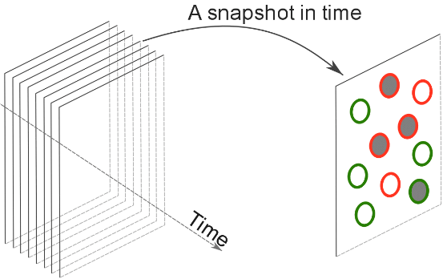
Cross-Sectional Studies
Another common study design used in initially investigating the association between a specific exposure and a disease of interest is the cross-sectional study.
This type of study design is called a cross-sectional study because both exposure and disease outcome are determined simultaneously for each study participant; it is as if we were viewing a snapshot of the population at a certain point in time.

Slide 19
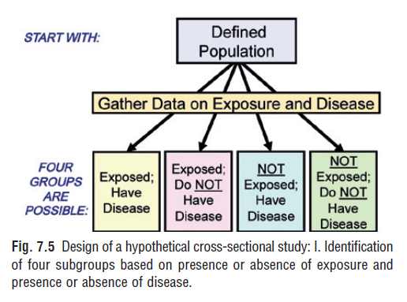
Cross-Sectional Studies
study is seen in Fig. 7.5. We define a population and determine the presence or absence of exposure and the presence or absence of disease for each individual at the same time.
Each subject then can be categorized into one of four possible subgroups.

Slide 20
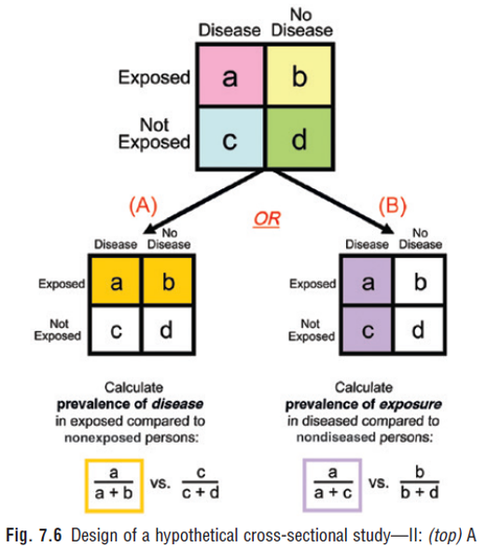
Cross-Sectional Studies
As seen in the 2 × 2 table in the top portion of Fig. 7.6, there will be:
a persons, who have been exposed and have the disease;
b persons, who have been exposed but do not have the disease;
c persons, who have the disease but have not been exposed;
d persons, who have neither been exposed nor have the disease.

Slide 21
Cross-Sectional Studies
In order to determine whether there is evidence of an association between exposure and disease from a cross-sectional study, we have a choice between two possible approaches, which in Fig. 7.6 are referred to as (A) and (B).
If we use (A), we can calculate the prevalence of disease in persons with the exposure (a/(a+b)) and compare it with the prevalence of disease in persons without the exposure (c/(c+d)).
If we use (B), we can compare the prevalence of exposure in persons with the disease (a/(a+c)) to the prevalence of exposure in persons without the disease (b/(b+d).

Slide 22
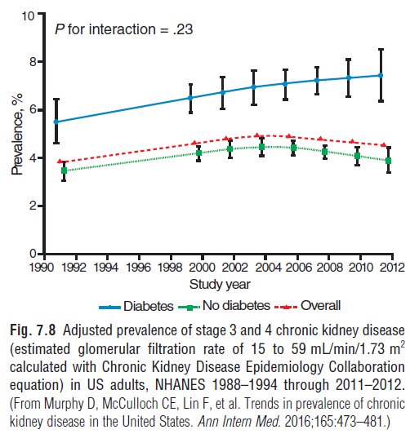
Cross-Sectional Studies
Serial cross-sectional studies are also useful to evaluate trends in disease prevalence over time in order to inform health care policy and planning.
Fig. 7.8 shows the temporal trends in adjusted prevalence of stages 3 and 4 CKD from NHANES 1988–1994 through 2011–2012, categorized by the presence or absence of diabetes.
As shown in the figure, there was an initial increase in adjusted prevalence of stages 3 and 4 CKD that leveled off in the early 2000s among nondiabetic individuals but continued to increase in diabetic individuals.

Slide 24
Bias
Investigators should be aware of bias when planning a cross-sectional study.
Bias may be defined as any systematic error in a study that results in an incorrect estimate of the true effect of an exposure on the outcome of interest.
There are many types of bias in clinical studies, but for simplicity, they can be broadly grouped into two categories:
Selection bias
Information bias.

