Slide 1
Medicine of the Elderly (Geriatric Medicine)
Dr.Hadeel B Heilat
Assistant Professor of Family Medicine/Yarmouk University
Fellow of the Royal Collage of physicians of Edinburgh/UK
Medicine of the Elderly fellowship/RIE/UK

Slide 3
Outline
Definitions.( Elderly, Medicine of the Elderly, Normal aging).
Statistics about Elderly population in Jordan and worldwide.
Why Medicine of the Elderly.
Normal physiological changes in the aging process.
Evaluating Elderly.
Comprehensive Geriatric Assessment.
Common diseases in Elderly.
Geriatric syndromes.
Caring for old people.
Research in Jordan.

Slide 4
Definition of elderly people
Depending on Chronological age: “retrospective age”, is a measure of how many years a person has already lived.
Africa: 50-55 .
United Nations and World Health Organization's guidelines : Age 60 and above.
In USA: Age equal or more than 65.
In UK: Age equal or more than 65.
In Jordan: Age equal or more than 60.

Slide 5
What is Geriatric Medicine
Geriatrics is the branch of medicine dealing with the physiologic characteristics of aging and the diagnosis and treatment of diseases affecting the aged.
A geriatrician is an internal or family medicine physician who also has special expertise in geriatrics. (sub-specialty)
UK: a separate specialty where doctors spent at least 7 training years.
Jordan Medical Council doesn’t recognize geriatrics as one of the medical specialties leading to the lack of geriatric specialists in Jordan.

Slide 6
Normal Aging
Aging is a progressive, universal decline in functional reserve that have little or no effect on daily activities but will be critical at times of stress.
Normal age-related changes can be anticipated & adapted so that the older person can live a happy, healthy & active life.
Ageing is NOT a disease; however, the risk of developing disease increases.

Slide 7
Factors That Affect Ageing
Heredity.
Activity .
Lifestyle.
Food.
Comorbidities
Environment
Social Support
Mental / Emotional Coping Abilities

Slide 8
Statistics about Elderly population worldwide
According to United Nations:
In 2020, there are an estimated 727 million persons aged 65 years or over worldwide.
This number is projected to more than double by 2050, reaching over 1.5 billion persons.
The share of older persons in the global population is expected to increase from 9.3 per cent in 2020 to 16.0 per cent in 2050.
By mid-century, one in six people globally will be aged 65 years or older

Slide 9
Statistics about Elderly population worldwide
According to data from United Nations World Population Prospects: the 2017 Revision:
The number of older persons — those aged 60 years or over — is expected to rise from 962 million globally in 2017 to 2.1 billion in 2050 and 3.1 billion in 2100.

Slide 10
Statistics in Jordan (According to the department of statistics)

Slide 11
Life Expectancy in Jordan

Slide 12
Life Expectancy in Jordan
75.0 years(life expectancy at birth, both sexes combined)
76.8 years(life expectancy at birth, females)
73.3 years(life expectancy at birth, males)

Slide 13
Why Medicine of the Elderly
People worldwide are living longer.
Every country in the world is experiencing growth in both the size and the proportion of older persons in the population.
Geriatric Medicine (GM) holds a crucial role in promoting health and managing the complex medical, cognitive, social, and psychological issues of older people.

Slide 14
Normal physiological changes in the aging process.
Decrease of all five senses: Vision, Taste, Smell , Hearing and Touch.
Changes in Muscles & Bones : ↓ Muscle strength, ↓ Flexibility, ↓ Calcium in bones→ ↓ bone mass, ↑ Risk for fractures, ↑ Risk for falls.
Skin Changes: Skin more dry, flaky, less elastic, thin, fragile , Nails tougher, brittle & thick, More wrinkles.
Changes in Heart and vasculature : ↓ heart muscle strength and efficiency, decrease heart rate, decrease ejection fraction . Increase peripheral resistant and increase tendency toward hypertension.
Lungs: Lungs less elastic, decrease vital capacity. ↑ Risk of infection.
Changes in Passing Urine : Bladder muscle weakens, ↓ Ability to hold urine, Leaking of urine, Enlarged prostate, ↑ Risk of infection.

Slide 15
Cont…..
Changes in Digestion : Decrease taste, smell and saliva secretion. Decrease gastric acidity, gastric movements, appetite and absorption. Increase problems associated with dentures chewing , Increase tendency toward constipation and diarrhoea.
Joints: Degeneration of cartilaginous tissue, Decrease elasticity which will result in tightening of joints and tendency toward osteoarthritis.
Mental Changes: Small decrease of brain cells, Slight ↓ of memory, ↓ Reaction time , slower learning, ↑ Risk of depression.
Liver: Decline in the activity of Cytochrome P-450 system.
Renal: Decrease in Glomerular Filtration Rat, Decrease in tubular function , Decreased creatinine clearance which will lead to increase serum levels and half time of creatinine.

Slide 16
The effects of aging must be taken into account during the diagnosis and treatment of older adults. Clinicians should not:
Mistake pure aging for disease (eg, slow information retrieval is not dementia).
Mistake disease for pure aging (eg, debilitating arthritis, tremor, or dementia to old age).
Ignore the increased risk of adverse drug effects on weak-link systems stressed by illness.
Forget that older adults often have multiple underlying disorders (eg, hypertension, diabetes, atherosclerosis) that accelerate the potential for harm.

Slide 17
Evaluation of an Elderly patient
Evaluation of older adults usually differs from a standard medical evaluation. For older patients, especially those who are very old or frail, history-taking and physical examination may have to be done at different times, and physical examination may require 2 sessions because patients become fatigued.

Slide 18
History-Taking in the Older Adult
The following should be considered:
Sensory deficits: Unless corrected, sensory deficits, especially hearing deficits, may interfere with history-taking.
Underreporting of symptoms: Older patients may not report symptoms that they may incorrectly consider part of normal aging.
Unusual manifestations of a disorder: In older adults, typical manifestations of a disorder may be absent. Instead, older patients may present with nonspecific symptoms (eg, fatigue, confusion, weight loss).
Functional decline as the only manifestation: Identifying people when they have just started to have difficulty doing basic activities of daily living (ADLs) or instrumental ADLs may provide more opportunities for interventions to restore function or to prevent further decline and thus maintain independence.

Slide 19
Difficulty recalling: Patients may not accurately remember past illnesses, hospitalizations, operations, and drug use; clinicians may have to obtain these data elsewhere (eg, from family members, a home health aide, or medical records).
Fear: Older adults may be reluctant to report symptoms because they fear hospitalization, which they may associate with dying.
Age-related disorders and problems: Depression (common among older adults who are vulnerable and sick), the cumulative losses of old age, and discomfort due to a disorder may make older adults less apt to provide health-related information to clinicians. Patients with impaired cognition may have difficulty describing problems, impeding the physician’s evaluation.

Slide 20
Special attention to
Medical History: On average, older patients have 6 diagnosable disorders, multiple disorders complicate diagnosis and treatment
Drug History: As part of the drug history, the patient or a family member should be asked to bring in all the patient’s drugs, including over-the-counter drugs, at the initial visit and periodically thereafter. Ask about medication use :
prescription and nonprescription drugs(use of herbal remedies).
treatments for depression
dietary supplements
any change in medications

Slide 21
Alcohol, Smoking, and Recreational Drug Use History.
Nutrition History.
Functional Status: Health care practitioners must often interview caregivers to obtain the history of functionally dependent older patients. Basic activities of daily living (personal maintenance activities) including:
dressing
bathing
eating
toileting

Slide 22
Functional status:
instrumental activities of daily living (higher-order skills required for independent living) including
managing money
preparing meals
taking medications
performing household tasks

Slide 23
Social History: Clinicians should obtain information about patients’ living arrangements, particularly where and with whom they live .
Mental Health History: important to assess mental capacity, driving license.
Advance Directives: Patient wishes regarding measures for prolonging life must be documented (DNACPR, Power of attorney)

Slide 24
DNACPR
DNACPR stands for do not attempt cardiopulmonary resuscitation. DNACPR is sometimes called DNAR (do not attempt resuscitation) or DNR (do not resuscitate) but they all refer to the same thing.
DNACPR means if your heart or breathing stops your healthcare team will not try to restart it.
A DNACPR decision is usually recorded on a special form. Different doctors or hospitals might use different forms, but they all serve the same purpose.
The patient has the right to change his/her mind about DNACPR decision at any time.

Slide 25
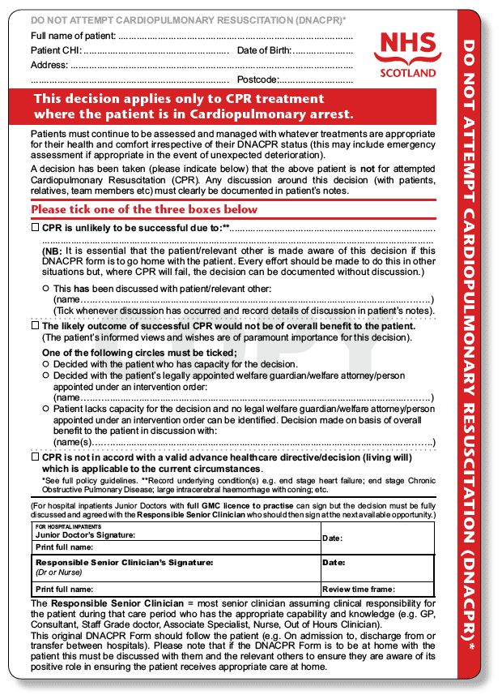

Slide 26
Power of attorney
A power of attorney is a legal document that gives one person the power to act for another person.
The person who receives the authority is the agent or attorney-in-fact while the subject of the POA is the principal.
It can be a broad or limited authority to make decisions about the principal's property, finances, investments, or medical care.
There are two main types of POAs, financial and health care—both of which provide the attorney-in-fact with general or limited powers.
It is used in the event of a principal's temporary or permanent illness or disability, or when they can't sign necessary documents.

Slide 27
Physical Examination
The physical examination of the older adult should include all major systems but with particular attention to areas of concern identified during the history .
If patients become fatigued, the physical examination may need to be stopped and continued at another visit.
Frail patients must not be left alone on the examination table.
Examination includes:
Vital Signs, Height is recorded annually to check for height loss due to osteoporosis, Weight should be recorded at each visit
Skin and Nails, Head and Neck, Chest and Back, Breasts, Heart, Gastrointestinal System, Male Reproductive System, Female Reproductive System, Musculoskeletal System, Feet, Neurologic System, Mental status.

Slide 28
Valuable information about a patient’s function can be gained by observing the patient.

Slide 29
Comprehensive Geriatric Assessment
A multidisciplinary assessment designed to identify and address increasingly complex and dynamic needs of older patients in multiple domains including functional ability, physical health, cognition/mental health, and socioenvironmental circumstances in order to optimize outcome.
Screen for Depression: Geriatric Depression Scale (GDS)
Screen for Cognition: MMSE, SLUMS, Mini-Cog, MOCA.
Functional Status: Activities of Daily Living (ADLs) and Instrumental Activities of Daily Living (IADLs).
Mobility Status: Get Up and Go Test.
Nutritional Assessment: Mini Nutritional Assessment.
Medication Review.
Comprehensive History and Physical Exam ; vision, hearing, and speech, fecal and urinary incontinence, socioenvironmental circumstances, which may help identify risk factors for decline or frailty, as well as help in determination of most appropriate living arrangements for the patient.

Slide 30
Comprehensive Geriatric Assessment
Comprehensive geriatric assessment is most successful when done by a geriatric interdisciplinary team (typically, a geriatrician, nurse, social worker, and pharmacist). Usually, assessments are done in an outpatient setting. However, patients with physical or mental impairments and chronically ill patients may require inpatient assessment.
The cost of geriatric assessment limits its use. Thus, this assessment may be used best mainly in high-risk older patients, such as the frail or chronically ill.

Slide 31
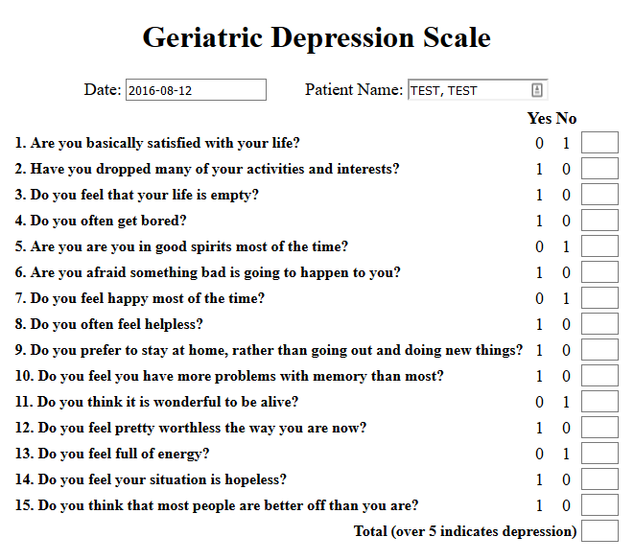

Slide 32
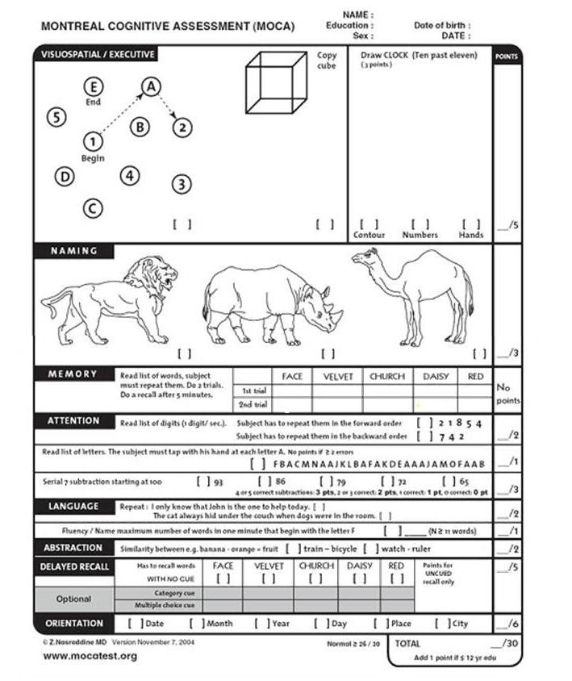

Slide 33
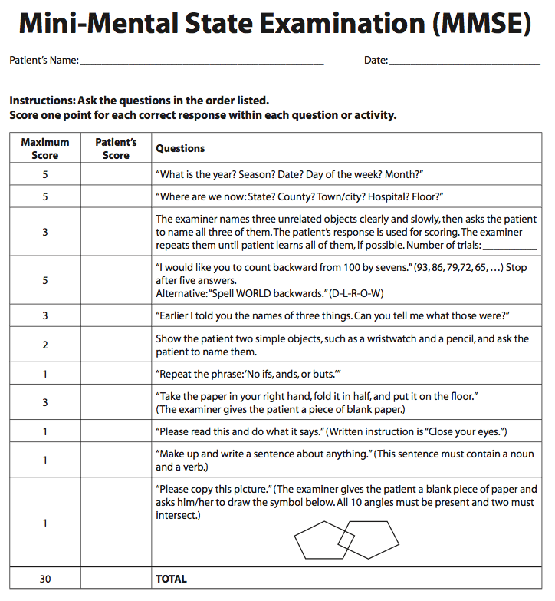

Slide 34
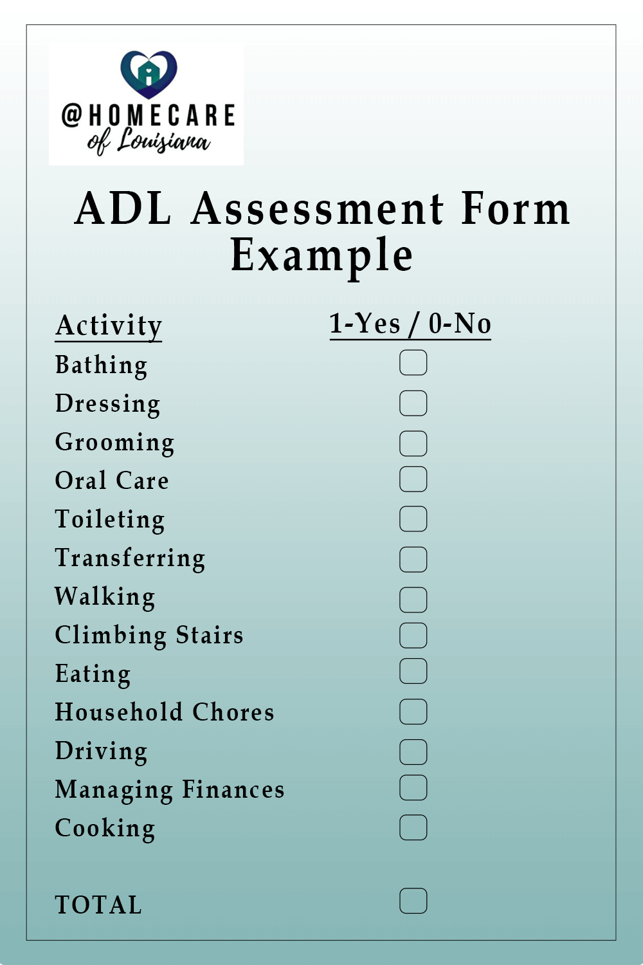

Slide 35
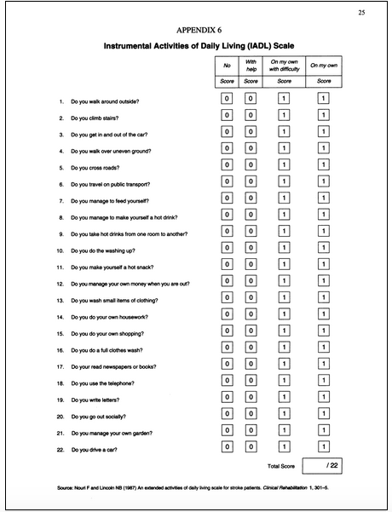

Slide 36
Get up and go test
Technique: Direct patient to do the following
Rise from sitting position
Walk 10 feet
Turn around
Return to chair and sit down
Interpretation
Patient takes <20 seconds to complete test
Adequate for independent transfers and mobility
However, risk of falls increases, if test takes >12 seconds to complete
Patient requires >30 seconds to complete test
Suggests higher dependence and risk of of falls

Slide 37
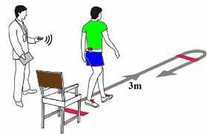

Slide 38
Common health conditions associated with ageing
Common conditions in older age include hearing loss, cataracts and refractive errors, back and neck pain and osteoarthritis, chronic obstructive pulmonary disease, diabetes, depression and dementia. As people age, they are more likely to experience several conditions at the same time.
Older age is also characterized by the emergence of several complex health states commonly called geriatric syndromes. They are often the consequence of multiple underlying factors and include frailty, urinary incontinence, falls, delirium, cognitive disorders, polypharmacy and pressure ulcers.

Slide 39
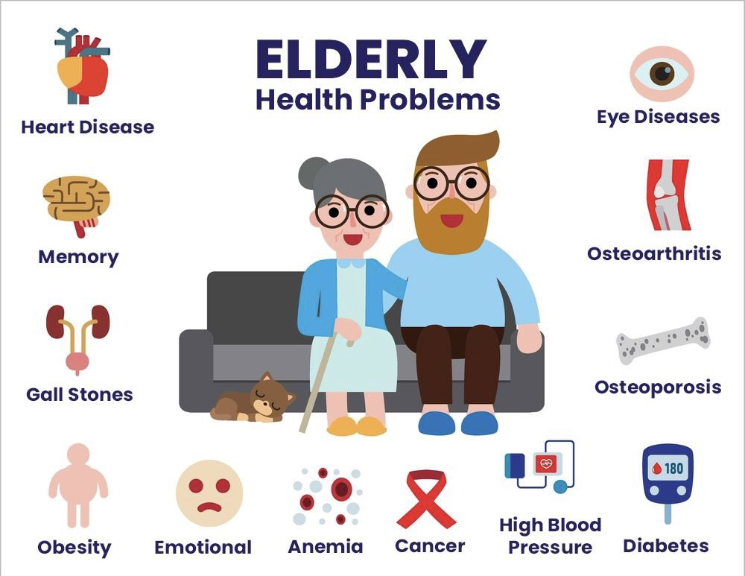

Slide 40
Geriatric syndromes

Slide 41
Geriatric syndromes
Geriatric Giants : 4 I
Immobility
Instability
Incontinence
Intellectual impairment ( cognitive impairment )

Slide 42
Intellectual/Cognitive impairment
Broadly intellectual function is maintained until at least 80 years but processing is slower.
Two factors support a diagnosis of normal aging rather than disease:
1. The ability to maintain function in normal life through aids( list or calendar) or adaptations ( of one’s environment).
2. Very long time scale of decline: 10-30 years, compared with months or a few years in disease.

Slide 43
Causes of Cognitive impairment in the Elderly
Neurodegenerative dementing illnesses (such as Alzheimer disease, dementia with Lewy bodies, and frontotemporal dementia), Parkinson’s disease and vascular dementia.
Delirium
Medication side-effects; Sedatives, tranquilizers, and anticholinergic.
Metabolic imbalances; Abnormal levels of blood sodium, calcium, or glucose, Kidney or liver dysfunction.
Psychiatric illness; Depression and anxiety .
Thyroid Disorders.
Deficiencies in vitamins and other key nutrients; B12 and folate.
Substance abuse and/or substance withdrawal; such as alcohol, illicit drugs, or even prescription drugs) can impair brain function.
Damage to brain neurons, due to an injury; strokes or some form of cerebral small vessel disease, Head injuries are also associated with temporary or longer-lasting cognitive impairment

Slide 44
Neurodegenerative conditions
Tend to slowly damage and kill neurons like :
Minimal cognitive impairment MCI or cognitive impairment no dementia ( CIND),
Dementia
Parkinson’s disease.

Slide 45
Dementia
Dementia is a clinical syndrome marked by an acquired impairment of memory, cognition, or language abilities, sufficient to impair functioning in an alert (non-delirious) person.
Prevalence increases dramatically with age : 1% of 60-65 year old, >30% of over 80s.
Major dementia syndromes:
Mixed pathology-( especially Alzheimer’s and vascular) is the commonest type in post mortem studies.
Dementia of Alzheimer’s type 60%
Vascular dementia 30%
Other neurodegenerative dementias 15% ; dementia with Lewy bodies, Parkinson’s disease with dementia, frontotemporal dementia.

Slide 46
Alzheimer’s Dementia
Alzheimer dementia (AD) is a chronic neurodegenerative disorder usually occurring in adults ≥ 65 years old characterized by progressive development of cognitive dysfunction, psychiatric and behavioral symptoms, and difficulty performing activities of daily living.
Before age 80 years, more common in men than women, after age 80 years, more common in women than men
Risk factors for Alzheimer dementia include presence of mild cognitive impairment, smoking, depression, diabetes, and a family history of Alzheimer dementia.
The typical disease pattern is gradual memory loss beginning with difficulty with word finding, and progressing to symptoms that interfere with work and social activities. Apathy and depression are common psychological findings in patients with Alzheimer dementia.
The length of survival after the initial diagnosis is approximately 4-6 years but it depends on the age at diagnosis, as length of survival decreases with increasing age.
Death usually results from dehydration, malnutrition and/or sepsis

Slide 47
Types
late-onset Alzheimer disease - adults ≥ 65 years old
early-onset Alzheimer disease - adults < 65 years old

Slide 48
Diagnosis
Diagnosis of probable Alzheimer disease dementia requires the patient meeting clinical criteria for dementia
A history of gradual onset over months to years
Clear worsening of cognitive abilities
The initial and most prominent cognitive deficits seen on patient's history and exam may be either amnestic (most common presentation, short term memory loss) or nonamnestic (language, visuospatial, or executive dysfunction presentation)
No evidence of other disease (such as features of other causes of dementia) or medication effect that could be affecting cognitive abilities

Slide 49
Management
Non-pharmacological:
Lifestyle, exercise programs, cognitive behavioral therapy, cognitive stimulation, caregiver support and counseling.

Slide 50
Continue Management
Medications to consider :
cholinesterase inhibitors: (donepezil, rivastigmine, or galantamine), they does not stop the progression of the disease.
Memantine: alone or in addition to cholinesterase inhibitors.
Antipsychotics : for treatment of aggression or psychosis.

Slide 51
Vascular cognitive impairment
Vascular cognitive impairment (VCI) is a spectrum of cognitive impairments associated with cerebrovascular disease, ranging from mild cognitive deficits to frank dementia.
Causes include brain infarcts, white matter lesions, cerebral hemorrhage, atherosclerosis, small vessel disease, cerebral amyloid angiopathy, and genetic disorders.

Slide 52
Diagnosis of Vascular Dementia
A probable diagnosis of vascular dementia or vascular mild cognitive impairment can be made when all of the following are present:
criteria of dementia or mild cognitive impairment
imaging evidence of cerebrovascular disease
cognitive impairment and cerebrovascular disease clearly related by the timing of the onset or by the severity and pattern of diffuse subcortical cerebrovascular pathology
no evidence of progressive cognitive impairment suggesting nonvascular neurodegenerative disease
Magnetic resonance imaging (MRI) is the imaging method of choice to diagnose vascular cognitive impairment.

Slide 53
Management of Vascular Dementia
Pharmacologic therapy for cognitive and functional impairment may include:
cholinesterase inhibitors.
Vascular secondary prevention; Aspirin, statin, ACE-inhibitors and control hypertension

Slide 54
Delirium
Delirium is characterized by acute or subacute fluctuating disturbances of consciousness which may include disorientation, inattention, disordered thinking, cognitive impairment, emotional lability, hallucinations or delusions, and sleep-wake cycle disturbance.
Psychomotor forms include hypoactive, hyperactive, and mixed delirium.
It often resolves within hours to days (rarely > 1 month) but may be associated with increased risk of death, cognitive dysfunction, functional decline, and institutionalization.

Slide 57
Risk Factors for Delirium
Age ≥ 65 years
cognitive impairment or dementia
visual impairment
hearing impairment
history of delirium
functional impairment
history of transient ischemic attack (TIA) or stroke
comorbid illness or severe illness
depression
alcohol misuse
history of hypertension

Slide 58
Management of Delirium
Delirium treatment maintain patient safety.
Identify and treat possible cause or causes of delirium
Manage symptoms with nonpharmacologic interventions including:
treatment of medical problems and possible causes of delirium
reduce, replace, or discontinue psychoactive drugs.
measures to reorient and engage patient
encourage patient mobility

Slide 59
Continue Management of Delirium
Pharmacologic treatment
Considered : If non pharmacologic methods ineffective and there is risk of self-harm or harm to others or extremely distressing psychotic .
Used to manage agitation and behavioral symptoms ; quetiapine and dexmedetomidine may shorten duration of delirium, but limited evidence for efficacy of other drugs for treating delirium .
Atypical antipsychotics quetiapine, olanzapine, and risperidone reported to have efficacy comparable to haloperidol.

Slide 61
Falls
Falls in the elderly are common, and a leading cause of injury, injury-related disability, and injury-related death.
Worldwide annual incidence of falls is reported as 28%-35% of adults ≥ 65 years old. An increased number of falls is reported with increasing age and in patients living in residential facilities or nursing homes.
About 50% of falls result in a major laceration, fracture, or traumatic brain injury. Other complications include the loss of mobility, admission to long-term care facility, depression, and increased anxiety.

Slide 62
Continue Falls
Risk factors for falling in the elderly
Intrinsic factors; such as a history of falling or abnormalities of gait or balance.
Medical factors such as neurological and medical conditions, gait instability, muscle weakness, visual impairment, pain, sleep disorders, and medications e.g psychotropic drugs.
Environmental factors in the home or institutional settings such as the lack of appropriate safety features, improper use of assistive devices, or use of physical restraints

Slide 63
Management of falls
Recommended strategies include exercise, an education component tailored to the patient's cognitive functioning and language, and an assessment and treatment of orthostatic hypotension.
Calcium and vitamin D supplementation is recommended for elderly patients with vitamin D deficiency.
Adjust medications to limit polypharmacy.
Home safety interventions.
Footwear modification
Appropriate vision care
Consideration of dual-chamber cardiac pacing for older persons who experience unexplained recurrent falls.

Slide 64
Polypharmacy
Defined as greater than four prescription medications or greater than three new medications in a 24-hour period.
Four or more prescription medications increases the risk for falls in the elderly.
Five or more prescription medications increases the risk of adverse drug reactions.
30% of older adult hospital admissions can be linked to drug-related effects, and polypharmacy is the fifth leading cause of death for hospitalized elders.

Slide 65
Frailty
Definition: Aging-related syndrome of decline in physiological reserve, characterized by marked vulnerability to adverse health outcomes. Frail older patients often present with an increased burden of symptoms including weakness and fatigue, medical complexity, and reduced tolerance to medical and surgical interventions.
Although there is no gold standard for detecting frailty, multiple frailty screening tools have been developed and utilized for risk assessment, they usually assess 5 dimensions:

Slide 66
Frailty
These five dimensions are:
unintentional weight loss,
exhaustion,
muscle weakness,
slowness while walking, and
low levels of activity.

Slide 67
Urinary incontinence
Urinary incontinence (UI)—the loss of bladder control—is common among older adults and can have significant consequences for those affected and their caregivers.
Prevalence rates are highest among women, people of advanced age, and those who have cognitive and physical disabilities.

Slide 68
Types of UI
Urgency UI: one of the most common types of UI in men, increases with age.
Urgency UI can coexist with a condition called detrusor hyperactivity with impaired contractility, in which contractions don't fully empty the bladder, leaving a large postvoid residual amount of urine.
Stress UI results from an inefficient urethral sphincter, which leads to urine loss as a result of exertional activity. This type of UI is common among women of all ages and may occur in men following prostate surgery.

Slide 69
Types of UI
Mixed UI. In older adults, urgency and stress UI frequently coexist. Referred to as mixed UI, this condition has a higher incidence rate and is of greater severity among older women than younger women.
Incontinence related to chronic retention of urine (or overflow incontinence) refers to urinary leakage resulting from an overfilled and distended bladder. This type of UI is frequently caused by bladder outlet obstruction, making it more prevalent among men who have hyperplasia of the prostate.²³
Functional UI is a result of cognitive, physical, or environmental factors that prevent a person from voiding appropriately.

Slide 70
Types of Senior and Elderly Care Living Options
Independent living communities
Independent living communities are for singles and couples who can look after themselves but want to live in a community with others of their own age group. It is a slight step from living in your own home and offers a sense of community and togetherness that can help combat one of the big problems of the elderly – loneliness.
Assisted living
Assisted living is the next step and can be varied in what it offers. It is for people who want some backup if they have problems or the reassurance that someone is around. It can be a single old age residential care home with a few residents or a large complex of apartments with on-site medical facilities and recreational centers.

Slide 71
Types of Senior and Elderly Care Living Options
Nursing or care homes
They can offer general old age care and respite care as well as special care for people with particular needs such as:
Dementia care
Mental health condition care
Physical disability care
Sensory impairment care

Slide 72
Types of Senior and Elderly Care Living Options
In-home care
This is the type of care where either a family or friend or a professional carer spends part or all of the day in the home of the elderly person to support them. This can be done with many people who have sometimes complex health issues as long as treatment can be successfully given in the home. It is often the most expensive care option.
Temporary or day care
Temporary or day care often involves a residential care home where the person stays for a short period of time, known as respite care, or where they visit during the day when a carer is at work. It is also a good way to get particular care after an operation or a period of ill health.

Slide 73
Types of Senior and Elderly Care Living Options
Palliative care
Palliative care is specialist care for those with serious long-term illnesses, untreatable or terminal conditions. It offers help with pain management and the various issues that affect people with the most serious conditions. A hospice is a type of palliative care where people stay for the last stages of their lives to provide comfort and support in their final time and is often a dedicated center for this purpose.

Slide 74
Care of the Elderly in Jordan
Usually conducted by family members.
Family members might hire a person( foreigner worker or a nurse ) to take care of their elder.
Few elderly residential nursing homes are available.

Slide 75
Care of the Elderly in Jordan
Jordanian instructions on licensing the elderly residential nursing homes require to license nursing homes buildings to have a health unit with medical supplies required by the Ministry of Health and to have also devices for physical therapy and medical cabinet. Every nursing home according to this instruction needs to have both resident or visitor doctor and nutritionist and to compile a medical and social file for every older person containing all the medical and social information that has been updated on a periodic basis.
The Ministry of Social Development is in charge of supervising elderly nursing homes and clubs. Furthermore, the Ministry obliged the elderly nursing homes and clubs under the law to take all necessary procedures to safeguard health and safety of the elderly, and to inform the elderly’s relatives in the cases of sickness or getting hurt.

Slide 76
Care of the Elderly in Jordan
According to a stud highlights challenges facing Kingdom’s elderly care homes which was conducted by The National Council for Family Affairs (NCFA) , results were published on Nov 02,2021:
There are nine elderly nursing homes distributed within four governorates (Amman, Balqa, Irbid and Zarqa). Four of these homes are within the voluntary sector, while four are owned and managed within the private sector.
The number of elderly people residing in residential care homes is currently 355: 172 men and 183 women. This number represents an occupancy rate of 66 per cent of the capacity of all homes until the end of August 2021, compared with 49 per cent at the end of 2016.

Slide 77
Research in Jordan

Slide 78
Thank you

