Slide 1
UGS Case 2
Dr. Nesreen bataineh

Slide 2
History
A 25 year-old married nurse had an emergency caesarean section performed for fetal distress associated with a placental abruption at 38 weeks gestation. The baby was delivered safely, but the post natal recovery was complicated by puerperal pyrexia and a foul-smelling vaginal discharge. She was next seen 3 years later in the gynaecology outpatient clinic complaining of infertility. She had started trying for a second child 6 months after her caesarean section, having relied on the sheath for contraception during this time. She was still married to the same husband, had remained in good health and menstruated regularly for 4 days out of every 28 days.

Slide 3
Physical Examination
Nothing untoward was found on examination and a postcoital test on the12th day of her cycles showed plentiful actively motile spermatozoa in a copious clear mucus.

Slide 4
Tests
Serum prolactin was 258mu/L, FSH 4.6U/L, LH 6.0 U/L and thyroid function was normal. Her Temperature chart was clearly biphasic and day 21 serum progesterone suggestive of ovulation (> 40 nmol/L).

Slide 5
Diagnostic laparoscopy was therefore performed and revealed a normal uterus, right tube and ovary. The left tube, however, was bound down by adhesions to the back of the broad ligament and there was evidence of chronic sepsis and adhesions in the pouch of Douglas.

Slide 6
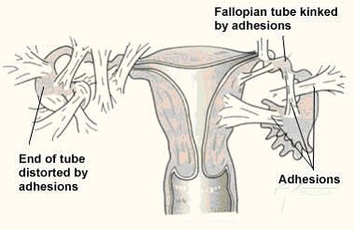

Slide 7
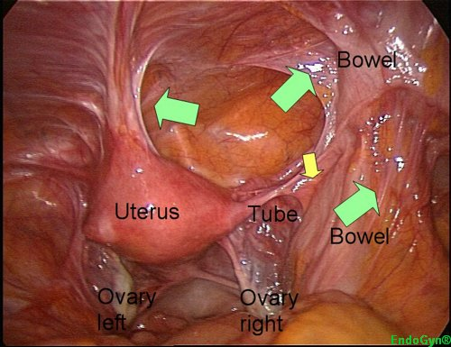

Slide 8
The left ovary could not be seen. Methylene blue dye was injected through the cervix and passed easily through the right tube but not the left.

Slide 9
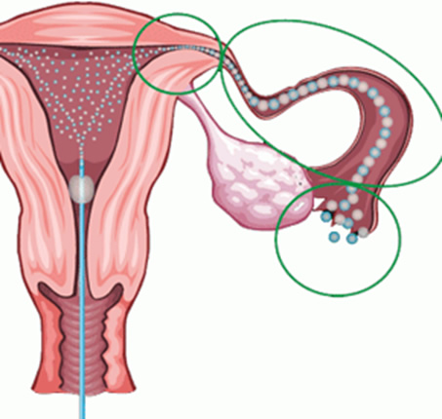

Slide 10
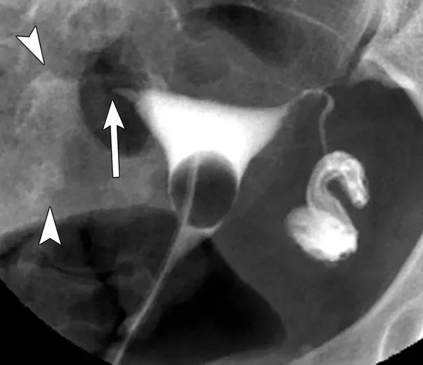

Slide 11
Objectives:
1) Briefly summarize the case to the students.
2) List the signs and symptoms that this patient had and explain them.
3) Define and classify infertility.
4) List the causes of infertility (male and female).
5) What investigations should be performed before embarking on the treatment of infertility?
6) How significant is the finding of unilateral tubal blockage in this particular case?
7) If the tubal blockage is responsible for this lady's secondary infertility, what can be done in the way of treatment?
8) Describe the basic principle in the treatment of infertility.

