Slide 1
Genital Tract Infections
Instructor : Noor Al-Saleh

Slide 2
Introduction
Lower genital tract infections:
Urethritis
Cervicitis
Vaginitis
Vaginosis
Ulceration

Slide 3
Urethritis
Sample:
Urethral swab
A swab is inserted 2 cm into the urethra and rotated gently
B. Urethral Discharge
When profuse discharge is present, sample is collected externally
Most isolated microorganisms:
Neisseria gonorrhoeae
Chlamydia trachomatis

Slide 4
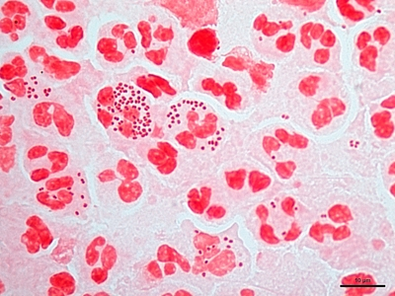
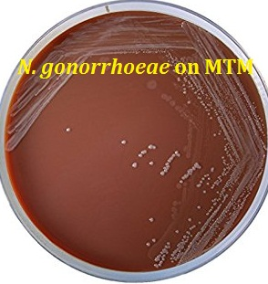
Neisseria gonorrhoeae
Diagnosis in MALES:
- Gram stain of urethral discharge
- presence of Gram Negative Intracellular Diplococci
Diagnosis in FEMALES:
- Gram stain of vaginal swab
- presence of Gram Negative Intracellular Diplococci
- Isolation of N. gonorrhoeae through modified Thayer-Martin (MTM) agar (selective for N. gonorrhoeae )
- Positive oxidase test

Slide 5
Cervicitis and Vaginitis
Sample:
Vaginal swab or discharge
B. Cervical swab
A swab is inserted into the vagina through a speculum to reach the tip of the cervix (avoiding vaginal contamination)
Most isolated microorganisms:
Trichomonas vaginalis
Candida albicans
Neisseria gonorrhoeae
Chlamydia trachomatis
speculum

Slide 6
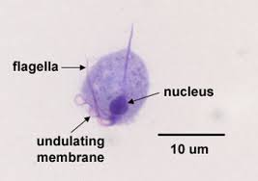
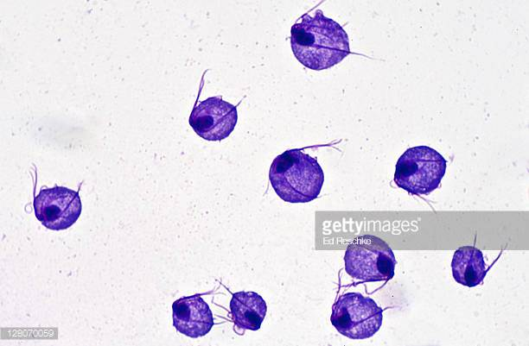
Trichomonas vaginalis
Trophozoite stage only
Oval or pear-shaped
Diagnosis
- wet mount of vaginal discharge
- presence of T. vaginalis trophozoite with "corkscrew" motility pattern

Slide 7
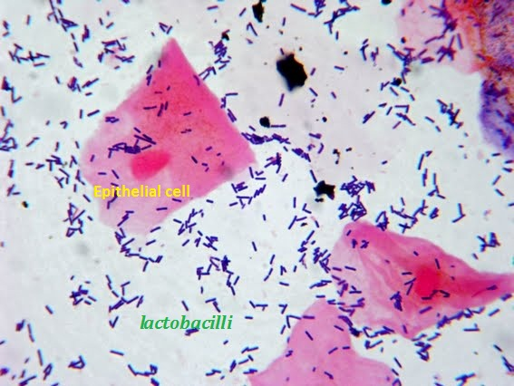
Bacterial Vaginosis
Healthy vaginal normal flora is dominated by Lactobacillus spp
Bacterial Vaginosis is a disequilibrium in the vaginal normal flora , with decline in the number of lactobacilli
Most infections start with Gardnerella vaginalis
Normal Vaginal gram stain →

Slide 8
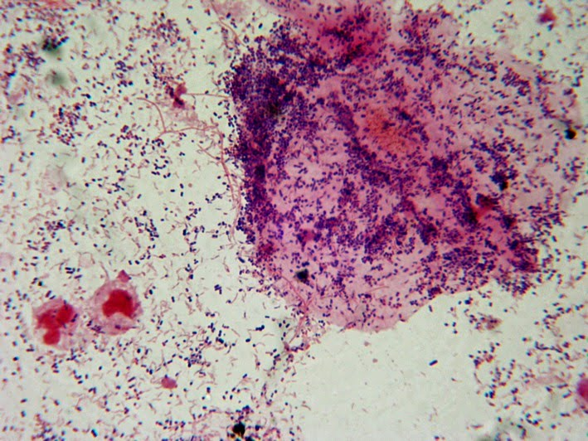
Bacterial Vaginosis
Bacterial Vaginosis is characterized by:
Homogenous gray discharge/fishy odor
pH greater than 4.5
Absence of lactobacilli on gram stain
Presence of CLUE CELLS
Clue cell: vaginal epithelial cell
coated with bacteria
CLUE CELL
Bacterial Vaginosis gram stain showing CLUE CELL →

Slide 9
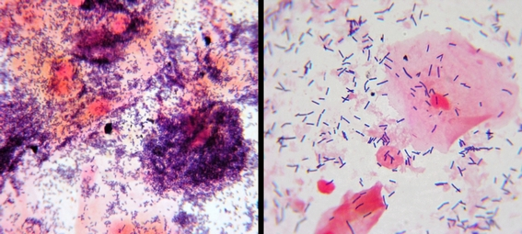
Bacterial Vaginosis
Bacterial Vaginosis VS Normal vaginal microflora

Slide 10
Ulcerative infections
Sample:
Ulcer swab of infected area
Most isolated microorganisms:
Haemophilus ducreyi (chancroid)
Treponema pallidum (chancre)

Slide 11
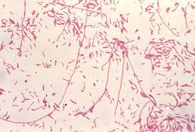
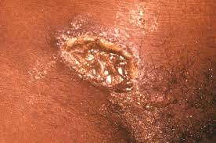
Haemophilus ducreyi
Fastidous gram-negative coccobacilli
Chancroid: sexually transmitted disease causing painful genital bleeding ulcers
Grows on Chocolate agar

Slide 12
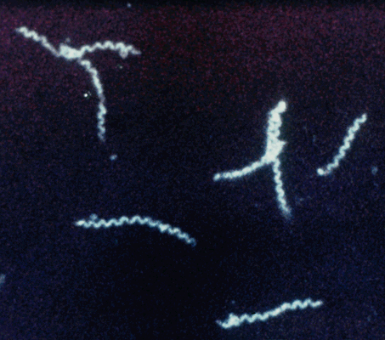
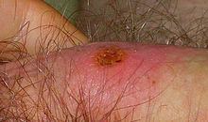
Treponema pallidum
Gram-negative spirochaete bacteria
Chancre: painless genital ulcer formed during the primary stage of syphilis
Wet mount preparation is examined under dark field microscope

